Slide 1
8+ Year Pooled Analysis: Adherence and HIV Incidence in >6000 Women on F/TDF for PrEP
Jeanne Marrazzo,¹ Marissa Becker,² Linda-Gail Bekker,³ Connie Celum,⁴ Michael Kiragu,⁵ Ashley A. Leech,⁶ Allan Taylor,⁷ Faith Ussery,⁷ Juan Yang,⁸ Melanie de Boer,⁸ Christoph Carter,⁸ Moupali Das,⁸ Jared Baeten,⁸ Li Tao⁸
¹University of Alabama at Birmingham School of Medicine, Birmingham, AL, USA; ²University of Manitoba, Winnipeg, Manitoba, Canada; ³The Desmond Tutu HIV Centre, Cape Town, South Africa; ⁴University of Washington, Seattle, WA, USA; ⁵LVCT Health, Nairobi, Kenya; ⁶Vanderbilt University School of Medicine, Nashville, TN, USA; ⁷Centers for Disease Control and Prevention, Atlanta, GA, USA; ⁸Gilead Sciences, Inc., Foster City, CA, USA
Presenting author disclosure: Merck (consulting or advisor fee)
Oral #163

Slide 2
Background
F/TDF for PrEP was approved for adults in 2012 and extended to adolescents in 2018^{1,2}
Real-world effectiveness and adherence with F/TDF for PrEP in cisgender women remain concerns
We pooled data from 11 F/TDF demonstration projects in 6 countries conducted over eight years (11/2012–12/2020) with 6,296 participants to better understand the overall efficacy of F/TDF in cisgender women in real-world settings
We explored adherence in a subset of 2,955 women with available objective and subjective data and used innovative methods to describe longitudinal patterns of adherence
1. Food and Drug Administration (FDA): FDA approves first drug for reducing the risk of sexually acquired HIV infection. Washington, DC, 2012. 2. National Institutes of Health. Item of Interest: FDA Approves PrEP Therapy for Adolescents at Risk for HIV. https://www.nichd.nih.gov/newsroom/releases/051618-PrEP. Published May 16, 2018.

Slide 3
Eleven Demonstration Projects of F/TDF for PrEP in Cisgender Women (N = 6296)
Study Lead investigator n/N: available adherence/ Total
PrEPception¹ Sullivan n / N = 16 / 24
CRUSH–PrEP for Women² Myers n / N = 7 / 25
Kenya IPCP⁵ Kiragu n / N = 507 / 1347 | CDC Botswana PrEP OLE¹⁰ Taylor, Ussery n / N = 45 /102
MPYA (Kenya)^{6,7} Baeten n / N = 348 / 348 | Power (Kenya, South Africa)¹¹ Celum n / N = 152 / 2551
SCIP Kenya⁸ Baeten n / N = 40 / 40 | 3P (South Africa)¹² Bekker n / N = 186 / 200
Partners PrEP (Kenya, Uganda)⁹ Baeten n / N = 330 / 334
Ashodaya PrEP (India)³ Moses n / N = 646 / 647
Durbar Mahila Samanwaya Committee⁴ Jana n / N = 678 / 678
1. Leech AIDS Patient Care STDS 2020; 2. Koester IAPAC 2019; 3. Reza-Paul Glob Public Health 2020; 4. Jana Int J STD AIDS 2021;32:638-47; 5. Masyuko Sex Health 2018; 6. Haberer Lancet HIV 2021 (MPYA); 7. Haberer J Acquir Immune Defic Syndr 2022; 8. Heffron Gates Open Res 2018; 9. Baeten PLOS Medicine 2016; 10Henderson FL, et al. IAS 2015; https://www.natap.org/2015/IAS/IAS_92.htm; 11. Celum J Int AIDS Soc. 2022; 12.Celum J Int AIDS Soc 2020.

Slide 4
Methods: Incidence and Adherence
Between November 2012 and December 2020, 6,296 cisgender women initiated F/TDF for PrEP*
11 Demonstration Projects N = 6296
We calculated overall efficacy (HIV incidence per 100 PY) by Poisson regression
Available adherence data n = 2955
We evaluated adherence in a subset (n=2955) who had either objective or self-reported data
*Study medication (F/TDF) was provided by Gilead.
Notes:
Don’t need to repeat the n=2,955; leave in circle. Don’t need “We..” just “Evaluated” or ”Calculated”

Slide 5
Methods: Adherence Metrics
Objective adherence measured by TFV-DP in dried blood spots (reflecting adherence over the past 12 weeks) or plasma TFV (reflecting adherence over the past 2-7 days)
Subjective adherence measures included electronic pill cap-monitoring (ECM), pill counts (PC), self-report (SR) or study-reported adherence scale (SS)
All measures categorized by corresponding estimated tablets per week
Overall Adherence Scale | Objective Adherence* n = 237 (DBS, fmol/punch) |  | Subjective Adherence, n = 2887
 |  |  | ECM | PC | SR |  | SS
≥7 Tablets | ≥1250 | or | ≥7 Tablets |  |  | or | Excellent
4–6 Tablets | 700 – <1250 |  | 4–6 Tablets |  |  |  | Very Good / Good
2–3 Tablets | 350 – <700 |  | 2–3 Tablets |  |  |  | Fair
<2 Tablets | <350 |  | <2 Tablets |  |  |  | Poor / Very Poor
*51 participants had only TFV plasma level data; those with TFV ≥40 ng/mL were assigned to the 4–6 Tablets group, and those with TFV <40 ng/mL to the <2 Tablets group
DBS, dried blood spot
Brooks K, Anderson, P. Clin Pharmacol Ther. 2018;104:1056-9

Slide 6
Methods: Longitudinal Patterns of Adherence by Group-based Trajectory
Adherence measures assessed at an individual visit reflect cross-sectional adherence at that single time point
In this analysis, we used group-based trajectory modeling to identify patterns of adherence over 96 weeks
Linear, quadratic, or cubic models employed to allow data to cluster into 2-6 groups based on ordinal adherence metrics
Using Bayes and Akaike information criterion (BIC, AIC), the final models were selected and groups defined

Slide 7
Baseline Characteristics
 | N = 6296 n (%)
Age at PrEP initiation
Mean age | 25 years (7 [SD])
<25 years | 1629 (26)
Primary education or less | 1675 (27)
Married | 3256 (51)
≥1 Children | 2775 (44)
Sexually transmitted infections | 781 (12)
BMI ≥30 kg/m² | 776 (12)
Commercial sex worker | 1294 (21)
3% Uganda (n = 183)
5% Botswana
(n = 102)
21% India
(n = 1325)
28% South Africa
(n = 1751)
1% USA
(n = 49)
45% Kenya
(n = 2886)

Slide 8
HIV Incidence (N = 6296)
 |  | HIV Diagnoses / n | HIV Incidence per 100 PY (95% CI)
Characteristic | Overall | 32 / 6296 |  | 0.72 (0.51-1.01)
Age at Enrollment | <25 | 26 / 3834 |  | 1.33 (0.90-1.95)
 | ≥25 | 6 / 2462 |  | 0.24 (0.11-0.53)
Marital Status | Married | 20 / 3256 |  | 1.15 (0.74-1.78)
 | Single | 10 / 1791 |  | 0.66 (0.35-1.22)
Education | ≤Primary | 4 / 1675 |  | 0.22 (0.08-0.59)
 | ≥Secondary | 11 / 1899 |  | 0.58 (0.32-1.05)
Parity | Nulliparous | 14 / 1816 |  | 1.68 (0.99-2.83)
 | ≥1 Child | 7 / 1506 |  | 0.71 (0.34-1.49)
Characteristics associated with higher incidence are consistent with those previously described

Slide 9
Cross-sectional Objective and Subjective Adherence by Visit (n = 2955)
Objective (DBS), n=237
Subjective (ECM, PC, SR, SS), n=2887
≥7 Tablets
4–6 Tablets
2–3 Tablets
<2 Tablets
Week
Week
n=
147 | 116 | 72 | 28 | 14 | 22
n=
2775 | 2187 | 1945 | 1645 | 1199 | 318
By both measures, overall adherence declined over time
Higher adherence reported with subjective vs objective measures
DBS, dried blood spot; ECM, electronic pill cap-monitoring; PC, pill-counts; SR, self-report; SS, study-reported adherence scale.

Slide 10
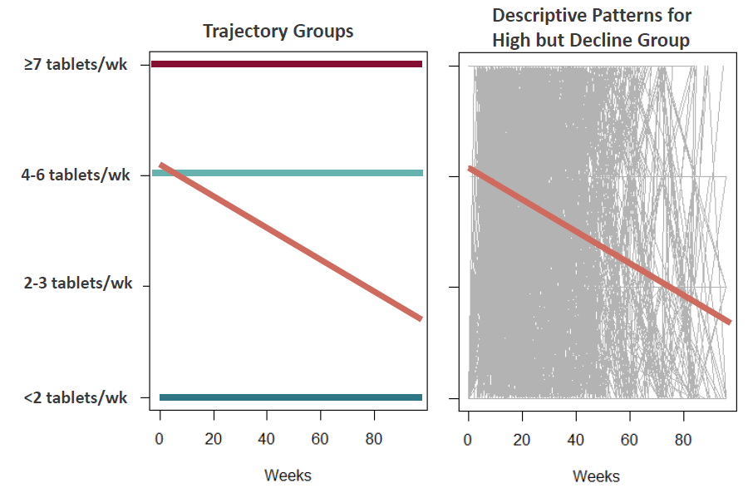
Longitudinal Patterns of Adherence By Group-based Trajectory
Descriptive Patterns for High-but-Declining Group
Trajectory Groups
Consistently Daily
n = 1156
Consistently High
High, but Declining
Consistently Low
Group-based trajectory modeling shows four groups with distinct patterns of adherence
Three groups had stable adherence over time, regardless of model used
One group had dynamic adherence over time – initially high then declined

Slide 11
HIV Incidence Rates Among Women with Available Adherence Data (n = 2955)
Consistently Daily | 0 / 498
Consistently High | 1 / 658
High, but Declining | 6 / 1166
Consistently Low | 5 / 632
HIV Diagnoses / n
HIV Incidence per 100 PY (95% CI)
0
0.13 (0.02-0.92)
0.49 (0.22-1.08)
1.27 (0.53-3.04)
Even with low incidence overall, higher patterns of adherence were directly associated with lower risk of HIV acquisition
Calculated by Poisson regression.

Slide 12
Limitations
Pooled analysis of heterogeneous demonstration projects
Differential follow-up (higher adherence associated with higher retention)
Objective adherence data was available for limited number of women
Group-based trajectory methodology depends on sample size & duration of follow-up

Slide 13
Conclusions
This pooled analysis of >6000 cisgender women is the largest assessment of effectiveness and adherence of F/TDF in diverse, global, real-world settings
Effectiveness of F/TDF was similar in cisgender women who demonstrated consistently high (>4 tablets/week) or high (7 tablets/week) adherence
Comparable to the adherence-efficacy relationship for cisgender MSM
However, over half of all participants did not use F/TDF consistently, highlighting the urgent need for additional prevention options such as long-acting modalities

Slide 14
Acknowledgements
We extend our thanks to all who participated in the original Demonstration Projects who made these additional analyses possible.
This analysis was funded by Gilead. The Bill & Melinda Gates Foundation, California HIV Research Program, CDC, NIH, and USAID funded the original Demonstration Projects.
Disclosures: M. Becker: none; L.-G. Bekker: honoraria for advisory roles for Merck PTY LTD, Gilead, ViiV, Jansen; C. Celum: served as scientific advisor, expert witness and received study drug from Gilead; M. Kiragu: none; A. A. Leech: none; A. Taylor, F. Ussery: received study drug from Gilead (TDF2 OLE study); J. Yang, M. de Boer, C. Carter, M. Das, J. Baeten, L. Tao: employees and stockholders of Gilead. Editing and production assistance were provided by BioScience Communications, New York, NY, funded by Gilead.

Slide 15
Back-up

Slide 16
HIV Incidence Rate by Country
 | Total N | HIV Diagnoses | Incidence Rate (95% CI)
Botswana | 102 | 0
India | 1325 | 0
Kenya | 2886 | 15 | 0.70 (0.42, 1.17)
South Africa | 1751 | 12 | 2.67 (1.52, 4.72)
USA | 49 | 0
Uganda | 183 | 5 | 2.91 (1.21, 7.00)

