Slide 1
Randomized Switch to B/F/TAF in African American Adults With HIV

Slide 2
Randomized Switch to B/F/TAF in African American Adults With HIV

Slide 3
Acknowledgements

Slide 4
Introduction

Slide 5
BRAAVE 2020: HIV Suppressed African American Adults Switched From NRTIs + 3rd Agent Study Design

Slide 6
Rate of Black Persons Living With HIV: USA 2016

Slide 7
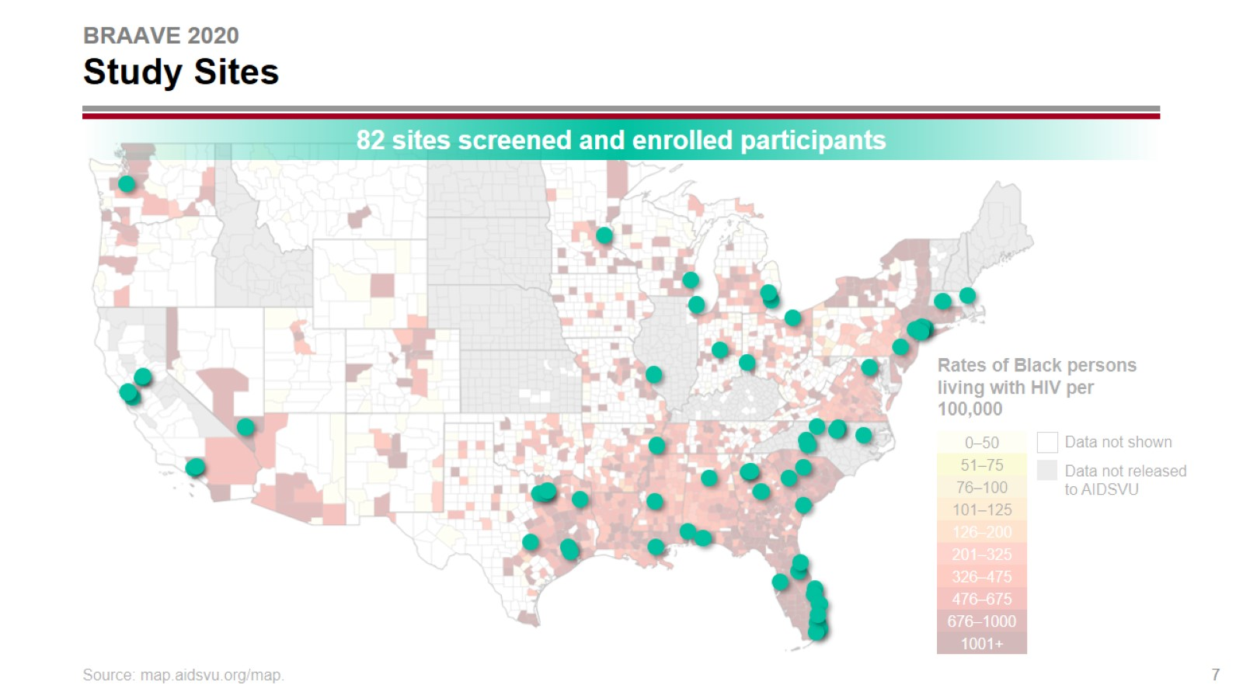
BRAAVE 2020 Study Sites

Slide 8
BRAAVE 2020 Participant Disposition

Slide 9
BRAAVE 2020 Baseline Characteristics

Slide 10
BRAAVE 2020 Baseline Regimens and Resistance

Slide 11
BRAAVE 2020 Virologic Outcomes at Week 24: Full Analysis Set

Slide 12
BRAAVE 2020 Virologic Outcome at Week 24 and Resistance Analysis

Slide 13
BRAAVE 2020 Adverse Events and Abnormal Labs Through Week 24

Slide 14
BRAAVE 2020 AEs Leading to Study Drug Discontinuation Through Week 24

Slide 15
BRAAVE 2020 Fasting Lipid Changes at Week 24

Slide 16
BRAAVE 2020 Weight Change From Baseline Through Week 24

Slide 17
BRAAVE 2020 Conclusions

