Slide 1
NEAR-PERFECT ACCURACY OF A REAL-TIME URINE TENOFOVIR TEST COMPARED TO LAB-BASED ELISA
Matthew A. Spinelli MD, MAS; Warren Rodrigues MS; Guohong Wang PhD; Michael Vincent; David V. Glidden PhD; Randy Stalter MPH; Patricia A. Defechereux PhD; Madeline Deutsch MD, MPH; Robert M. Grant MD; Kenneth Ngure PhD; Nelly R. Mugo MMBChB, MPH; Jared Baeten MD, PhD; Monica Gandhi MD, MPH

Slide 2
Background: Rising uptake of PrEP, adherence remains a challenge
Tenofovir disoproxil fumarate/emtricitabine (TDF/FTC) highly effective in preventing HIV with adequate adherence^{1,2}
PrEP adherence a challenge in various settings despite high self-reported adherence: up to 66-91% with low adherence in some demonstration projects:^{3,4}
  Key groups: Young MSM, Black and Latinx MSM, young African women ^{3,4,5}
Grant Lancet ID 2014 2. Hare CROI 2019 3. Hosek J Int AIDS Soc 2016 4. Celum IAS Conference 2019
5. Serota CID 2019

Slide 3
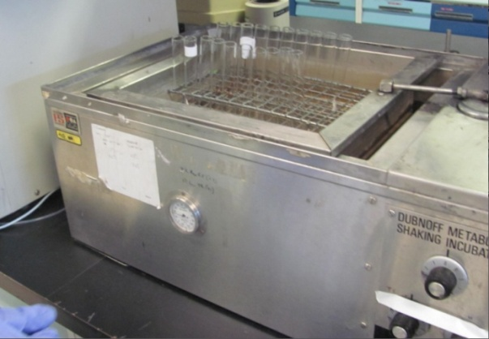
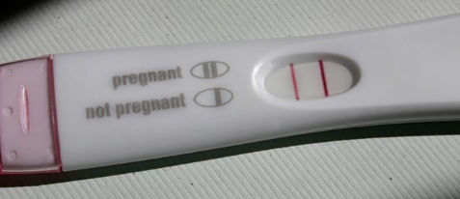
Background: Therapeutic Drug Monitoring Techniques not Scalable—Need a Point-of-Care Test
PrEP trials and demonstration projects have often relied on pharmacologic metrics of adherence for interpretation
Usual methods to measure PrEP drugs in any matrix (dried blood spot, urine, hair etc.) require liquid chromatography tandem mass spectrometry
  Expensive
  Trained personnel
  Sample processing/shipping time
Antibody-based tests allow for rapid point-of-care testing
¹Hendrix ARHR 2016; ²Hendrix PLOS One 2013; ³Calcagno. Pharmacogenomics 2016; ⁴Anderson Sci Trans Med 2012; ⁵Castillo-Mancilla. ARHR 2013; ⁶Castillo-Mancilla. ARHR 2015; ⁷Zheng. J Pharm Biomed Anal 2014; ⁸Liu PLOS One 2014; Rosen. Anal Chem 2016;¹⁰Koenig HIV Med 2017; ¹¹Simile. J Pharm Biomed Anal. 2015; ¹²Haaland AIDS 2017; ¹³Lalley-Chareczko. Antiviral Ther 2017

Slide 4
Background: Developed one of first antibodies highly selective for tenofovir, then developed a point-of-care test
Evaluated for antibodies that bind to enzyme-labeled tenofovir derivatives; found one with high selectivity¹
Tenofovir levels measured by ELISA with this antibody → high correlation and agreement with LC-MS/MS levels²
Developed a lateral flow assay (LFA):³ a point-of-care platform to measure TFV (yes/no) in urine
Adherence measured over 4-7 days
¹Gandhi. EClinicalMedicine 2018; ²Gandhi JAIDS 2019; ³Gandhi AIDS 2020

Slide 5
Current Study- Objective
To test the point-of-care LFA strip read-out in urine against laboratory-based assays in large, diverse participant populations to show its utility as a real-time adherence measure

Slide 6


Study Populations and Samples Tested
Partners PrEP Study (NCT00557245): First study to establish efficacy of TDF/FTC in heterosexual men and women
  Enrolled 4747 heterosexual men and women in Kenya and Uganda
  PK substudy included 297 participants/454 urine samples (41% women)
IBrEATHe substudy of Triumph Project: Substudy of 46 transgender men and women on gender-affirming hormone therapy
  231 urine samples tested; 50% transgender women

Slide 7
Methods
Comparator: ELISA with a lower limit of quantification of 1000 ng/ml¹
LFA: 2-3 drops of urine applied and read after 5 minutes visually
Cut-off for LFA is 1,500 ng/ml: >98% positive if daily dosing and negative if no dose at 120 hours¹
1.Gandhi JAIDS 2019

Slide 8
Results:
10⁶
Overall 684 samples from 324 participants comparing LFA to ELISA (comparator)
Sensitivity: 505/505= 100% (97.5% CI: 99.3)
Specificity: 176/179= 98.3%
(95% CI: 95.2%-99.7%)
Accuracy: 681/684= 99.6%
(95% CI: 98.7%-99.9%)
10⁵
ELISA Urine Tenofovir Level
10⁴
1500
ng/ml
Negative Positive
Urine Tenofovir Point of Care Test

Slide 9
Discussion:
Sensitivity, Specificity, and Accuracy of a novel urine point-of-care adherence test all 98-100% compared to the laboratory-based assay in diverse populations
LFA ready for field testing
Literature on drug-level targeted adherence interventions: real-time information is most acceptable/effective¹⁻³
Adherence information can be used to implement interventions in clinical settings: i.e. motivational interviewing, action planning, incentives
San Francisco General Hospital
1. Landovitz JAIDS 2017 2. Celum IAS Conference 2019 3. Koester AIDS Care 2015

Slide 10
Discussion: Useful in PrEP but Real-Time Adherence Information could inform ART
San Francisco General Hospital

Slide 11
Discussion
Recent adherence information is susceptible to “white-coat effects”
  Not seen so far in PrEP^{1,2}
Will need to test interventions with cumulative adherence metric as outcome (dried blood spot or hair)
Testing targeted adherence interventions in young Kenyan Women (PUMA study NCT03935464) and U.S. Young MSM (PrEP2-BAY study K23MH122286)
San Francisco General Hospital
1. Landovitz JAIDS 2017 2. Koss CID 2018

Slide 12
Acknowledgements
Partners PrEP and IBrEATHe study participants
Coauthors:
  Warren C. Rodrigues
  Guohong Wang
  Michael Vincent
  David V. Glidden
  Hideaki Okochi
  Randy Stalter
  Patricia Defechereux
  Madeline Deutsch
  Robert M. Grant
  Kenneth Ngure
  Nelly R. Mugo
  Jared M. Baeten
  Monica Gandhi
Abbott Rapid Diagnostics
Mentors:
  Monica Gandhi
  Susan Buchbinder
  Diane Havlir
Reference: Spinelli et al. High Accuracy Of A Real-time Urine Antibody-based Tenofovir Point-of-care Test Compared To Laboratory-based ELISA In Diverse Populations. JAIDS 2020. March 10. In press.
San Francisco General Hospital

