Slide 1
iFACT
TUPDX0107LB
Akarin Hiransuthikul, Kanittha Himmad, Stephen Kerr, Narukjaporn Thammajaruk, Tippawan Pankam, Rena Janamnuaysook, Stephen Mills, Ravipa Vannakit, Praphan Phanuphak, Nittaya Phanuphak on behalf of the iFACT study team
This work was made possible by the generous support of the American people through the United States Agency for International Development (USAID) and the U.S. President’s Emergency Plan for AIDS Relief (PEPFAR). The contents are the responsibility of the LINKAGES project and do not necessarily reflect the views of USAID, PEPFAR, or the United States Government. LINKAGES, a five-year cooperative agreement (AID-OAA-A-14-00045), is led by FHI 360 in partnership with IntraHealth International, Pact, and the University of North Carolina at Chapel Hill.

Slide 2
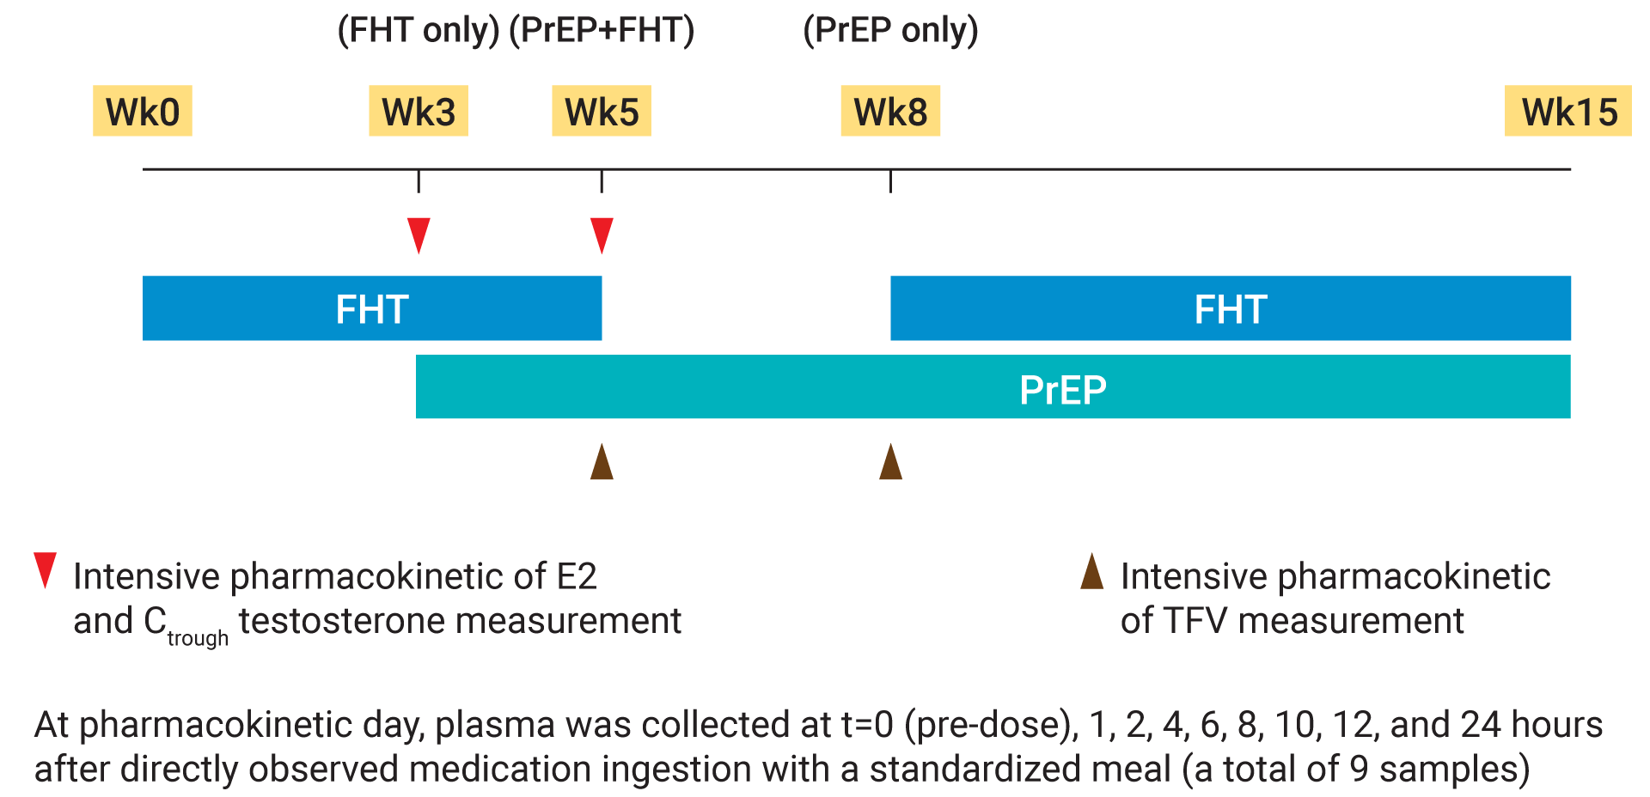
Objective
Methods
To determine drug-drug interactions (DDI) between FHT and PrEP
20 TGW who never underwent orchiectomy and had not received injectable FHT within 6 months were enrolled between January and March 2018.
FHT = estradiol valerate 2mg/day plus cyproterone acetate 25 mg/day
Notes:
On behalf of the co-investigators, I would like to thank the conference organizers for the chance to present these data. We are excited to have a chance to share the results with you all today.
It’s an established fact by now that PrEP is among the effective methods for HIV prevention. However, we began to have concerns over the efficacy of PrEP among TGW mainly because studies have shown that TGW have lower blood concentration of PrEP compared to non-TG population. I think the reasons for that could be categorized into 2 main possibilities: firstly, TGW did have good adherence to PrEP, but there was this unknown drug-drug interaction between FHT and PrEP; or secondly, TGW simply had poor adherence. Now, if that’s the case; one of the hypothesis was that it could be due to the fact that TGW prioritized FHT over PrEP. And again, this comes back to the same thing in that there was a concern over whether or not there are any interactions between FHT and PrEP.
So, we established a study called iFACT to determine whether there really are DDIs between FHT and ARV agents, PrEP for this case, among TGW. This is a 2-way analysis meaning that we measured the effect of PrEP towards FHT and vice versa. The components that we measured were intensive PK parameters of plasma TFV (for PrEP), and intensive PK parameters of E2 (for FHT). In addition to that, we also measured the trough testosterone concentration to indirectly determine the anti-androgenic effect of the hormones.
20 healthy TGW were enrolled earlier this year. They were eligible if they never underwent orchiectomy, and had not received injectable hormones within past 6 months. Right off the bat, I have to emphasize that FHT regimens may vary depending on the region you live in. The hormones we used here were estradiol valerate, a form of estrogen, plus cyproterone acetate, a form of antiandrogen. Both hormones were given at entry visit. The first intensive PK parameters of E2 were measured at wk 3 (so this is kind of like the “hormones only” week because PrEP was not yet initiated at entry). After the blood test for E2 PK parameters was done, PrEP (the standard daily dose of TDF + FTC) was initiated at the same visit. Intensive PK parameters of E2 and tenofovir were then measured at wk 5 (so wk 5 is the “hormones and PrEP” week). At the same visit, hormones were then stopped and intensive PK parameters of TDF were measure again at wk 8 (so basically the “PrEP only” week). Trough testosterone concentrations were measured at wk 3 and 5.

Slide 3
Results
E2 PK parameter | Week 3 (FHT) | Week 5 (PrEP+FHT) | GMR (95%CI) | p-value
AUC₀₋₂₄ (pg*h/mL) | 775.13 (26.2) | 782.84 (39.6) | 1.01 (0.89 – 1.15) | 0.88
C_{max} (pg/mL) | 51.47 (26.9) | 55.76 (32.9) | 1.08 (0.94 – 1.24) | 0.25
C₂₄ (pg/mL) | 15.15 (42.0) | 14.32 (67.4) | 0.95 (0.75 – 1.19) | 0.63
Half-life (h) | 11.25 (32.6) | 11.83 (50.9) | 1.05 (0.87 – 1.27) | 0.60
TFV PK parameter | Week 5 (PrEP+FHT) | Week 8 (PrEP only) | GMR (95%CI) | p-value
AUC₀₋₂₄ (mg*h/L) | 2.28 (26.2) | 2.63 (26.9) | 0.87 (0.78 - 0.96) | 0.009
C_{max} (mg/L) | 0.36 (34.8) | 0.32 (25.3) | 1.10 (0.95 - 1.28) | 0.2
C₂₄ (mg/L) | 0.04 (28.8) | 0.05 (28.0) | 0.83 (0.76 - 0.90) | <0.001
Half-life (h) | 15.19 (15.4) | 15.69 (23.0) | 0.97 (0.88 - 1.07) | 0.53
[Table. Summary of E2 and TFV pharmacokinetic parameters; data are presented in geometric mean (%CV)]
Median (IQR) C_{trough} of bioavailable testosterone between week 3 and 5: 0.10 [0.04-0.18] vs 0.08 [0.03-0.15] ng/mL, p=0.71
Notes:
So, let’s take a look at the results. The upper table shows the parameters of E2 so it compared wk3 and wk5. Overall, there were no significant differences in any of the parameters between the two weeks. Also, there were no significant changes in trough testosterone concentration. As a result PrEP did not significantly affect the level of FHT.
The lower table is the parameters of tenofovir so it compared wk5 and wk8. Here we can see that the geometric mean of area under curve from time 0 to 24 hrs and concentration at 24 hours of tenofovir were significantly lower at wk 5 compared to wk 8. This means that the plasma tenofovir exposure was lower in the presence of FHT, by about 13%.

Slide 4
Conclusions
Our study demonstrated lower plasma TFV exposure (13%) in the presence of FHT, suggesting that FHT may potentially affect PrEP efficacy among TGW
E2 exposure was not affected by PrEP
Further studies are warranted to determine whether these
DDIs occur in PBMC and target tissue as well?
DDIs occur in other FHT regimens?
reductions in TFV are clinically significant?
Notes:
In conclusions, our study demonstrated lower plasma TFV exposure (13%) in the presence of FHT, suggesting that FHT may potentially affect PrEP efficacy among TGW.And equally as important, E2 exposure was not affected by PrEP. While I think it’s great that our study as able to show this previously unknown DDI between the 2 meds, there are definitely some key questions that need to be answered before moving forward in implementing this result to the services. For instance, does this interaction occurs in the cells and target tissue, rectal tissue for instance, which is usually the first site of HIV contact? Or does this interaction applies to other FHT regimens? And last but not least, we don’t know whether the 13% reduction in blood TFV exposure in the presence of FHT means anything regarding the preventive effect of PrEP in TGW.

