Slide 1
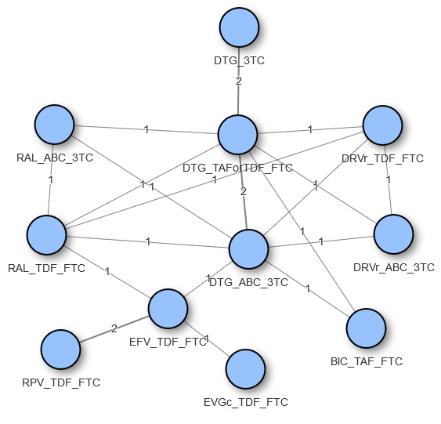
COMPARATIVE EFFICACY AND SAFETY OF A COMBINATION THERAPY OF DOLUTEGRAVIR AND LAMIVUDINE VS 3-DRUG ANTIRETROVIRAL REGIMENS IN TREATMENT-NAIVE HIV-1 INFECTED PATIENTS AT 96 WEEKS: A SYSTEMATIC REVIEW AND NETWORK META-ANALYSIS
Katharina Nickel,¹ Nicholas J. Halfpenny,² Sonya J. Snedecor,³ Yogesh Suresh Punekar⁴
¹Pharmerit International, Berlin, Germany; ²Pharmerit International, Rotterdam, the Netherlands; ³Pharmerit International, Bethesda, MD, USA; ⁴ViiV Healthcare, London, UK
PDB0104
Introduction
Traditional antiretroviral therapy for patients living with HIV (PLHIV) includes combinations of 3 or more antiretroviral drugs (ARVs). Recent arrival of the 2-drug regimen (2DR) of DTG+3TC has demonstrated non-inferiority to 3-drug regimens (3DRs) in treatment-naive PLHIV up to Week 96 in the GEMINI-1 and GEMINI-2 studies.
A previous Network Meta-analysis (NMA) showed DTG+3TC having comparable efficacy and safety to the guideline-recommended 3DRs at Week 48.¹
The objective of this analysis was to evaluate efficacy and safety of DTG+3TC compared to standard of care 3DRs up to Week 96 in treatment-naive PLHIV.
Results
Efficacy results (Figure 2)
Virologic suppression (VS) achieved by DTG+3TC was superior to DRV/r+TDF/FTC and comparable to other 3DRs. The probability of DTG+3TC achieving better VS ranged from 2.5% with DTG+TAForTDF/FTC to 95.4% with EFV+TDF/FTC.
Stratified by baseline viral load of >100,000 RNA copies/mL and ≤100,000 RNA copies/mL or CD4 >200 cells/µL and ≤200cells/µL, DTG+3TC was broadly comparable to all the 3DRs also reporting those subgroup data with some significant differences.
Mean CD4 cell changes with DTG+3TC were statistically significantly higher from baseline when compared to BIC+TAF/FTC, DRV/r+TDF/FTC, EFV+TDF/FTC and RPV+TDF/FTC. DTG+3TC was otherwise comparable with all other regimens.
Table 1. Safety Endpoint Results for NMA Week 96
Comparator | Discontinuations (Odds Ratio) | Any Adverse Events (Odds Ratio) | Drug-Related Adverse Events (Odds Ratio) | Serious Adverse Events (Odds Ratio)
BIC+TAF/FTC | 1.04 (0.59, 1.83) | 1.18 (0.67, 2.07) | 0.87 (0.56, 1.35) | 1.94 (1.09, 3.5)
DRV/r+TDF/FTC | 1.47 (0.53, 4) | 1.88 (0.44, 7.94) | Not reported | Not reported
DTG+ABC/3TC | 0.87 (0.4, 1.86) | 2.09 (0.85, 5.33) | 1.49 (0.85, 2.57) | 2.12 (1.0, 4.57)
DTG+TAF or TDF/FTC | 0.74 (0.54, 1) | 1.19 (0.9, 1.58) | 1.37 (1.07, 1.76) | 1.05 (0.73, 1.51)
EFV+TDF/FTC | 1.45 (0.62, 3.31) | 3.35 (1.18, 9.98) | 3.84 (2.06, 7.11) | 2.48 (1.05, 5.95)
EVG/c+TDF/FTC | 1.24 (0.48, 3.11) | Not reported | Not reported | Not reported
RAL+TDF/FTC | 0.99 (0.38, 2.54) | 1.49 (0.36, 6.22) | 0.95 (0.46, 1.96) | 3.01 (1.11, 8.26)
RPV+TDF/FTC | 1.02 (0.41, 2.48) | 2.46 (0.76, 8.35) | Not reported | 2.06 (0.8, 5.34)
*Results in bold are statistically significant; fixed effects model was selected for all analyses based on model diagnostics (Deviance Information Criterion). Numbers >1 in this table favoured the DTG+3TC arm. Numbers in parentheses represent 95% credible intervals.
Methods
Systematic literature review
The previously published SLR was updated on July 19, 2019, using PubMed, Embase and Cochrane databases to identify Phase 3/4 RCTs evaluating the efficacy and/or safety of DTG+3TC vs. guideline-recommended 3DRs among treatment-naive adult or adolescent (≥13 years) PLHIV.¹
Regimens of interest were core agents recommended by DHHS or EACS guidelines. ^{2,3}
Endpoints and statistical analysis
Endpoints included in efficacy analyses were virologic suppression, defined as proportion of subjects with HIV-1 RNA ≤50 copies/mL and CD4 cell change, defined as mean CD4 cell change from baseline after initiating therapy.
Endpoints included in the safety analysis were discontinuation rates, adverse events (AEs), drug-related AEs and serious AEs. Safety endpoints were reported as odds ratios.
Figure 2. Efficacy Endpoint Results for NMA Week 96
Virologic Suppression
CD4+ Cell Change
Favours DTG+3TC
Favours 3-drug regimen
Favours DTG+3TC
Favours 3-drug regimen
BIC+TAF/FTC
DRV/r+ABC/3TC
DRV/r+TDF/FTC
DTG+ABC/3TC
DTG+TAForTDF/FTC
EFV+TDF/FTC
EVG/c+TDF/FTC
RAL+ABC/3TC
RAL+TDF/FTC
RPV+TDF/FTC
Fixed effects model is represented first, with a black filled symbol. Random effects model is represented below, with a red filled symbol. Error bars represent 95% credible intervals.
Figure 1. Network of Studies
Conclusions
DTG+3TC provides an efficacious and durable long-term treatment alternative, with a good safety profile, for clinicians treating naive PLHIV.
Mean (95% CrI) difference
Mean (95% CrI) difference from baseline
Safety results (See Table 1)
Discontinuation rates were comparable between DTG+3TC and all other regimens, with no significant differences.
Any adverse event rates for DTG+3TC were significantly lower than with EFV+TDF/FTC and comparable to other regimens.
Drug-related AEs incidence in DTG+3TC patients were significantly lower when compared to DTG+TAForTDF/FTC and EFV+TDF/FTC. DTG+3TC drug-related AE rates were comparable to other regimens.
Serious adverse events reported incidence in the DTG+3TC arm were significantly lower compared to BIC+TAF/FTC, DTG+ABC/3TC, EFV+TDF/FTC and RAL+TDF/FTC and comparable to other 3DRs.
Acknowledgments: This study was funded by ViiV Healthcare. We thank Augustas Lignugaris from ViiV Healthcare for the poster preparation.
References:
1. Radford M et al. AIDS. 2019;33(11):1739-1749.
2. DHHS Panel on Antiretroviral Guidelines for Adults and Adolescents – A Working Group of the Office of AIDS Research Advisory Council (OARAC). Guidelines for the use of antiretroviral agents in adults and adolescents with HIV. 2019.
3. European AIDS Clinical Society. Guidelines, Version 10.0. 2019.
Corresponding author: Katharina Nickel; knickel@pharmerit.com

