Slide 1
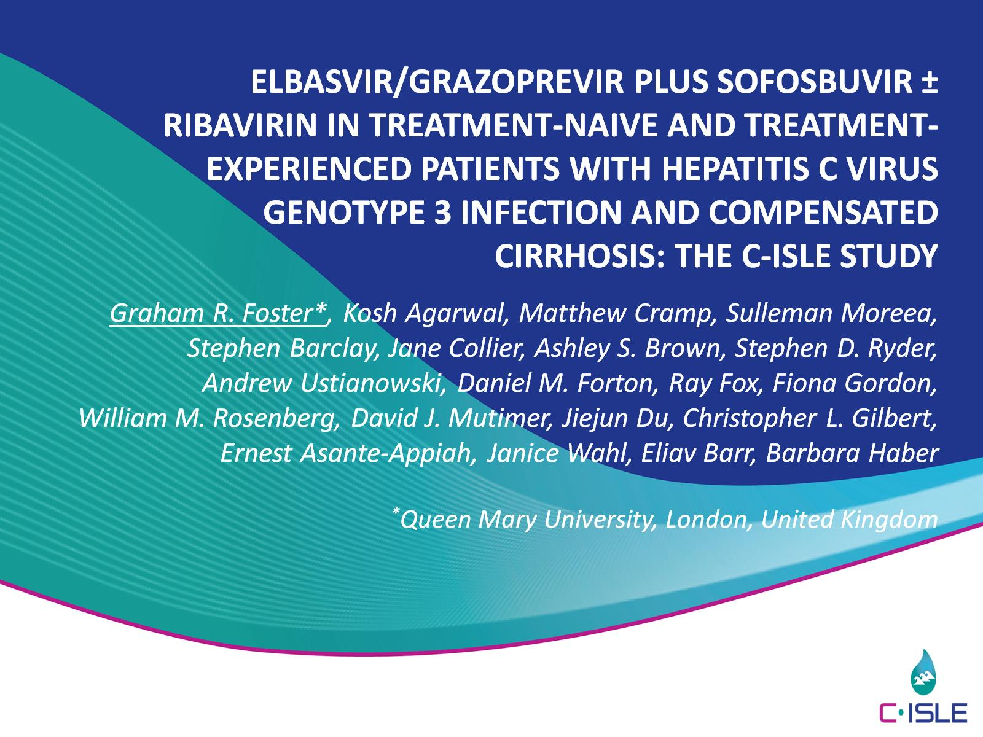
Elbasvir/Grazoprevir plus Sofosbuvir ± Ribavirin in Treatment-naive and Treatment-experienced Patients with Hepatitis C Virus Genotype 3 Infection and Compensated Cirrhosis: The C-ISLE Study

Slide 2
Disclosures and ACKNOWLEDGMENTS

Slide 3
BACKGROUND

Slide 4
AIM

Slide 5
C-ISLE: A randomized, open-label, UK-based clinical trial in gT3-INFECTED cirrhotics

Slide 6
Patients and Methods

Slide 7
Patient Demographics

Slide 8
SVR12 (FAS)

Slide 9
SVR12 (mFAS)

Slide 10
Non-SVR Patients

Slide 11
GT3 NS5A RAVs: Prevalence and impact on SVR12

Slide 12
Response in Y93H positive patients (>15%)

Slide 13
Adverse Events (AEs)

Slide 14
Conclusions

