Slide 1
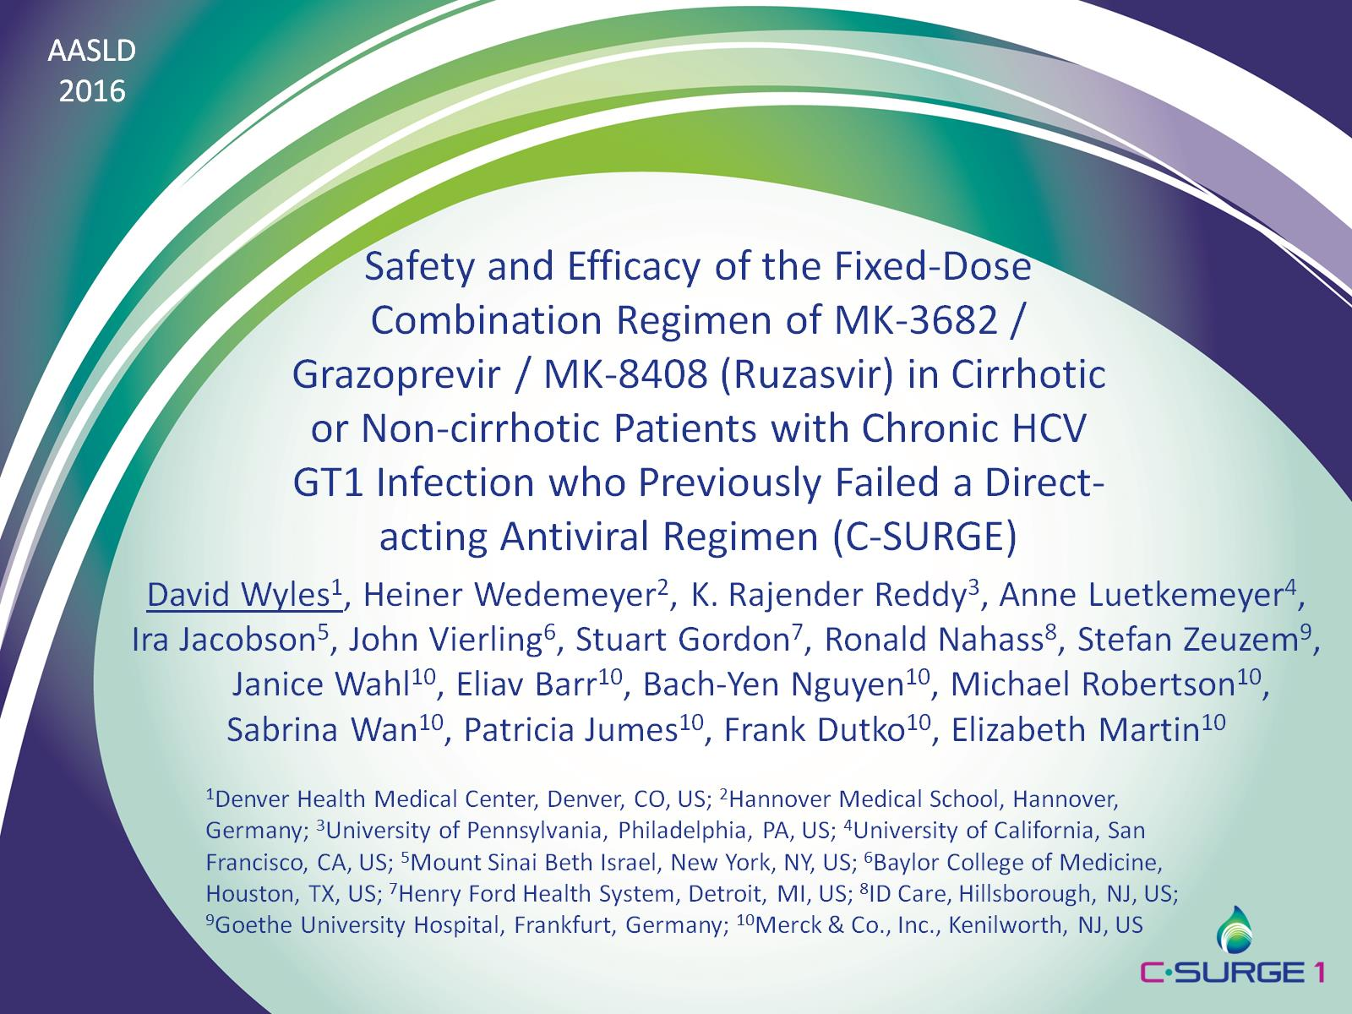
Safety and Efficacy of the Fixed-Dose Combination Regimen of MK-3682 / Grazoprevir / MK-8408 (Ruzasvir) in Cirrhotic or Non-cirrhotic Patients with Chronic HCV GT1 Infection who Previously Failed a Direct-acting Antiviral Regimen (C-SURGE)

Slide 2
Disclosures and Acknowledgements

Slide 3
MK3 (MK-3682 + Grazoprevir + Ruzasvir)

Slide 4
Background and Aim

Slide 7
Efficacy (Full Analysis Set*)

Slide 8
Efficacy (mFAS*)

Slide 9
No Impact of Baseline NS5A or NS3 RAVs on SVR4 (Resistance Analysis Population)

Slide 10
No Impact of Baseline Y93 RAVs in NS5A on SVR4 (Resistance Analysis Population)

Slide 11
Baseline NS5A or NS3 RAVs

Slide 13
Conclusions

