Slide 1
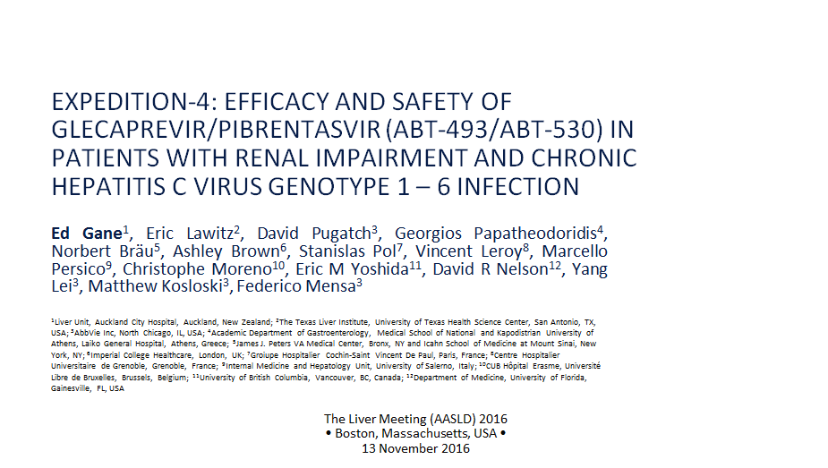
EXPEDITION-4: EFFICACY AND SAFETY OF GLECAPREVIR/PIBRENTASVIR (ABT-493/ABT-530) IN PATIENTS WITH RENAL IMPAIRMENT AND CHRONIC HEPATITIS C VIRUS GENOTYPE 1 – 6 INFECTION

Slide 2
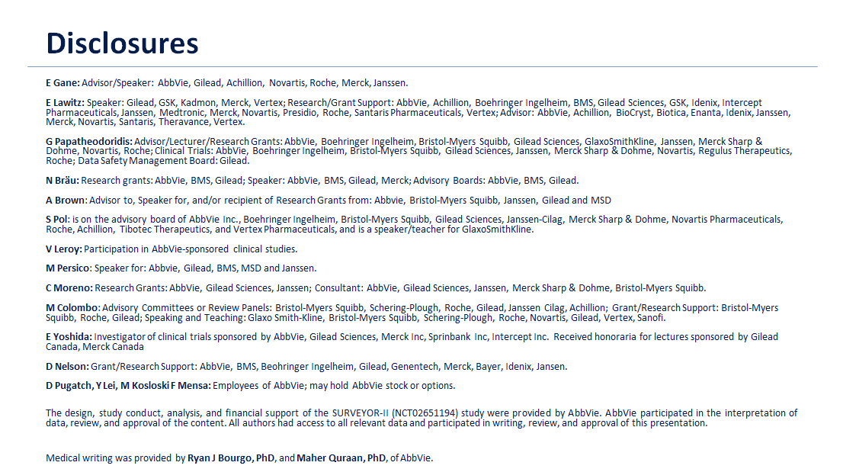

Slide 4
Next Generation Direct-Acting Antivirals

