Slide 1
ENDURANCE-2: Safety and Efficacy of Glecaprevir/Pibrentasvir in Hepatitis C Virus Genotype 2-infected Patients without Cirrhosis: a Randomized, Double-Blind, Placebo-Controlled Study

Slide 2
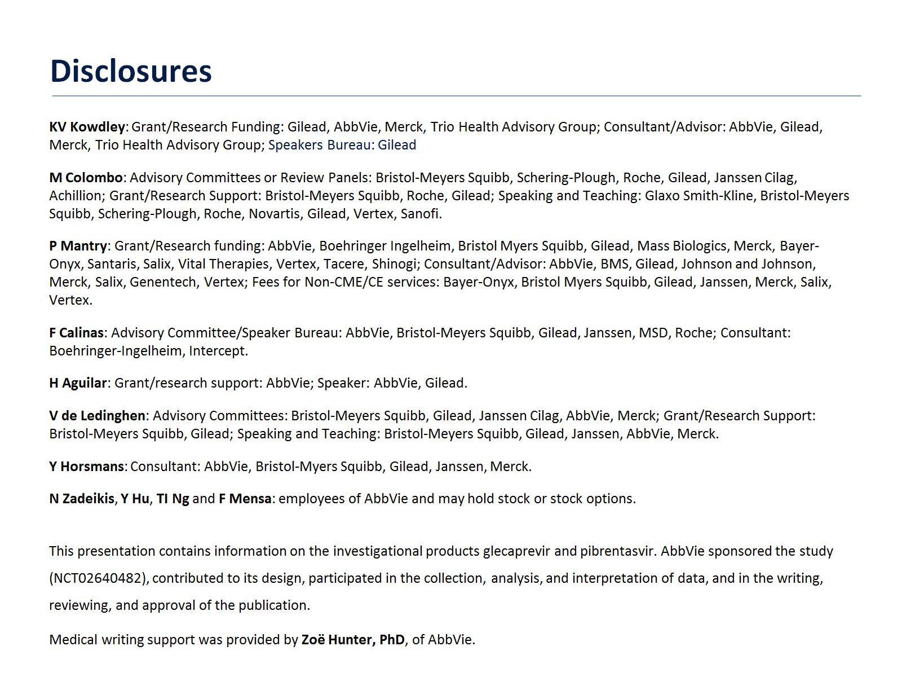

Slide 7
Next Generation Direct-Acting Antivirals

Slide 9
Geographic Distribution of Enrolled Patients

Slide 16
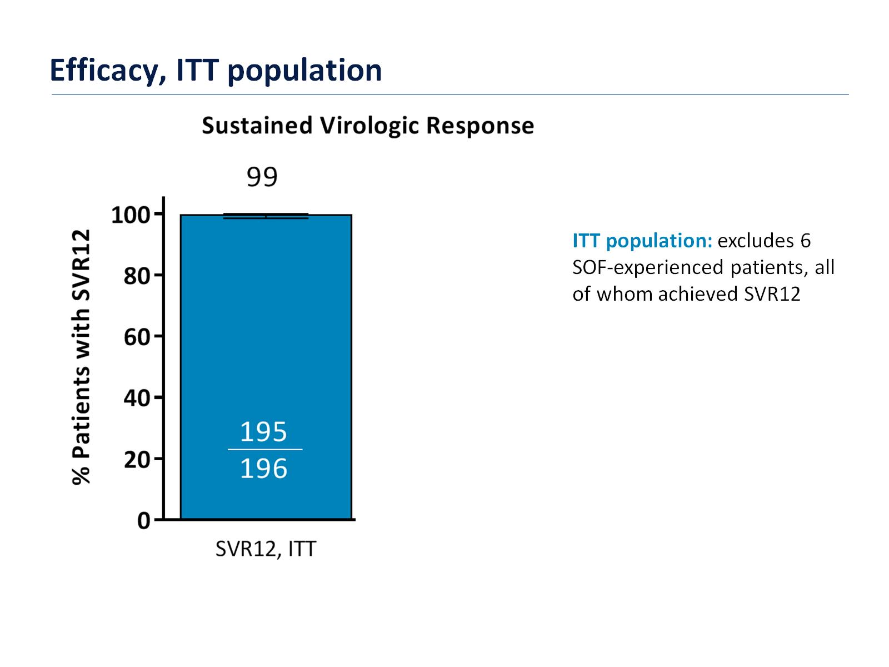

Slide 17
