Slide 1
SURVEYOR-II, PART 3: EFFICACY AND SAFETY OF GLECAPREVIR/PIBRENTASVIR (ABT-493/ABT-530) IN PATIENTS WITH HEPATITIS C VIRUS GENOTYPE 3 INFECTION WITH PRIOR TREATMENT EXPERIENCE AND/OR CIRRHOSIS

Slide 2
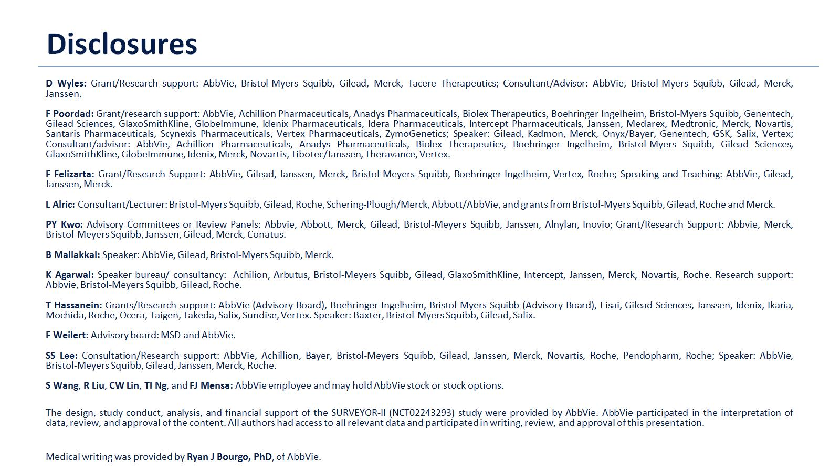

Slide 7
Next Generation Direct-Acting Antivirals

Slide 17
