Slide 1
Safety of Tenofovir Alafenamide in Renal Impairment
A Pozniak¹, J Arribas², SK Gupta³, FA Post⁴, A Avihingsanon⁵, G Crofoot⁶,
K Lichtenstein⁷, M Ramgopal⁸, P Chetchotisakd⁹, MW Fordyce¹⁰
¹Chelsea and Westminster Hospital NHS Foundation Trust, London, UK; ²Hospital Universitario La Paz, Madrid, Spain; ³Indiana University School of Medicine, Indianapolis, IN, USA; ⁴King’s College Hospital NHS Foundation Trust, London, UK; ⁵HIV-NAT, Thai Red Cross AIDS Research Center and Faculty of Medicine, Chulalongkorn University, Bangkok, Thailand; ⁶Crofoot Research, Houston, TX, USA; ⁷National Jewish Health, Denver, CO, USA; ⁸Midway Research Center, Ft. Pierce, FL, USA; ⁹Khon Kaen University, Khon Kaen, Thailand; ¹⁰Gilead Sciences Inc., Foster City, CA, USA
22nd Conference on Retroviruses and Opportunistic Infections
February 23-26, 2015
Seattle, Washington
Poster #795
Notes:
1
1

Slide 2
Tenofovir Alafenamide (TAF, GS-7340)
Novel Prodrug of Tenofovir
TDF has been associated with clinically significant renal and bone toxicity¹⁻³
  Patients with estimated glomerular filtration rate (eGFR) <50 mL/min require dose adjustment
  Patients with eGFR <70 mL/min should not initiate Stribald (elvitegravir/cobicistat/emtricitabine/TDF [E/C/F/TFD])
DeJesus E, et al. Lancet 2012;379:2429-38
Gallant JE, et al. J Infect Dis 2013;208:32-39
Sax PE, et al. Lancet 2012;379:2439-48
Pozniak, et al. CROI, 2015, #795
Notes:
2

Slide 3
Tenofovir Alafenamide (TAF, GS-7340)
Novel Prodrug of Tenofovir (cont’d)
Relative to TDF 300 mg, TAF at an equivalent dose of 25 mg has 90% lower circulating plasma TFV, while maintaining high antiviral activity⁴
In 2 randomized, blinded, Phase 3 studies of E/C/F/TAF vs E/C/F/TDF:
  E/C/F/TAF was noninferior to E/C/F/TDF⁵
  Prespecified renal and bone safety endpoints (hip bone mineral density [BMD], spine BMD, serum creatinine, and treatment-emergent proteinuria) showed significantly less change with E/C/F/TAF compared with E/C/F/TDF⁶
Ruane P, et al. J Acquir Immune Defic Syndr 2013; 63:449-5
Wohl D, et al. CROI 2015, Abstract 113LB
Sax P, et al. CROI 2015, Abstract 143LB
Pozniak, et al. CROI, 2015, #795

Slide 4
Objective
To evaluate safety and efficacy of a once-daily, single-tablet regimen of E/C/F/TAF in HIV-1–infected patients with mild to moderate renal impairment
Pozniak, et al. CROI, 2015, #795

Slide 5
Study Design
Phase 3, 96-week, multicenter, open-label study (NCT01818596)
Virologically suppressed adults with stable eGFR_{CG} (30–69 mL/min) switched from TDF- or non-TDF–containing regimens to open-label E/C/F/TAF
Week 48 efficacy and safety data are described, including tests of renal function and BMD
Actual GFR (aGFR) was assessed with iohexol clearance in a patient subset
*eGFR measured using Cockcroft-Gault formula (eGFRCG) in all patients. †Actual GFR measured using iohexol plasma clearance (CLiohexol) in a
subset of patients at 3 time points: baseline; Week 2, 4, or 8; and Week 24.
Pozniak, et al. CROI, 2015, #795

Slide 6
Methods (cont’d)
Key Inclusion Criteria
CD4 cell count ≥50 cells/μL
No chronic hepatitis B or C virus infection
HIV-1 RNA
  HIV-suppressed patients: <50 copies/mL for ≥6 months
Primary Safety Endpoint
Change from baseline in eGFR at Week 24
Secondary Endpoints
Efficacy, safety, and tolerability through Week 48
Proportion of patients with HIV-1 RNA <50 copies/mL
Pozniak, et al. CROI, 2015, #795

Slide 7
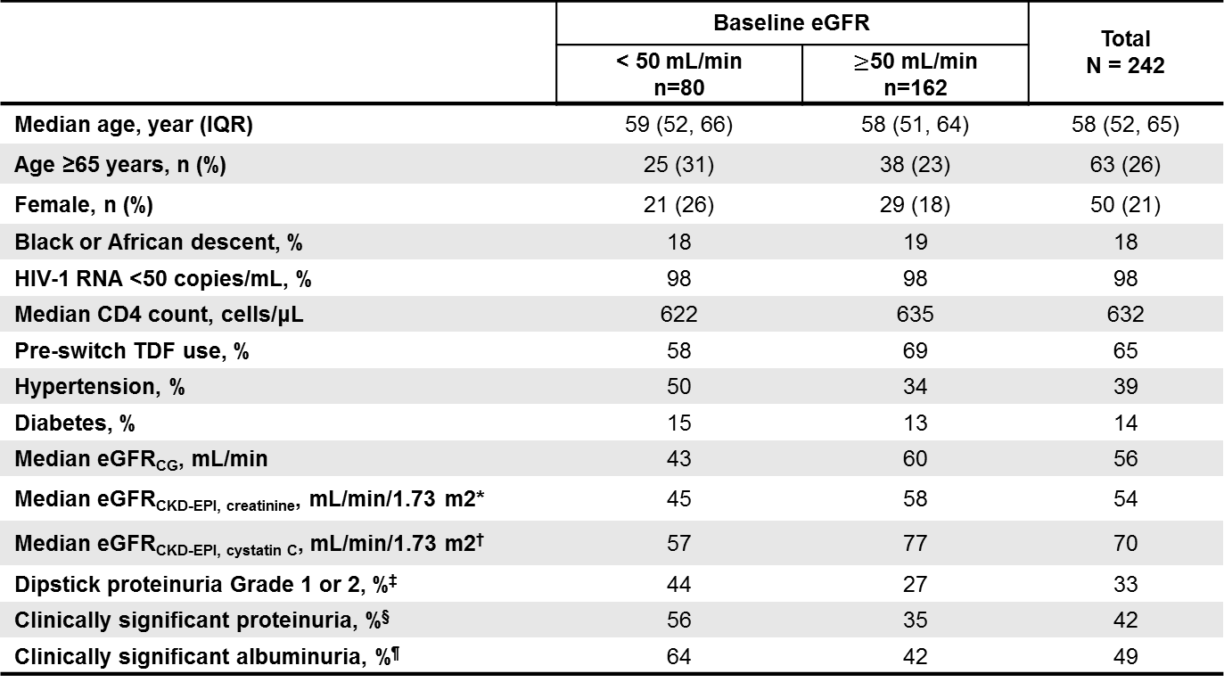
Baseline Characteristics
 | Baseline eGFR |  | Total N = 242
 | < 50 mL/min n=80 | $≥$50 mL/min n=162
Median age, year (IQR) | 59 (52, 66) | 58 (51, 64) | 58 (52, 65)
Age ≥65 years, n (%) | 25 (31) | 38 (23) | 63 (26)
Female, n (%) | 21 (26) | 29 (18) | 50 (21)
Black or African descent, % | 18 | 19 | 18
HIV-1 RNA <50 copies/mL, % | 98 | 98 | 98
Median CD4 count, cells/μL | 622 | 635 | 632
Pre-switch TDF use, % | 58 | 69 | 65
Hypertension, % | 50 | 34 | 39
Diabetes, % | 15 | 13 | 14
Median eGFR_{CG}, mL/min | 43 | 60 | 56
Median eGFR_{CKD-EPI, creatinine}, mL/min/1.73 m2* | 45 | 58 | 54
Median eGFR_{CKD-EPI, cystatin C}, mL/min/1.73 m2† | 57 | 77 | 70
Dipstick proteinuria Grade 1 or 2, %‡ | 44 | 27 | 33
Clinically significant proteinuria, %§ | 56 | 35 | 42
Clinically significant albuminuria, %¶ | 64 | 42 | 49
*Chronic Kidney Disease Epidemiology Collaboration equation for eGFR using serum creatinine (eGFR_{CKD-EPI, creatinine}); adjusted for age, sex, and race.
†CKD-EPI equation for eGFR using cystatin C (eGFR_{CKD-EPI, cystatin C}); adjusted for age and sex. ‡Grade 1 (1+ on dipstick), Grade 2 (2–3+ on dipstick).
§Urine protein:creatinine (UPCR) >200 mg/g. ¶Urine albumin:creatinine (UACR, ie, microalbuminuria) ≥30 mg/g.
Pozniak, et al. CROI, 2015, #795

Slide 8
Antiretroviral Treatment Prior to Switching to E/C/F/TAF
*Some regimens included >1 third agent; therefore, total percentage >100%.
Pozniak, et al. CROI, 2015, #795

Slide 9
Change in eGFR From Baseline to Week 48
At Week 24, median (Q1, Q3) change from baseline in eGFR_{CG} was -0.4 (-4.8, 4.5) mL/min, and in eGFR_{CKD-EPI, cystatin C} was 3.8 (-4.8, 11.2) mL/min/1.73 m²
There was no significant change in eGFR_{CG} or eGFR_{CKD-EPI, cystatin C} to Week 48
Pozniak, et al. CROI, 2015, #795

Slide 10
Actual GFR by Iohexol Clearance (n=32)
CI, confidence interval; GLSM, geometric least squares mean.
Predefined lack of alteration boundary defined as 80–125% (GLSM)
Actual GFR was not affected over 24 weeks of treatment
  No difference between patients with baseline eGFR_{CG} <50 vs ≥50 mL/min, or between those taking TDF vs non-TDF–containing regimens before switching to E/C/F/TAF (data not shown)
Pozniak, et al. CROI, 2015, #795

Slide 11
Proteinuria and Albuminuria Change From Baseline at Week 48
*Urine dipstick was used; 33% of patients (79/242) had proteinuria at baseline. †Patients with non-missing values at both baseline and Week 48.
Improved proteinuria = baseline Grade 1 → Grade 0, or baseline Grade 2 → Grade 1 or 0.
Worsened proteinuria = baseline Grade 0 → Grade 1, or baseline Grade 1 → Grade 2.
Pozniak, et al. CROI, 2015, #795

Slide 12
Proteinuria and Albuminuria Change From Baseline at Week 48 (cont’d)
Most patients with dipstick proteinuria at baseline improved
Decreased prevalence of clinically significant proteinuria and albuminuria
*Significant median decrease from baseline to Week 48 by two-sided Wilcoxon signed-rank test (p <0.001).
Improved = change from clinically significant UPCR (>200 mg/g) or UACR (≥30 mg/g) to nonsignificant UPCR or UACR.
Worsened = change from nonsignificant to clinically significant UPCR or UACR. UACR, urine albumin:creatinine ratio; UPCR, urine protein:creatinine ratio.
Pozniak, et al. CROI, 2015, #795

Slide 13
Measures of Renal Tubular Function
β2MG, beta-2 microglobulin/creatinine ratio; RBP, retinol binding protein.
Significant improvements in urine retinol binding protein/creatinine ratio, beta-2 microglobulin/creatinine ratio, and fractional excretion of uric acid levels were observed (p <0.001 for all)
*Significant change from baseline by two-sidedWilcoxon signed-rank test; p <0.001. TmP/GFR, ratio of tubular maximum reabsorption of phosphate (TmP) to GFR.
Pozniak, et al. CROI, 2015, #795

Slide 14
Change in Spine and Hip Bone Mineral Density
*Two-sided Wilcoxon signed-rank test.
Pozniak, et al. CROI, 2015, #795

Slide 15
Change in Spine and Hip Bone Mineral Density (cont’d)
Median percentage changes (Q1, Q3) in hip and spine BMD from baseline to Week 48 were 0.9% (-0.3, 2.7) and 1.9% (-0.3, 4.3), respectively
Pozniak, et al. CROI, 2015, #795

Slide 16
Metabolic Changes at Week 48
Fasting lipid levels decreased in patients who used non-TDF-containing regimens prior to switching to E/C/F/TAF, whereas levels increased in those using TDF-containing regimens prior to switching to E/C/F/TAF
Pozniak, et al. CROI, 2015, #795

Slide 17
Virologic Outcomes at Week 48 (by FDA snapshot)
92% (222 patients) maintained HIV-1 viral load <50 copies/mL at Week 48
7% (17 patients), virologic data not available
  7 patients discontinued due to adverse events (AEs) by Week 48: renal failure (see next column), diarrhea, choking, fatigue/pain/pruritus, arthralgia/joint swelling, sleep disorder, bladder cancer
    After Week 48, 1 patient died (cardiopulmonary arrest), and 1 additional patient discontinued due to chronic renal failure (see next column)
  7 patients discontinued due to other reasons and last available HIV-1 RNA <50 copies/mL (lost to follow-up, noncompliance, protocol violation, or discontinued by sponsor)
  3 patients had missing data in the Week 48 window
Pozniak, et al. CROI, 2015, #795

Slide 18
Virologic Outcomes at Week 48 (by FDA snapshot)
1% (3 patients) had virologic failure
  2 patients showed resistance
    1 patient with HIV-1 RNA <50 copies/mL on E/C/F/TAF prior to switching to new regimen
    1 patient with HIV-1 RNA <400 copies/mL on E/C/F/TAF; NRTI and PI resistance identical to pre-study historical genotype
  1 patient took additional antiretrovirals (rilpivirine/emtricitabine/TDF) through Day 67 (protocol violation)
    Now on E/C/F/TAF alone with HIV-1 RNA <50 copies/mL through Week 48
Pozniak, et al. CROI, 2015, #795

Slide 19
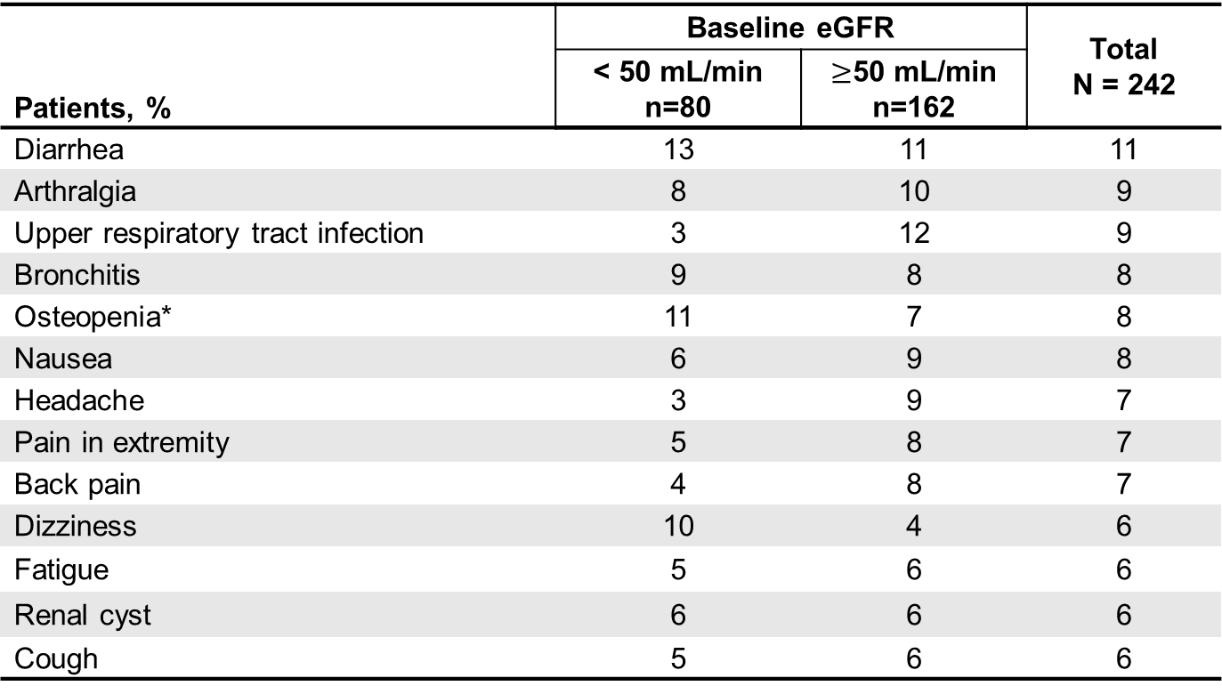
Adverse Events in ≥5% of Patients to Week 48
Patients, % | Baseline eGFR |  | Total N = 242
 | < 50 mL/min n=80 | $≥$50 mL/min n=162
Diarrhea | 13 | 11 | 11
Arthralgia | 8 | 10 | 9
Upper respiratory tract infection | 3 | 12 | 9
Bronchitis | 9 | 8 | 8
Osteopenia* | 11 | 7 | 8
Nausea | 6 | 9 | 8
Headache | 3 | 9 | 7
Pain in extremity | 5 | 8 | 7
Back pain | 4 | 8 | 7
Dizziness | 10 | 4 | 6
Fatigue | 5 | 6 | 6
Renal cyst | 6 | 6 | 6
Cough | 5 | 6 | 6
*Of 19 patients, 16 had osteopenia at baseline; the other 3 had an AE of osteopenia reported within 12 days after switching to E/C/F/TAF.
Pozniak, et al. CROI, 2015, #795

Slide 20
Adverse Events in ≥5% of Patients to Week 48 (cont’d)
Diarrhea (9%), arthralgia (8%), and bronchitis (8%) were the most commonly reported adverse events
Adverse events, grades, and frequencies were similar in patients with baseline eGFR <50 vs ≥50 mL/min
2 patients (0.8%) discontinued study drug for decreased GFR by eGFR_{CG} and eGFR_{CKD-EPI, cystatin C}, neither with evidence of renal tubulopathy
  1 patient with labile hypertension assessed as possibly related to concomitant ramipril and valsartan use and study drug
  1 patient assessed as likely related to progression of hypertension-related chronic kidney disease and not related to study drug
No patient developed proximal renal tubulopathy or Fanconi syndrome
Pozniak, et al. CROI, 2015, #795

Slide 21
Conclusions
This is the first study of a single-tablet antiretroviral regimen without dose adjustment in patients with eGFR between 30 and 69 mL/min, in which the median baseline age is 58 years
92% of patients maintained HIV-1 RNA <50 copies/mL at Week 48
Switching to E/C/F/TAF was associated with no change in actual GFR, reductions in proteinuria and markers of proximal renal tubular function, and improvements in hip and spine bone mineral density
Adverse events, grades, and frequencies were similar in patients with baseline eGFR <50 vs ≥50 mL/min
These 48-week data support the virologic efficacy and renal and bone safety of once daily, single-tablet E/C/F/TAF therapy for patients with HIV and mild to moderate renal impairment (eGFR 30–69 mL/min)
Pozniak, et al. CROI, 2015, #795

Slide 22
Acknowledgments
The authors gratefully acknowledge the investigators, study staff, and all participating patients of study GS-US-292-0112.
This study was funded by Gilead Sciences, Inc.
Pozniak, et al. CROI, 2015, #795

Slide 23
Study Investigators
J Andrade-Villanueva, J Arribas, A Avihingsanon, J Bartczak, P Benson,
M Bloch, R Bolan, I Brar, F Bredeek, T Campbell, K Casey, P Chetchotisakd,
A Clarke, C Cohen, L Cotte, G Crofoot, D Cunningham, C Dietz, R Dretler,
C Fichtenbaum, D Fish, J Flamm, S Follansbee, F Garcia, J Gathe,
R Grossberg, S Gupta, T Hawkins, K Henry, T Jefferson, R Kalayjian,
C Katlama, S Kerkar, A Khalsa, S Kiertiburanakul, D Klein, E Koenig, S Lewis, K Lichtenstein, C Martorell, C McDonald, J McGowan, J McMahon, A Mills,
T Mudrikova, E Negredo, O Osiyemi, P Palmieri, D Podzamczer, F Post,
A Pozniak, D Prelutsky, M Ramagopal, W Ratanasuwan, G Richmond,
W Robbins, N Roth, P Ruane, A Scarsella, G Schembri, S Schneider, P Shalit, W Short, J Slim, L Sloan, D Stein, J Stephens, P Tebas, D Ward, T Wills.
Pozniak, et al. CROI, 2015, #795

