Slide 1
Switching to F/TAF (Tenofovir Alafenamide) from F/TDF (Tenofovir DF) based Regimen
Study 311-1089: 48-Week Data
Joel Gallant¹, Eric Daar², Francois Raffi³, Cynthia Brinson⁴,
Peter Ruane⁵, Edwin DeJesus⁶, Mingjin Yan ⁷, Andrew Plummer⁷,
Andrew Cheng⁷, Martin S Rhee⁷
¹Southwest CARE Center, Santa Fe, NM; ²Los Angeles Biomedical Research Institute at Harbor-UCLA Medical Center, Torrance, CA; ³CHU Hotel Dieu-CHU De Nantes, Nantes, France; ⁴Central Texas Clinical Research, Austin, TX; ⁵Ruane Medical and Liver Health Institute, Los Angeles, CA; ⁶Orlando Immunology Center, Orlando, FL;
⁷Gilead Sciences, Foster City, CA
Abstract 29

Slide 2
Disclosures
Dr Gallant receives research grants awarded to his institution from AbbVie, Bristol-Myers Squibb, Gilead Sciences, Janssen Therapeutics, Merck & Co, Inc., Sangamo BioSciences, and ViiV Healthcare.
He serves as an advisor/consultant to Bristol-Myers Squibb, Gilead Sciences, Merck & Co, Inc., Janssen Therapeutics, and ViiV Healthcare.

Slide 3
Background
Emtricitabine/TDF (F/TDF)
  N(t)RTI backbone of most regimens recommended by major guidelines^{1,2}
Tenofovir disoproxil fumarate (TDF)
  Associated with renal and bone toxicities
Tenofovir alafenamide (TAF)
  91% lower plasma tenofovir exposures than TDF³
Elvitegravir/cobicistat/F/TAF (E/C/F/TAF)
  In treatment naïve and virologically suppressed patients, TAF showed improved renal and bone safety profiles compared with TDF^{3,4}
  Can be used in patients with eGFR as low as 30 mL/min⁵
  A recommended initial regimen by US DHHS¹ and several European country guidelines
1. https://aidsinfo.nih.gov/contentfiles/lvguidelines/adultandadolescentgl.pdf;
2. http://www.eacsociety.org/files/2015_eacsguidelines_8.0-english_rev-20151221.pdf; 3. Sax PE, et al. Lancet 2015;385:2606-15; 4. Mills A, et al. Lancet Infect Dis 2016;16:43-52 [Epub 2015 Nov 2]; 5. GENVOYA US PI and EU SmPC

Slide 4
Switch from F/TDF to F/TAF
Randomized, double-blind, double-dummy, active-controlled study
F/TAF (200/10 or 200/25 mg)* QD
n=333
F/TDF Placebo QD
Virologically Suppressed
(< 50 c/mL)
F/TDF + Third Agent
eGFR ≥50 mL/min
Continue Third Agent
F/TDF (200/300 mg) QD
F/TAF* Placebo QD
n=330
Continue Third Agent
BL
Wk 48
Wk 96
Primary Endpoint
HIV-1 RNA <50 c/mL
Secondary
Endpoint
*F/TAF Dose:
200/10 mg with boosted PIs
200/25 mg with unboosted third agents

Slide 5
Baseline Characteristics
 | F/TAF n=333 | F/TDF n=330
Median age (range), years | 48 (22, 78) | 49 (22, 79)
Female, n (%) | 48 (14) | 54 (16)
Race, n (%)
White | 244 (73) | 253 (77)
Black or African descent | 69 (21) | 67 (20)
Other | 20 (6) | 10 (3)
Hispanic/Latino ethnicity, n (%) | 48 (14) | 78 (24)
Median CD4 count, cells/mm³ | 663 | 624
<200 cells/mm³, n (%) | 5 (2) | 4 (1)
Median eGFR*, mL/min | 99 | 100
Use of third agent, n (%)
Boosted PI | 155 (47) | 150 (45)
Unboosted third agents | 178 (53) | 180 (55)
*eGFR calculated with Cockcroft-Gault equation

Slide 6
Patient Disposition through Week 48
F/TAF
Randomized and Treated
n=333
F/TDF
Randomized and Treated
n=330
21 (6%) | Reason for D/C, n | 21 (6%)
10 | Withdrew consent | 10
7 | Adverse event | 3
1 | Lost to follow-up | 1
1 | Noncompliance | 2
1 | Investigator discretion | 1
1 | Pregnancy | 0
0 | Protocol violation | 4
94% Continuing
n=312
94% Continuing
n=309

Slide 7
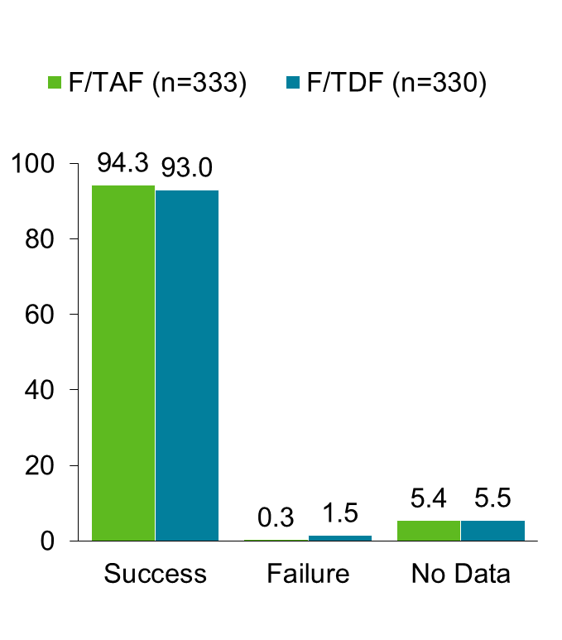
Efficacy at Week 48 (Snapshot)
Virologic Outcome
Treatment Difference (95% CI)
F/TDF
F/TAF
HIV-1 RNA <50 c/mL, %
1.3
-2.5
5.1
‒10%
0
+10%
Non-success

Slide 8
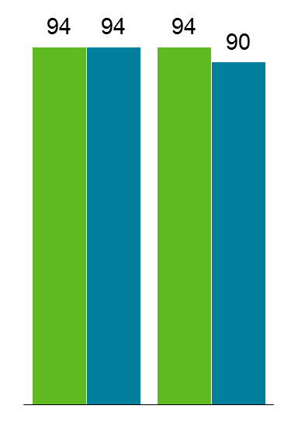
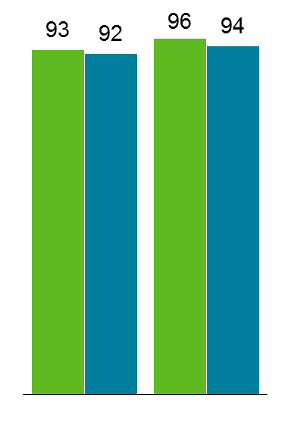
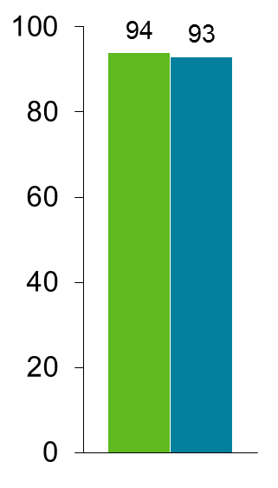
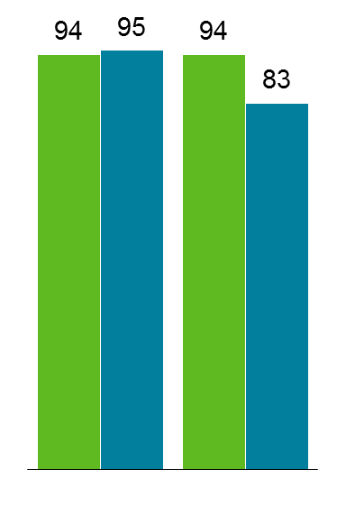
Virologic Success in Select Subgroups
F/TAF (n=333)
F/TDF (n=330)
Overall
Age
Sex
Race
HIV-1 RNA <50 c/mL, %
314
333
307
330
170
183
171
186
144
150
136
144
269
285
262
276
45
48
45
54
248
263
246
262
65
69
60
67
<50 yr
≥50 yr
Male
Female
Non-black
Black
Notes:
8

Slide 9
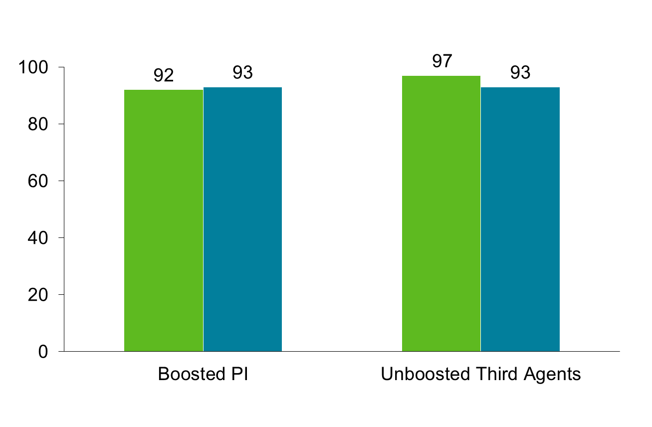
Virologic Success by Third Agent
F/TAF (n=333)
F/TDF (n=330)
HIV-1 RNA <50 c/mL, %
142
155
140
151
172
178
167
179

Slide 10
Emergent Resistance
n (%) | F/TAF n=333 | F/TDF n=330
Analyzed for resistance* | 2 (<1) | 1 (<1)
Development of resistance | 1 (<1) | 0
NRTI: M184V | 1 | 0
NNRTI | 0 | 0
PI | 0 | 0
INSTI | 0 | 0
*Confirmed HIV-1 RNA ≥50 c/mL at any visit or unconfirmed >400 c/mL at endpoint or discontinuation

Slide 11
Adverse Events
All grades >5% in either group, n (%) | F/TAF n=333 | F/TDF n=330
Upper respiratory tract infection | 30 (9) | 45 (14)
Diarrhea | 30 (9) | 33 (10)
Headache | 27 (8) | 15 (5)
Nasopharyngitis | 25 (8) | 20 (6)
Cough | 21 (6) | 16 (5)
Bronchitis | 21 (6) | 17 (5)
Back pain | 21 (6) | 15 (5)
Arthralgia | 19 (6) | 9 (3)
Fatigue | 18 (5) | 13 (4)
Sinusitis | 12 (4) | 22 (7)

Slide 12
Adverse Events Leading to Discontinuation
n (%) | F/TAF n=333 | F/TDF n=330
Overall | 7 (2) | 3 (1)
Insomnia / Mood altered | 1 | 0
Dysphagia | 1 | 0
Atrial fibrillation | 1 | 0
Diarrhea | 1 | 0
Peripheral edema | 1 | 0
Overdose | 1 | 0
Lymphoma | 1 | 0
Increased serum creatinine | 0 | 1
Rectal tenesmus | 0 | 1
Feeling abnormal / Headache | 0 | 1
No reported cases of proximal renal tubulopathy or Fanconi syndrome in either group
Notes:
_{Source: Listing 4}

Slide 13
Grade 3 to 4 Lab Abnormalities
≥ 1% in either group, n (%) | F/TAF n=333 | F/TDF n=330
Overall | 71 (21) | 62 (19)
LDL | 20 (6) | 8 (3)
Total bilirubin | 17 (5) | 18 (5)
Creatine kinase | 13 (4) | 10 (3)
Total cholesterol | 9 (3) | 3 (1)
Glycosuria | 8 (2) | 5 (2)
Hematuria | 5 (2) | 3 (1)
AST | 4 (1) | 5 (2)
Amylase | 4 (1) | 8 (2)
Hyperglycemia | 4 (1) | 2 (1)
GGT | 3 (1) | 9 (3)
Notes:
_{Source: Table 33}

Slide 14
Changes in eGFR
8.4 mL/min
p <0.001
2.8 mL/min
*eGFR calculated with Cockcroft-Gault equation

Slide 15
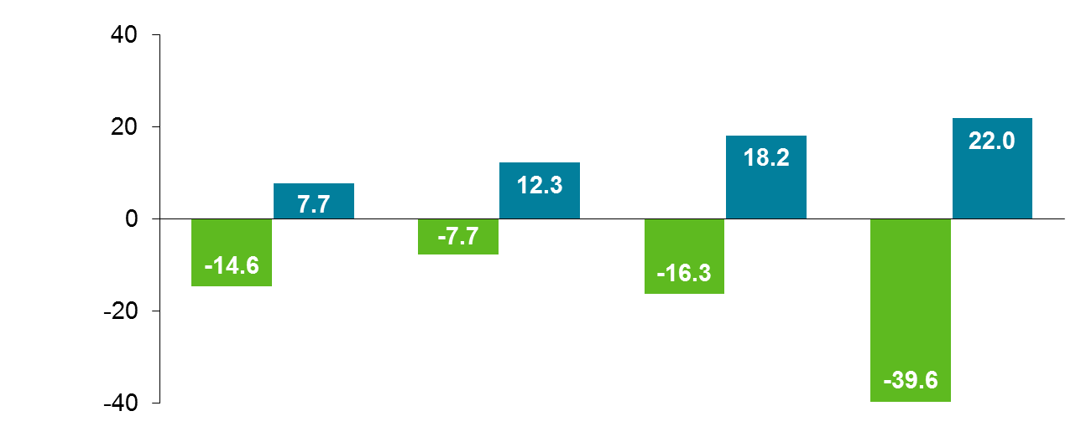
Change in Renal Biomarkers at Week 48
Urine Protein to Creatinine Ratio
Protein
Albumin
RBP
β2M
F/TAF
Median % change
F/TDF
All differences between treatments statistically significant (p <0.001)
RBP, retinol-binding protein; β2M, β2-microglobulin.

Slide 16
Change in Bone Mineral Density through Week 48
Spine
Hip
Mean % change (95% CI)
1.5
1.1
p <0.001
p <0.001
-0.2
-0.2
Weeks
Weeks
F/TAF, n
321
310
300
321
309
300
F/TDF, n
320
310
306
317
305
303
≥ 3% BMD increase at Week 48
F/TAF | 30% | p<0.001 |  | 17% | p=0.003
F/TDF | 14% |  |  | 9%

Slide 17
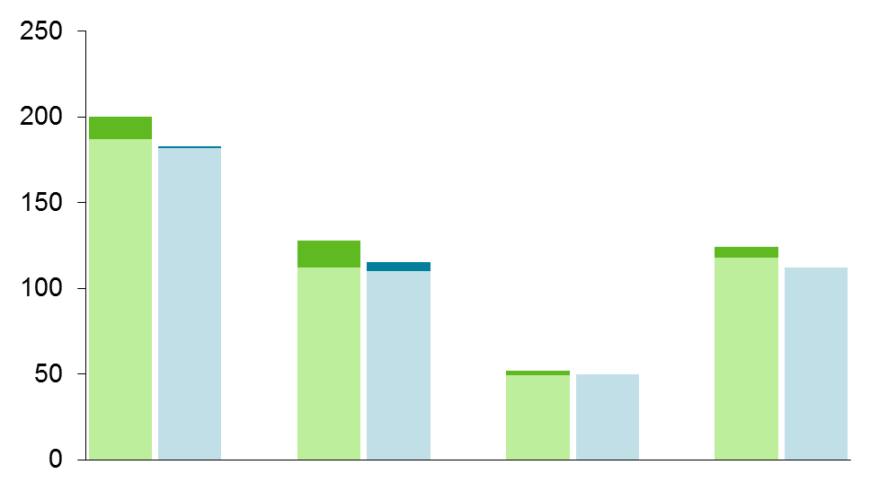
Fasting Lipid Results
 | F/TAF | F/TDF
Week 48
Baseline
p=0.069
p <0.001
3.7
3.6
200
3.6
3.6
183
p <0.001
187
182
p=0.004
Median value (mg/dL)
128
124
115
112
112
110
p=0.12
118
112
52
50
49
50
Total
Cholesterol
LDL
HDL
Triglycerides
TC: HDL Ratio
 | F/TAF | F/TDF
Patients initiating lipid-lowering agents | 4% | 4%

Slide 18
Week 48 Conclusions
F/TAF was noninferior to F/TDF in maintaining virologic suppression in combination with a variety of third agents
Significant improvements in multiple measures of renal and bone safety after switching from F/TDF to F/TAF
  Improvements in eGFR, proteinuria, including tubular proteinuria
  Improvements in BMD
Efficacy and safety results are consistent with E/C/F/TAF studies
These data support that F/TAF is an important NRTI backbone for antiretroviral treatment with safety benefits over F/TDF

Slide 19
Summary
Complete results in press in a peer-reviewed journal
F/TAF is under regulatory review by several health authorities
F/TAF is a backbone of multiple single-tablet regimens
  E/C/F/TAF (approved in US, EU, and several other countries)
  Rilpivirine/F/TAF (under regulatory review by several health authorities)
  GS-9883/F/TAF (in development)
  Darunavir/c/F/TAF (in development)

Slide 20
Acknowledgments
We extend our thanks to:
The patients and their families
All participating study investigators and staff:
J. Angel, N. Bellos, P. Benson, C. Brinson, J. Brunetta, A. Cheret, A. Clarke, N. Clumeck,
B. Conway, D. Coulston, G. Crofoot, E. Daar, E. DeJesus, C. Dietz, H. Edelstein, R. Elion, J. Flamm, J. Gallant, J. Gathe, R. Grossberg, B. Hare, K. Henry, R. Hsu,
M. Johnson, C. Kinder, D. Klein, LaMarca, A. Lazzarin, K. Lichtenstein, C. Lucasti,
F. Maggiolo, C. McDonald, J. McGowan, A. Mills, M. Mogyoros, J. Morales-Ramirez,
G. Moyle, H. Olivet, C. Orkin, O. Osiyemi, M. Para, A. Petroll, G. Pierone, C. Polk, F. Post,
D. Prelutsky, F. Raffi, M. Ramgopal, B. Rashbaum, J. Reynes, G. Richmond, A. Roberts,
P. Ruane, M. Saag, J. Santana-Bagur, L. Santiago, P. Sax, A. Scarsella, G. Schembri,
S. Segal-Maurer, P. Shalit, D. Shamblaw, L. Slama, J. Slim, L. Sloan, M. Sokol-Anderson, D. Stein, J. Stephens, M. Thompson, T. Vanig, G. Voskuhl, B. Wade, S. Walmsley, D. Ward, M. Wohlfeiler, Y. Yazdanpanah, B. Young, C. Zurawski
This study was funded by Gilead Sciences, Inc.

Slide 21
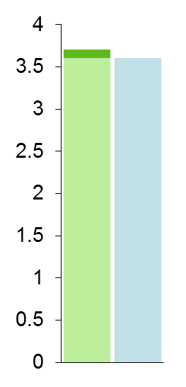
Fasting Lipid Results
 | F/TAF | F/TDF
Week 48
Baseline
p=0.069
p <0.001
3.7
3.6
5.18
3.6
3.6
4.74
p <0.001
3.32
Median value (mmol/L)
2.97
p=0.12
p=0.004
1.35
1.30
1.40
1.26
Total
Cholesterol
LDL
HDL
Triglycerides
TC: HDL Ratio
 | F/TAF | F/TDF
Patients initiating lipid-lowering agents, % | 3.9 | 3.6
Notes:
Bring clinicians back and evaluate are these increases clinically significant?
DAD 5 year risk equations supporting there were no changes in risk between the two treatment arms.
Importantly, the switch to F/TAF does not alter the risk compare to those who stayed on F/TDF.
There were increases from baseline in fasting values of total cholesterol, LDL cholesterol, and
triglycerides in the F/TAF+3rd Agent group, while these parameters had little change in the
FTC/TDF+3rd Agent group at both Week 24 and Week 48 (p < 0.001 for the differences
between groups for total cholesterol and LDL cholesterol; p = 0.016 at Week 24 and p = 0.002 at
Week 48 for triglycerides).
Median (Q1, Q3) changes from baseline at Week 48 for the F/TAF+3rd Agent group compared
with FTC/TDF+3rd Agent group were as follows: total cholesterol 14 (−2, 33) mg/dL vs
1 (−17, 15) mg/dL; LDL cholesterol 13 (−1, 28) mg/dL vs 4 (−9, 16) mg/dL; HDL cholesterol
2 (−4, 8) mg/dL vs. –1 (−6, 5) mg/dL; and triglycerides 10 (−22, 46) mg/dL vs
−2 (−30, 31) mg/dL. The changes were not considered clinically relevant.

