Slide 1
Cabotegravir + Rilpivirine as Long-Acting Maintenance Therapy: LATTE‑2 Week 32 Results
David A. Margolis,¹ Juan Gonzalez-Garcia,² Hans-Jürgen Stellbrink,³ Joe Eron,⁴ Yazdan Yazdanpanah,⁵ Sandy K. Griffith,¹ David Dorey,⁶ Kimberly Y. Smith,¹ Peter E. Williams,⁷ William R. Spreen¹
¹ViiV Healthcare, Research Triangle Park, NC; ²Hospital La Paz, Madrid, Spain; ³ICH Hamburg, Germany; ⁴University of North Carolina, Chapel Hill, NC; ⁵Hôpital Bichat Claude Bernard, Paris, France; ⁶GlaxoSmithKiline, Mississauga, Ontario, Canada; ⁷Janssen Research and Development, Beerse, Belgium

Slide 2
Disclosures
Dr. David A. Margolis is an employee of ViiV Healthcare
Margolis et al. CROI 2016; Boston, MA. Abstract 31LB.

Slide 3
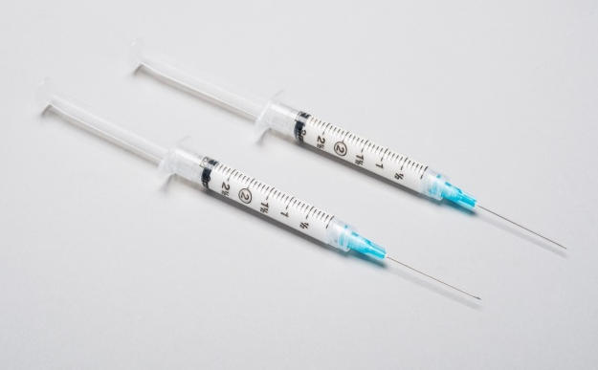
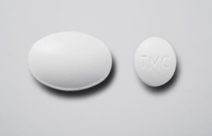
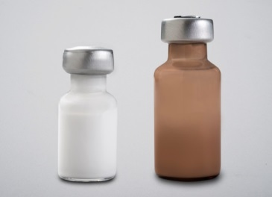
Background
CAB is an HIV-1 integrase inhibitor
Oral 30 mg tablet (t½, ~40 hours)
LA nanosuspension 200 mg/mL (t½, ~20-40 days)
RPV is an HIV-1 NNRTI
Oral 25 mg tablet (t½, ~50 hours)
LA nanosuspension 300 mg/mL (t½, ~30-90 days)
Oral 2-drug CAB + RPV proof of efficacy through Week 96 in LATTE-1
Proportion, % (95% CI)
BL
242628 32 36 40 48 60 72 84 96
2
4
8
12
16
Margolis et al. Lancet Infect Dis. 2015;15:1145-1155.
BL, baseline; CAB, cabotegravir; CI, confidence interval; EFV, efavirenz; LA, long-acting; NNRTI, non-nucleoside reverse transcriptase inhibitor; RPV, rilpivirine; t_{1/2}, half-life.
Margolis et al. CROI 2016; Boston, MA. Abstract 31LB.

Slide 4
LATTE-2 Objectives
Establish proof of principle for the first ever LA HIV treatment regimen
Primary Objective
Evaluate the safety and efficacy of CAB LA + RPV LA as maintenance therapy, and
Select a dosing schedule of CAB LA + RPV LA for progression into phase III studies
Key Secondary Objectives
Characterize LA pharmacokinetics
Evaluate the tolerability and acceptability of injectable dosing
Margolis et al. CROI 2016; Boston, MA. Abstract 31LB.

Slide 5
LATTE-2 Study Design
Induction period
Inclusion criteria | >18 years old Naive to antiretroviral therapy CD4+ >200 cells/mm³
Exclusion criteria | Positive for hepatitis B ALT ≥5 × ULN Creatinine clearance <50 mL/min
Qualification for maintenance | HIV-1 RNA <50 c/mL between Week -4 and Day 1
CAB 30 mg + ABC/3TC for 20 weeks
(N=309)
Add RPV
4 weeks
ABC/3TC, abacavir/lamivudine; ALT, alanine aminotransferase; ULN, upper limit of normal.
Margolis et al. CROI 2016; Boston, MA. Abstract 31LB.

Slide 6
LATTE-2 Study Design
Induction period
Maintenance periodª
CAB 400 mg IM + RPV 600 mg IM
Q4W (n=115)
CAB 30 mg + ABC/3TC for 20 weeks
CAB loading dose at Day 1
CAB 600 mg IM + RPV 900 mg IM
Q8W (n=115)
CAB loading doses at Day 1 and Week 4
CAB 30 mg + ABC/3TC PO QD (n=56)
Day 1 Randomization
2:2:1
Week 32 Primary analysis Dosing regimen selection
Week 48 Analysis Dosing regimen confirmation
Week 96^{b}
ABC/3TC, abacavir/lamivudine; IM, intramuscular; PO, orally; Q4W, every 4 weeks; Q8W, every 8 weeks; QD, once daily. ªSubjects who withdrew after at least 1 IM dose entered the long-term follow-up period. ^{b}Subjects can elect to enter LA Extension Phase beyond Week 96.
Margolis et al. CROI 2016; Boston, MA. Abstract 31LB.

Slide 7
Baseline Characteristics: ITT-ME Population
 | Q8W IM (n=115) | Q4W IM (n=115) | Oral CAB (n=56) | Total (N=286)
Median age, years | 35.0 | 36.0 | 35.0 | 35.0
Female, n (%) | 8 (7) | 6 (5) | 10 (18) | 24 (8)
African American/African heritage, n (%) | 17 (15) | 12 (10) | 15 (27) | 44 (15)
CDC class C, n (%) | 1 (<1) | 2 (2) | 0 | 3 (1)
Median HIV-1 RNA, log₁₀ c/mL | 4.419 | 4.455 | 4.289 | 4.393
≥100,000, n (%) | 16 (14) | 28 (24) | 7 (12) | 51 (18)
Median CD4+, cells/mm³ | 449.0 | 499.0 | 517.5 | 489.0
CDC, Centers for Disease Control and Prevention; ITT-ME, intent-to-treat maintenance exposed.
Margolis et al. CROI 2016; Boston, MA. Abstract 31LB.

Slide 8
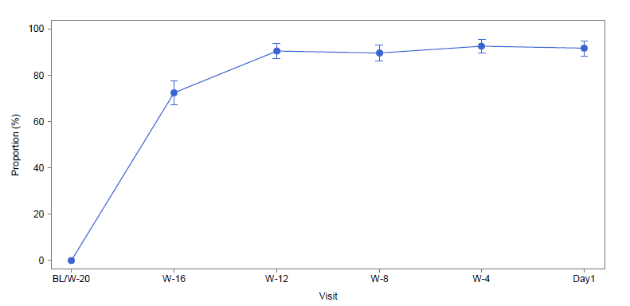
Day 1 Induction Outcomes (ITT-E)
91%
Day 1 Snapshot outcome | Oral CAB (N=309)
Virologic success | 282 (91%)
Virologic non-response | 14 (5%)
Data in window not <50 c/mL | 9 (3%)
Discontinued for lack of efficacy | 2 (<1%)
Discontinued for other reason while not <50 c/mL | 3 (<1%)
No virologic data in window | 13 (4%)
Discontinued due to AE or death | 6 (2%)
Discontinued for other reasons | 7 (2%)
ITT-E Snapshot <50 c/mL
Day 1 drug-related AEs | Oral CAB (N=309)
Preferred term ≥3%
Nausea | 27 (9%)
Dyspepsia | 9 (3%)
Headache | 9 (3%)
Fatigue | 8 (3%)
Margolis et al. CROI 2016; Boston, MA. Abstract 31LB.

Slide 9
LATTE-2 Week 32 Results: HIV-1 RNA <50 c/mL by Snapshot (ITT-ME)
100
80
60
Snapshot success: D1
Q4W | 99%
Q8W | 95%
Oral CAB | 98%
Proportion of patients with
virological suppression, %
40
20
0
BL
W-16
W-12
W-8
W-4
D1
W4
W8
W12
W16
W20
W24
W28
W32
Study visit
Margolis et al. CROI 2016; Boston, MA. Abstract 31LB.

Slide 10
LATTE-2 Week 32 Primary Endpoint: HIV-1 RNA <50 c/mL by Snapshot (ITT-ME)
Virologic outcomes
Treatment differences (95% CI)
*
*
Oral
IM
Q8W
-4.8
12.2
Q4W
-5.8
11.5
Both Q8W and Q4W comparable to oral CAB at Week 32
*Met pre-specified threshold for concluding IM regimen is comparable to oral regimen (Bayesian posterior probability >90% that true IM response rate is no worse than -10% compared with the oral regimen).
Margolis et al. CROI 2016; Boston, MA. Abstract 31LB.

Slide 11
Snapshot Outcomes: HIV-1 RNA <50 c/mL at Week 32 (ITT-ME)
Week 32 outcome | Q8W IM (n=115) | Q4W IM (n=115) | Oral CAB (n=56)
Virologic success | 109 (95%) | 108 (94%) | 51 (91%)
Virologic non-response | 5 (4%) | 1 (<1%) | 2 (4%)
Data in window not <50 c/mLª | 3 (3%) | 1 (<1%) | 1 (2%)
Discontinued for lack of efficacy | 1 (<1%) | 0 | 1 (2%)
Discontinued for other reason while not <50 c/mL | 1 (<1%) | 0 | 0
No virologic data in window | 1 (<1%) | 6 (5%) | 3 (5%)
Discontinued due to adverse event or death^{b} | 0 | 4 (3%) | 1 (2%)
Discontinued for other reasons^{c} | 1 (<1%) | 2 (2%) | 2 (4%)
ªWeek 32 HIV-1 RNA Q8W: 53 c/mL, 70 c/mL, 91 c/mL; Q4W: 70 c/mL; oral CAB: 243 c/mL. All 5 are still in the study. ^{b}Q4W: hepatitis C, rash, depression, and psychosis; oral CAB: hepatitis C. ^{c}Q8W: ISR; Q4W: pregnancy and prohibited medication; oral CAB: lost to follow-up, relocation.
Margolis et al. CROI 2016; Boston, MA. Abstract 31LB.

Slide 12
Protocol-Defined Virologic Failure (PDVF): Genotype
No INI, NNRTI, or NRTI mutations were detected through Induction or Maintenance
Maintenance period | Q8W IM (n=115) | Q4W IM (n=115) | Oral CAB (n=56)
Subjects with PDVFª | 1^{b} (1%) | 0 | 1 (2%)
INI-r mutations | 0 | 0 | 0
NRTI-r mutations | 0 | 0 | 0
NNRTI-r mutations | 0 | 0 | 0
ªOne additional PDVF occurred during oral Induction Period due to oral medication non-adherence. ^{b}PDVF at Week 4; no detectable RPV at Week 4 and Week 8, suggesting maladministration.
PDVF: <1.0 log₁₀ c/mL decrease in plasma HIV-1 RNA by Week 4, OR confirmed HIV-1 RNA ≥200 c/mL after prior suppression to <200 c/mL, OR >0.5 log₁₀ c/mL increase from nadir HIV-1 RNA value ≥200 c/mL.
Margolis et al. CROI 2016; Boston, MA. Abstract 31LB.

Slide 13
Adverse Events and Labs— Maintenance Period
ITT-ME population, n (%) | Q8W IM (n=115) | Q4W IM (n=115) | Oral CAB (n=56) | IM subtotal (N=230)
Drug-related AEs, excluding ISRs (≥3%)
Pyrexia | 3 (3) | 5 (4) | 0 | 8 (3)
Fatigue | 2 (2) | 4 (3) | 1 (2) | 6 (3)
Influenza-like illness | 3 (3) | 2 (2) | 0 | 5 (2)
Grade 3 and 4 AEs, excluding ISRs | 10 (9) | 12 (10) | 1 (2) | 22 (10)
Drug-related Grade 3/4 AEsª, excluding ISRs | 3 (3) | 4 (3) | 0 | 7 (3)
Serious AEs^{b} | 7 (6) | 6 (5) | 3 (5) | 13 (6)
AEs leading to withdrawal^{c} | 2 (2) | 6 (5) | 1 (2) | 8 (3)
Grade 3 and 4 labs^{d} | 17 (15) | 20 (17) | 8 (14) | 37 (16)
ªQ8W: influenza-like illness, chills and pain, and lipase; Q4W: influenza-like illness, rash, depression, and psychosis. ^{b}None drug related; one death (epilepsy) evaluated as not likely related to study drug. ^{c}Q8W: ISR × 2; Q4W: Churg Strauss vasculitis, hepatitis C, depression, epilepsy, psychosis, and rash; oral CAB: hepatitis C. dMaintenance emergent. AE, adverse event; ISR, injection-site reaction.
Margolis et al. CROI 2016; Boston, MA. Abstract 31LB.

Slide 14
Adverse Events and Labs— Maintenance Period
 | Q8W IM (n=115) | Q4W IM (n=115) | IM subtotal (N=230)
Number of injections | 1623 | 2663 | 4286
Number of ISRs (events/injection) | 1054 (0.65) | 1228 (0.46) | 2282 (0.53)
Grades
Grade 1 | 839 (80%) | 1021 (83%) | 1860 (82%)
Grade 2 | 202 (19%) | 197 (16%) | 399 (17%)
Grade 3 | 12 (1%) | 10 (<1%) | 22 (<1%)
Grade 4 | 0 | 0 | 0
Duration, days
≤7 | 943 (89%) | 1121 (91%) | 2064 (90%)
Median | 3.0 | 3.0 | 3.0
Most common ISR events overall were pain (67%), swelling (7%), and nodules (6%)
Number of subjects reporting ISRs decreased over time, from 86% (Day 1) to 33% (Week 32)ª
2/230 subjects (1%) withdrew as a result of injection reactions (Q8W)
ªRepresents percent of subjects with a Week 32 visit (n=220).
Margolis et al. CROI 2016; Boston, MA. Abstract 31LB.

Slide 15
Patient-Reported Outcomes at Week 32: Maintenance Treatment Compared With Oral Induction Treatmentª
How satisfied are you with your current treatment?
How satisfied would you be to continue with your present form of treatment?
3%
1%
2%
1%
3%
1%
Note: based on observed case dataset of subjects who completed Week 32 questionnaires.
ªHIV Treatment Satisfaction Questionnaire change version (HIVTSQc).
Margolis et al. CROI 2016; Boston, MA. Abstract 31LB.

Slide 16
Pharmacokinetics
500
Cτ
Cτ
Cτ
0 1 4 8 12 16 20 24 25 28 32
0 1 4 8 12 16 20 24 25 28 32
Cτ, trough concentration; PA-IC90, protein binding–adjusted 90% inhibitory concentration; SD, standard deviation.
Margolis et al. CROI 2016; Boston, MA. Abstract 31LB.

Slide 17
Conclusions
LATTE-2 results successfully demonstrate the potential to maintain HIV-1 viral load <50 c/mL with LA IM CAB + RPV, dosed once Q4W or Q8W
Two subjects met PDVF criteria
Q8W (n=1), oral CAB (n=1); both without evidence of resistance at failure
Injection tolerability
Majority of ISRs were Grade 1 to 2 pain, with a median duration of 3 days
Few subjects had an ISR that led to discontinuation, with high overall reported satisfaction
Regimen selection criteria
Neither Q4W IM or Q8W IM dosing was ruled out on the basis of pre-specified criteria
Upcoming Week 48 analysis will contribute to final dose selection for phase III studies
Margolis et al. CROI 2016; Boston, MA. Abstract 31LB.

Slide 18
Thank You
We thank everyone who has contributed to the success of this study, including
All study participants and their families
The LATTE-2 clinical investigators and their staff in Spain, Germany, France, Canada, and the United States
The ViiV Healthcare, GSK, Parexel, and Janssen study team members
Margolis et al. CROI 2016; Boston, MA. Abstract 31LB.

