Slide 1
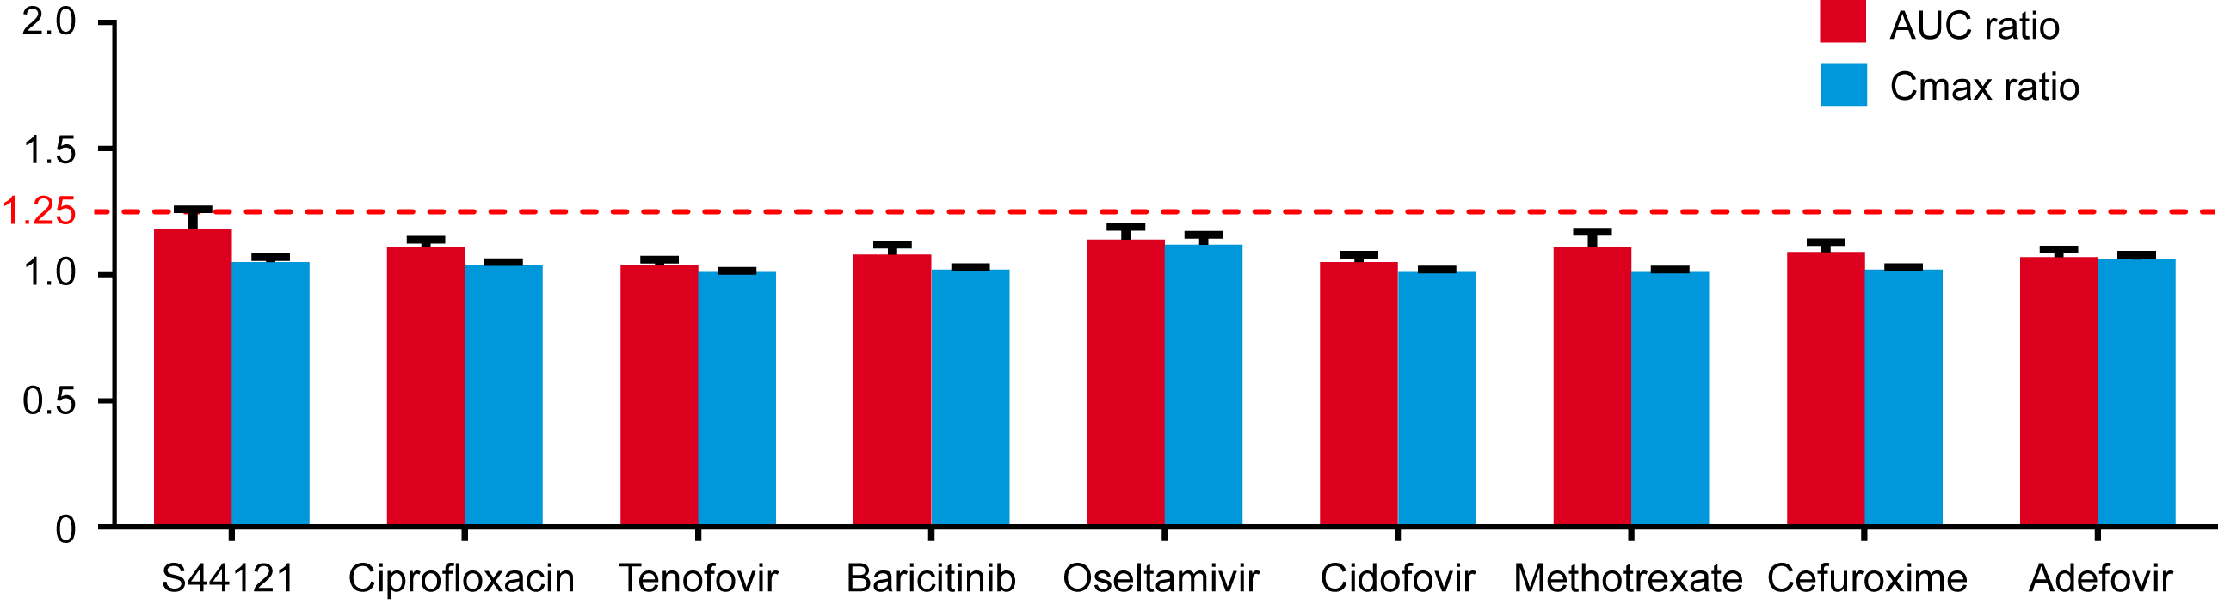
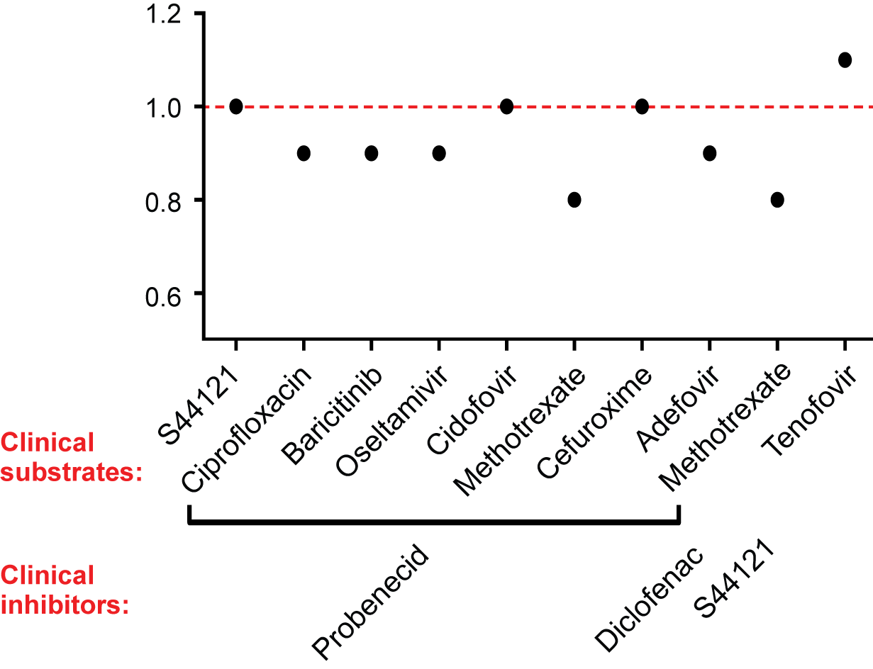
Prediction of Renal OAT1 and OAT3 Inhibition by Cabotegravir Using PBPK Modelling
0470
Kunal S. Taskar,¹ Aarti Patel,¹ Simon J. Cozens,¹ Helen Tracey,¹ Susan Ford,² Kelong Han,² William Spreen,³ Mark Baker,⁴ Parul Patel³
  ¹GlaxoSmithKline, Ware, UK; ²GlaxoSmithKline, Research Triangle Park, NC, USA; ³ViiV Healthcare, Research Triangle Park, NC, USA; ⁴ViiV Healthcare, Nyon, Switzerland
Introduction
      Cabotegravir (CAB) is an integrase strand transfer inhibitor being investigated
      for the treatment and prevention of HIV infection. It is being developed as a long-acting (LA) intra-muscular injection to facilitate every 1- or 2-month dosing.
      In vitro studies indicated that CAB inhibits renal Organic Anion Transporters (OAT1 and OAT3) with half maximal inhibitory concentrations of 0.81 and 0.41 µM, respectively, and hence it is necessary to evaluate the impact of CAB on the exposure and clearance of co-medications which are OAT1/OAT3 substrates. CAB does not markedly inhibit other renal transporters like MATE1, MATE2-K, MRP4 and OCT2.
      The objective of the present analysis was to build a physiologically based pharmacokinetic (PBPK) model of CAB to predict the clinical implications of renal OAT1/OAT3 inhibition on co-medications such as methotrexate, tenofovir, adefovir and other clinically relevant OAT1/3 substrates.
            Table 1. Key Input Parameters for CAB PBPK Model
            Figure 3. DDI Predictions of OAT1/OAT3 Substrates When Co-dosed With Repeat Oral CAB 30 mg Dosing
Parameter | Value | Source
Molecular weight | 405.4 | Measured value
Log P | 1.58 | Measured value
pKa | 7.71 | Measured value
Blood/Plasma ratio | 0.54 | Measured value
Fraction unbound in plasma (Fu) | 0.006 | Measured value from clinical and in vitro investigations
Papp (10⁻⁶ cm/s) | 25.6 | Measured value (MDCK)
Vss (L/kg) | 0.12 | Predicted by Simcyp® (Method 2)
Clearance – enzymatic CL_{int} (µL/min/mg) | UGT1A1 – 4.5 UGT1A9 – 2.2 | Measured value from in vitro investigations
Transporter inhibition Ki (µM) | OAT1 – 0.4 OAT3 – 0.2 | Measured value from in vitro investigations (Ki = IC₅₀/2)
            Increase in OAT1/OAT3 substrate
            AUC or Cmax ratios when
            co-dosed with CAB
Methods
      A mechanistic PBPK model of CAB in the adult population was built using the Simcyp® v17.1 simulator and validated through comparison with available clinical PK data following oral CAB 30 mg administration in healthy volunteers.
      DDI simulations were performed to evaluate the effect of CAB oral doses on the exposure of OAT1/OAT3 substrates. Details of model development strategy are described in Figure 1.
Results
            Figure 2. Simulated and Observed CAB Plasma Profiles Following Single and Repeat Oral CAB 30 mg Dosing
      CAB PBPK model was verified and deemed suitable for prospective DDI simulations as:
        Predicted CAB PK parameters were within the range acceptable for bioequivalence (0.8 to 1.25) following single and repeat oral CAB 30 mg dosing.
        Simulated PK profiles were comparable to data in healthy and patient populations
        from clinical studies, including rifampin DDI, renal impairment, and individuals with UGT1A1 polymorphisms.
      DDI simulations predicted a mean change in systemic exposure for tested OAT1/OAT3 substrates of <25% after co-administration with CAB at steady state.
            Figure 4. Qualification of Simcyp® Simulator for OAT1/OAT3 Drug-Drug Interaction Predictions
Conclusions
      A PBPK model of CAB was developed and validated that accurately predicted human pharmacokinetics observed in healthy volunteers.
      CAB is predicted to be a clinically weak inhibitor of OAT1/3-mediated transport with mean increase of <25% in systemic exposure of OAT1/3 substrate drugs, such as tenofovir, cidofovir, NSAIDs and methotrexate.
      Sensitivity analyses predicted a mean increase of <25% in systemic exposure of narrow therapeutic index OAT1/OAT3 substrate drugs such as methotrexate even up to 4-fold more potent inhibition values than the measured CAB OAT1/OAT3 IC₅₀ or at 3-fold higher CAB oral dose or at 10-fold higher CAB fraction unbound in plasma.
      Similar CAB concentrations following oral and LA administration suggest that these results would apply to CAB LA.
      The predicted lack of interactions supports CAB co-administration with OAT1/OAT3 substrates without dose adjustments.
            Figure 1. Workflow for CAB PBPK Model Development, Verification
            and Application
CAB Model Development
Physicochemical properties, in vitro clearance,
in vitro enzyme or transporter interactions
            Predicted to observed
            systemic exposure ratio
Simcyp® OAT1/OAT3 Inhibition Qualification
DDI between OAT1/OAT3 substrates – methotrexate, tenofovir, ciprofloxacin, S44121, oseltamivir, cidofovir, baricitinib, cefuroxime, adefovir and OAT1/OAT3 inhibitors such as probenecid, diclofenac, S44121
CAB Model Verification
PK profile verified by comparing with observed clinical PK following: single or repeated oral dose, clinical DDIs, special population
Simcyp® UGT1A1/UGT1A9 Qualification
UGT1A1 induction with raltegravir-rifampin, UGT1A1 inhibition with raltegravir-atazanavir, UGT1A9 inhibition
with dapagliflozin-mefenamic acid
Model Application
Solid line = simulated mean CAB plasma profile; dotted lines = simulated 5th-95th percentile; dots = observed individual CAB plasma profiles.
CAB as OAT1/OAT3 Inhibitor
CAB as UGT1A1/UGT1A9 Substrate
CAB as Perpetrator
DDI predictions with OAT1 and/or OAT3 substrates
CAB as Victim
DDI predictions with UGT1A1 and UGT1A9 inhibitors – atazanavir, mefenamic acid
  Acknowledgments: Simon Bate, Manish Gupta, Pratik Saha. This study was funded by ViiV Healthcare.
      Extensive simulations qualified Simcyp® for OAT1/3 inhibition predictions.
Reference: 1. Bowers GD, Culp A, Reese MJ, et al. Disposition and metabolism of cabotegravir: a comparison of biotransformation and excretion between different species and routes of administration in humans. Xenobiotica. 2016;46(2):147-162.

