Slide 1
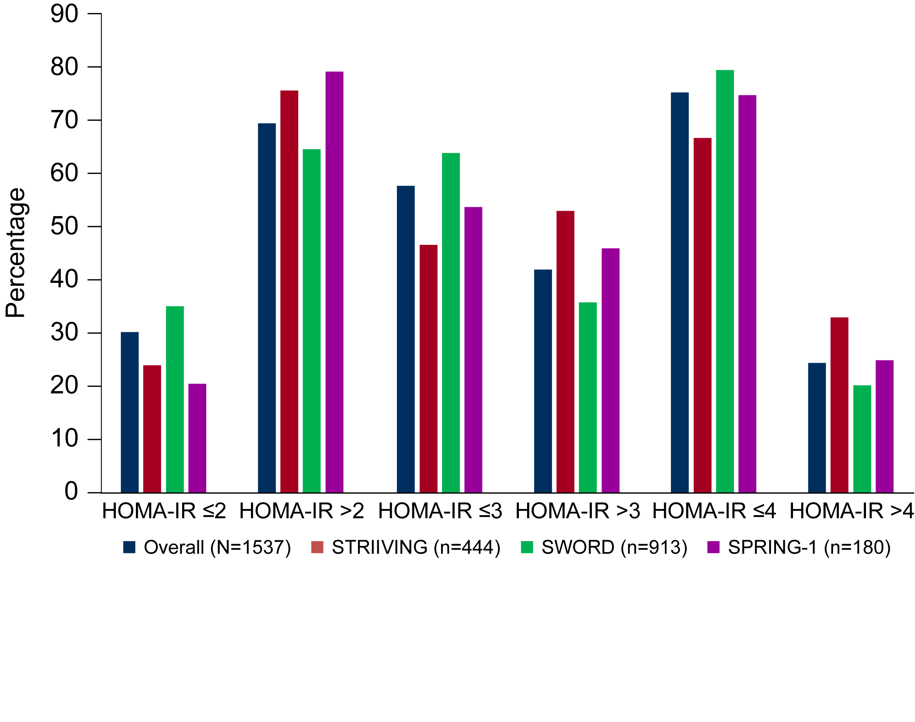
Dolutegravir and Insulin Resistance
679
Janet Lo,¹ James Oyee,² Melissa Crawford,² Richard Grove,² Ralph DeMasi,³ Lloyd Curtis,² Anna Fettiplace,² Vani Vannappagari,³ Nassrin Payvandi,⁴ Michael Aboud,⁴ Jean van Wyk⁴
¹Massachusetts General Hospital and Harvard Medical School, Boston, MA; ²GlaxoSmithKline, Uxbridge, Middlesex, UK; ³ViiV Healthcare, Research Triangle Park, NC; ⁴ViiV Healthcare, Brentford, UK
Introduction
Insulin resistance (IR) is a condition in which a greater than normal amount of insulin is required to obtain a quantitatively normal glucose response and can be assessed by homeostasis model of assessment (HOMA)–IR as a surrogate marker
HIV infection has been independently associated with IR, potentially through chronic immune activation/inflammation¹
This effect is not necessarily mitigated through successful antiretroviral therapy (ART)²
ART has been associated with IR through 2 principal mechanisms³
Interference with insulin signaling at the cellular level
Defects in lipid metabolism (eg, as seen with lipodystrophy)
In the context of combination ART, increased obesity, and an aging population with HIV infection, potential associations of an individual antiretroviral with IR are difficult to evaluate
Objective
Evaluate the association between baseline HOMA-IR and patient/disease characteristics
Explore risk factors associated with IR post-baseline
Evaluate any effect of DTG on IR over time compared with control
Table 1. Treatment Groups, Participant Populations, and Data Timepoints by Study
Figure 1. HOMA-IR Assessments at Baseline
Consistent with the ANCOVA, logistic regression analysis showed no association between treatment (DTG vs control) and HOMA-IR >2, >3 or >4 at Week 48; proportion of participants with IR was similar between DTG and control groups irrespective of the HOMA-IR cut off used
Same observations were made for Week 24 analysis
Treatment-emergent changes in HOMA-IR were not assessed
Risk factors for HOMA-IR >2 at Week 48: baseline HOMA-IR, female sex, higher BMI, AIDS Centers for Disease Control and Prevention category, smoking history, and elevated ALT
Study number | Population | Actual treatment groups | No. of participants analyzedª DTG vs control | Baseline | Week 24 | Week 48
ING112276 SPRING-1 | ART naive | DTG (10, 25, and 50 mg once daily) vs EFV | 137 vs 43 | X | X | X
201636/ 201637 SWORD-1/-2 | ART experienced, suppressed | DTG 50 mg + RPV 25 mg vs CAR | 460 vs 453 | X |  | X
201147 STRIIVING | ART experienced, suppressed | Early-switch DTG/ABC/3TC vs late-switch DTG/ABC/3TC | 227 vs 217 | X | X
ªParticipants with available data at baseline (not all participants have data post-baseline). ABC, abacavir; ART, antiretroviral therapy; CAR, current ART; DTG, dolutegravir; EFV, efavirenz; 3TC, lamivudine; RPV, rilpivirine.
Table 3. Changes in HOMA-IR Over Time and Relative to Controls
 |  |  | ANCOVA analysis |  |  | Logistic regression analysis
Study timepoint | Arm | n | LS means estimates (SE)ª | Geometric LS mean ratio (95% CI)^{b} | P value | HOMA-IR >2/n | Odds ratio (95% CI) | P value
Overall Week 48^{c} | Control | 460 | 1.18 (0.024) |  |  | 360/460
 | DTG | 543 | 1.16 (0.022) | 0.98 (0.92-1.04) | 0.497 | 413/543 | 0.81 (0.57-1.14) | 0.222
SPRING-1 Week 24 | Control^{d} | 35 | 1.07 (0.090) |  |  | 29/35
 | DTG | 125 | 1.02 (0.047) | 0.95 (0.77-1.16) | 0.583 | 98/125 | 0.46 (0.12-1.45) | 0.215
SPRING-1 Week 48 | Control^{d} | 38 | 1.06 (0.092) |  |  | 29/38
 | DTG | 123 | 1.13 (0.050) | 1.07 (0.86-1.32) | 0.546 | 99/123 | 0.20 (0.03-1.16) | 0.086
STRIIVING Week 24e | Control^{f} | 184 | 0.97 (0.046) |  |  | 131/184
 | DTG | 179 | 1.05 (0.046) | 1.07 (0.95-1.22) | 0.273 | 147/179 | 1.86 (1.08-3.23) | 0.027
SWORD-1/-2 Week 48 | Control^{f} | 422 | 1.21 (0.024) |  |  | 331/422
 | DTG | 420 | 1.15 (0.024) | 0.95 (0.89-1.02) | 0.161 | 314/420 | 0.78 (0.55-1.11) | 0.167
HOMA-IR formula: [insulin (μU/mL × glucose (mmol/L)/22.5]. ªGeometric LS mean ratio estimates the LS ratio at the analysis timepoint over baseline values. The following baseline characteristics were selected from the final ANCOVA model as potential risk factors for the development of IR at Week 48: baseline HOMA-IR, female sex, bodyweight, immune disorder, and increased triglycerides, ALT, and viral load. ^{b}Baseline characteristics selected from the final logistic model as potential risk factors for developing IR at Week 48: baseline HOMA-IR, female sex, body mass index, smoking history, immune disorder, elevated ALT, and increased viral load. ^{c}Includes SPRING-1 and SWORD studies. ^{d}Efavirenz. ^{e}Only Week 24 data are presented as all participants switched to DTG after this timepoint. ^{f}Current antiretroviral therapy (boosted protease inhibitor, integrase strand transfer inhibitor, NRTI, non-NRTI). ALT, alanine transaminase; ANCOVA, analysis of variance; CI, confidence interval; DTG, dolutegravir; HOMA, homeostasis model of assessment; IR, insulin resistance; N, number of participants with evaluable HOMA-IR data at baseline and analysis time point; LS, least squares; NRTI, nucleoside reverse transcriptase inhibitor; SE, standard error based on log scale.
Methods
4 dolutegravir (DTG) clinical trials with fasting insulin and glucose measurements available were identified and included in the analysis: SPRING-1, STRIIVING, and SWORD-1/-2
Participants with diabetes at baseline and those participants without results for glucose and insulin at either baseline or post-baseline timepoints were excluded from the analysis
IR was determined by HOMA mathematical model calculated from the measurement of fasting insulin compared with fasting glucose using formula [insulin (μU/mL) × glucose (mmol/L)/22.5]
There is no well-defined HOMA-IR cut-off established to be clinically relevant
For this analysis, a cut-off of 2 was used, with additional cut-offs of 3 and 4 used for sensitivity
Analysis of relationship between baseline risk factors and HOMA-IR was completed
Analysis of covariance (ANCOVA) calculated change from baseline for HOMA-IR by examining the ratio between log HOMA-IR value at Weeks 24 and 48 compared with baseline
Relationship between potential risk factors and the proportion of participants with HOMA-IR cut-off >2, 3, or 4 was explored using a logistic regression model
Basic and multivariable logistic regression models were used
Table 2. Demographic and Baseline Characteristics
Variable | Participants, n (%) N=1537
Previous exposure to antiretroviral therapy
Experienced (from SWORD and STRIIVING studies) | 1357 (88.3)
Naive (from SPRING-1) | 180 (11.7)
Third agent classª
Integrase strand transfer inhibitor | 301 (19.6)
Non-nucleoside reverse transcriptase inhibitor | 623 (40.5)
Protease inhibitor | 433 (28.2)
Body mass index category 1, kg/m²
Underweight: <18.5 | 28 (1.8)
Normal: 18.50-24.99 | 739 (48.1)
Overweight: 25.00-29.99 | 504 (32.8)
Obese: ≥30 | 260 (16.9)
Smoking history
Current | 475 (30.9)
Former | 276 (18.0)
None | 786 (51.1)
High blood pressure, mm Hg
<140/90 | 1449 (94.3)
≥140/90 | 88 (5.7)
Cardiovascular treatment
Yes | 383 (24.9)
No | 1154 (75.1)
ªSWORD and STRIIVING studies only (N=1357).
HOMA, homeostasis model of assessment; IR, insulin resistance.
Figure 2. Distribution of HOMA-IR: Median Plot of HOMA-IR by Visit
SPRING-1
STRIIVING
Median HOMA-IR
Limitations
These results should be interpreted with caution because the studies were not primarily designed to assess effects of DTG exposure on IR
These analyses are exploratory, and logistic regression and ANCOVA were not adjusted for multiplicity
In SWORD-1/-2, 33 participants (6%) in the early-switch group and 29 participants in the late-switch group were taking a DTG-containing regimen prior to baseline; in STRIIVING, 1 patient was already taking a DTG-containing regimen
These patients were not excluded from the analysis, but it is not anticipated that these small numbers should impact the interpretation of the results
SWORD-1
SWORD-2
Results
Table 1 shows the study details, treatment groups, participant numbers for analysis, and the timepoints of data available
SPRING-1 evaluated different doses of DTG; all doses were pooled for analysis of the DTG arm
HOMA-IR data were available at baseline, Week 24, and Week 48 for 824, 304, and 543 DTG-exposed participants and 713, 219, and 460 controls, respectively
Participants were mostly men (81%), white (76%), and from Europe or North America (92%), with a median age of 43 years (range, 20-80 years)
Approximately 50% of the population were overweight or obese at baseline based on body mass index (BMI)
Table 2 shows additional demographic and baseline characteristics
Prevalence of IR at baseline based on different HOMA-IR thresholds is shown in Figure 1
Overall, 70% of participants had a HOMA-IR >2 at baseline
An association between baseline HOMA-IR >2 and the following baseline factors was noted
Increasing age, geographic region (higher in participants in North America and Europe compared with the rest of the world), increased BMI and body weight, presence of a metabolic or cardiac disorder, lipid abnormalities, and abnormal liver function tests (alanine transaminase [ALT], albumin, and alkaline phosphatase)
Visit
Conclusions
High prevalence of IR (70% with HOMA-IR >2) at baseline was observed and consistent across the 4 studies
Numerical increase in HOMA-IR was observed for DTG and control groups, but differences between groups were not statistically significant, with no evidence of a treatment effect over 48 weeks
Increase in HOMA-IR over time is not surprising in this population, because many participants had elevated HOMA-IR at baseline and were at increased risk of worsening IR
Incidence of IR was similar in DTG and control arms irrespective of HOMA-IR threshold
In general, potential risk factors identified as being associated with IR at Week 48 were consistent with known risk factors for diabetes and IR
ABC, abacavir; ART, antiretroviral therapy; CAR, current antiretroviral therapy; DTG, dolutegravir; EFV, efavirenz; HOMA, homeostasis model of assessment; IR, insulin resistance; 3TC, lamivudine; QD, once daily; RPV, rilpivirine.
Table 3 shows results for changes in HOMA-IR over time (logistic regression) and relative to controls (ANCOVA)
ANCOVA of HOMA-IR demonstrated no statistically significant difference between DTG and control treatment groups at Week 48 using either the basic or full multivariate model
Both groups showed a similar modest increase in HOMA-IR from baseline by Week 48 (least squares means estimated)
No statistically significant difference was observed between the study examined and IR or between DTG and control treatment groups or study at Week 24
Unadjusted median HOMA-IR by study and timepoint are shown in Figure 2
There are no clear shifts in median HOMA-IR over time that are consistent across all 4 studies
In SPRING-1, in which 3 different doses of DTG were given (10, 25, and 50 mg), a modest increase was observed in median HOMA-IR from baseline to Week 48 with the 25-mg dose that was not apparent in the other 2 dose groups or the control group
Median HOMA-IR in this dose group decreased from Week 48 to Week 96, tending toward the baseline value
Acknowledgments: This study was funded by ViiV Healthcare. Editorial assistance and graphic design support for this poster were provided under the direction of the authors by MedThink SciCom and funded by ViiV Healthcare.
References: 1. Brener et al. Am Cardiol. 2016;117:993-1000. 2. Hunt et al. J Infect Dis. 2016;214:S44-S50. 3. Feeney et al. Best Pract Res Clin Endocrinol Metab. 2011;25:443-458.

