Slide 1
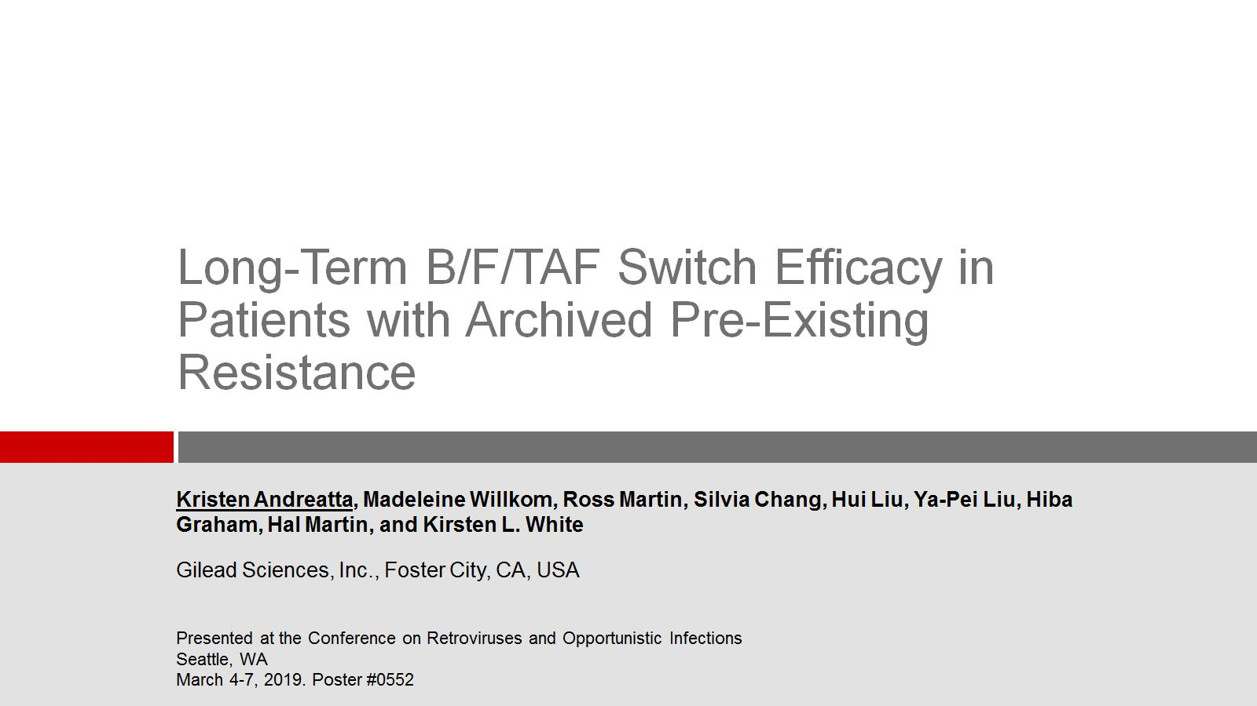
Long-Term B/F/TAF Switch Efficacy in Patients with Archived Pre-Existing Resistance

Slide 2
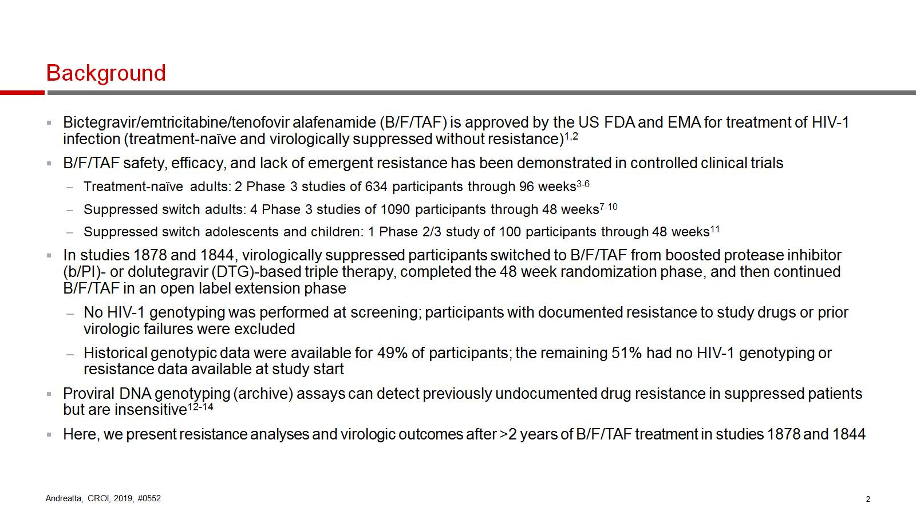
Background

Slide 3
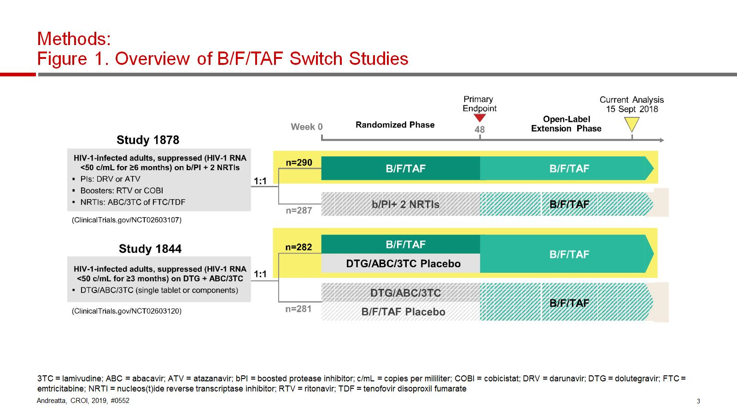
Methods:
Figure 1. Overview of B/F/TAF Switch Studies

Slide 4
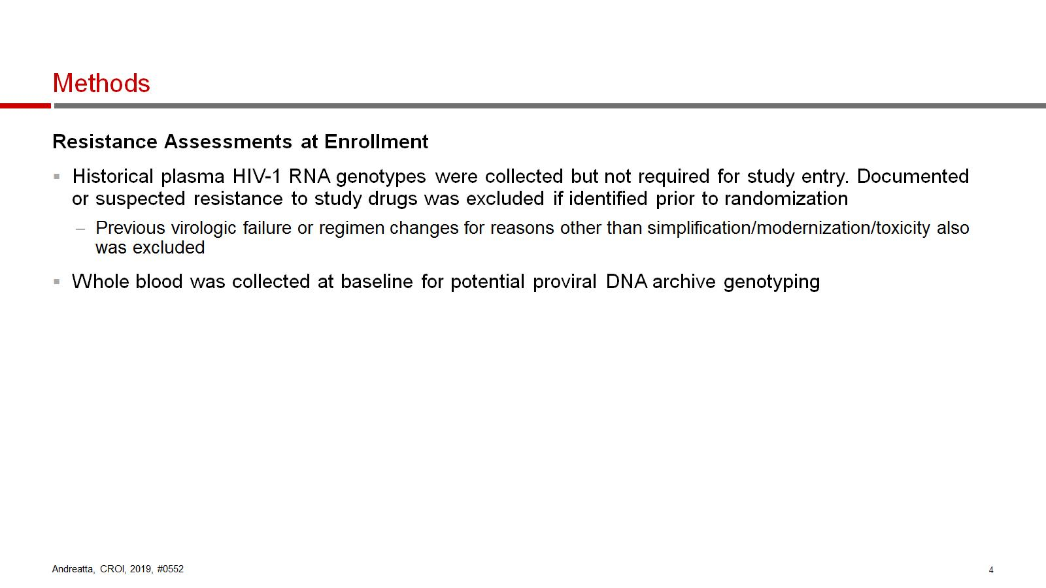
Methods

Slide 5
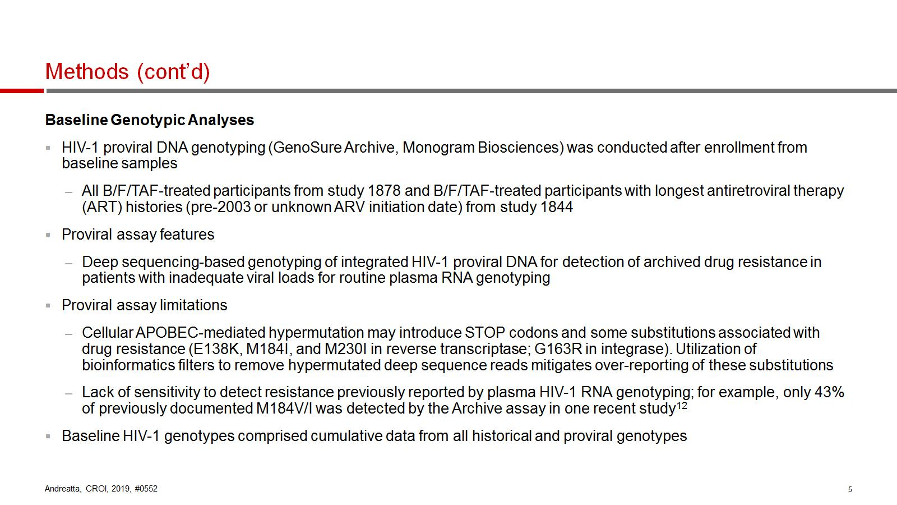
Methods (cont’d)

Slide 6
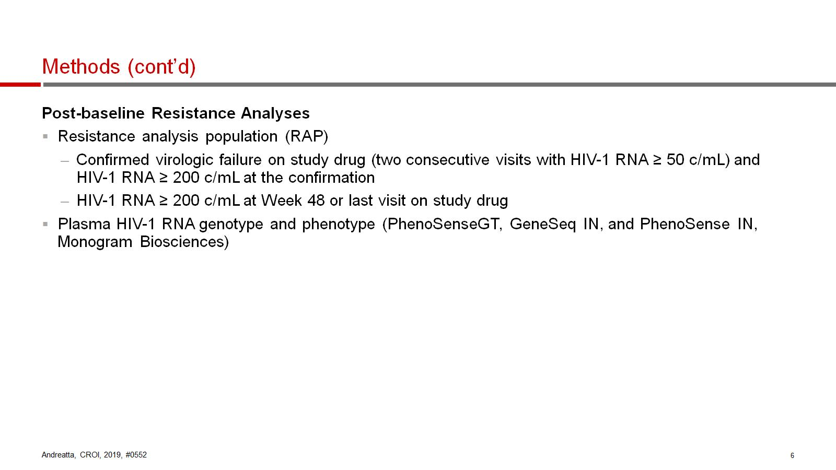
Methods (cont’d)

Slide 7
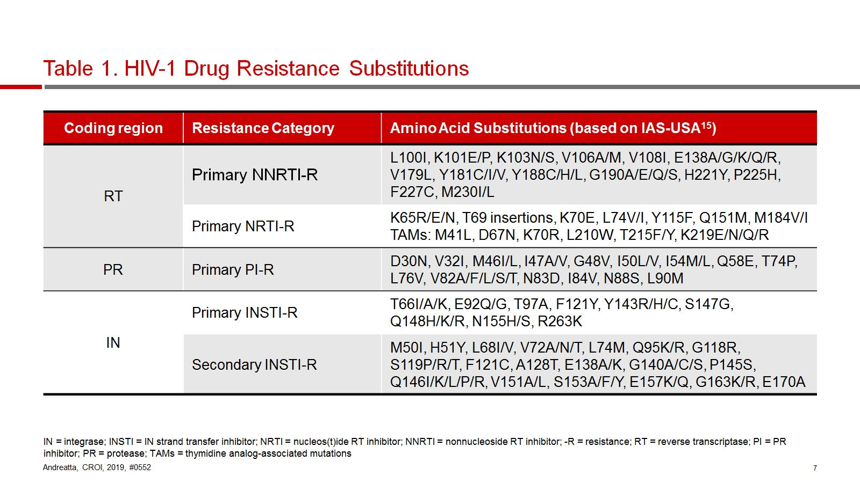
Table 1. HIV-1 Drug Resistance Substitutions

Slide 8
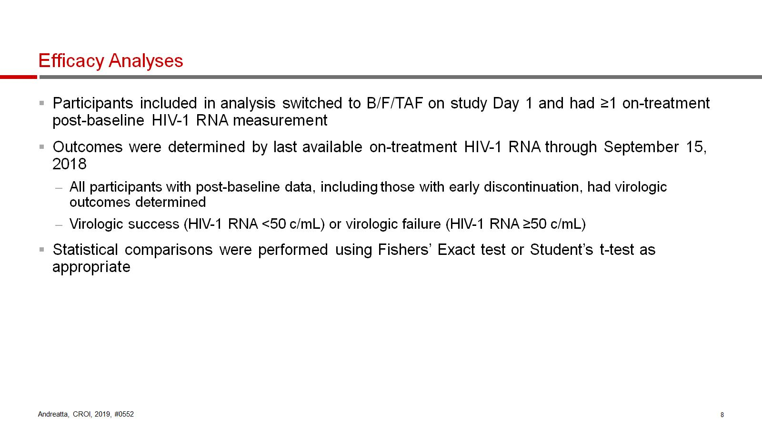
Efficacy Analyses

Slide 9
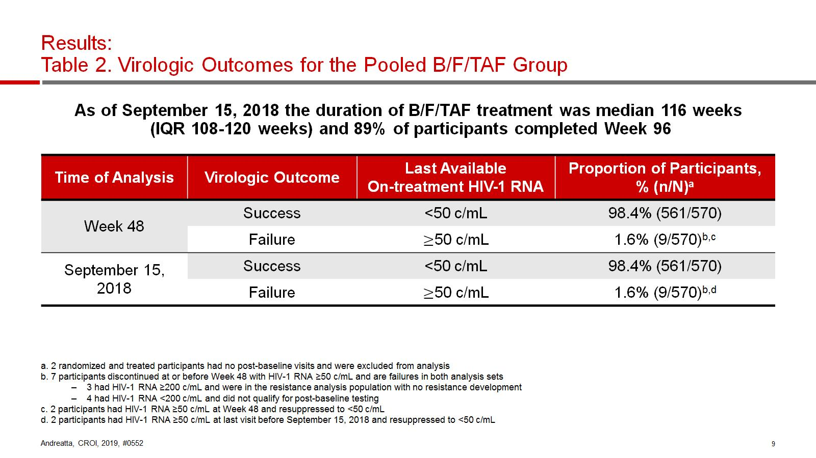
Results:
Table 2. Virologic Outcomes for the Pooled B/F/TAF Group

Slide 10
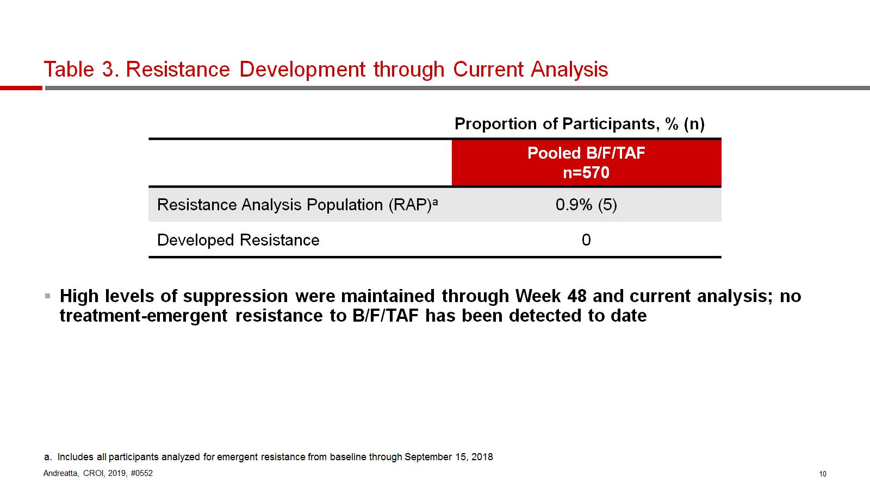
Table 3. Resistance Development through Current Analysis

Slide 11
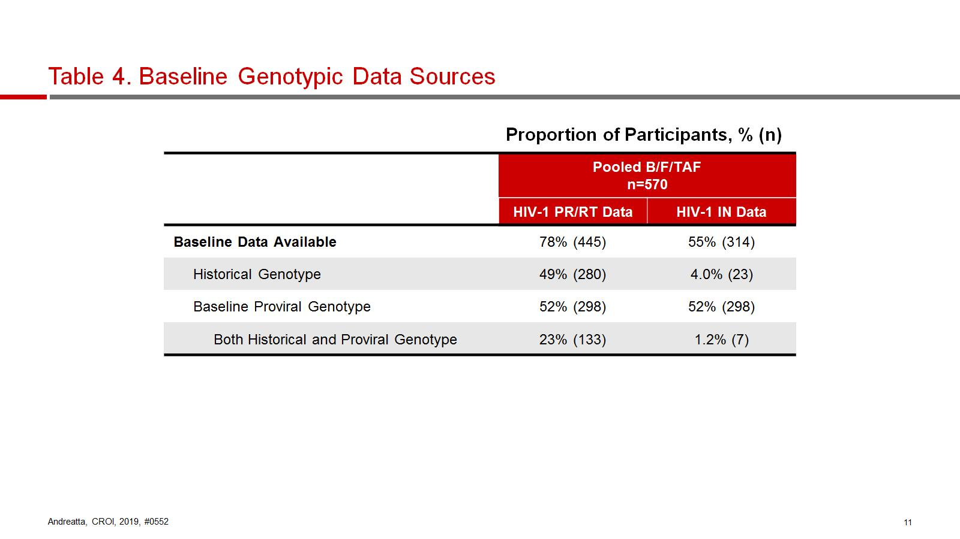
Table 4. Baseline Genotypic Data Sources

Slide 12
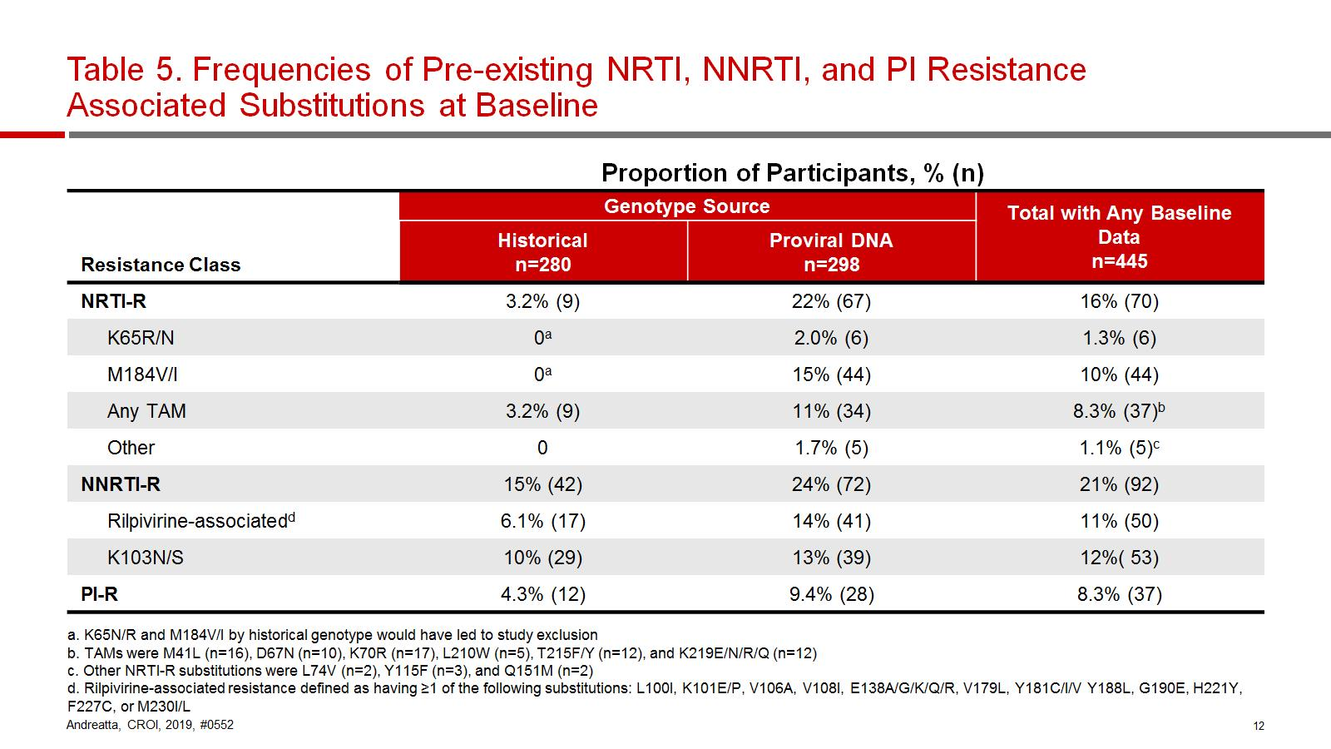
Table 5. Frequencies of Pre-existing NRTI, NNRTI, and PI Resistance
Associated Substitutions at Baseline

Slide 13
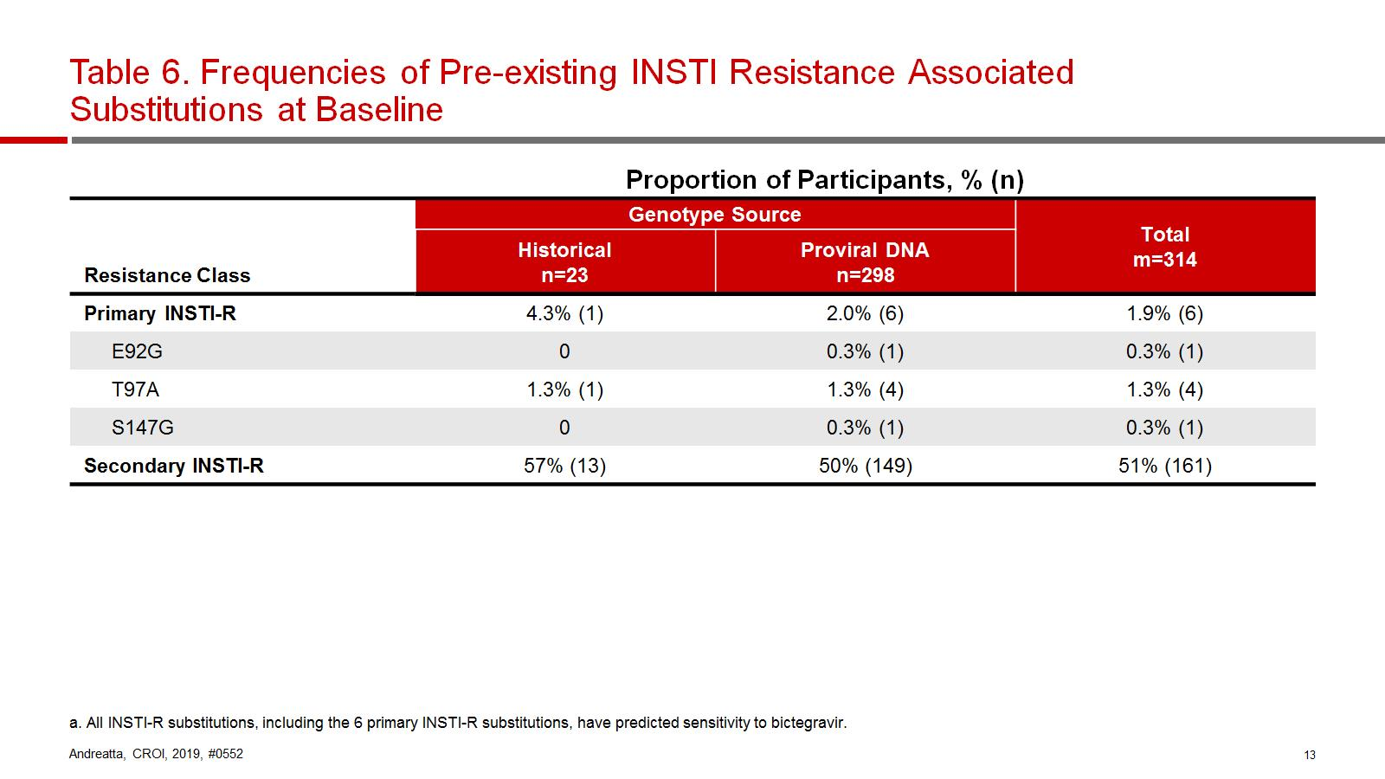
Table 6. Frequencies of Pre-existing INSTI Resistance Associated
Substitutions at Baseline

Slide 14
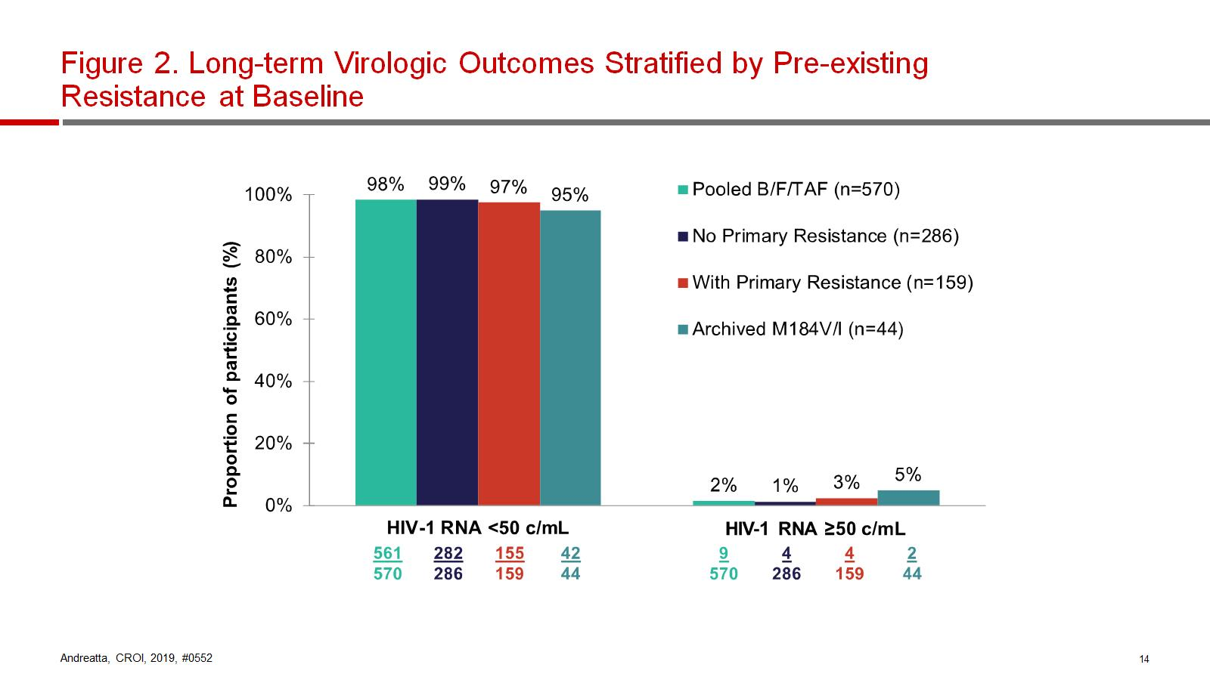
Figure 2. Long-term Virologic Outcomes Stratified by Pre-existing
Resistance at Baseline

Slide 15
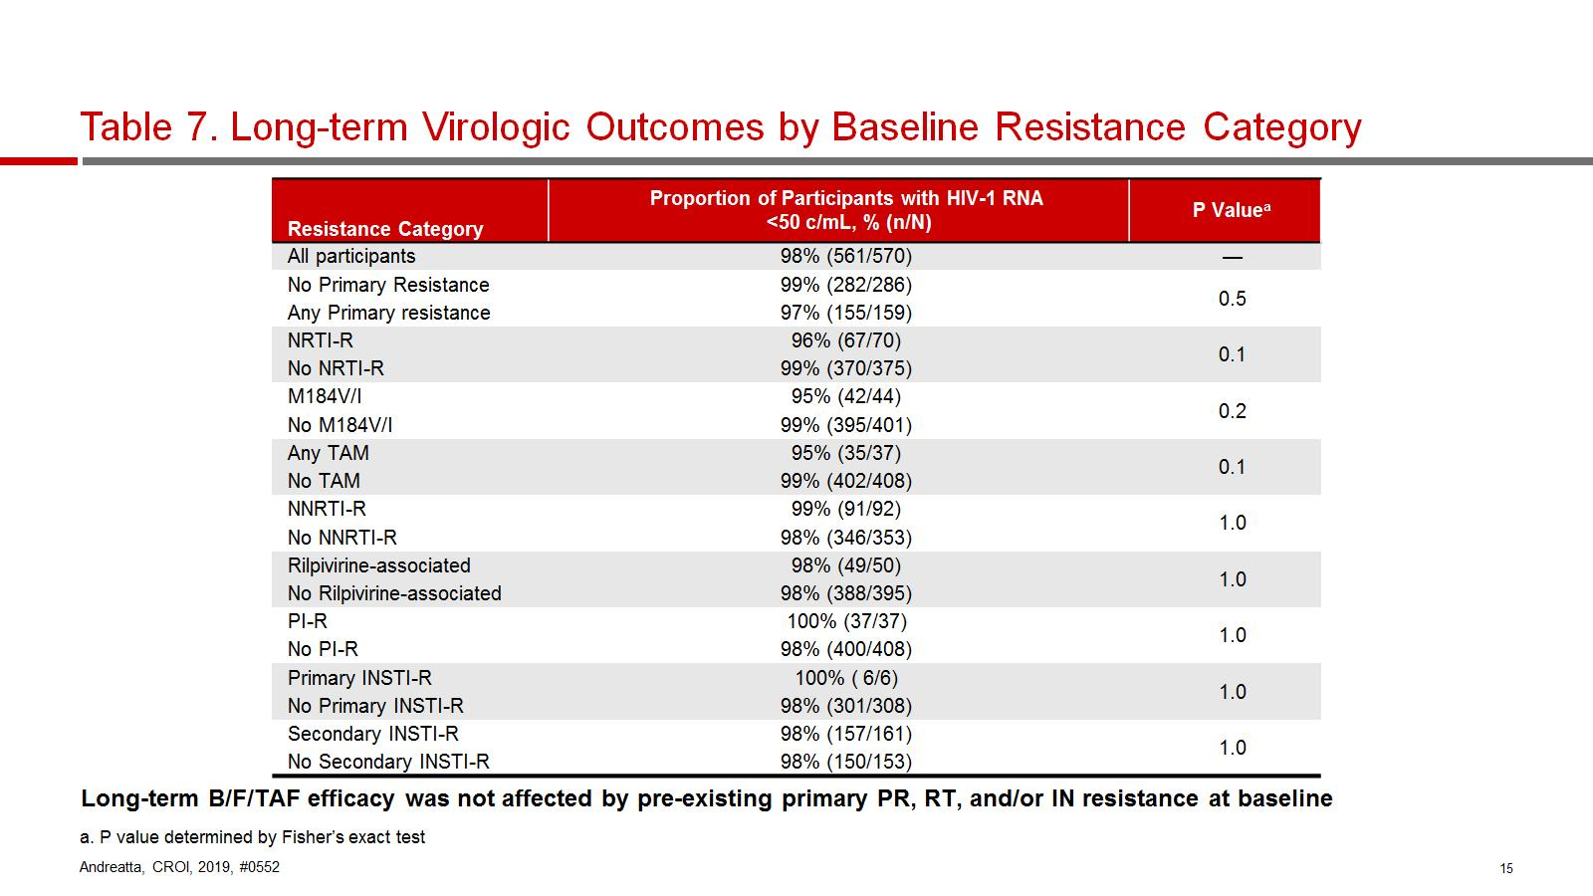
Table 7. Long-term Virologic Outcomes by Baseline Resistance Category

Slide 16
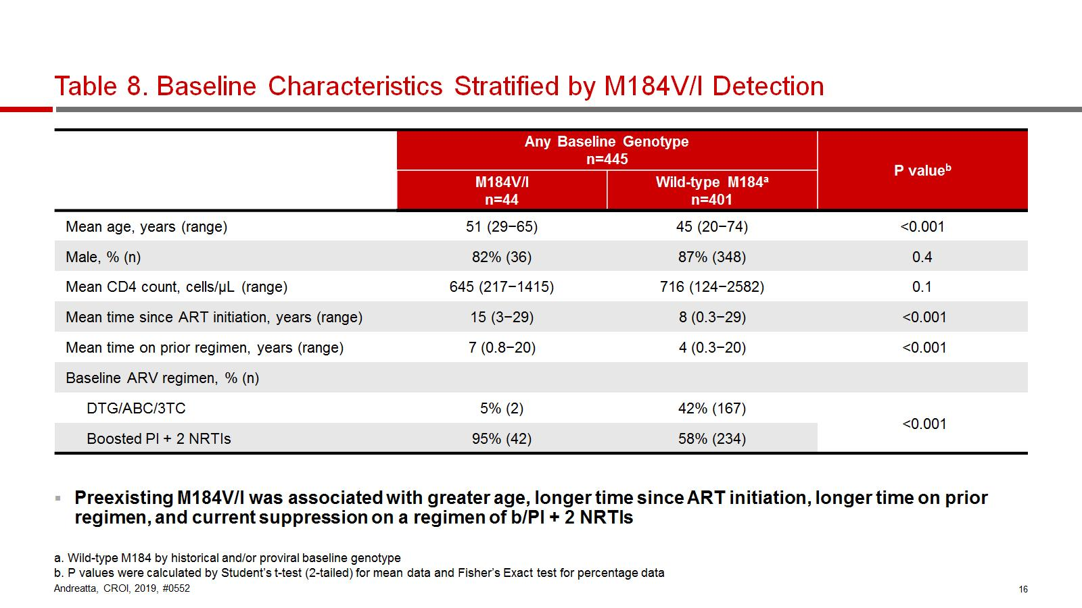
Table 8. Baseline Characteristics Stratified by M184V/I Detection

Slide 17
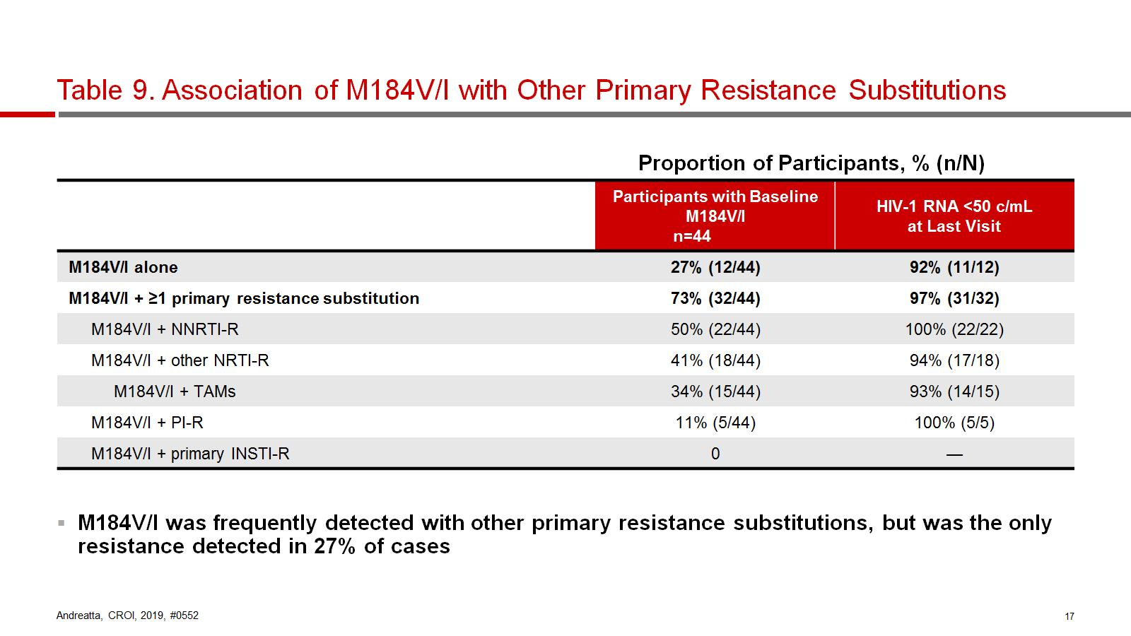
Table 9. Association of M184V/I with Other Primary Resistance Substitutions

Slide 18
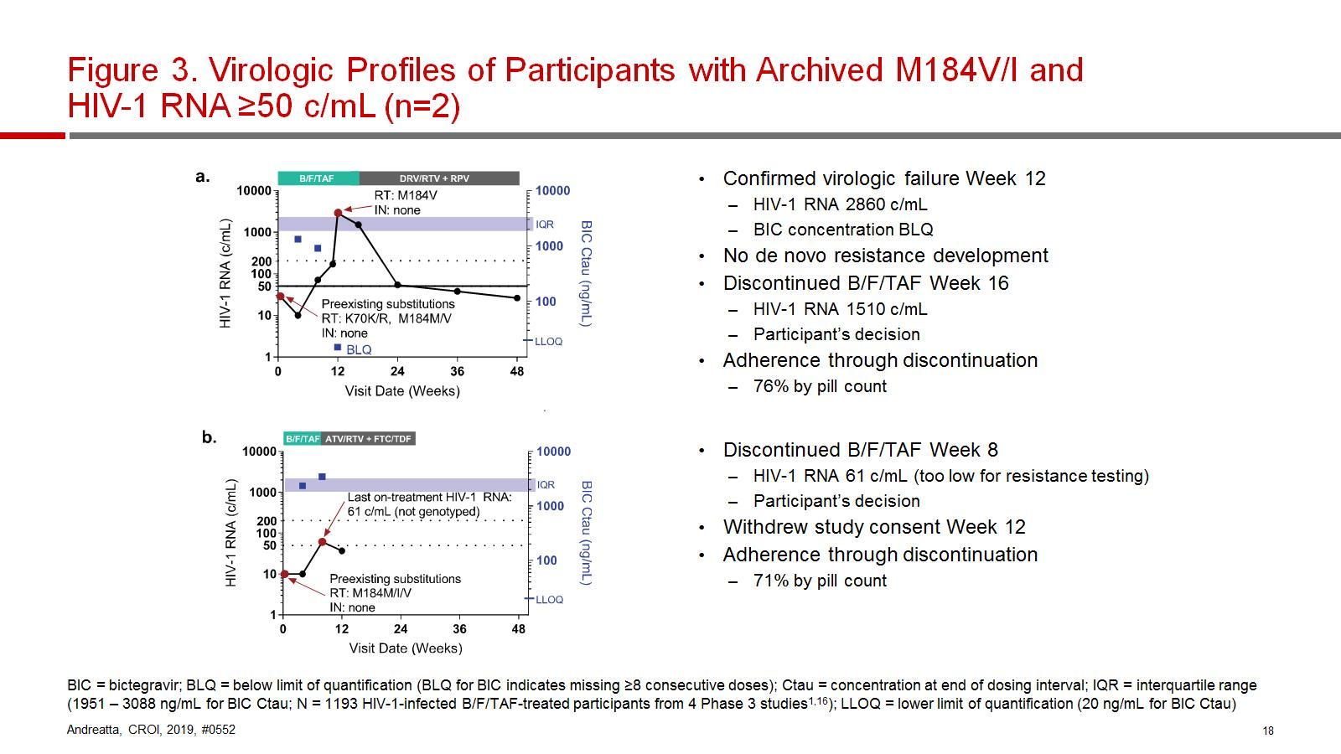
Figure 3. Virologic Profiles of Participants with Archived M184V/I and
HIV-1 RNA ≥50 c/mL (n=2)

Slide 19
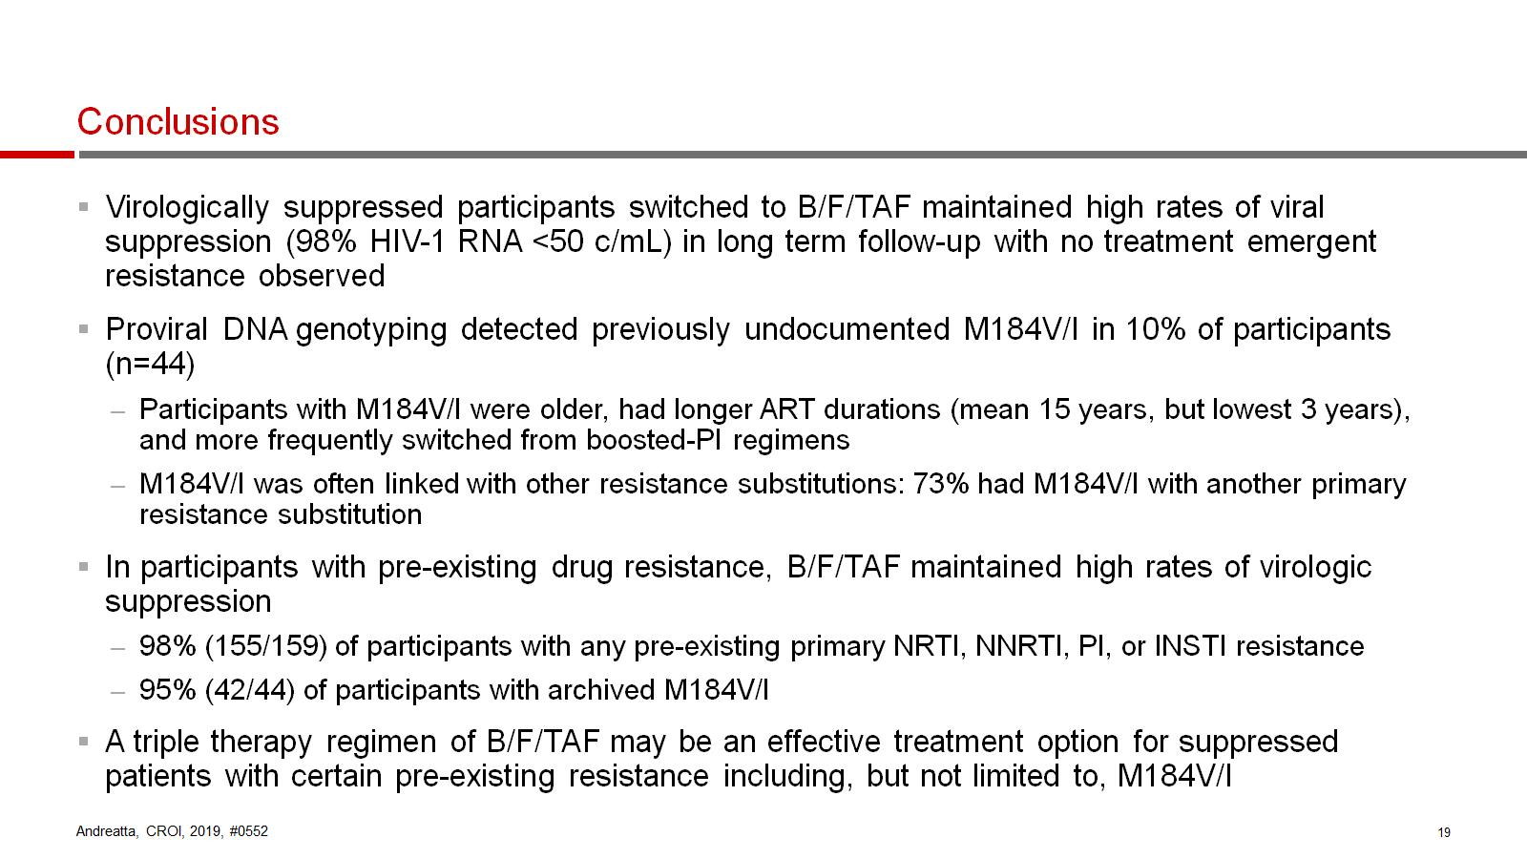
Conclusions

Slide 20
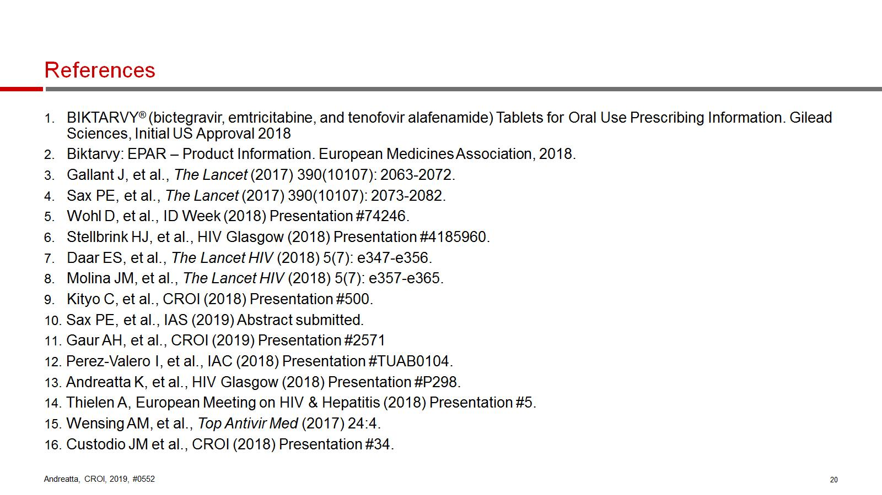
References

Slide 21
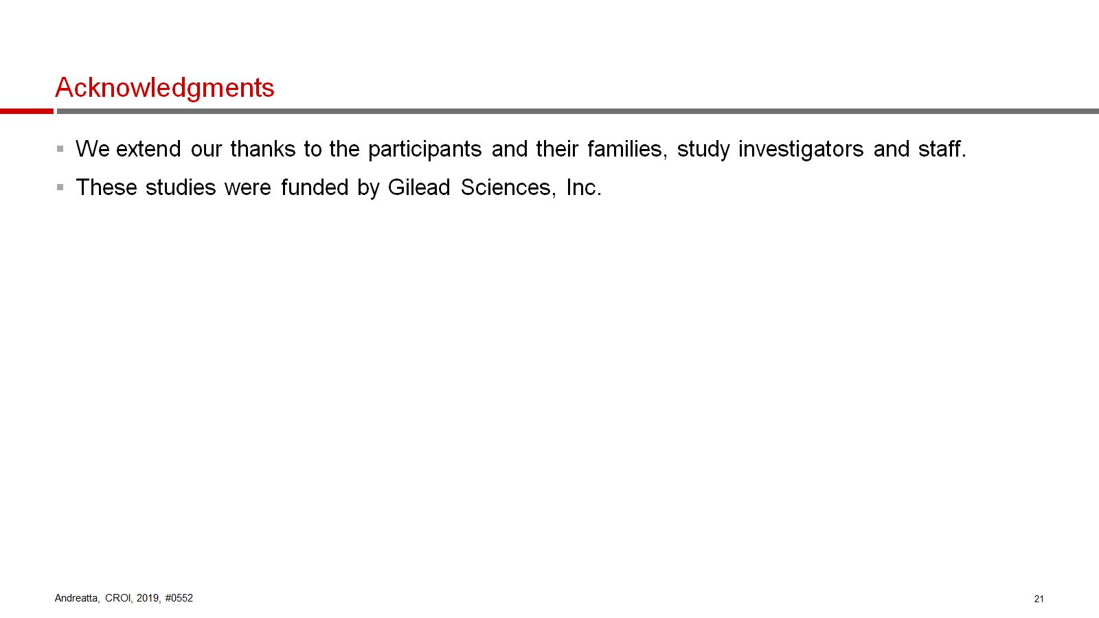
Acknowledgments

