Slide 1
In der vorliegenden Präsentation können Informationen zu Arzneimitteln von Janssen enthalten sein, die in Deutschland nicht zugelassen sind und/oder die nicht mit der Zulassung übereinstimmen (off-label Inhalte). Zudem können in dieser Präsentation solche Informationen auch zu Fremd-Arzneimitteln enthalten sein. Der Einsatz eines Arzneimittels in einer von der Fachinformation abweichenden Weise liegt in der Verantwortung des behandelnden Arztes. Bitte beachten Sie die jeweilige Fachinformation.
Diese Präsentation dient ausschließlich der wissenschaftlichen Information gegenüber ärztlichen Fachkreisen.
Die Präsentation enthält keine werblichen Aussagen und dient nicht zu Werbezwecken.

Slide 2
Week 96 Subgroup Analyses of D/C/F/TAF in HIV-1 Treatment Naïve and Suppressed Adults
G Huhn, E DeJesus, P-M Girard, C McDonald, C Mussini, C Spinner, J Jezorwski, E Van Landuyt, E Lathouwers, K Brown,
B Baugh, on behalf of the AMBER/EMERALD study groups

Slide 3
EMERALD/AMBER Week 96 Subgroup: Introduction
Once-daily boosted DRV regimens, including the single-tablet regimen of D/C/F/TAF 800/150/200/10 mg, have demonstrated a high, durable virologic response, a high genetic barrier to resistance, and long-term safety in a broad range of patients^{1–8} and are included in international HIV-1 treatment guidelines^{9‒11}
In two Phase III, randomized trials, D/C/F/TAF demonstrated non-inferior efficacy, no primary PI, DRV or TFV resistance and favorable renal and bone safety versus the control arms:
Versus D/C + FTC/TDF in ART-naïve adults (AMBER)
Primary outcome: 91% vs 88%, respectively (Δ3%; 95% CI –2; 7; p<0.0001), had virologic response (FDA Snapshot; VL <50 copies/mL) at Week 48⁵
Virologic response was 85% at Week 96 in the D/C/F/TAF arm⁶
Versus bPI + FTC/TDF in ART-experienced, virologically-suppressed adults (EMERALD)
Primary outcome: 2.5% vs 2.1%, respectively (Δ0.4%; 95% CI –1.5; 2.2; p<0.0001), had PDVR; confirmed VL ≥50 copies/mL) cumulative through Week 48;⁷ and 3.1% through Week 96 in the D/C/F/TAF arm⁸
Secondary outcome: Week 48 virologic response (FDA Snapshot; VL <50 copies/mL): 95% vs 94% (Δ1%; 95% CI –2; 4);⁷ and 91% at Week 96 in the D/C/F/TAF arm⁸; Week 48 VF, (FDA snapshot; VL ≥50 copies/mL) was 0.8% vs 0.5%, respectively⁷ and Week 96 VF was 1.2% in the D/C/F/TAF arm⁸
1. Orkin C, et al. HIV Med 2013;14:49–59.
2. Cahn P, et al. AIDS 2011;25:929–39.
3. Flynn P, et al. PIDJ 2014;33:940–5.
4. Lathouwers E, et al. HIV Clin Trials 2017;18:196–204.
5. Eron J, et al. AIDS 2018;32:1431–42.
6. Orkin C, et al. HIV Glasgow 2018. Abstract 0212.
7. Orkin C, et al. Lancet HIV 2018;5:e23–e34.
8. Eron J, et al. IDWeek 2018. Abstract 1768.
9. DHHS guidelines. Updated October 25, 2018.
10. EACS Guidelines, Version 9.1. October 2018.
11. Saag MS, et al. JAMA 2018;320:379‒96.
DRV, darunavir; D/C/F/TAF, darunavir/cobicistat/emtricitabine/tenofovir alafenamide;
PI, protease inhibitor; TFV, tenofovir; D/C, darunavir/cobicistat; ART, antiretroviral treatment;
FTC/TDF, emtricitabine/tenofovir disoproxil fumarate; CI, confidence interval; VL, viral load;
bPI, boosted protease inhibitor; PDVR, protocol-defined virologic rebound; VF, virologic failure.

Slide 4
EMERALD/AMBER Week 96 Subgroup: Introduction (cont.)
We present a Week 96 preplanned subgroup analysis of the D/C/F/TAF arms by:
Baseline VL, CD4⁺ cell count (screening stratification factors) and WHO clinical stage in AMBER
Prior VF, ART experience, screening bPI (stratification factor) and boosting agent in EMERALD
DRV, darunavir; D/C/F/TAF, darunavir/cobicistat/emtricitabine/tenofovir alafenamide;
bPI, boosted Protease inhibitor; WHO, World Health Organization; VF, virologic failure;
VL viral load.

Slide 5
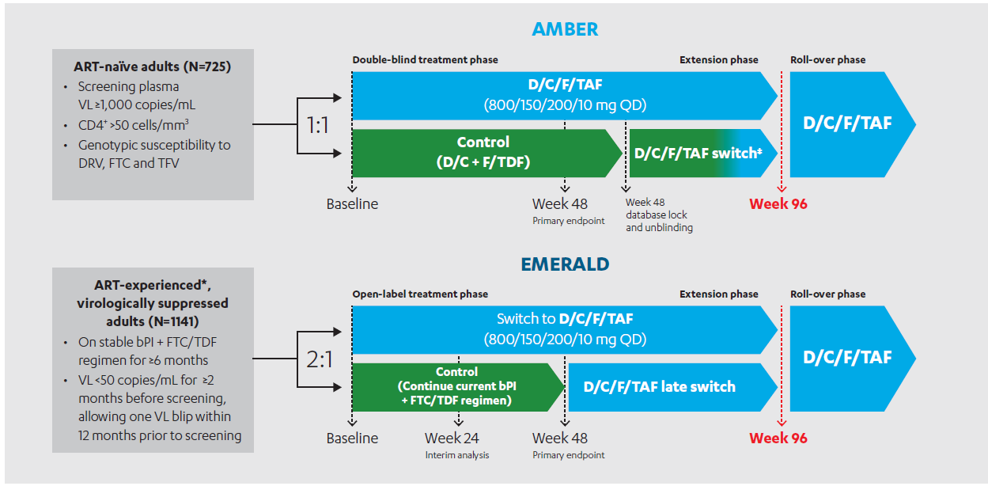
EMERALD/AMBER Week 96 Subgroup: AMBER and EMERALD Study Design
*Previous ART VF allowed, with no history of VF on DRV-based regimens and absence of DRV resistance-associated mutations (RAMs)¹ if historical genotypes were available; No restriction on any other RAMs, including FTC or TFV RAMs; ‡Patients switched to D/C/F/TAF at different time points (not uniformly) leading to a lack of uniform D/C/F/TAF exposure post-switch.
DRV, darunavir; D/C/F/TAF, darunavir/cobicistat/emtricitabine/tenofovir alafenamide;
TFV, tenofovir; FTC/TDF, emtricitabine/tenofovir disoproxil fumarate; VL, viral load;
bPI, boosted protease inhibitor; ART, antiretroviral therapy; QD, once daily.
1. Wensing AM, et al. Top Antivir Med 2014;22:642–50.
Notes:
AMBER (TMC114FD2HTX3001; NCT02431247)5 and EMERALD (TMC114IFD3013; NCT02269917)7 are international, multicenter, Phase III, randomized, active-controlled non-inferiority trials
Patients in the D/C/F/TAF and control arms of both trials continued on or switched to D/C/F/TAF in a single-arm, open-label extension phase until Week 96, provided they consented and continued to derive benefit

Slide 6
EMERALD/AMBER Week 96 Subgroup: Week 96 Analysis
In AMBER, the Week 96 efficacy endpoint was virologic outcome (virologic response, VL <50 copies/mL and VF, VL ≥50 copies/mL; FDA Snapshot)
In EMERALD, Week 96 efficacy endpoints were PDVR cumulative through Week 96, and virologic outcome at Week 96 by FDA Snapshot
This analysis, based on descriptive statistics, focuses on long-term efficacy and safety over 96 weeks in the D/C/F/TAF arm for each study
D/C/F/TAF, darunavir/cobicistat/emtricitabine/tenofovir alafenamide;
PDVR, protocol defined virologic rebound; VL, viral load; VF, virologic failure.

Slide 7
EMERALD/AMBER Week 96 Subgroup: AMBER D/C/F/TAF Arm-ART Naïve Patients Results
Baseline Characteristics
Among 362 patients in the D/C/F/TAF arm of AMBER at baseline:
303 (84%) patients had VL ≤100,000 copies/mL and 340 (94%) had a CD4+ cell count ≥200 cells/mm³
For WHO clinical stage of HIV infection, 314 (87%) patients had stage 1, 42 (12%) had stage 2, six (2%) had stage 3 and none had stage 4
D/C/F/TAF, darunavir/cobicistat/emtricitabine/tenofovir alafenamide;
VL, viral load; VF, WHO, World Health Organization.

Slide 8
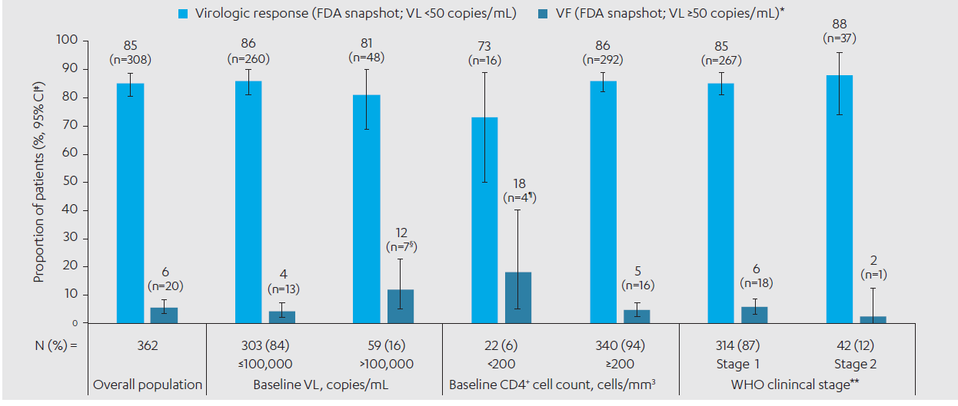
EMERALD/AMBER Week 96 Subgroup: AMBER Virologic Outcomes at Week 96 (FDA Snapshot) in the D/C/F/TAF Arm by Patient Subgroup (ITT Population)
VF was low across the majority of patient subgroups
A VF rate of 18% (4/22) was observed in the subgroup with CD4+ cell count <200 cells/mm; only one of the four VFs were efficacy related with VL ≥50 copies/mL at last on-treatment visit
*VF was defined as last VL in the Week 96 window ≥50 copies/mL, or discontinuations for efficacy reasons, or premature discontinuations not due to efficacy, adverse events or death with a last VL ≥50 copies/mL; ‡Two-sided Exact Clopper-Pearson 95% CI; §One patient had last VL in the Week 96 window ≥50 copies/mL; Four patients discontinued for efficacy reasons; Two patients discontinued due to other reasons (both lost to follow up) with last available VL ≥50 copies/mL; ¶Two patients discontinued for efficacy reasons, although one patient had VL <50 copies/mL at last on-treatment visit; Two patients discontinued due to other reasons (lost to follow-up and non-compliance with study medication) with last available VL ≥50 copies/mL; **Data not reported for WHO clinical stage 3 and 4 subgroups due to small sample sizes.
D/C/F/TAF, darunavir/cobicistat/emtricitabine/tenofovir alafenamide; ITT, intent-to-treat;
CI confidence interval; VF, virologic failure; VL, viral load.
1. Flynn P, et al. PIDJ 2014;33:940–5.
Notes:
A high proportion of patients in the D/C/F/TAF arm had VL <50 copies/mL at Week 96 overall (85%; 308/362) and across the baseline VL, CD4+ cell count and WHO clinical stage subgroups (virologic response ranged from 73% to 88%)
Results for certain subgroups, such as the baseline CD4+ cell count <200 cells/mm3 subgroup, should be interpreted with caution due to the small sample sizes

Slide 9
EMERALD/AMBER Week 96 Subgroup: AMBER Resistance
No emerging DRV, primary PI or TFV resistance-associated mutations (RAMs) were observed post-baseline in the nine patients with protocol-defined VF (virologic non-response, virologic rebound and/or viremic at final timepoint) and VL ≥400 copies/mL at failure or at later timepoints in the D/C/F/TAF arm, regardless of baseline VL, CD4⁺ cell count or WHO clinical stage
The N(t)RTI RAM M184I/V, conferring FTC and 3TC resistance was detected at Week 36 in one patient who had:
Transmitted NNRTI resistance at screening, and M184V was detected pretreatment as a minority variant (9%); the patient discontinued due to non-compliance
A baseline VL of 20,100 copies/mL, a CD4⁺ cell count of 126 cells/mm³ and was WHO clinical stage 1
DRV, darunavir; PI, protease inhibitor; TFV, tenofovir; VL, viral load; WHO, World Health Organization;
FTC, emtricitabine; 3TC, lamivudine; NNRTI, non-nucleoside reverse transcriptase inhibitor.

Slide 10
EMERALD/AMBER Week 96 Subgroup: AMBER Safety Through Week 96 in the D/C/F/TAF Arm by Patient Subgroup (ITT Population)
Incidence, n (%) | All (N=362) | Baseline VL |  | Baseline CD4+ count |  | WHO clinical stage*
 |  | ≤100,000 copies/mL (N=303) | >100,000 copies/mL (N=59) | <200 cells/mm³ (N=22) | ≥200 cells/mm³ (N=340) | Stage 1 (N=314) | Stage 2 (N=42)
≥1 AE, any grade | 334 (92) | 280 (92) | 54 (92) | 19 (86) | 315 (93) | 289 (92) | 39 (93)
Study drug-related AEs | 142 (39) | 119 (39) | 23 (39) | 10 (46) | 132 (39) | 117 (37) | 21 (50)
Study drug-related Grade 3 or 4 AEs | 11 (3) | 8 (3) | 3 (5) | 1 (5) | 10 (3) | 7 (2) | 3 (7)
≥1 serious AE | 39 (11) | 36 (12) | 3 (5) | 2 (9) | 37 (11) | 32 (10) | 6 (14)
Study drug-related serious AEs | 1 (<1) | 1 (<1) | 0 | 0 | 1 (<1) | 1 (<1) | 0
≥1 AE leading to discontinuation | 10 (3) | 10 (3) | 0 | 0 | 10 (3) | 8 (3) | 2 (5)
Median Δ eGFR_{cyst} at Week 84,‡ mL/min/1.73 m² | n=204 +3 | n=172 +3 | n=32 +8 | n=12 +6 | n=192 +3 | n=169 +3 | n=32 +6
There were no deaths and no cases of Fanconi Syndrome or subclinical PRT were observed
eGFR^{cyst}, eGFR based on serum cystatin C (CKD-EPI formula)*Data not reported for WHO clinical stage 3 and 4 subgroups due to small sample sizes;
‡Cystatin C was not routinely collected during the open-label phase so only 22 patients had results for the Week 96 timepoint.
AEs, adverse events; D/C/F/TAF, darunavir/cobicistat/emtricitabine/ tenofovir alafenamide;
ITT, intent to treat; PRT, proximal renal tubulopathy; eGFR, estimated glomerular filtration rate.
Notes:
AEs were similar in occurrence across subgroups through Week 96 in the D/C/F/TAF arm
Study drug-related Grade 3 or 4 and serious AEs and AEs leading to discontinuation were low and similar across subgroups, and there were no deaths
No clinically relevant changes in eGFR and no cases of Fanconi syndrome or subclinical PRT were observed

Slide 11
EMERALD/AMBER Week 96 Subgroup: EMERALD D/C/F/TAF Arm: Virologically-suppressed, ART‑Experienced Patients
Baseline Characteristics
Among 763 patients in the D/C/F/TAF arm of EMERALD at baseline:
447 (59%) of patients had received prior ≥5 ARVs, including screening ARVs and boosters
252 (33%) discontinued prior ARVs (including screening ARVs) due to convenience, 220 (29%) discontinued due to AEs and 116 (15%) had prior non-DRV VF (51 [7%] patients on a PI, 90 [12%] on an N(t)RTI, 50 [7%] on an NNRTI, and seven [1%] on an integrase inhibitor)
bPI at screening was DRV (70%; n=537), ATV (22%; n=167) and LPV (8%; n=59)
104 (14%) of patients received COBI and 659 (86%) received RTV as a boosting agent
D/C/F/TAF, darunavir/cobicistat/emtricitabine/tenofovir alafenamide; ARVs, antiretrovirals;
AEs, adverse events; PI, protease inhibitor; NNRTI, non nucleoside reverse transcriptase inhibitor;
bPI, boosted protease inhibitor; COBI, cobicistat; RTV, ritonavir; DRV, darunavir; ATV, atazanavir;
LPV, lopinavir; N(t)RTI, nucleotide reverse transcriptase inhibitors.

Slide 12
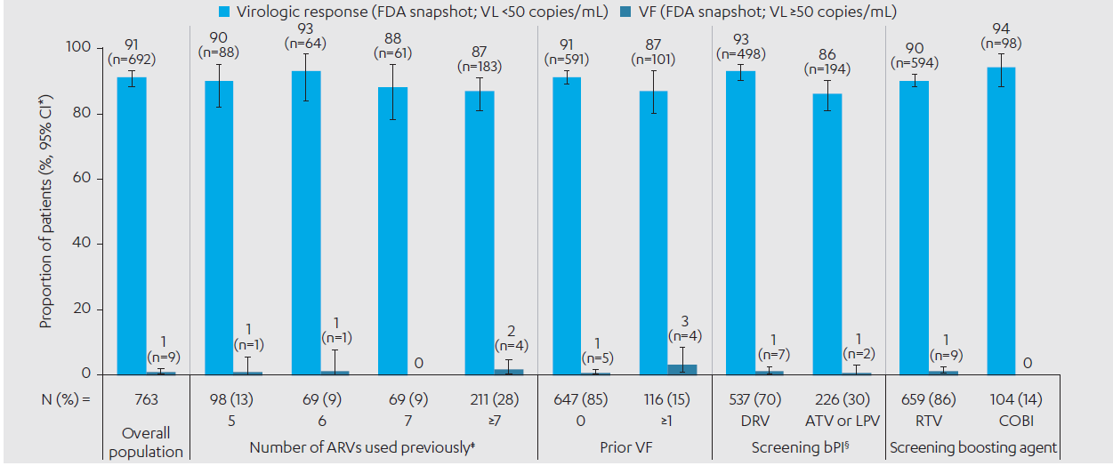
EMERALD/AMBER Week 96 Subgroup: EMERALD D/C/F/TAF Arm: Virologically-suppressed, ART‑Experienced Patients Efficacy
*Two-sided Exact Clopper-Pearson 95% CI; ‡Includes ARVs and booster used at screening. Data not reported for patients who had previously used 3 or 4 ARVs prior to baseline; §DRV with RTV or COBI, ATV with RTV or COBI, and LPV with RTV.
D/C/F/TAF, darunavir/cobicistat/emtricitabine/tenofovir alafenamide; VF, virologic failure; CI, confidence interval; VL, viral load; ARV, antiretroviral;
DRV, darunavir; RTV, ritonavir; COBI, cobicistat; ATV, atazanavir; LPV, lopinavir.
Notes:
High sustained virologic response rates (86–94%) and low VF rates (0–3%) were maintained in the D/C/F/TAF arm at Week 96, regardless of number of prior ARVs used, prior VF, screening bPI and boosting agent

Slide 13
EMERALD/AMBER Week 96 Subgroup: EMERALD PDVR Cumulative Through Week 96 in the D/C/F/TAF Arm by Subgroup (ITT Population)
EMERALD | All | Number of ARVs previously used* |  |  |  | Prior VF |  | Screening bPI‡ |  | Screening boosting agent
 |  | 5 | 6 | 7 | >7 | 0 | ≥1 | DRV | ATV or LPV | RTV | COBI
N (%) | 763 | 98 (13) | 69 (9) | 69 (9) | 211 (28) | 647 (85) | 116 (15) | 537 (70) | 226 (30) | 659 (86) | 104 (14)
PDVR (VL ≥50 copies/mL)§ cumulative through Week 96, n (%) (95% CI)¶ | 24 (3) (2; 5) | 4 (4) (1; 10) | 5 (7) (2; 16) | 0 | 6 (3) (1; 6) | 19 (3) (2; 5) | 5 (4) (1; 10) | 16 (3) (2; 5) | 8 (4) (2; 7) | 22 (3) (2; 5) | 2 (2) (<1; 7)
Cumulative confirmed virologic rebound rates were low through Week 96 in the D/C/F/TAF arm and results were consistent across subgroups
Post-baseline genotype data was available for 4 PDVRs with VL ≥400 copies/mL at the time of VF, at later post-rebound timepoints or at discontinuation in the D/C/F/TAF arm
No DRV, primary PI, FTC or TFV RAMs were observed post-baseline across subgroups
*Includes ARVs and booster used at screening. Data not reported for patients who had previously used 3 or 4 ARVs prior to baseline; ‡DRV with RTV or COBI, ATV with RTV or COBI, and LPV with RTV; §Confirmed VL ≥50 copies/mL or premature discontinuation with last VL ≥50 copies/mL (cumulative through Week 96); ¶Two-sided Exact Clopper-Pearson 95% CI
D/C/F/TAF, darunavir/cobicistat/emtricitabine/tenofovir alafenamide; DRV, darunavir; bPI, boosted protease inhibitor;
ARVs, antiretrovirals; ITT, intent-to-treat; ATV, atazanavir; LPV, lopinavir;
PDVR, protocol defined virologic rebound; CI, confidence interval.

Slide 14
EMERALD/AMBER Week 96 Subgroup: EMERALD Safety Through Week 96 in the D/C/F/TAF Arm by Patient Subgroup (ITT Population)*
Incidence, n (%) | All (N=763) | Screening bPI‡ |  | Screening boosting agent
 |  | DRV (N=537) | ATV or LPV (N=226) | RTV (N=659) | COBI (N=104)
≥1 AE, any grade | 690 (90) | 495 (92) | 195 (86) | 600 (91) | 90 (87)
Study drug-related AEs | 165 (22) | 495 (92) | 54 (24) | 154 (23) | 11 (11)
Study drug-related Grade 3 or 4 AEs | 14 (2) | 495 (92) | 3 (1) | 14 (2) | 0
≥1 serious AE | 66 (9) | 42 (8) | 24 (11) | 58 (9) | 8 (8)
Study drug-related serious AEs | 2 (<1) | 1 (<1) | 1 (<1) | 2 (<1) | 0
≥1 AE leading to discontinuation | 17 (2) | 6 (1) | 11 (5) | 15 (2) | 2 (2)
Fatal AEs§ | 3 (<1) | 2 (<1) | 1 (<1) | 3 (<1) | 0
Median Δ eGFR_{cyst} at Week 84,‡ mL/min/1.73 m² | n=686 –1 | n=494 –1 | n=192 –1 | n=588 –1 | n=98 +2
No cases of Fanconi Syndrome or subclinical PRT were detected
*Week 96 analysis by prior VF or ART experience subgroups was not preplanned so data are not presented; ‡DRV with RTV or COBI, ATV with RTV or COBI, and LPV with RTV; §Two cases of myocardial infarction (one in a patient who was a smoker with ongoing medical history of hyperlipidemia and hypertension, and one in a patient with ongoing medical history of obesity and hypertension), and one metastatic pancreatic cancer
D/C/F/TAF, darunavir/cobicistat/emtricitabine/tenofovir alafenamide; DRV, darunavir; ARVs, antiretrovirals; ITT, intent-to-treat; ATV, atazanavir;
LPV, lopinavir; COBI, cobicistat; PDVR, protocol defined virologic rebound; CI, confidence interval; AEs, adverse events;
eGFR_{cyst}, estimated glomular filtration rate cysteine; PRT, proximal renal tubulopathy.
Notes:
The overall incidence of AEs in the D/C/F/TAF arm through Week 96 was generally similar in the overall population and across screening PI and boosting agent subgroups
Rates of study drug-related Grade 3 or 4 and serious AEs and discontinuations due to AEs were low overall and across subgroups
eGFR improved or was stable in the D/C/F/TAF arm across subgroups through Week 96, and no cases of Fanconi syndrome or subclinical PRT were detected

Slide 15
EMERALD/AMBER Week 96 Subgroup: Authors’ Conclusions
In EMERALD and AMBER through 96 weeks across patient subgroups in ART-naïve and -experienced virologically suppressed adults, D/C/F/TAF resulted in:
High virologic response rates (VL <50 copies/mL; FDA Snapshot) and low VF rates (VL ≥50 copies/mL)
Few discontinuations due to AEs and favorable renal outcomes
No treatment-emergent DRV, primary PI or TFV RAMs in 1,125 patients
In only one patient in the D/C/F/TAF arm of AMBER, an FTC RAM (M184I/V) was identified post‑VF (<0.1%)
These findings continue to support the use of D/C/F/TAF in HIV-1 patients without DRV or TFV RAMs who are:
ART-naïve, or
Virologically suppressed on a stable ART regimen and require a switch in therapy
ART, antiretroviral therapy; D/C/F/TAF, darunavir/cobicistat/emtricitabine/tenofovir alafenamide;
VL, viral load; VF, virologic failure; DRV, darunavir; PI, protease inhibitor; TFV, tenofovir;
RAMs, resistance associated mutations; FTC, emtricitabine.

