Slide 1
In der vorliegenden Präsentation können Informationen zu Arzneimitteln von Janssen enthalten sein, die in Deutschland nicht zugelassen sind und/oder die nicht mit der Zulassung übereinstimmen (off-label Inhalte). Zudem können in dieser Präsentation solche Informationen auch zu Fremd-Arzneimitteln enthalten sein. Der Einsatz eines Arzneimittels in einer von der Fachinformation abweichenden Weise liegt in der Verantwortung des behandelnden Arztes. Bitte beachten Sie die jeweilige Fachinformation.
Diese Präsentation dient ausschließlich der wissenschaftlichen Information gegenüber ärztlichen Fachkreisen.
Die Präsentation enthält keine werblichen Aussagen und dient nicht zu Werbezwecken.

Slide 2
Efficacy and Safety of the Once-daily Darunavir/Cobicistat/Emtricitabine/Tenofovir Alafenamide (D/C/F/TAF) Single-tablet Regimen in Antiretroviral Treatment (ART)-Experienced and ART-Naïve Women Living with HIV-1: EMERALD and AMBER Week 96 Results
A Wilkin, K Tashima, C Katlama, J Jezorwski,
E Van Landuyt, E Lathouwers, K Brown,
B Baugh on behalf of the EMERALD and AMBER study groups

Slide 3
EMERALD/AMBER Week 96 Women: Introduction
Once-daily boosted DRV regimens, including the D/C/F/TAF 800/150/200/10 mg single-tablet regimen, have demonstrated a high, durable virologic response, a high genetic barrier to resistance, and long-term safety in a broad range of patients,^{1–8} and are included in international HIV- treatment guidelines^{9‒11}
In two Phase 3 randomized trials, D/C/F/TAF demonstrated non-inferior efficacy, no primary PI, DRV or TFV resistance, and favorable renal and bone safety vs the control arms:
Versus bPI + FTC/TDF in ART-experienced, virologically suppressed adults (EMERALD)
Primary outcome: 2.5% vs 2.1% (Δ0.4%; 95% CI –1.5; 2.2; p<0.0001), respectively, had PDVR; confirmed VL ≥50 copies/mL) cumulative through Week 48;⁵ and 3.1% through Week 96 in the D/C/F/TAF arm⁶
Secondary outcome: Week 48 virologic response (FDA snapshot; VL <50 copies/mL): 95% vs 94% (Δ1%; 95% CI –2; 4);⁵ and 91% at Week 96 in the D/C/F/TAF arm⁶
Versus D/C + FTC/TDF in ART-naïve adults (AMBER)
Primary outcome: 91% vs 88% (Δ3%; 95% CI –2; 7; p<0.0001), respectively, had a virologic response (FDA snapshot) at Week 48⁷
Virologic response was 85% at Week 96 in the D/C/F/TAF arm⁸
We present a cumulative through Week 96 preplanned gender-based analysis of the D/C/F/TAF arms in each trial
1. Orkin C, et al. HIV Med 2013;14:49–59.
2. Cahn P, et al. AIDS 2011;25:929–39.
3. Flynn P, et al. PIDJ 2014;33:940–5.
4. Lathouwers E, et al. HIV Clin Trials 2017;18:196–204.
5. Orkin C, et al. Lancet HIV 2018;5:e23–e34.
6. Eron J, et al. IDWeek 2018. Abstract 1768.
7. Eron J, et al. AIDS 2018;32:1431–42.
8. Orkin C, et al. HIV Glasgow 2018. Abstract 0212.
9. DHHS guidelines. Updated October 25, 2018.
10. EACS Guidelines, Version 9.1. October 2018.
11. Saag MS, et al. JAMA. 2018;320:379‒96.
ART, antiretroviral therapy; DRV, darunavir; PI, protease inhibitor; TFV, tenofovir; VL, viral load;
D/C/F/TAF. darunavir/cobicistat/emtricitabine/tenofovir alafenamide; CI, confidence interval;
bPI, boosted protease inhibitor; FTC/TDF, emtricitabine/tenofovir disoproxil fumarate.

Slide 4
EMERALD/AMBER Week 96 Women: Study Designs and Primary Endpoints
EMERALD (TMC114IFD3013; NCT02269917)¹ and AMBER (TMC114FD2HTX3001; NCT02431247)² are international, multicenter, Phase 3, randomized, active-controlled non-inferiority trials
Patients in the D/C/F/TAF and control arms of both trials continued on or switched to D/C/F/TAF in a single-arm, open-label extension phase until Week 96, provided they consented and continued to derive benefit
In EMERALD, Week 96 efficacy endpoints were PDVR cumulative through Week 96, and Week 96 virologic outcome (virologic response, VL <50 copies/mL, and VF, VL ≥50 copies/mL; FDA snapshot)
In AMBER, the Week 96 efficacy endpoint was virologic outcome (virologic response and VF; FDA snapshot)
D/C/F/TAF, darunavir/cobicistat/emtricitabine/tenofovir alafenamide;
PDVR, protocol defined virologic rebound; VL, viral load; VF, virologic failure.
1. Orkin C, et al. Lancet HIV 2018;5:e23–e34.
2. Eron J, et al. AIDS 2018;32:1431–42.

Slide 5
EMERALD/AMBER Week 96 Women: DXA Sub-Studies
At selected sites for consenting patients from both trials, DXA scans for hip, lumbar spine (L1–L4), and femoral neck BMD were performed at baseline, Weeks 24, 48, and 96
BMD changes from baseline to Weeks 24, 48, and 96 were calculated
DXA, dual energy x-ray absorptiometry; BMD, bone mineral density.

Slide 6
EMERALD/AMBER Week 96 Women: Endpoints and Gender Analysis
This secondary analysis focuses on long-term efficacy and safety over 96 weeks in the D/C/F/TAF arm of each study
This gender subgroup analysis was based on descriptive statistics; as the female subgroups in each study are small, especially in the DXA sub-studies, results should be interpreted with caution
D/C/F/TAF, darunavir/cobicistat/emtricitabine/tenofovir alafenamide;
DXA, dual energy x-ray absorptiometry.

Slide 7
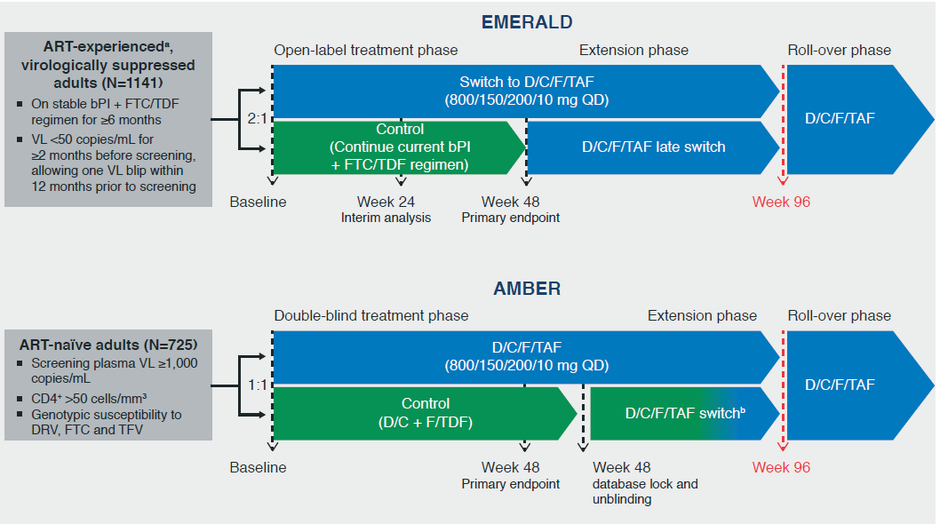
EMERALD/AMBER Week 96 Women: EMERALD and AMBER Study Designs
ªPrevious ART VF allowed, with no history of VF on DRV-based regimens and absence of DRV resistance-associated mutations (RAMs)¹ if historical genotypes were available; No restriction on any other RAMs, including FTC or TFV RAMs. ^{b}Patients switched to D/C/F/TAF at different time points (not uniformly) leading to a lack of uniform D/C/F/TAF exposure post-switch.
D/C/F/TAF, darunavir/cobicistat/emtricitabine/tenofovir alafenamide; FTC, emtricitabine;
TFV, tenofovir; F/TDF, emtricitabine/tenofovir disoproxil fumarate; bPI, boosted protease inhibitor;
RAMs, resistance associated mutations; VF, virologic failure; VL, viral load.
1. Wensing AM, et al. Top Antivir Med 2014;22:642–50.

Slide 8
EMERALD/AMBER Week 96 Women: EMERALD D/C/F/TAF Arm-Virologically-Suppressed, ART-Experienced Patients
Patient Disposition and Baseline Characteristics
Of the total randomized and treated patients, 205/1,141 patients (18%) were women (936 [82%] men), and 140/763 (18%) were women (623 [82%] men) in the D/C/F/TAF arm, and all ongoing patients continued on D/C/F/TAF in the extension phase
At baseline, the median (range) age of women was 45 (19; 69) years in the D/C/F/TAF arm and was similar in men (46 (20; 75) years)
Most women were White (51%) or African American (45%); most men were White (81%)
D/C/F/TAF, darunavir/cobicistat/emtricitabine/tenofovir alafenamide.

Slide 9
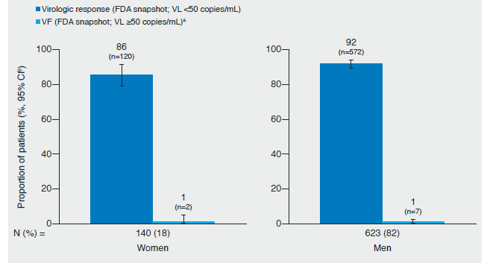
EMERALD/AMBER Week 96 Women: EMERALD Virologic Outcomes at Week 96 (FDA Snapshot) in the D/C/F/TAF Arm by Gender
A high sustained Week 96 virologic response rate of 86% was maintained in the D/C/F/TAF arm in women (men: 92%) with a low VF rate of 1% in both genders
ªVF was defined as last VL in the Week 96 window ≥50 copies/ml, or discontinuations for efficacy reasons, or premature discontinuations not due to efficacy, adverse events or death with a last VL ≥50 copies/ml; ^{b}Two-sided Exact Clopper-Pearson 95% CI.
D/C/F/TAF, darunavir/cobicistat/emtricitabine/tenofovir alafenamide; VF, virologic failure;
VL, viral load; CI, confidence interval.

Slide 10
EMERALD/AMBER Week 96 Women: EMERALD PDVR Cumulative Through Week 96 in the D/C/F/TAF Arm by Gender
EMERALD | Women | Men
N (%) | 140 (18) | 623 (82)
PDVR (VL ≥50 copies/mL) ª cumulative through week 96, n (%) (95% CI)^{b} | 4 (3) (1; 7) | 20 (3) (2;5)
The PDVR rate cumulative through Week 96 was low (3%) in both genders
ªConfirmed VL ≥50 copies/mL or premature discontinuation with last VL ≥50 copies/mL (cumulative through Week 96).
^{b}Two-sided Exact Clopper-Pearson 95% CI
D/C/F/TAF, darunavir/cobicistat/emtricitabine/tenofovir alafenamide;
PDVR, protocol defined virologic rebound; CI, confidence interval.

Slide 11
EMERALD/AMBER Week 96 Women: Resistance
In the D/C/F/TAF arm, post-baseline genotype data were available for 4 PDVRs (2 women; 2 men) with VL ≥400 copies/mL at the time of VF, at later post-rebound time points or at discontinuation in the D/C/F/TAF arm
No DRV, primary PI, FTC, or TFV RAMs were observed post-baseline across subgroups
D/C/F/TAF, darunavir/cobicistat/emtricitabine/tenofovir alafenamide;
PDVR, protocol defined virologic rebound; VL, viral load; VF, virologic failure; DRV, darunavir;
PI, protease inhibitor; FTC, emtricitabine; TFV, tenofovir; RAMs; resistance associated mutations.

Slide 12
EMERALD/AMBER Week 96 Women: Safety Results
Incidence, n(%) | Women (N=140) | Men (N=623)
≥1 AE, any grade | 122 (87) | 568 (91)
Study drug-related AEs | 33 (24) | 132 (21)
Study drug-related Grade 3 or 4 AEs | 2 (1) | 12 (2)
≥1 serious AE | 13 (9) | 53 (9)
Study drug-related serious AEs | 0 | 2 (<1)
≥1 AE leading to discontinuation | 3 (2) | 14 (2)
Fatal AEsª | 0 | 3 (<1)
Rates of study drug-related Grade 3 or 4 and serious AEs and discontinuations due to AEs were low and similar in women and men in the D/C/F/TAF arm
The most common AEs (≥10% overall D/C/F/TAF arm through 96 weeks) were URTI (16% both genders), viral URTI (14% women; 13% men) diarrhea (8% women; 11% men), headache (16% women; 9% men) and back pain (9% women; 10% men)
ªTwo cases of myocardial infarction (one in a patient who was a smoker with ongoing medical history of hyperlipidemia and hypertension, and one in a patient with ongoing medical history of obesity and hypertension), and one case of metastatic pancreatic cancer
D/C/F/TAF, darunavir/cobicistat/emtricitabine/tenofovir alafenamide; AEs, adverse events;
URTI, upper respiratory tract infection.

Slide 13
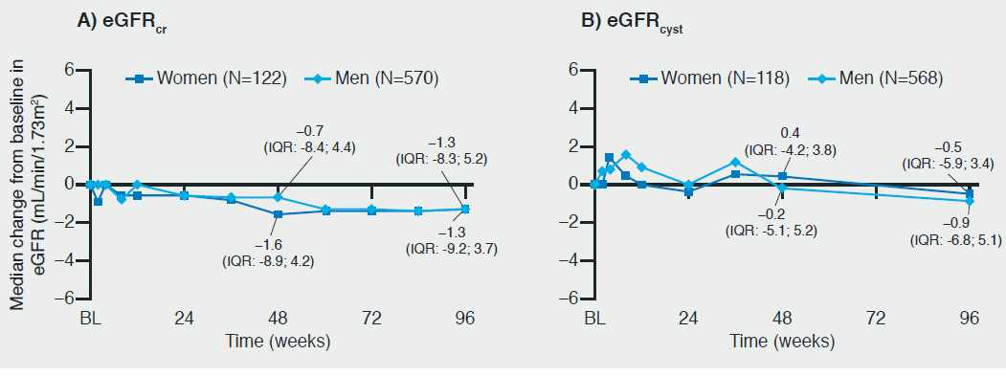
EMERALD/AMBER Week 96 Women: EMERALD Median Change form Baseline to Week 96 in eGFR_{cr} and eGFR_{cyst} in the D/C/F/TAF Arm by Gender
Median change in estimated Median change in eGFR remained stable through Week 96 for both genders and no cases of Fanconi Syndrome or subclinical PRT were detected
eGFRcr and eGFRcyst (both based on serum levels and CKD-EPI formula); GFR normal range: 90‒120 mL/min/1.73m2; N is the number of evaluable women or men at Week 96
D/C/F/TAF, darunavir/cobicistat/emtricitabine/tenofovir alafenamide; PRT, proximal renal tubulopathy;
eGFR_{cr}, estimated glomular filtration rate creatinine; eGFR, estimated glomular filtration rate cystatin C;
IQR, interquartile range; BL baseline; CKD, chronic kidney disease.

Slide 14
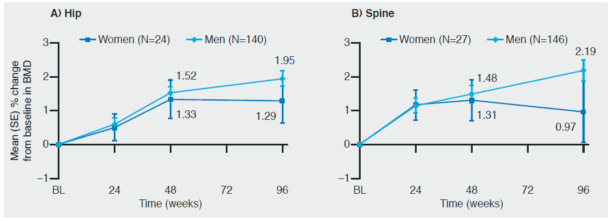
EMERALD/AMBER Week 96 Women: EMERALD Mean (SE) Percent Change from Baseline to Week 96 in A) Hip and B) Spine BMD in the D/C/F/TAF Arm by Gender
Numerical increases in hip and spine BMD through Week 96 versus baseline were observed for both genders, with overall numerically smaller increases in women; femoral neck BMD changes followed the same pattern at Week 96 (women: +0.05%; men: +1.61%)
BMD was evaluated in a substudy of EMERALD. N is the number of evaluable women or men at Week 96.
D/C/F/TAF, darunavir/cobicistat/emtricitabine/tenofovir alafenamide; BMD, bone mineral density;
SE, standard error.

Slide 15
EMERALD/AMBER Week 96 Women: AMBER D/C/F/TAF Arm – ART-Naïve Patients
Patient Disposition and Baseline Characteristics
Of the total randomized and treated patients, 85/725 patients (12%) were women (640 [88%] men); 44/362 (12%) were women (318 [88%] men) in the D/C/F/TAF arm, and all ongoing patients continued on D/C/F/TAF in the extension phase
At baseline, median (range) age of women in the D/C/F/TAF arm was 36.5 (20; 61) years and was similar in men (34.0 (19; 60) years)
The majority of women (73%) and men (85%) were White
Median baseline log₁₀ HIV-1 viral load was 4.5 in women (men: 4.4), and median baseline CD4⁺ cell count was 365 cells/mm³ in women (men: 472 cells/mm³)
D/C/F/TAF, darunavir/cobicistat/emtricitabine/tenofovir alafenamide; ART, antiretroviral therapy.

Slide 16
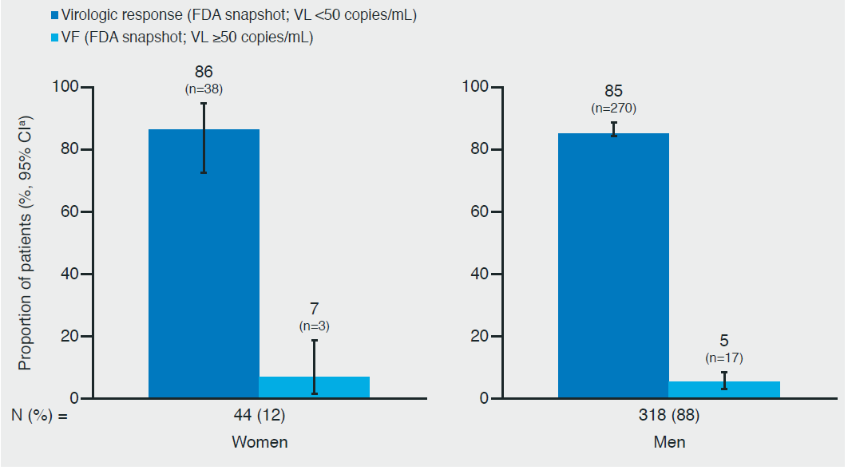
EMERALD/AMBER Week 96 Women: AMBER Virologic Outcomes at Week 96 (FDA Snapshot) in the D/C/F/TAF Arm by Gender (ITT Population)
A high proportion of women in the D/C/F/TAF arm had a virologic response (86%) at Week 96 (men: 85%) and a low proportion had VF (women: 7%; men: 5%)
ªTwo-sided Exact Clopper-Pearson 95% CI.
D/C/F/TAF, darunavir/cobicistat/emtricitabine/tenofovir alafenamide; VF, virologic failure;
ITT, intent-to-treat; VL, viral load; CI, confidence interval.

Slide 17
EMERALD/AMBER Week 96 Women: AMBER Resistance
In the D/C/F/TAF arm, post-baseline genotype data were available for 9 patients (2 women; 7 men) with protocol defined VF (virologic non-response, virologic rebound, and/or viraemic at final timepoint) and VL ≥400 copies/mL at failure or at later time points in the D/C/F/TAF arm
No emerging DRV, primary PI, or TFV RAMs were observed post-baseline
The N(t)RTI RAM M184I/V RAM, conferring FTC and 3TC resistance, was detected at Week 36 in one female patient who had transmitted NNRTI resistance at screening, and in a post-hoc analysis M184V was detected pre-treatment as a minority variant (9%)¹
D/C/F/TAF, darunavir/cobicistat/emtricitabine/tenofovir alafenamide; VF, virologic failure;
VL, viral load; DRV, darunavir; PI, protease inhibitor; TFV, tenofovir;
RAMS, resistance associated mutations; FTC, emtricitabine; 3TC, lamivudine;
N(t)RTI, nucleoside reverse transcriptase inhibitor;
NNRTI, non nucleoside reverse transcriptase inhibitor.
1. Lathouwers E, et al. HIV Glasgow 2018. Abstract P294.

Slide 18
EMERALD/AMBER Week 96 Women: AMBER Safety Through Week 96 in the D/C/F/TAF Arm by Gender (ITT Population)
Incidence, n (%) | Women (N=44) | Men (N=318)
≥1 AE, any grade | 41 (93) | 293 (92)
Study drug-related AEs | 26 (59) | 116 (36)
Study drug-related Grade 3 or 4 AEs | 3 (7) | 8 (3)
≥1 serious AE | 5 (11) | 34 (11)
Study drug-related serious AEs | 0 | 1 (<1)
≥1 AE leading to discontinuation | 3 (7) | 7 (2)
Study drug-related Grade 3 or 4 and serious AEs and AEs leading to discontinuation were low in both genders in the D/C/F/TAF arm and there were no deaths
Most common AEs (≥10% overall D/C/F/TAF arm through 96 weeks) were diarrhea (16% women; 24% men), nasopharyngitis (9% women; 17% men), and headache (14% women; 15% men)
D/C/F/TAF, darunavir/cobicistat/emtricitabine/tenofovir alafenamide; AEs, adverse events;
ITT, intent-to-treat.

Slide 19
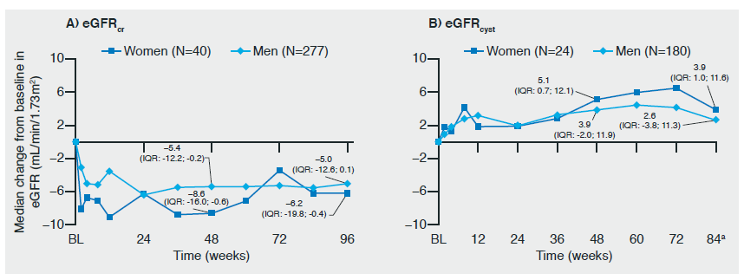
EMERALD/AMBER Week 96 Women: AMBER Median Change from Baseline to Week 96 in A)eGFR_{cr} B)eGFR_{cyst} in the D/C/F/TAF Arm by Gender
No clinically relevant changes in eGFR and no cases of Fanconi Syndrome or subclinical PRT were observed through Week 96 for either gender
Baseline eGFRcr = eGFR based on creatinine and eGFRcyst = eGFR based on cystatin C (both based on serum levels and CKD-EPI formula); IQR.
GFR normal range: 90‒120 mL/min/1.73m2; ªCystatin C was not routinely collected during the open-label phase so only 22 patients had results for the Week 96 time point; N is the number of evaluable women or men at A) Week 96 or B) Week 84
D/C/F/TAF, darunavir/cobicistat/emtricitabine/tenofovir alafenamide; BL, baseline; IQR, inter-quartile range; eGFR_{cr}, estimated glomular filtration rate creatinine; eGFR, estimated glomular filtration rate cystatin; GRF, glomular filtration rate;
PRT, proximal renal tubulopathy.

Slide 20
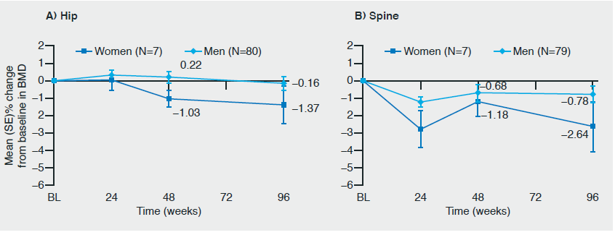
EMERALD/AMBER Week 96 Women: AMBER Mean (SE) Percent Change from Baseline to Week 96 in A) Hip and B) Spine BMD in the D/C/F/TAF Arm by Gender
At Week 48, mean change in BMD at each site was statistically favorable for the D/C/F/TAF arm versus the control arm
In the D/C/F/TAF arm through Week 96, there were small decreases in hip and lumbar spine BMD, with overall numerically greater decreases in women; femoral neck BMD changes followed the same pattern at Week 96 (women: –2.27%; men: –1.17%)
BMD was evaluated in a substudy of AMBER; N is the number of evaluable women or men at Week 96.
D/C/F/TAF, darunavir/cobicistat/emtricitabine/tenofovir alafenamide; BL, baseline;
BMD, bone mineral density; SE, standard error.

Slide 21
EMERALD/AMBER Week 96 Women: Conclusions
Efficacy and safety results for D/C/F/TAF were generally consistent across genders through Week 96 in virologically suppressed ART-experienced and -naive patients living with HIV-1 in EMERALD and AMBER
Through Week 96, D/C/F/TAF resulted in:
A high virologic response rate of 86% (VL <50 copies/mL; FDA Snapshot) in women in both studies
Few discontinuations due to AEs and overall favorable bone/renal outcomes
No treatment-emergent DRV, primary PI, or TFV RAMs in 1,125 patients
In only one female patient in the D/C/F/TAF arm of AMBER, an FTC RAM (M184I/V) was identified post-VF (<0.1%)
These findings confirm the efficacy, high genetic barrier to resistance and bone/renal safety benefits of D/C/F/TAF for all patients, irrespective of gender
D/C/F/TAF, darunavir/cobicistat/emtricitabine/tenofovir alafenamide; VL, viral load; AEs, adverse events;
DRV, darunavir; TFV, tenofovir; RAMS, resistance associated mutations; FTC, emtricitabine;
PI, protease inhibitor.

