Slide 1
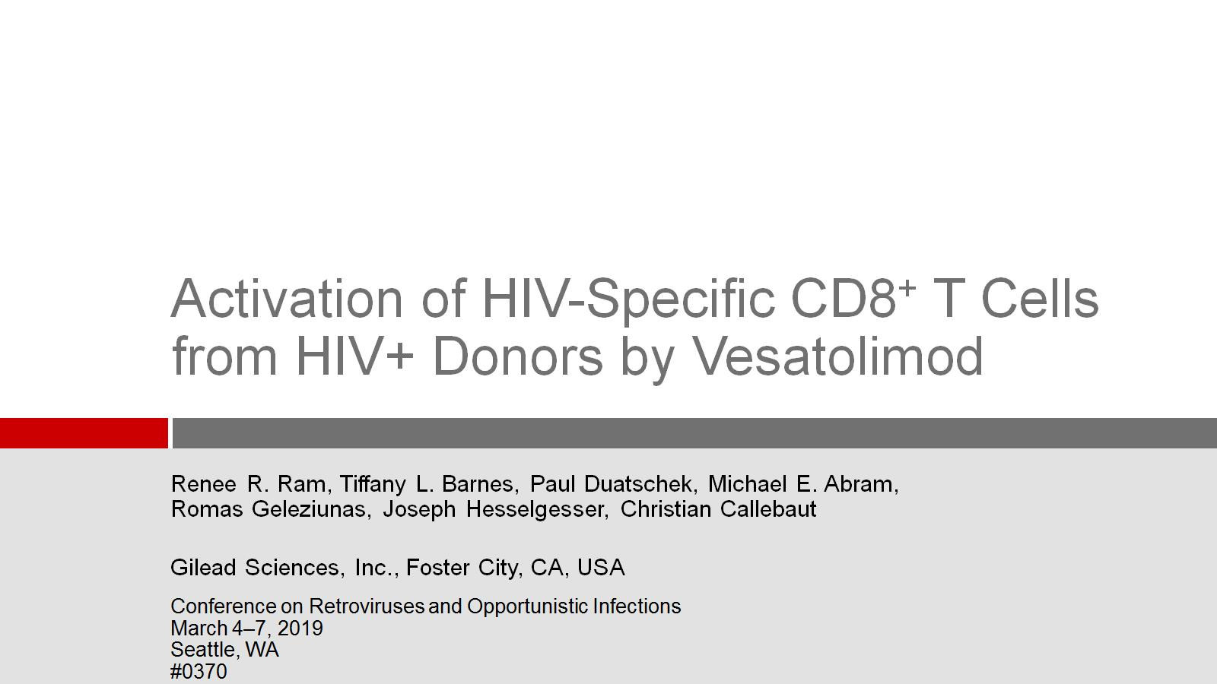
Activation of HIV-Specific CD8⁺ T Cells from HIV+ Donors by Vesatolimod

Slide 2
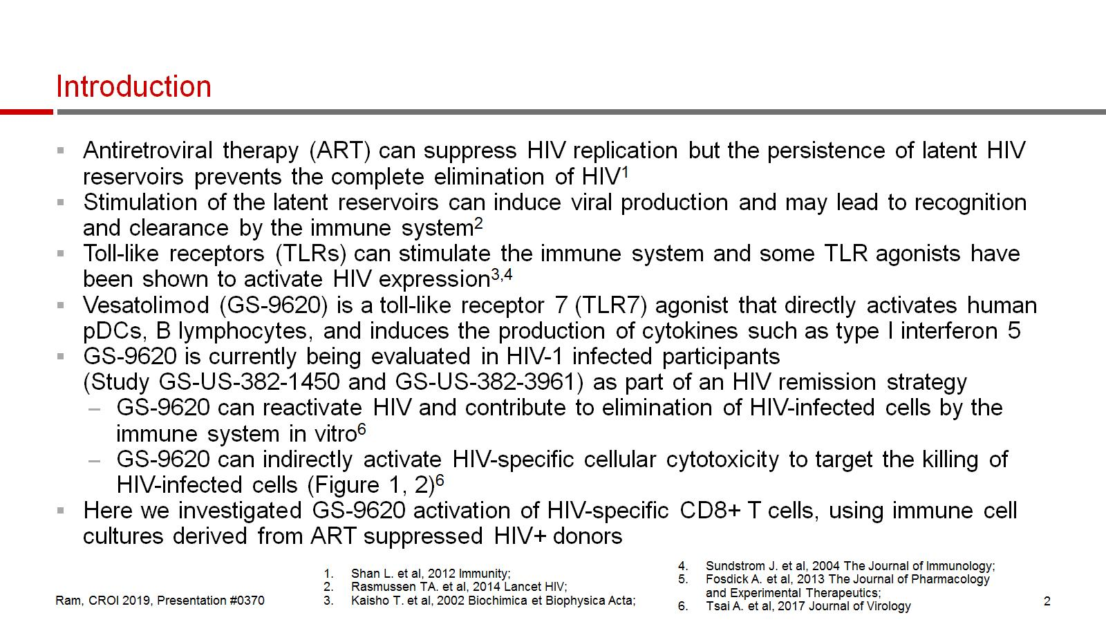
Introduction

Slide 3
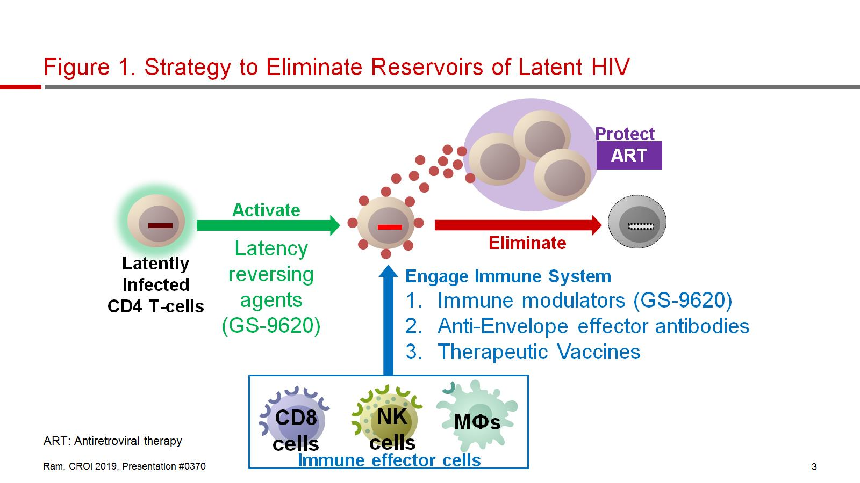
Figure 1. Strategy to Eliminate Reservoirs of Latent HIV

Slide 4
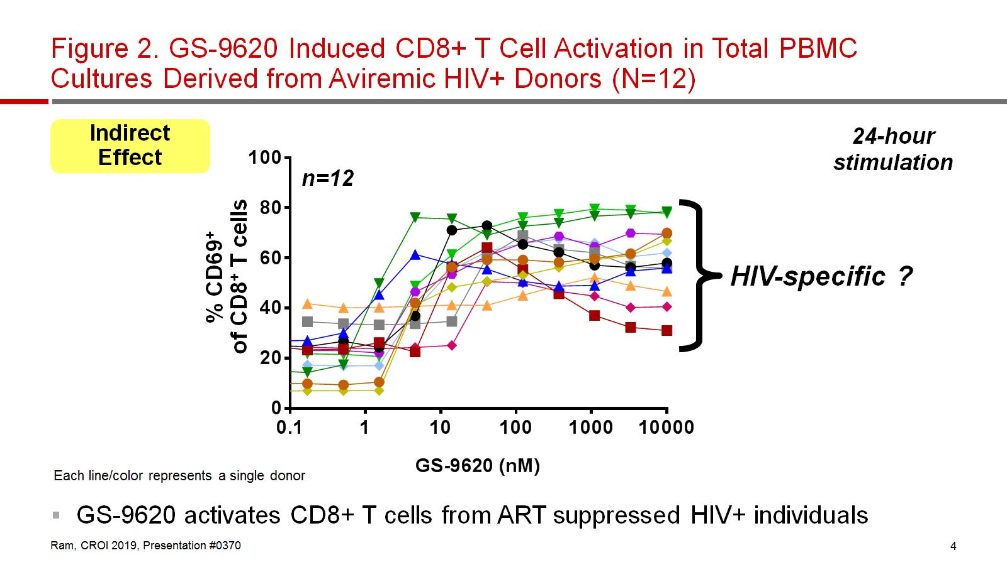
Figure 2. GS-9620 Induced CD8+ T Cell Activation in Total PBMC Cultures Derived from Aviremic HIV+ Donors (N=12)

Slide 5
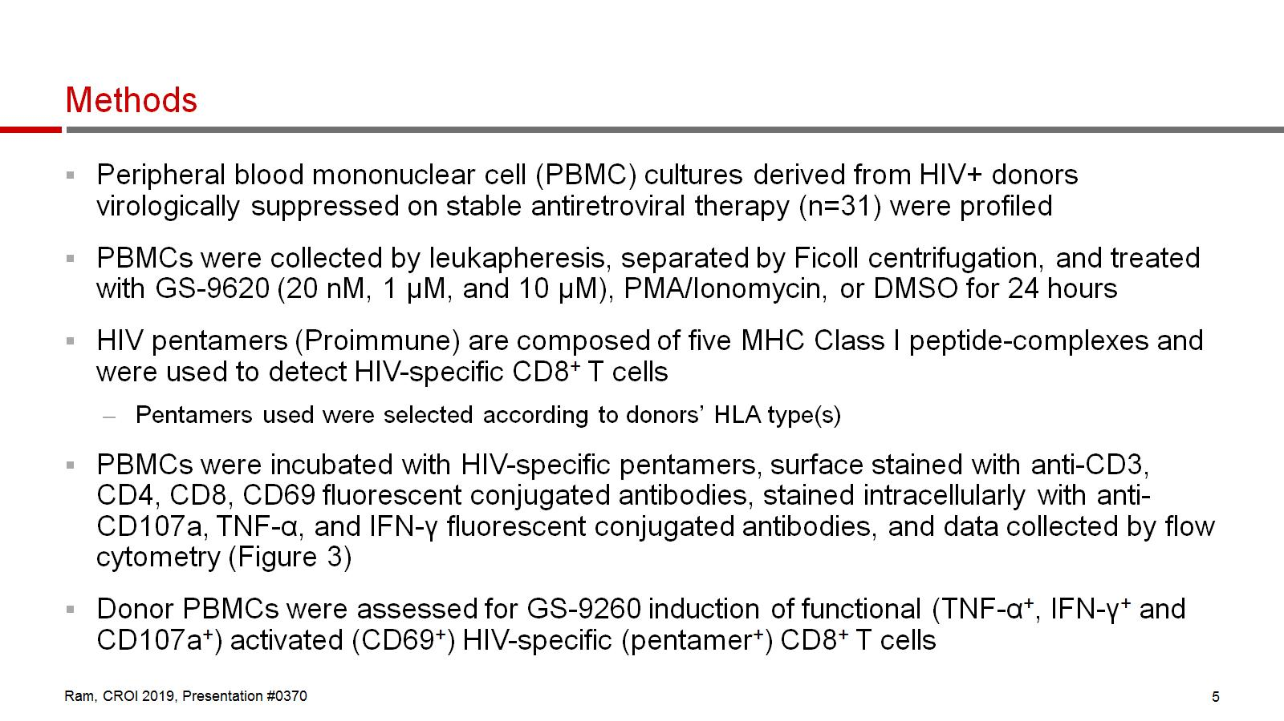
Methods

Slide 6
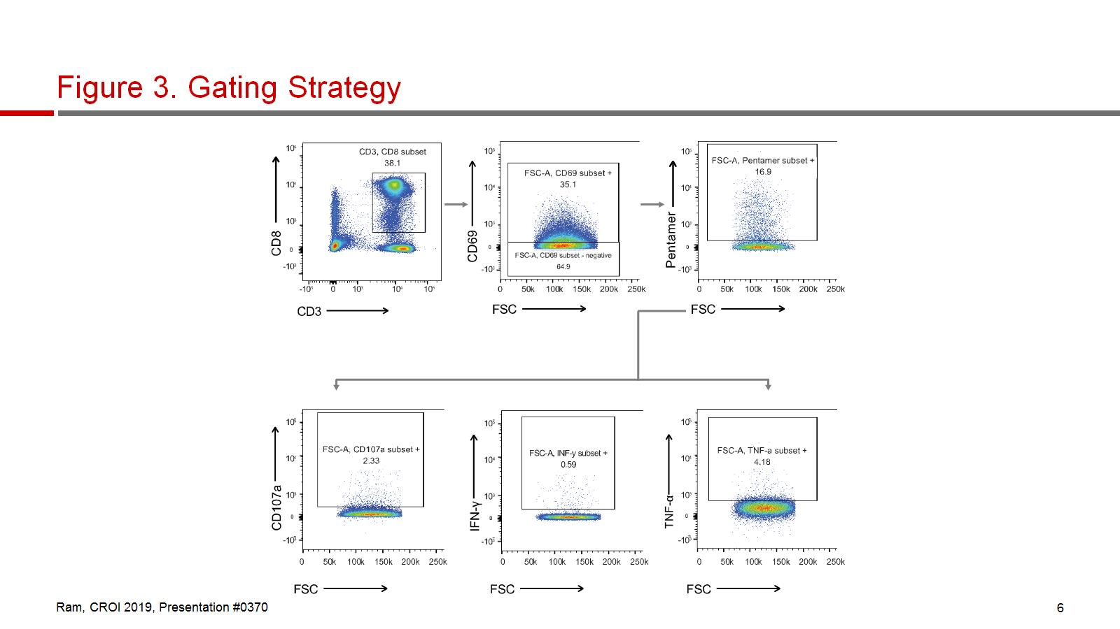
Figure 3. Gating Strategy

Slide 7
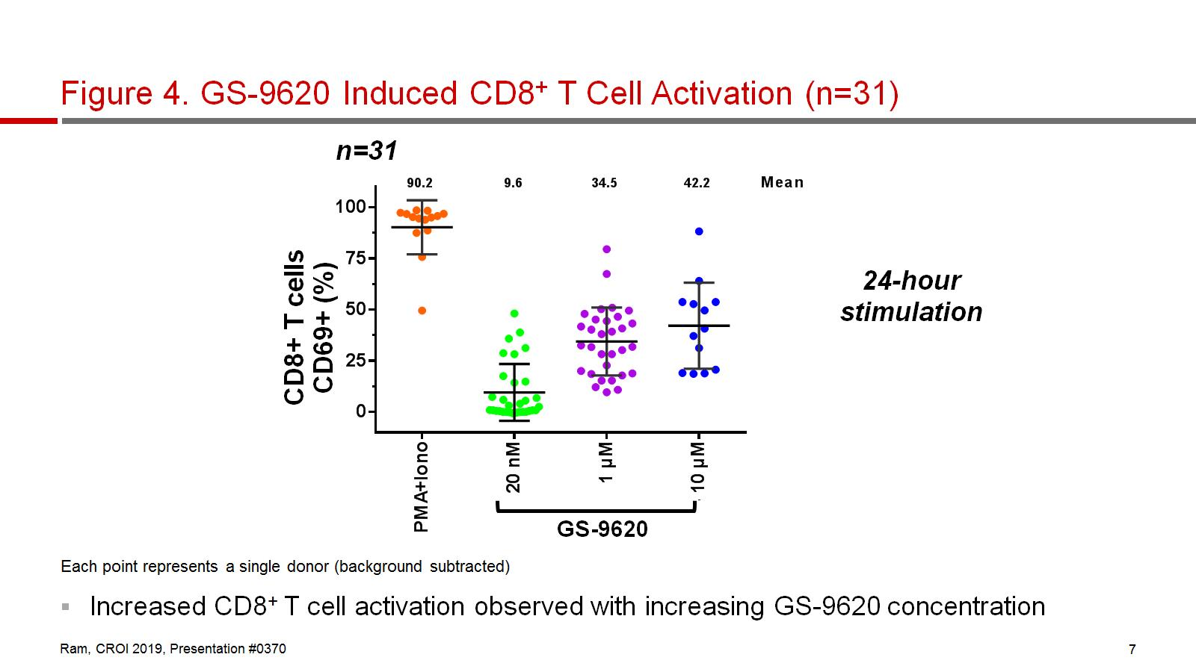
Figure 4. GS-9620 Induced CD8⁺ T Cell Activation (n=31)

Slide 8
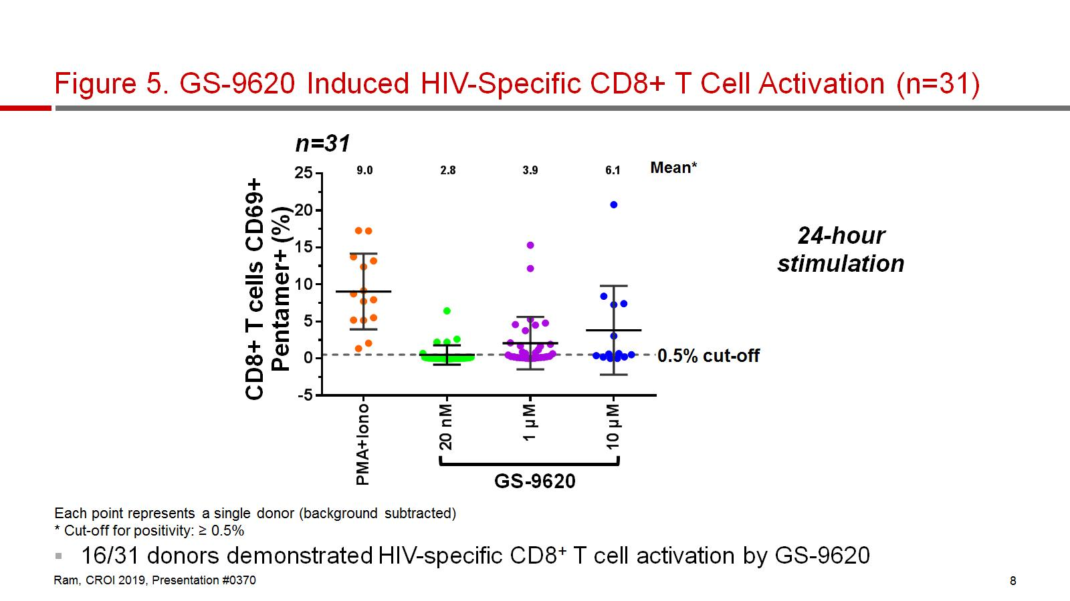
Figure 5. GS-9620 Induced HIV-Specific CD8+ T Cell Activation (n=31)

Slide 9
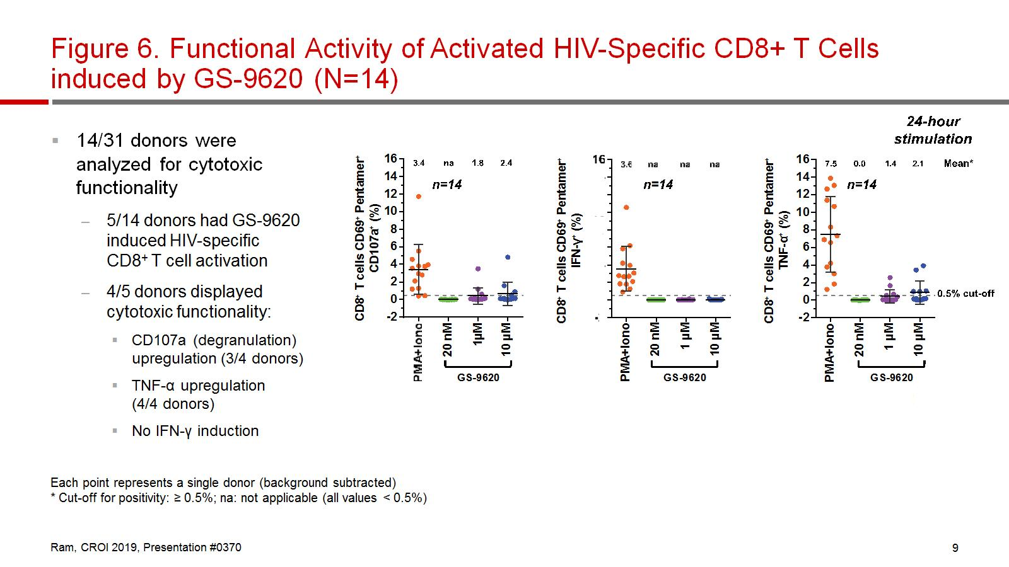
Figure 6. Functional Activity of Activated HIV-Specific CD8+ T Cells induced by GS-9620 (N=14)

Slide 10
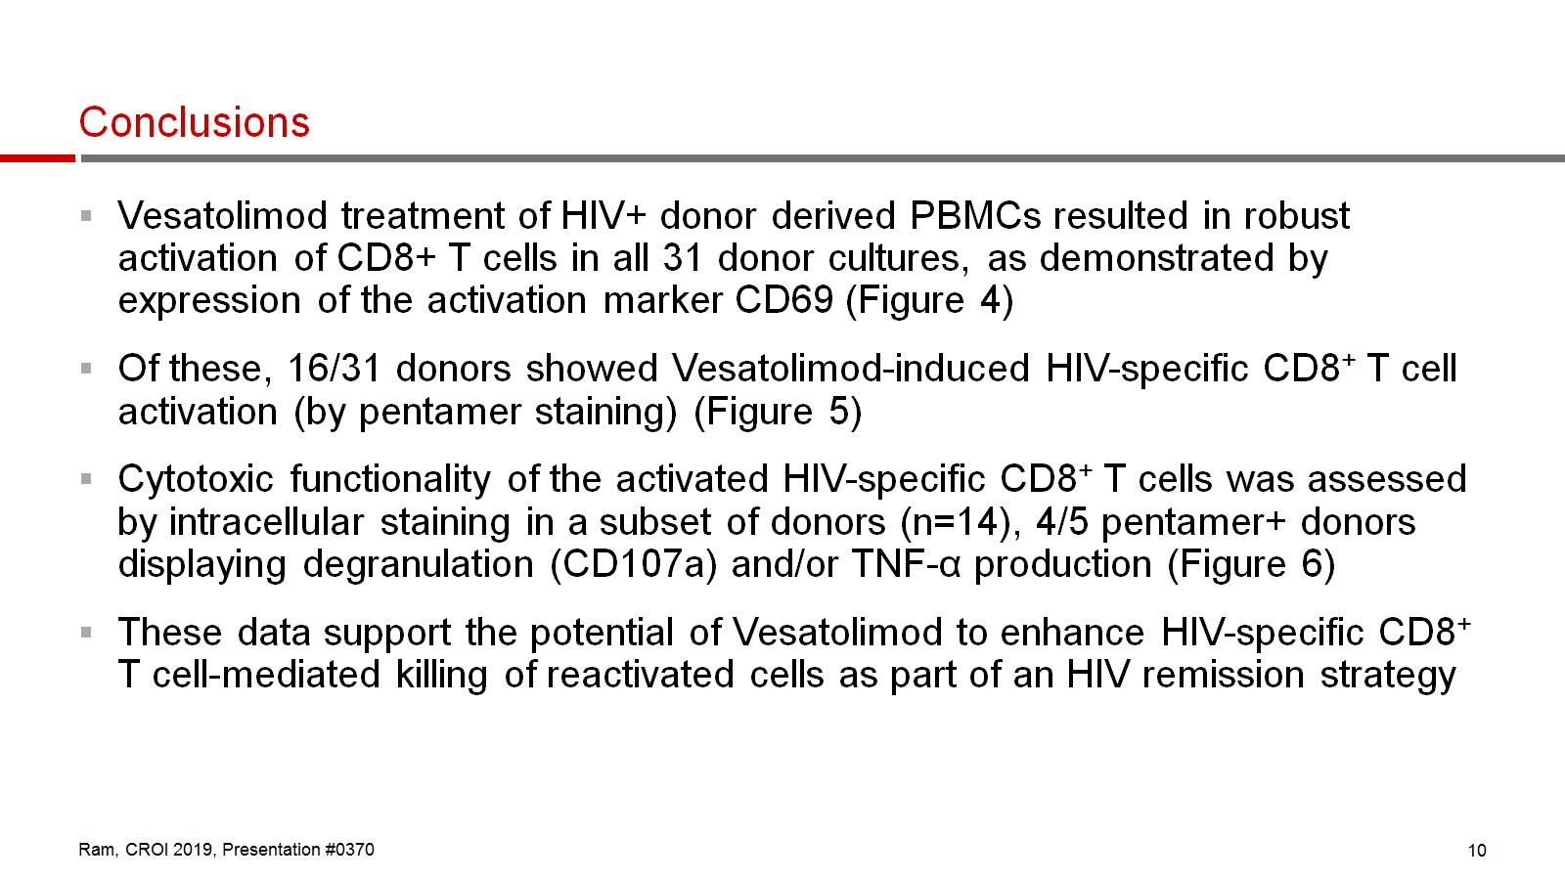
Conclusions

