Slide 1
FTC/TAF + BIC Postexposure Prophylaxis Protects Macaques Against Rectal SHIV Infection

Slide 2
Antiretroviral Approaches in HIV Prevention

Slide 3
NHP Study Objectives

Slide 4
NHP Model for HIV Prevention

Slide 5
Single-Dose Pharmacokinetic Study Design

Slide 6
TAF, FTC, and BIC PK Profile in Rhesus Macaques

Slide 7
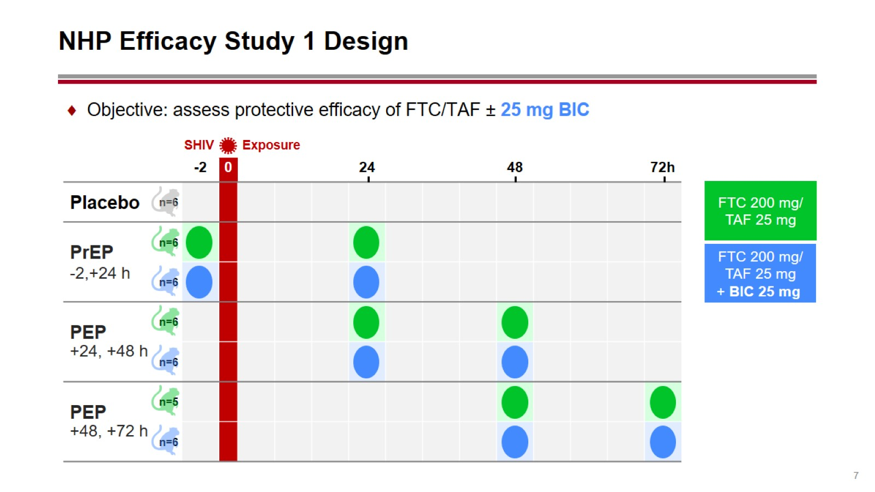
NHP Efficacy Study 1 Design

Slide 8
Study 1: Both 2-Dose Regimens Effective for PrEP, But Not PEP

Slide 9
NHP Efficacy Study 2 Design

Slide 10
Study 2: 100-mg BIC Extends Postexposure Protective Window

Slide 11
NHP Study Conclusions and Future Directions

Slide 12
Acknowledgments

