Slide 1
Study Question
Background
Integrase strand transfer inhibitor (INSTI)-based ART is implicated in greater weight gain among PWH initiating treatment.
Many ART-experienced PWH have switched to newer INSTI-based regimens. We hypothesized PWH with sustained viral suppression switched from an NNRTI-based to an INSTI-based regimen would have greater weight gain compared to those switched from a PI-based regimen.
Population
Adult PWH switched from NNRTI- or PI-based to INSTI-based ART in the multisite North American AIDS Cohort Collaboration on Research and Design (NA-ACCORD).
HIV-1 RNA <1000 copies/mL for 2 years prior to and following the switch.
Analysis
Piecewise linear mixed effects models estimated pre- and post-switch weight over time.
Models adjusted for age, sex, race, cohort site, HIV acquisition mode, calendar year, and CD4⁺ T cell count and BMI at the time of switch.
Interaction terms for sex, race, and age (<50 vs. ≥50) with regimen and time (separate models).

Slide 2
Results
Source Population:
17 contributing cohorts from NA-ACCORD
Study Population:
870 persons meeting viral suppression criteria
83% Male
59% White
Median age 50 years
Median CD4 620 cells/μl
Median BMI 26 kg/m²
Regimen Switch
^{343 NNRTI ➔ INSTI}
^{146 NNRTI ➔ RAL}
^{81 NNRTI ➔ DTG}
^{117 NNRTI ➔ EVG}
^{527 PI ➔ INSTI}
^{285 PI ➔ RAL}
^{95 PI ➔ DTG}
^{146 PI ➔ EVG}

Slide 3
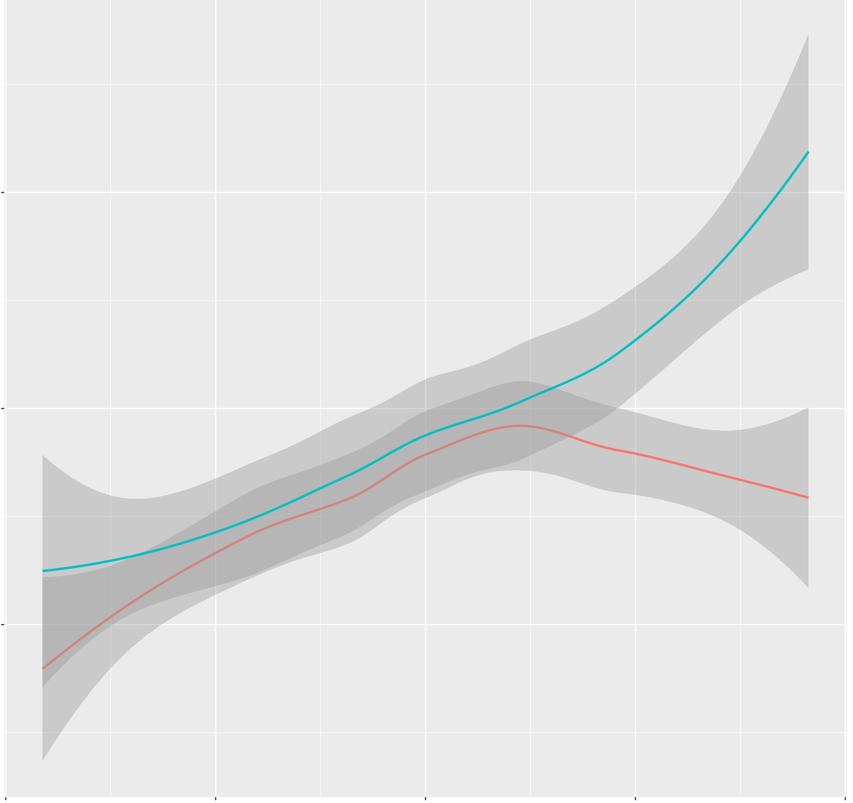
Results
Regimen switch |  | Pre-switch weight slope (kg/year) | Post-switch weight slope (kg/year) | P-value for slope change
NNRTI ➔ INSTI |  | 0.63 | 1.13 | <0.001
 | NNRTI ➔ DTG | 0.84 | 1.73 | <0.001
 | NNRTI ➔ RAL | 0.74 | 0.97 | 0.21
 | NNRTI ➔ EVG | 0.56 | 1.00 | 0.07
NNRTI ➔ INSTI
87
84
81
Estimated weight (kg)
PI ➔ INSTI
PI ➔ INSTI |  | 0.80 | 0.34 | <0.001
 | PI ➔ DTG | 0.84 | -0.04 | <0.001
 | PI ➔ RAL | 0.74 | 0.17 | <0.001
 | PI ➔ EVG | 0.56 | 0.89 | 0.11
-2 Switch +2
Time (years)

Slide 4
Results
Group | Females |  | Males |  | Non-white |  | White |  | Age <50 |  | Age >50
Pre-switch regimen | NNRTI | PI | NNRTI | PI | NNRTI | PI | NNRTI | PI | NNRTI | PI | NNRTI | PI
Weight slope before switch (kg/year) | 0.14 | 0.94 | 0.72 | 0.77 | 0.76 | 1.04 | 0.60 | 0.61 | 0.97 | 0.87 | 0.21 | 0.70
Weight slope after switch to INSTI (kg/year) | 1.58 | 0.49 | 1.04 | 0.30 | 2.03 | 0.44 | 0.49 | 0.25 | 0.89 | 0.63 | 1.38 | 0.04
p-value for slope change | <0.001 | 0.07 | 0.04 | <0.001 | <0.001 | <0.001 | 0.54 | 0.01 | 0.69 | 0.13 | <0.001 | <0.001

Slide 5
Conclusions
PWH on stable NNRTI-based ART with long-term viral suppression had higher annualized weight gain after a switch to INSTI regimens compared to person who switched from PI-based ART.
1
Among those switched from NNRTI- to INSTI-based ART, annualized weight gain was greatest for females, non-whites and older PWH
2
These findings may reflect a heterogenous effect of ART class and agent on body weight regulation that is not limited to the initiation of first regimens in the treatment-naïve.
3

