Slide 1
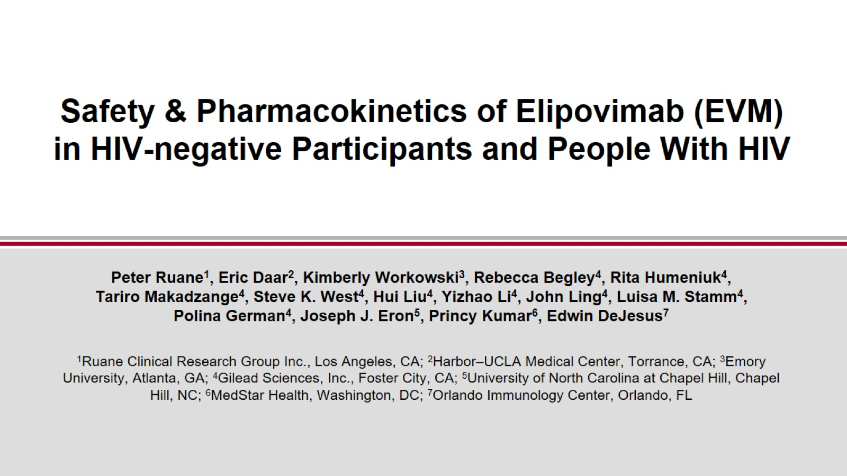
Safety & Pharmacokinetics of Elipovimab (EVM) in HIV-negative Participants and People With HIV

Slide 2
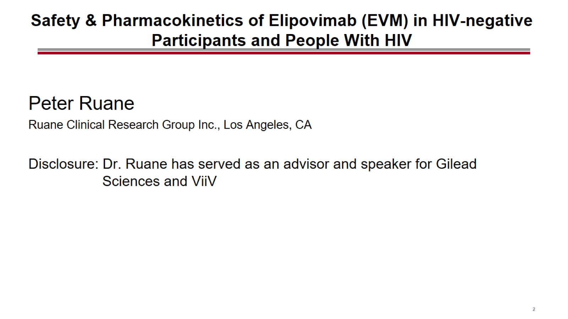
Safety & Pharmacokinetics of Elipovimab (EVM) in HIV-negative Participants and People With HIV

Slide 3
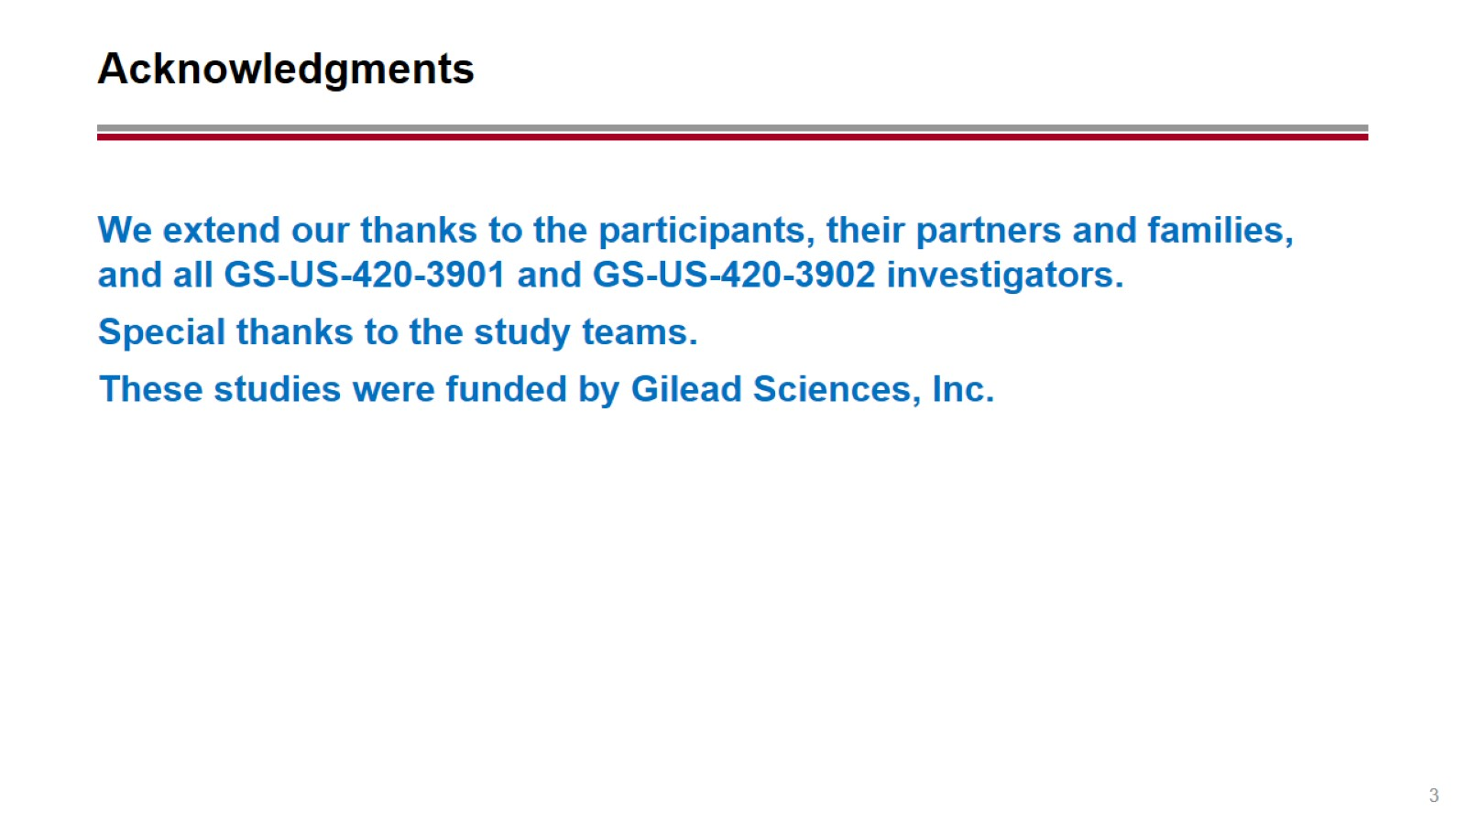
Acknowledgments

Slide 4
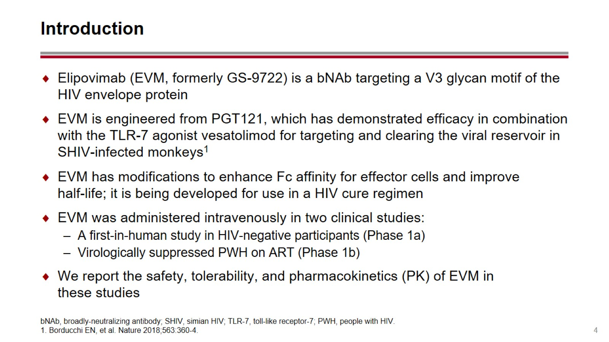
Introduction

Slide 5
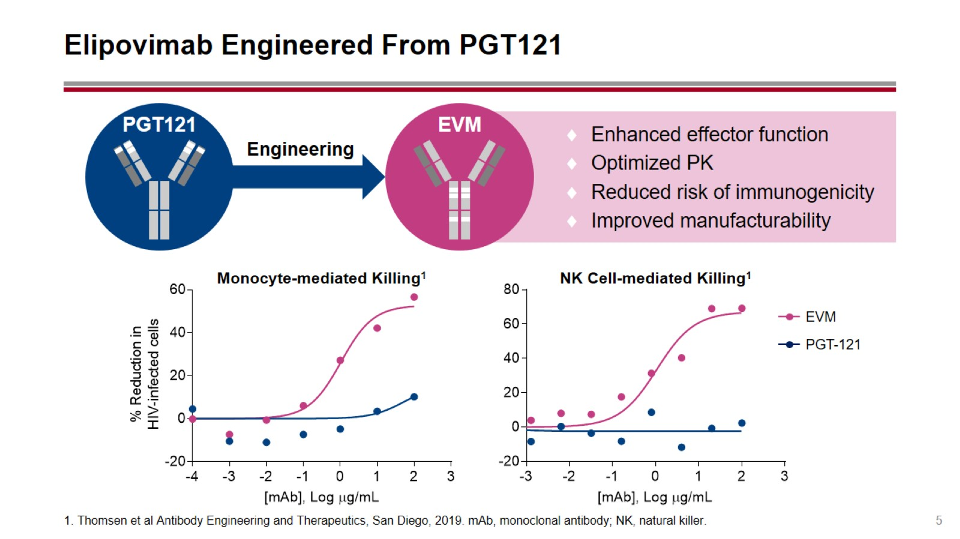
Elipovimab Engineered From PGT121

Slide 6
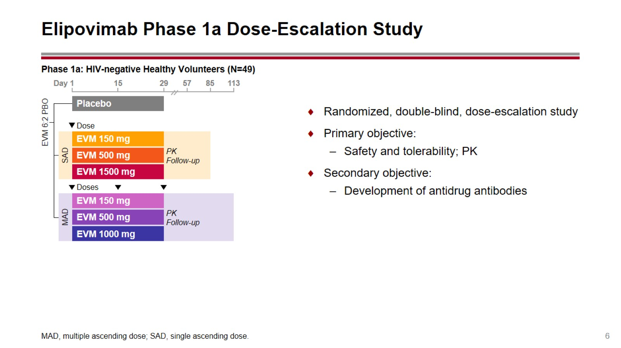
Elipovimab Phase 1a Dose-Escalation Study

Slide 7
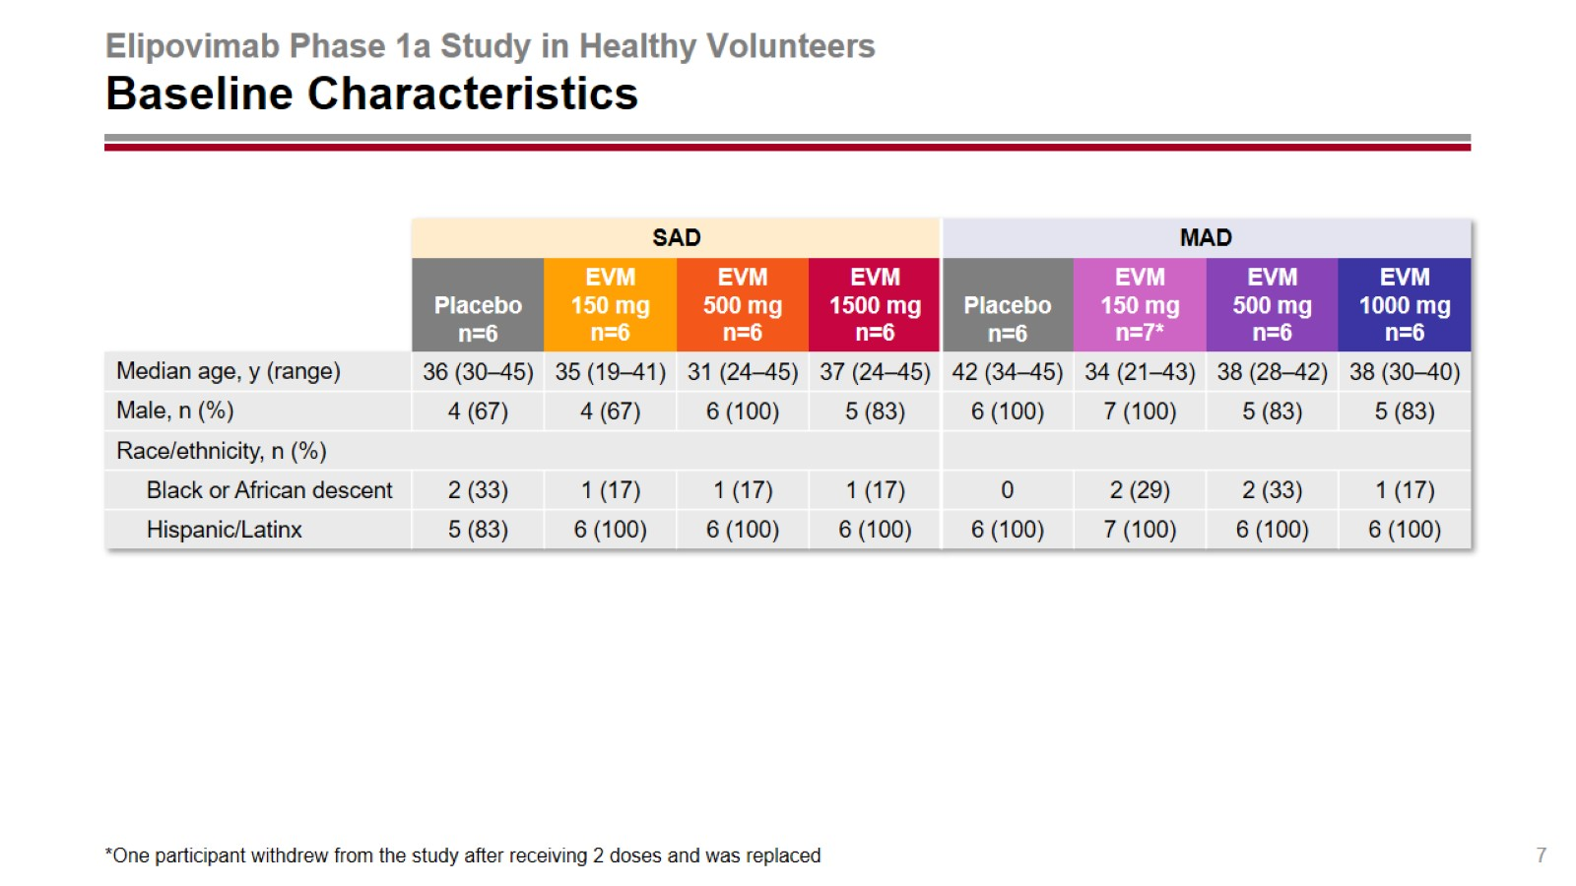
Elipovimab Phase 1a Study in Healthy Volunteers
Baseline Characteristics

Slide 8
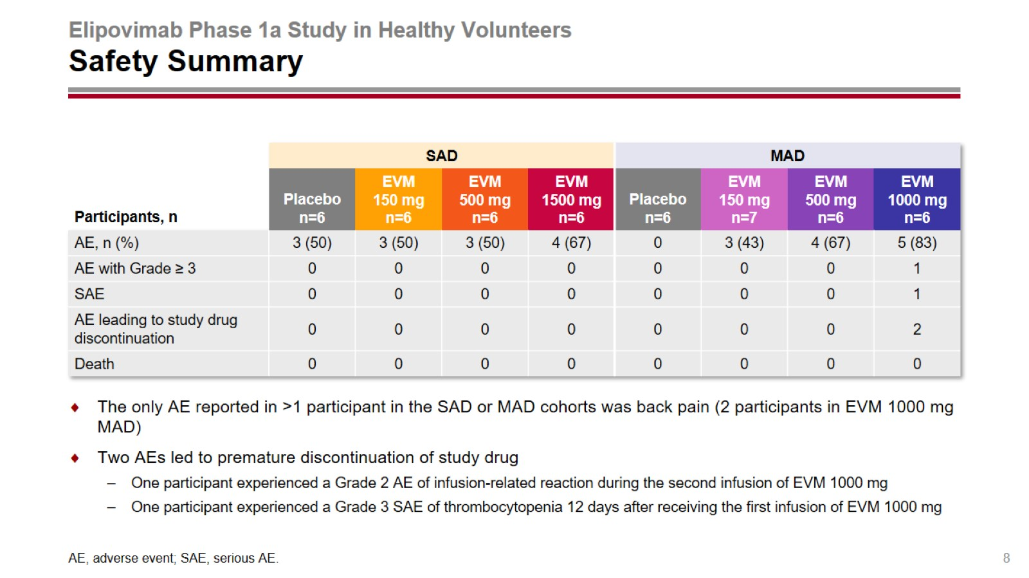
Elipovimab Phase 1a Study in Healthy Volunteers
Safety Summary

Slide 9
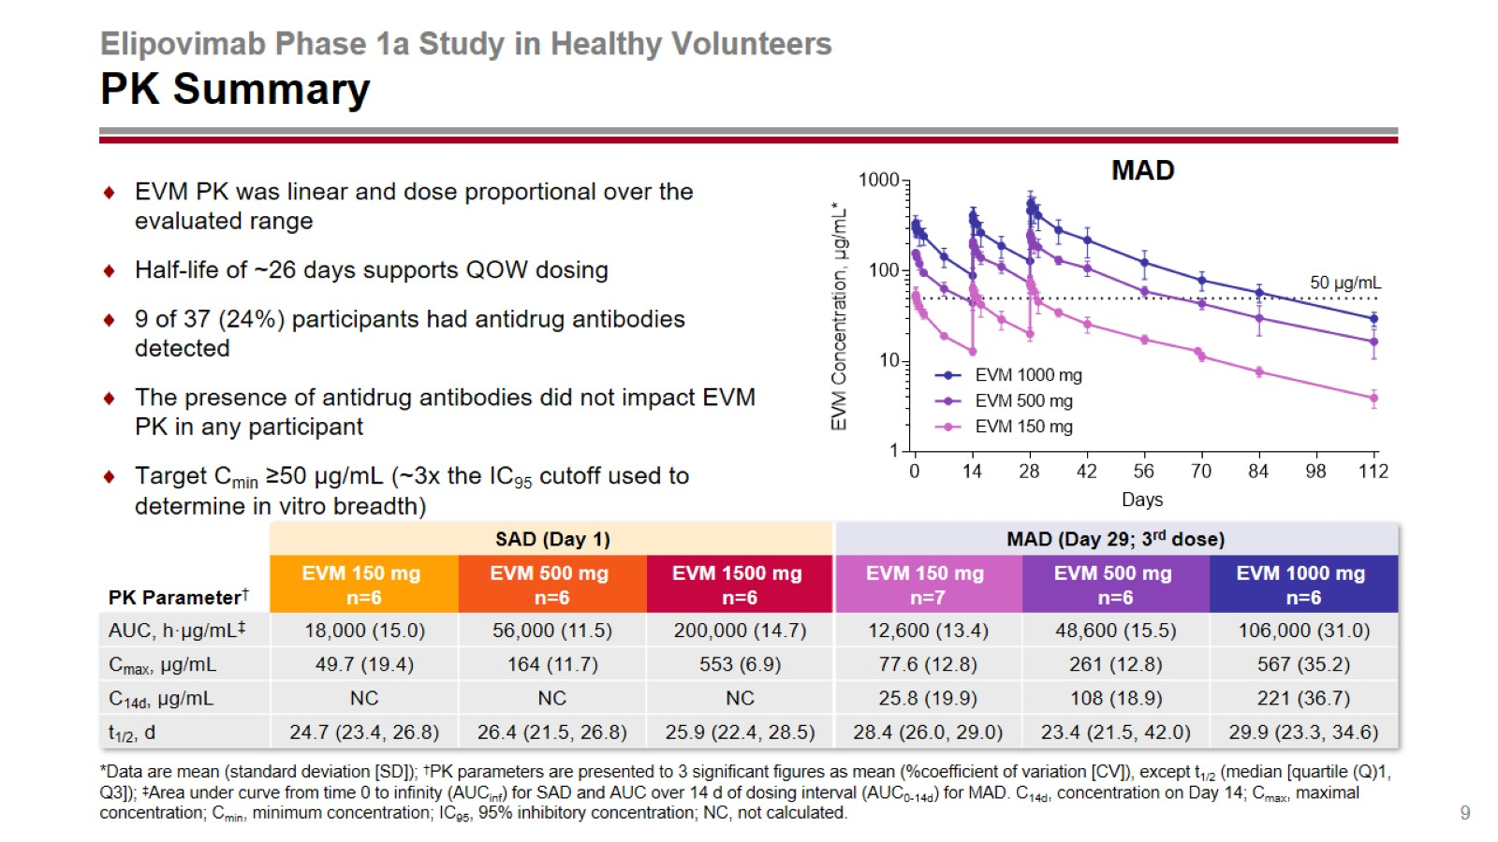
Elipovimab Phase 1a Study in Healthy Volunteers
PK Summary

Slide 10
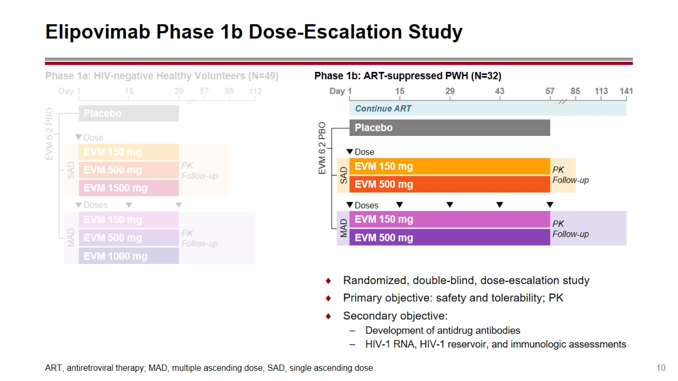
Elipovimab Phase 1b Dose-Escalation Study

Slide 11
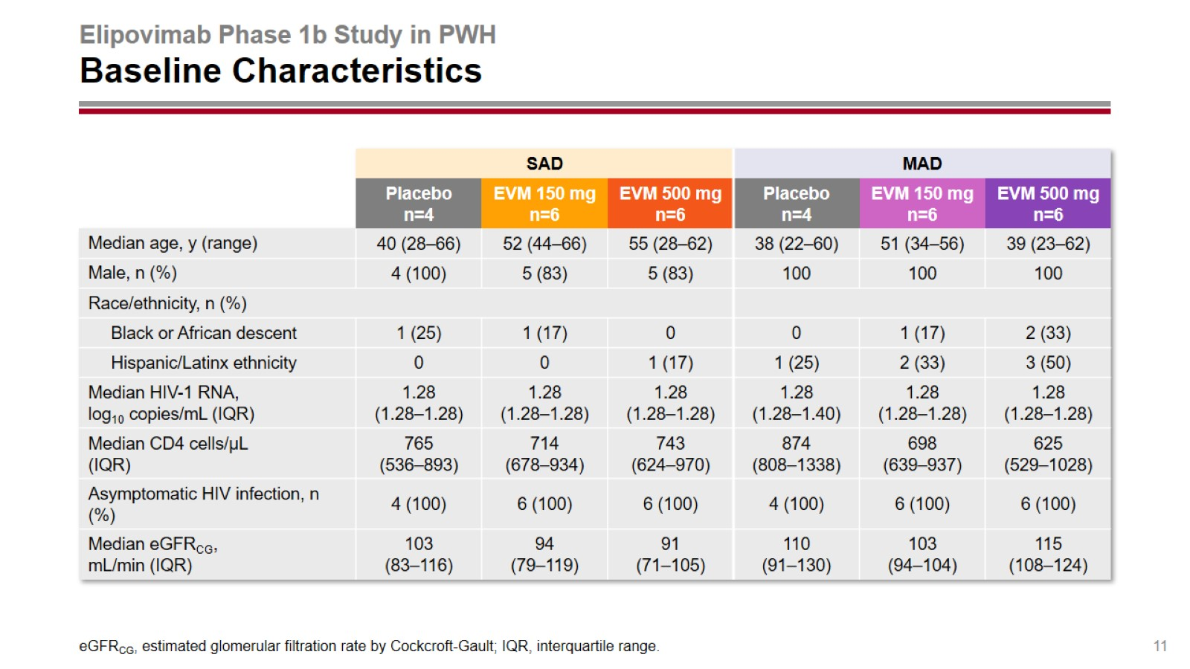
Elipovimab Phase 1b Study in PWH
Baseline Characteristics

Slide 12
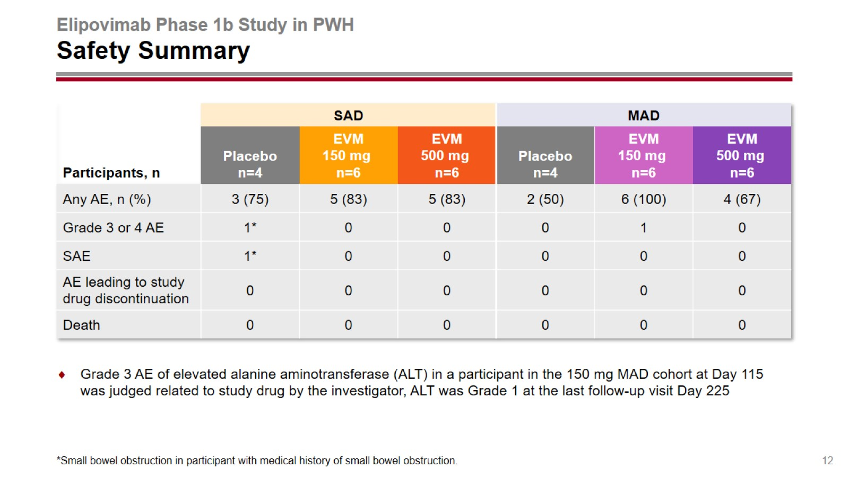
Elipovimab Phase 1b Study in PWH
Safety Summary

Slide 13
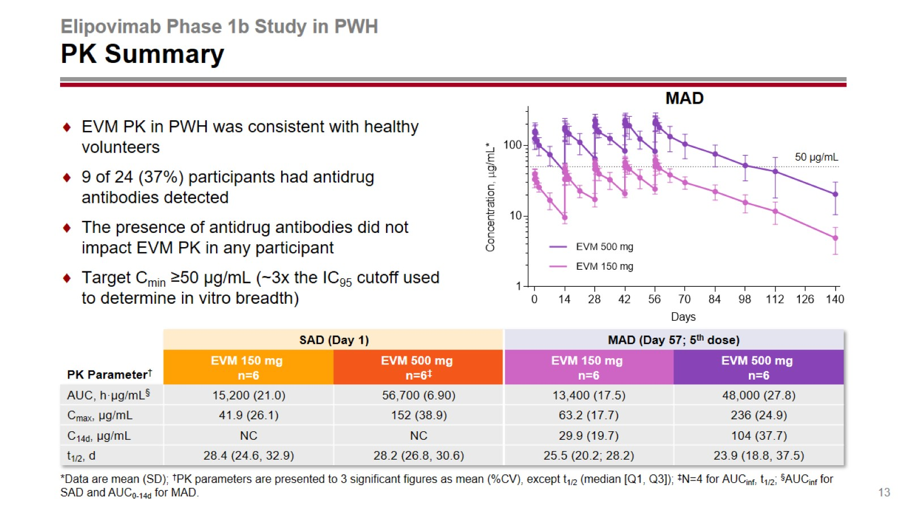
Elipovimab Phase 1b Study in PWH
PK Summary

Slide 14
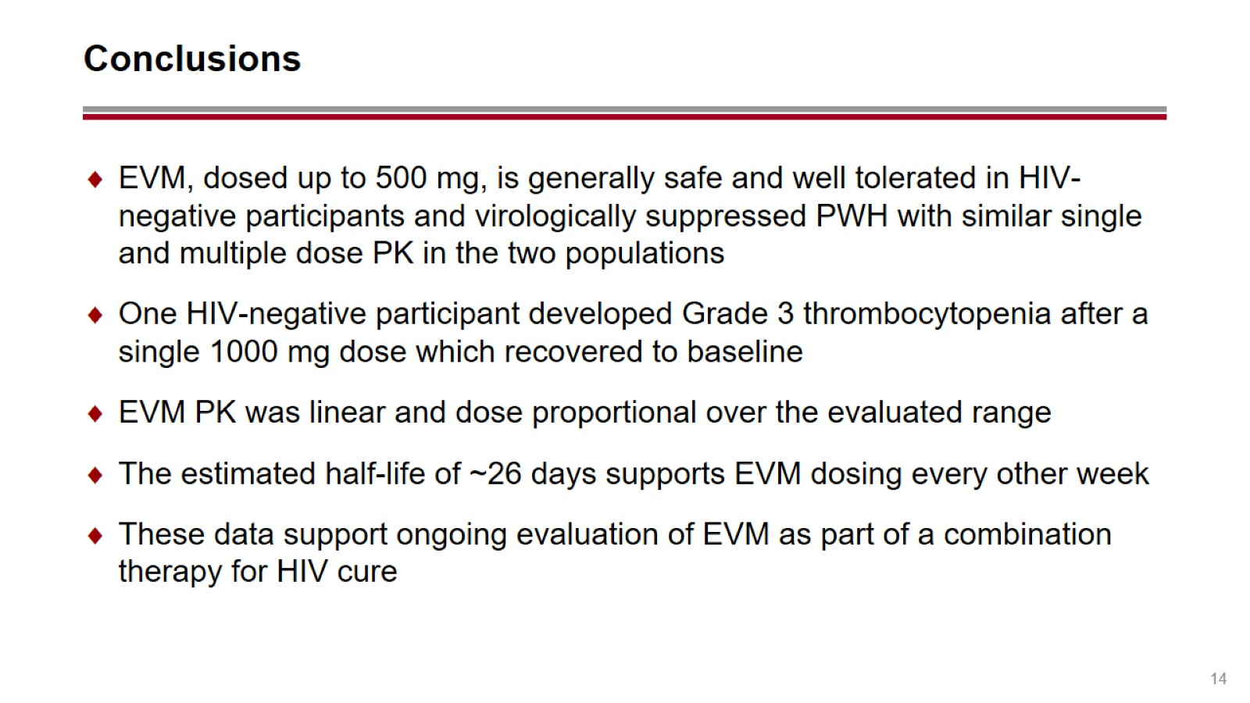
Conclusions

