Slide 1
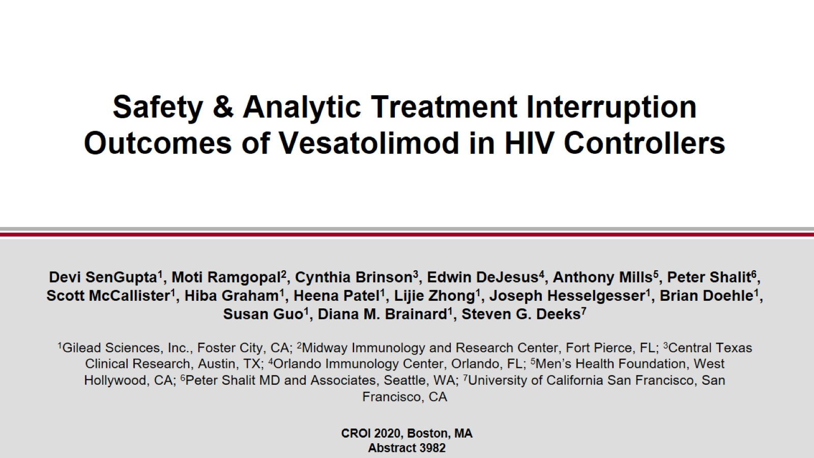
Safety & Analytic Treatment Interruption Outcomes of Vesatolimod in HIV Controllers

Slide 2
Acknowledgments

Slide 3
Introduction

Slide 4
Study Design

Slide 5
Baseline Characteristics

Slide 6
Overall Safety

Slide 7
Overall ATI Results (all participants)

Slide 8
ATI Results by Group

Slide 9
Changes in HIV DNA

Slide 10
Vesatolimod Induces ISG & Cytokines in a Dose-dependent Manner

Slide 11
Vesatolimod Increases CD4+ and CD8+ T Cell Activation

Slide 12
HIV-specific CD8+ Responses by Intra-cellular Cytokine Staining

Slide 13
Conclusions

