Slide 1

Antepartum weight gain and adverse pregnancy outcomes in IMPAACT 2010
Risa M. Hoffman, Lauren Ziemba, Sean Brummel, Lameck Chinula, Teacler Nematadzira, Frances Nakayiwa, Jeff Stringer, Chelsea Krotje, Patrick Jean-Philippe, Anne Coletti, Rebecca Zash, Roger Shapiro, Paul Sax, Judith S. Currier, Shahin Lockman on behalf of IMPAACT 2010
March 10, 2021

Slide 2
Antepartum weight gain and adverse pregnancy outcomes in IMPAACT 2010
Risa M. Hoffman, Lauren Ziemba, Sean Brummel, Lameck Chinula, Teacler Nematadzira, Frances Nakayiwa, Jeff Stringer, Chelsea Krotje, Patrick Jean-Philippe, Anne Coletti, Rebecca Zash, Roger Shapiro, Paul Sax, Judith S. Currier, Shahin Lockman on behalf of IMPAACT 2010 Team

Slide 3
Background and Rationale
3
ART containing dolutegravir (DTG) and/or tenofovir alafenamide fumarate (TAF) is associated greater weight gain in both non-pregnant and pregnant women^{1,2}
Efavirenz (EFV) and tenofovir disoproxil fumarate (TDF) have been associated with low weight gain in pregnancy²
Both insufficient and excessive weight gain in pregnancy have been associated with adverse pregnancy outcomes³
IMPAACT 2010: pregnant women with HIV-1 randomized to start treatment with DTG+FTC/TAF, DTG+FTC/TDF, or EFV/FTC/TDF
  Significantly lower rate of adverse pregnancy outcomes in women in DTG+FTC/TAF arm than other two arms⁴
1-Venter WDF et al NEJM 2019; 2-Caniglia E et al, Eclinical Medicine 2020; 3-Ukah UV et al. PLOS Medicine 2019; 4-Primary outcomes presented at CROI 2020, Abstract 130

Slide 4
Objectives and Methods
4
Estimated by-arm differences in average antepartum weekly weight gain using generalized estimating equations
Evaluated associations between weight gain and adverse pregnancy outcomes using Cox-proportional hazards regression*:
    Composite outcome of stillbirth (≥20 wks GA), preterm delivery (<37 wks GA) and small for gestational age (SGA: <10th percentile)
    Individual components of the composite outcome
    Neonatal death
Weight categories: low weight gain <0.18 kg/week and high weight gain >0.59 kg/week (Institute of Medicine Guidelines)
*Weight included as a time-varying covariate; analyses adjusted for gestational age at baseline
Notes:
Time to event analyses using Cox-proportional hazards regression models with weight gain as a time-varying covariate

Slide 5

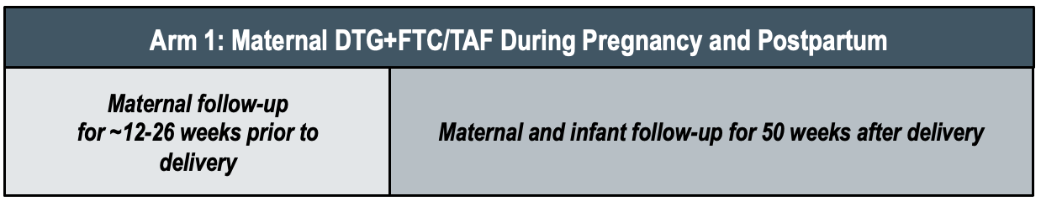
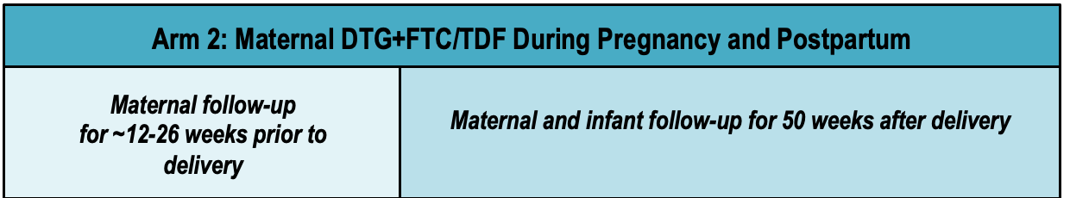
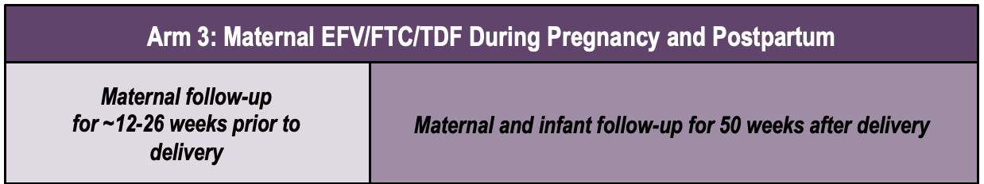
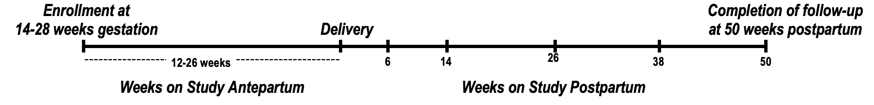
IMPAACT 2010 Study Design
Arm 1: Maternal DTG+FTC/TAF During Pregnancy and Postpartum
Key Eligibility Criteria
Pregnant women 14-28 weeks gestation
ART-naïve

Slide 6
Enrollment and Weight Data Availability
6
Screened = 810
Enrolled = 643 (79%)
Jan 2018 – Feb 2019
Antepartum weight data available = 643 (100%)
Antepartum weight and pregnancy outcome data available = 632 (98.3%)
Participants were enrolled at
22 sites in 9 countries
(Botswana, Brazil, India, South Africa, Tanzania, Thailand, Uganda, US, Zimbabwe)

Slide 7
Maternal Baseline Characteristics
 | DTG+FTC/TAF (N = 217) | DTG+FTC/TDF (N = 215) | EFV/FTC/TDF (N = 211) | Total (N = 643)
Age (median years) | 26.8 | 26.0 | 26.6 | 26.6
Enrolled in Africa | 187 (86%) | 189 (88%) | 188 (89%) | 564 (88%)
Gestational age (median weeks) | 22.1 | 21.3 | 22.1 | 21.9
CD4 count (median cells/mm³) | 467 | 481 | 439 | 466
HIV-1 RNA (median copies/mL) | 781 | 715 | 1357 | 903
Enrollment weight, mean kg (SD) | 67.7 (15.1) | 66.3 (16.8) | 64.5 (13.3) | 66.2 (15.2)
Median duration of antepartum follow-up: 17.4 weeks

Slide 8
8
Results: Average Weekly Maternal Weight Gain by Arm
Recommended IOM
weight gain 2nd/3rd trimesters
(0.42 kg/week)
p<0.001
p=0.011
p=0.19

Slide 9
9
Low, Normal, and High Antepartum Weight Gain by Arm

Slide 10
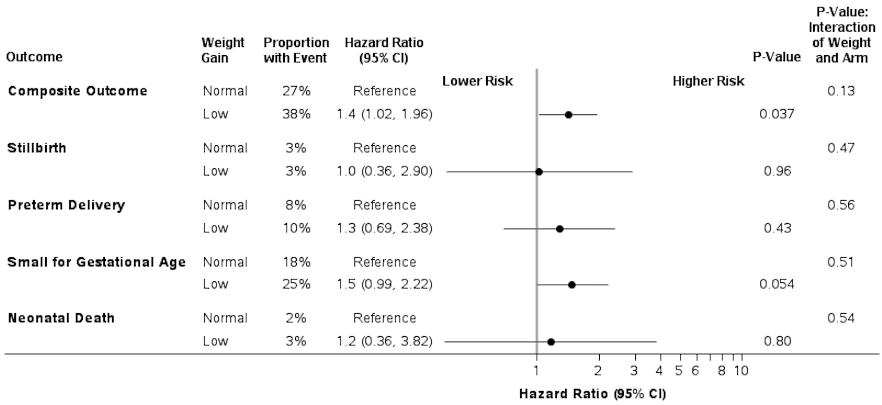
10
Low Antepartum Weight Gain and Adverse Pregnancy Outcomes
Composite outcome definition: stillbirth (≥20 wks), preterm delivery (<37 wks), and small for gestational age (<10th percentile)
Adjusted for gestational age stratum at baseline

Slide 11
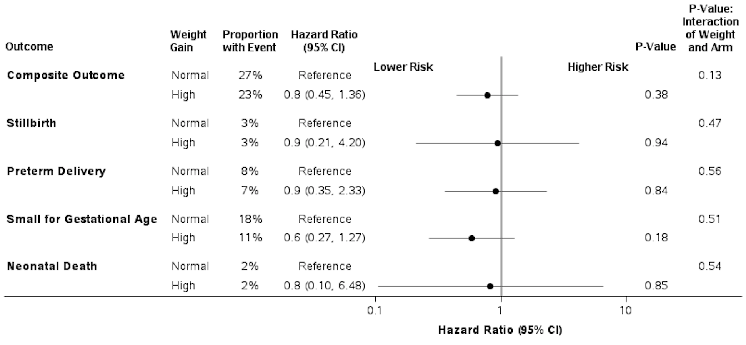
11
High Antepartum Weight Gain and Adverse Pregnancy Outcomes
Over all treatment arms, significant association between higher average weekly weight gain and a lower risk of any adverse pregnancy outcome:
HR 0.50 (95%CI 0.25-0.97, p= 0.04).
Composite outcome definition: stillbirth (≥20 wks), preterm delivery (<37 wks), and small for gestational age (<10th percentile)
Adjusted for gestational age stratum at baseline

Slide 12
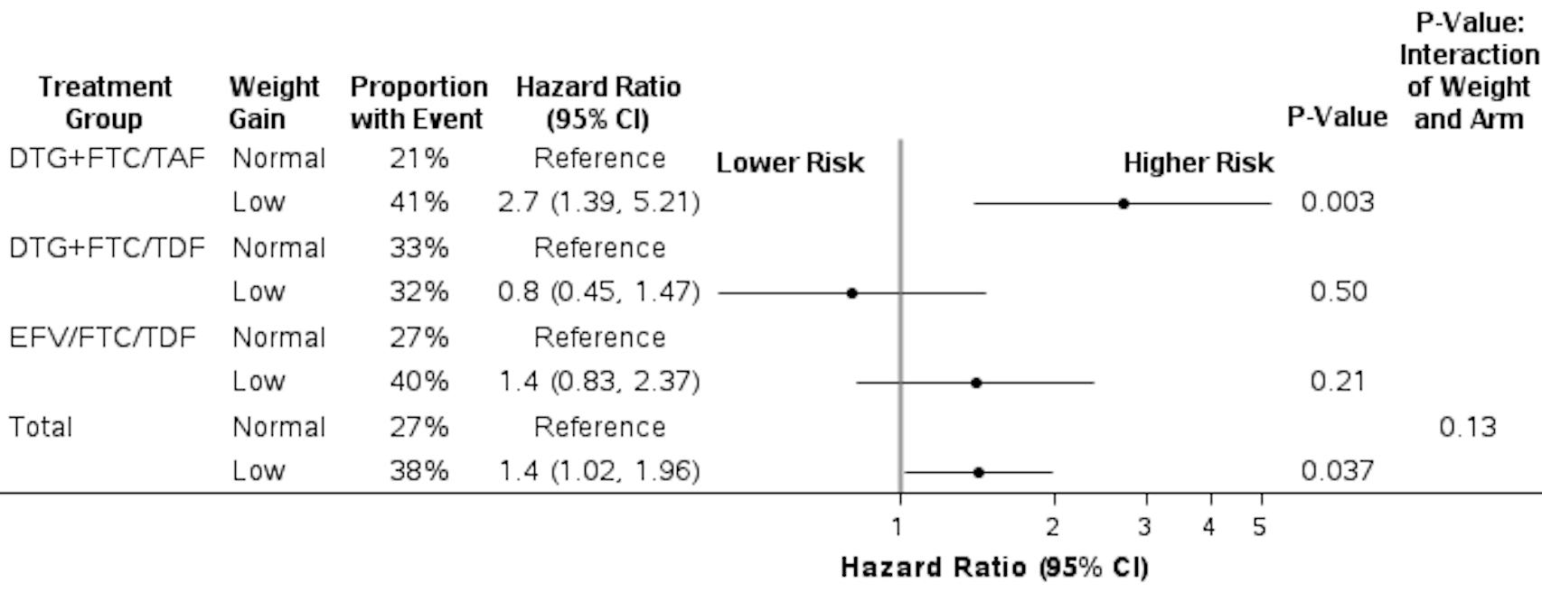
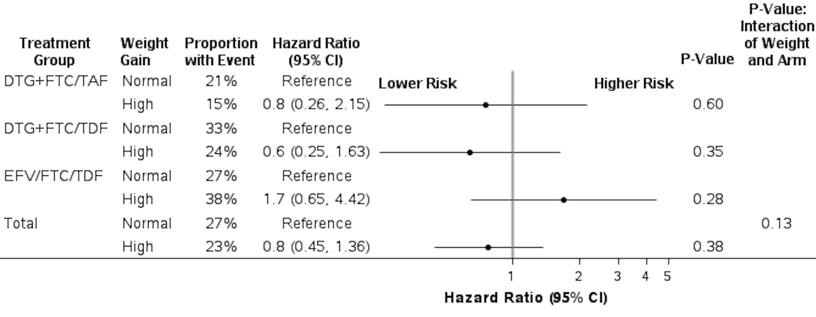
Weight Gain and Composite Adverse Pregnancy Outcome* by Arm
12
Low vs Normal Weight Gain
Adjusted for gestational age stratum at baseline
*Composite outcome definition: stillbirth (≥20 wks), preterm delivery (<37 wks), and small for gestational age (<10th percentile)
High vs Normal Weight Gain

Slide 13
Future Analyses and Limitations
13
Further planned analyses
  Comparison of average weekly weight gain by arm within low/normal/high groups
  Further study of by arm weight trajectories over antepartum period
  Detailed analysis of postpartum weight through 50 weeks
Limitations: lack of pre-pregnancy weight/BMI; predominantly an African population, all women initiating ART in pregnancy

Slide 14
Conclusions
14
Low weight gain during pregnancy was most common in women starting EFV/FTC/TDF and least common with DTG+FTC/TAF
Low but not high weight gain associated with adverse pregnancy outcomes
Weight gain on DTG+FTC/TAF approached average weight gain recommended in the 2nd/3rd trimester based on IOM standards
The lower rate of adverse pregnancy outcomes observed in the DTG+FTC/TAF arm could be related to higher antepartum weight gain

Slide 15

Acknowledgements
The IMPAACT 2010/VESTED Protocol Team gratefully acknowledges the dedication and commitment of the 643 mother-infant pairs, their communities, and CAB representatives,
without whom this study would not have been possible.
Sponsors:
US National Institutes of Health (Patrick Jean-Philippe,
Renee Browning, Lynette Purdue, Nahida Chakhtoura)
Gilead Sciences, Mylan, ViiV Healthcare Ltd
Protocol Co-Chairs: Shahin Lockman and Lameck Chinula
Operations Center: Anne Coletti and Katie McCarthy
Statistical and Data Management Center: Sean Brummel,
Lauren Ziemba, Benjamin Johnson, Chelsea Krotje, Kevin Knowles, Kyle Whitson
Laboratory Center: Frances Whalen, William Murtaugh,
Sikhulile Moyo
Protocol Team Investigators: Rivet Amico, Judith Currier, Lee Fairlie, Lisa Frenkel, Risa Hoffman, Lew Holmes, Gaerolwe Masheto, Mark Mirochnick, Jeremiah Momper, Chelsea Morroni, Paul Sax, Roger Shapiro, Lynda Stranix-Chibanda, Jeffrey Stringer
Community: Nagawa Jaliaah, Cheryl Blanchette
Site Investigators of Record:
Botswana: Gaborone and Molepolole: Gaerolwe Masheto
Brazil: Inst de Puericultura e Pediatria Martagao Gesteira: Elizabeth Machado; Hosp Fed dos Servidores do Estado: Esaú João; SOM Fed Univ Minas Gerais: Jorge Pinto; Hosp Geral de Nova Iguacu: Jose Pilotto
India: BJMC: Pradeep Sambarey
  South Africa: Umlazi: Sherika Hanley; FAMCRU: Gerhard Theron; Soweto: Haseena Cassim; Wits RHI Shandukani: Lee Fairlie
  Tanzania: KCMC: James Ngocho
  Thailand: Siriraj: Kulkanya Chokephaibulkit; Chiang Rai: Jullapong Achalapong; Chiang Mai Univ: Linda Aurpibul
  Uganda: MUJHU: Deo Wabwire; Baylor-Uganda: Violet Korutaro
  United States: Univ Miami: Gwendolyn Scott; Univ Fl Jacksonville: Mobeen Rathore
  Zimbabwe: St. Mary’s: Patricia Mandima; Seke North: Lynda Stranix-Chibanda; Harare Family Care: Tichaona Vhembo
Notes:
On behalf of the protocol team, I would like to acknowledge the dedication and commitment of the 643 mother-infant pairs, their communities and CAB representatives without whom this study would not have been possible. I also acknowledge the sponsors, protocol chairs, clinical trials specialists (Anne and Katie), Frances, William and Sikhulile from the lab center, the protocol team investigators, Nagawa and Cheryl, and all site investigators.

Slide 16
Acknowledgements
IMPAACT 2010/VESTED is funded by the US National Institutes of Health (NIH).
Overall support for the International Maternal Pediatric Adolescent AIDS Clinical Trials Network (IMPAACT) was provided by the National Institute of Allergy and Infectious Diseases (NIAID) with co-funding from the Eunice Kennedy Shriver National Institute of Child Health and Human Development (NICHD) and the National Institute of Mental Health (NIMH), all components of the National Institutes of Health (NIH), under Award Numbers UM1AI068632 (IMPAACT LOC), UM1AI068616 (IMPAACT SDMC) and UM1AI106716 (IMPAACT LC), and by NICHD contract number HHSN275201800001I.
The content is solely the responsibility of the authors and does not necessarily represent the official views of the NIH.
The study products were provided by ViiV Healthcare Ltd, Gilead Sciences, Mylan.
Notes:
This study was funded by NIH

