Slide 1
EVALUATION OF bNAb SENSITIVITY BY GENOTYPING AND PHENOTYPING FOR HIV CLINICAL TRIALS
Brian Moldt
Gilead Sciences, Inc.
Foster City, CA, USA
Brian Moldt is an employee of Gilead Sciences, Inc.

Slide 2
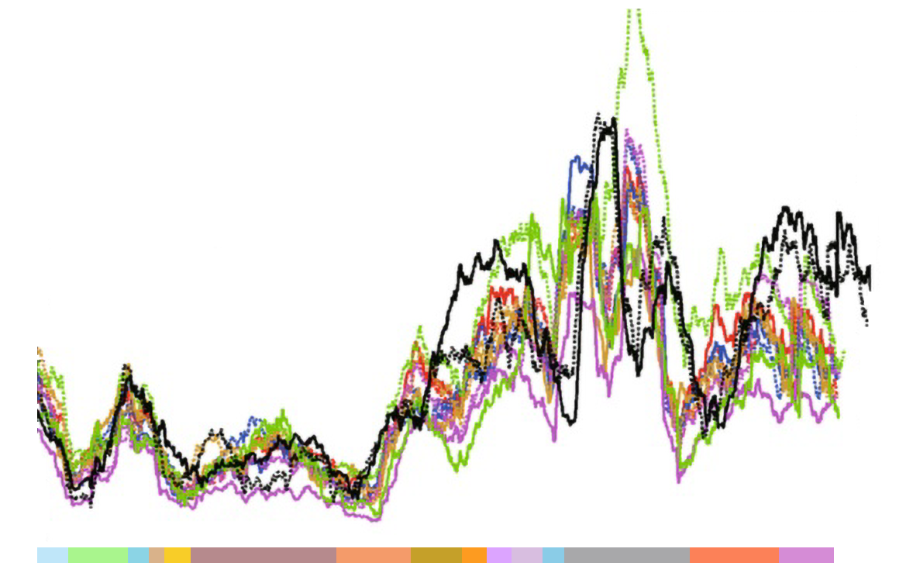

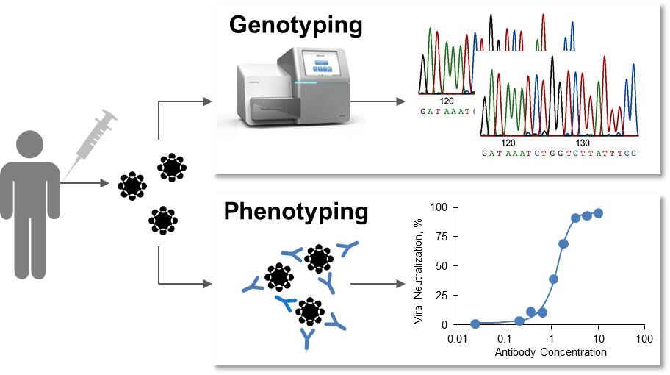
Introduction and Methods
HIV env diversity¹ presents a clinical challenge for bNAbs
Genotyping and phenotyping for bNAb sensitivity
HIV-1 subtype B
HIV-1 subtype A1
HIV-1 subtype C
HIV-1 subtype D
HIV-1 subtype F1
HIV-1 subtype G
HIV-1 CRF 01_AE
HIV-1 CRF 02_AG
HIV-1 group N
HIV-1 group O
HIV-2 group A
HIV-2 group B
40
30
Amino Acid Diversity
20
10
0
MA
CA
NC
p6
PR
RT
IN
Vif
Vpr
Tat
Rev
Vpu
Env
Nef
HIV-1 Protein Region
Sensitivity to bNAbs is important for determining clinical efficacy
No standard method to screen HIV env for bNAb sensitivity has been established
Gilead Sciences investigational bNAbs EVM (elipovimab, derived from PGT121) and 3BNC117
Pre-ART plasma virus from 96 participants in the Zurich Primary HIV Infection Study (ZPHI) who initiated ART during primary HIV infection
GenoSure HIV envelope RNA Assay (NGS assay) and PhenoSense mAb Assay; bNAbs, broadly neutralizing antibodies; HIV env, HIV envelope; Elipovimab (EVM) is a V3 glycan antibody; 3BNC117 is a CD4-binding site antibody
1. Adapted from Li G, et al. Retrovirology 2015;12:18.

Slide 3
Identification of genotypic signatures to predict bNAb sensitivity
Elipovimab
Env amino acid positions | PPV (%)
No signature | 62
N332 | 75
N332/D325 | 80
N332/D325/H330 | 83
N332/D325/H330/T63 | 91
N332/D325/H330/T63/T320 | 93
N332/D325/H330/T63/T320/L179 | 97
3BNC117
Env amino acid positions | PPV (%)
No signature | 75
I201 | 78
I201/F353 | 84
I108/I201/F353 | 86
I108/I201/A281/F353 | 91
E102/I108/I201/A281/F353 | 92
E102/I108/I201/A281/V318/F353 | 93
Neutralization data combined with virus sequence information to identify HIV env amino acid positions important for sensitivity to elipovimab and 3BNC117
Positive Predictive Value (PPV), probability that a virus with a given signature is sensitive; Analysis based on 203 subtype B viruses for elipovimab and 234 subtype B viruses for 3BNC117;
HXB2 numbering used for HIV env amino acid positions; N332, N332 glycan N-X-S/T

Slide 4
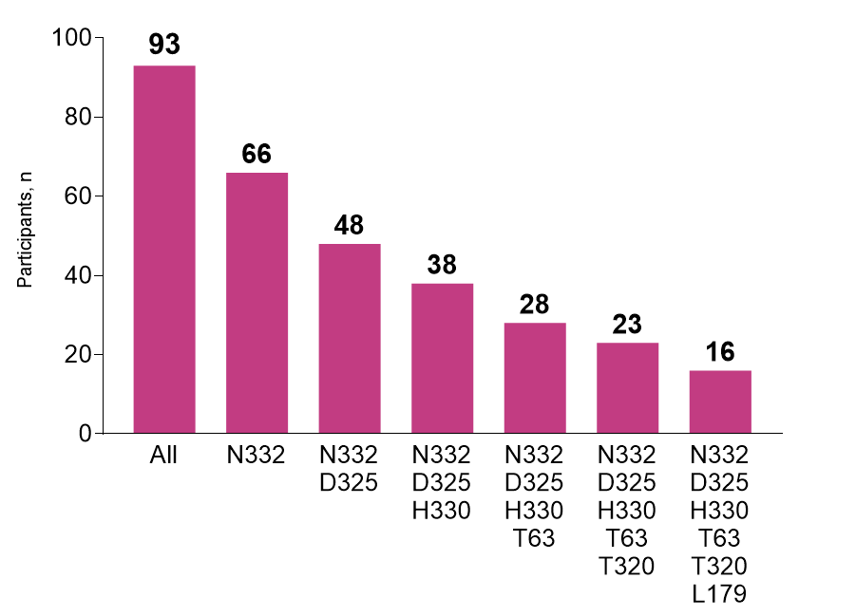
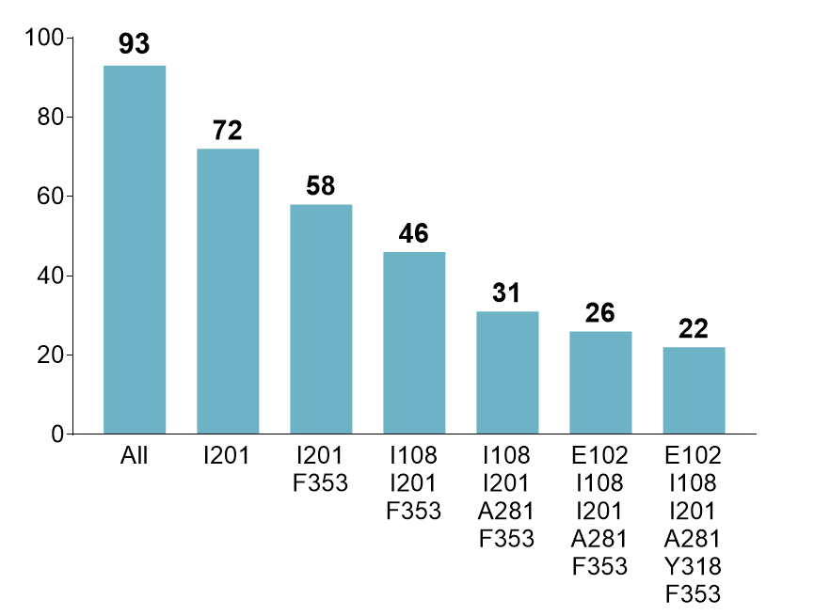
Prevalence of HIV env signatures by genotypic assessment
Elipovimab
3BNC117
Virus from ZPHI participants was genotyped and analyzed for the presence of the specified HIV env signatures
No sequence variability was permitted in the positions to qualify for a given HIV env signature
Pre-ART plasma virus were analyzed using the GenoSure HIV envelope RNA Assay; N332, N332 glycan N-X-S/T

Slide 5
Phenotypic assessment of bNAb sensitivity by viral neutralization
Elipovimab
3BNC117
79%
92%
62% (49/79) of participants have viruses sensitive to EVM
83% (65/78) of participants have viruses sensitive to 3BNC117
Virus from ZPHI participants was phenotyped for sensitivity to elipovimab and 3BNC117
ZPHI participants were categorized based on HIV env signatures
Pre-ART plasma virus was analyzed using the PhenoSense mAb Assay; IC₅₀, 50% inhibitory concentration; Viruses considered sensitive with IC₅₀ <1 µg/mL; N332, N332 glycan N-X-S/T

Slide 6
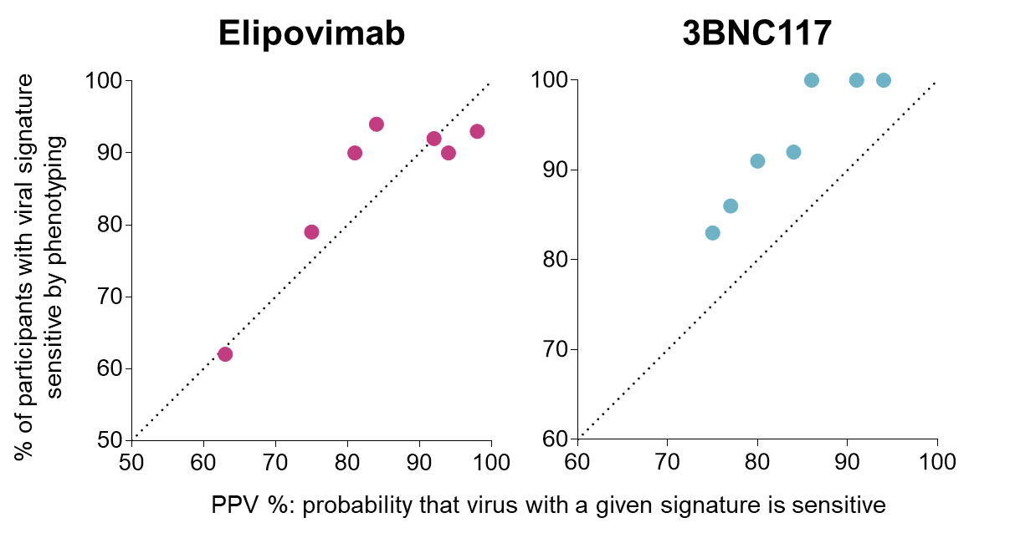
Virus sensitivity to bNAbs can be predicted with high probability by genotyping
Conclusions
Phenotypic assessment provides a direct measurement of virus sensitivity to bNAbs
Genotypic assessment can with high probability predict virus sensitivity to bNAbs
A significant number of the analyzed ZPHI participants have virus that is sensitive to these two investigational antibodies and could be potential participants in trials using these agents
Acknowledgments: We are grateful to the Zurich Primary HIV Infection Study participants and clinical study team
Gilead Sciences Inc, USA: PC Parvangada, Ross Martin, Craig Pace, Mini Balakrishnan, Nathan Thomsen, Sean Collins, Romas Geleziunas, and Christian Callebaut
University Hospital Zurich and University of Zurich, Switzerland: Herbert Kuster, Dominique L. Braun, and Huldrych F. Günthard

