Slide 1
TREATMENT AND OUTCOMES OF COVID-19 IN THE US: ARE THEY DIFFERENT ACCORDING TO RACE?
Essy Mozaffari
Gilead Sciences, Foster City, CA
Employment and stock options (Self)– Gilead Sciences

Slide 2
Introduction
Objective
Examine the use of COVID-19 treatments over time and by race in patients hospitalized with COVID-19 in the US
Examine length of stay (LOS), intensive care unit (ICU) LOS and mortality outcomes over time and by race in patients hospitalized with COVID-19
Methods
Data source: Premier Hospital Database– chargemaster inpatient data
Study design: Retrospective cohort study of adult patients hospitalized with COVID-19 between May-Nov 2020
Analysis: Treatment utilization and outcomes were examined descriptively over time and by race
LOS: Number of days in the hospital for all patients (including those that died)
Mortality: Identified from “expired” discharge status
Inclusion Criteria:
Admitted to the hospital between May-Nov 2020 (only the FIRST admission in this time period)
Age ≥18 years old
With a discharge primary or secondary diagnosis of COVID-19 (ICD-10-CM: U07.1)
Exclusion Criteria:
Pregnant women
Patients received RDV being part of a clinical trial/study
Patients had extended length of stay of > 100 days

Slide 3
Demographic Characteristics
 |  | Overall cohort | White 64% | Black 19% | Other¹ 13%
# of Hospitals |  | 823 | 808 | 655 | 636
# of Patients | N | 190,529 | 121,978 | 35,621 | 24,874
Age | Mean ± SD | 64 ± 17 | 66 ± 16 | 60 ± 16 | 58 ± 17
Age Group | 18-34 | 6% | 5% | 8% | 9%
 | 35-49 | 15% | 12% | 17% | 23%
 | 50-64 | 28% | 25% | 33% | 32%
 | 65+ | 51% | 58% | 42% | 36%
Gender | Female | 47% | 47% | 52% | 43%
Primary Payor | Commercial | 24% | 23% | 25% | 27%
 | Medicare | 53% | 59% | 50% | 34%
 | Medicaid | 12% | 9% | 16% | 22%
 | Other Payor | 10% | 9% | 9% | 17%
Black patients:
Higher proportion in South (69% vs. 51% White)
Lower proportion in Mid-West (18% vs. 27% White) and West (4% vs. 13% White)
Other races:
Higher proportion in Northeast (17% vs. 9% White) and West (28% vs. 13% White)
Lower proportion in Mid-West (14% vs. 27% White) and South (40% vs. 51% White)
*US national Racial distribution- 76% White, 13% Black, ref: https://www.census.gov/quickfacts/fact/table/US#
¹Other races include Asian, American Indian or Alaska Native, Native Hawaiian or Pacific Islander; patients with unknown race are excluded

Slide 4
Comorbidities greater than 5%
 |  | Overall cohort | White 64% | Black 19% | Other¹ 13%
# of Patients | N | 190,529 | 121,978 | 35,621 | 24,874
Key comorbidities | Chronic pulmonary disease | 23% | 25% | 23% | 16%
 | Hypertension | 69% | 70% | 78% | 59%
 | Obesity | 32% | 31% | 37% | 28%
 | Renal disease | 23% | 22% | 30% | 17%
 | Diabetes | 13% | 13% | 14% | 14%
 | Congestive Heart Failure | 18% | 19% | 20% | 12%
 | Dementia | 13% | 15% | 12% | 7%
 | Myocardial Infarction | 9% | 9% | 8% | 7%
 | Cerebrovascular disease | 6% | 5% | 8% | 5%
¹Other races include Asian, American Indian or Alaska Native, Native Hawaiian or Pacific Islander; patients with unknown race are excluded

Slide 5
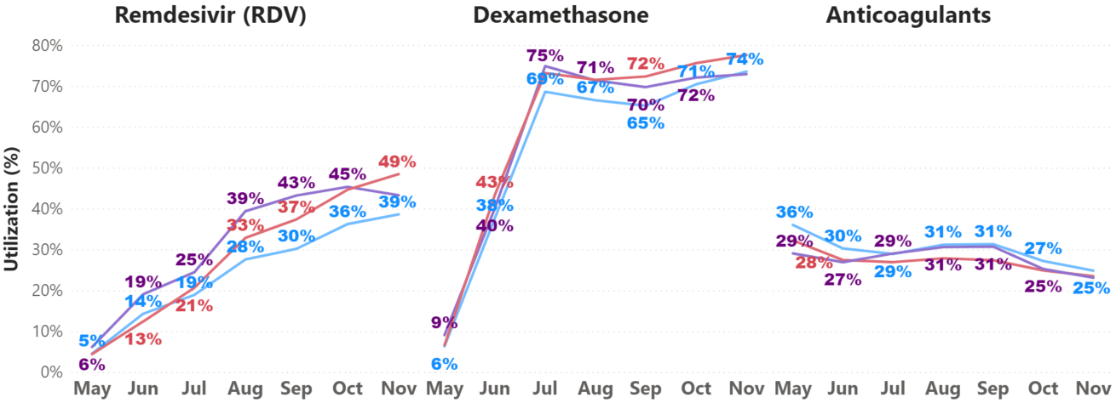
COVID-19 treatment utilization over time
RDV use increased approximately 10-fold over time
There was a rapid increase in use of Dexamethasone between May-Jun, followed by consistent utilization till Nov
A slow decline in use of anticoagulant treatments was observed over time
No major differences in these trends were observed by race
Few patients received tocilizumab (5%), sarilumab (0.02%) and baricitinib (0.003%) in the overall cohort

Slide 6
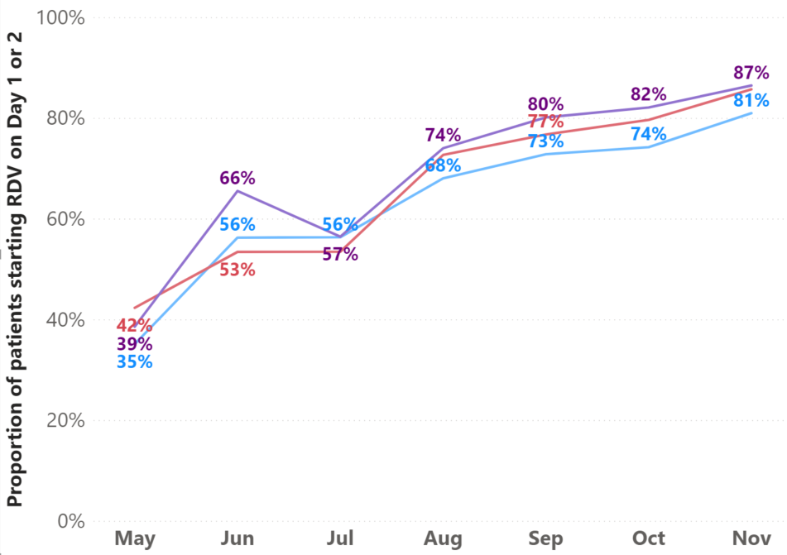
Initiation of RDV on day 1 or 2 of hospitalization over time
Among all RDV patients, initiation of RDV on day 1 or 2 of hospitalization increased over two-fold from May to Nov

Slide 7
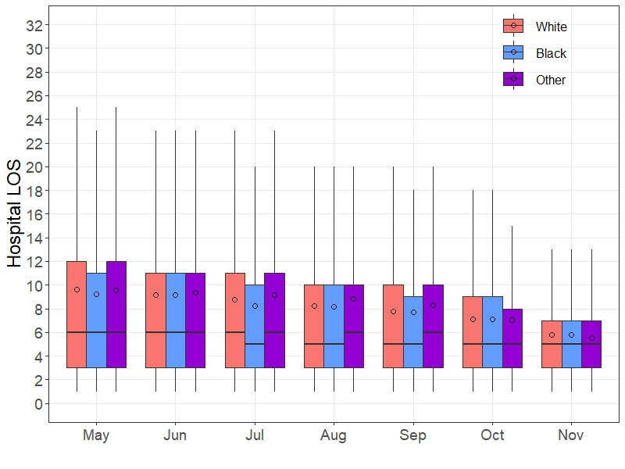
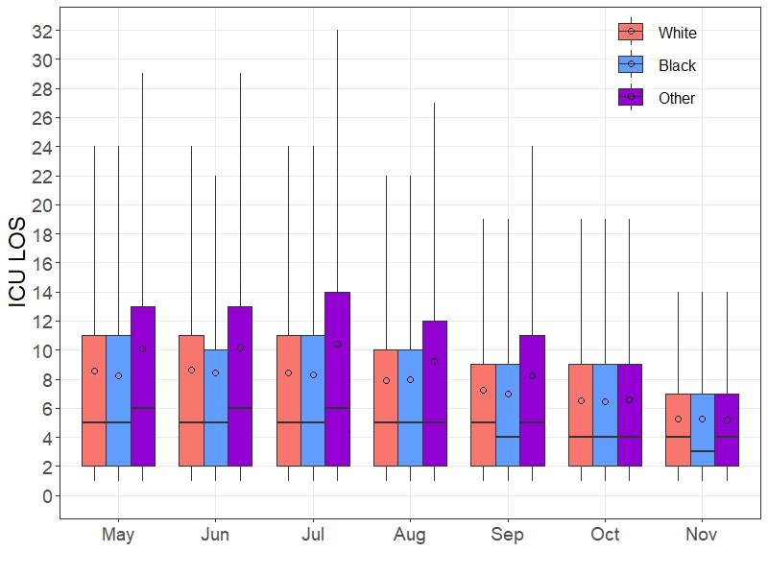
Hospital LOS and ICU LOS over time
Hospital LOS, by race
ICU LOS, by race
Median
○ Mean
Box IQR
Median
○ Mean
Box IQR
6
6
6
5
5
6
5
5
5
4
4
3
From May to Nov, reductions in hospital LOS from 6 days to 5 days across all races was observed
During this time, ICU LOS decreased from 5 days to 4 days for White patients, 5 days to 3 days for Black patients and 6 days to 4 days for other races

Slide 8
In-hospital all-cause mortality over time
Overall in-hospital mortality rate decreased by 35% for the overall cohort
In-hospital mortality rate decreased by 38% in Black patients; 38% in White patients; 33% in other races

Slide 9
Conclusion
Among patients hospitalized with COVID-19 in the US, use of RDV increased approximately 10-fold from May to Nov. A similar increase was observed with dexamethasone utilization.
Among RDV patients, initiation of RDV on day 1 or 2 of the hospitalization increased more than two-fold during this time.
Over this time period, a 35% reduction in mortality, a 17% reduction in LOS and 20% reduction in ICU stay were observed.
Similar treatment trajectories and outcomes patterns over time were observed in Black, White, and other races.
Further analyses are required to understand the association between practice patterns, treatments, and outcomes.

Slide 10
TREATMENT AND OUTCOMES OF COVID-19 IN THE US: ARE THEY DIFFERENT ACCORDING TO RACE?
Essy Mozaffari¹, Aastha Chandak², Shuting Liang¹, Julie Gayle³, Mark Thrun¹, Paul Hodgkins¹, Richard H. Haubrich¹
¹Gilead Sciences, Foster City, CA; ²Certara, New York, NY; ³Premier Inc., Charlotte, NC
¹Employment and stock options (Self)– Gilead Sciences
²Employment and stock options (Self)– Certara
³Employment (Self)– Premier, Inc.

Slide 11
Back-up

Slide 12
Hospital characteristics
 |  | Overall cohort | White 64% | Black 19% | Other¹ 13%
# of Hospitals |  | 823 | 808 | 655 | 636
# of Patients | N | 190,529 | 121,978 | 35,621 | 24,874
Hospital setting | Urban | 86% | 85% | 87% | 92%
 | Rural | 14% | 15% | 13% | 8%
Teaching status | Teaching | 43% | 40% | 46% | 48%
 | Non-teaching | 57% | 60% | 54% | 52%
Region | Midwest | 23% | 27% | 18% | 14%
 | Northeast | 10% | 9% | 9% | 17%
 | South | 53% | 51% | 69% | 40%
 | West | 13% | 13% | 4% | 28%
Bed size | <100 | 7% | 8% | 5% | 4%
 | 100-499 | 61% | 62% | 59% | 65%
 | 500+ | 32% | 30% | 36% | 31%
¹Other races include Asian, American Indian or Alaska Native, Native Hawaiian or Pacific Islander or unknown; patients with unknown race are excluded

