Slide 1
ACTIVITY AND RESISTANCE CHARACTERIZATION OF THE HIV CAPSID INHIBITOR LENACAPAVIR
Laurie VanderVeen, Ph.D.
Gilead Sciences
Foster City, CA / USA
Employment at and stock/stock options in Gilead Sciences

Slide 2
Lenacapavir (LEN): First-in-Class HIV Capsid Inhibitor
Capsid
assembly
Capsid (CA)
Reverse transcriptase
Virus
production
Integrase
Gag/Gag-Pol
(capsid precursors)
Capsid disassembly and nuclear transport
HIV RNA
HIV DNA
LEN

Slide 3
LEN: First-in-Class HIV Capsid Inhibitor
Favorable in vitro pharmacology profile:
  Potent antiviral activity (30–100 pM), with high selectivity (>140,000) ¹
  Activity against mutants resistant to existing ARV classes^{1,2}
In Phase 1b clinical study, potent antiviral activity observed with 10-day single-dose monotherapy^{1,3}
  Up to 2.3 log₁₀ decline in HIV RNA
Currently in clinical development as component of long-acting regimen for the treatment of HIV-1 infection
  Presentation 2228: Segal-Maurer et al.
LEN
1. Link, Nature 2020; 2. Margot, Antimicrob Agents Chemother (in press); 3. Daar, CROI 2020.

Slide 4
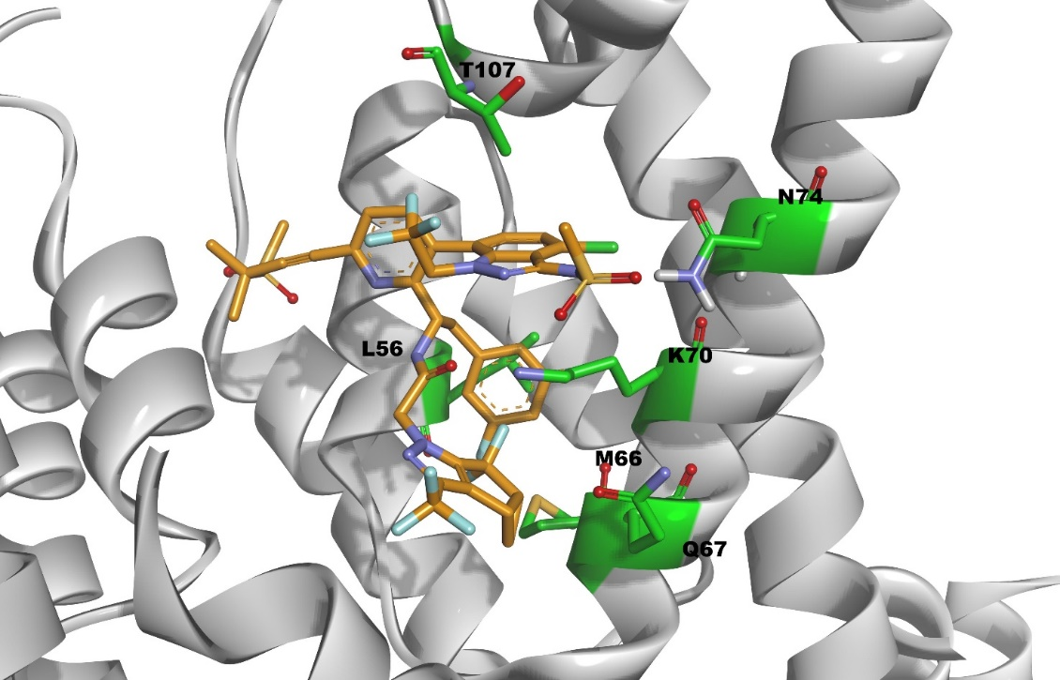
Capsid Resistance Mutations Map to LEN Binding Site
In vitro resistance selections in MT-2 cells and human PBMCs identified 7 mutations arising at 6 amino acids in capsid¹
  L56I, M66I, Q67H, K70N, K74S/D, T107N
  All mutations map to LEN binding site
Resistance correlated with low replication capacity for all mutants, except Q67H
LEN mutations not found in analysis of 1500 HIV clinical isolates²
  Treatment-naïve or -experienced, with or without PI-treatment failure
  Lack of pre-existing genotypic resistance to LEN
PBMC, peripheral blood mononuclear cell; PI, protease inhibitor.
1. Link, Nature 2020; 2. Marcelin, J Antimicrob Chemother 2020.

Slide 5
Multi-Assay Characterization of LEN Resistance Mutations
9 Site-directed Mutants
(single and double)
MT-2
CD4+ T Cell
MT-2
PhenoSense
Gag-Pro Assay
(HEK293)
Single-cycle
(SC)
Multi-cycle
(MC)
Multi-cycle
(MC)
Single-cycle
(SC)
In-house¹
In-house¹
In-house
Monogram
1. Link, Nature 2020.

Slide 6
LEN-Selected Mutations Confer Reduced Susceptibility to LEN
PhenoSense Gag-Pro (Single-cycle) vs. MT-2 (Single-cycle)
 | PhenoSense Gag-Pro (SC)
HIV-1 Capsid Sequence | LEN Fold-Resistanceª | Replication capacity, % WT^{b}
T107N | 3.8 | 32
Q67H | 4.8 | 58
N74D | 16 | ND
Q67H+N74S | 20 | 15
Q67H+T107N | 87 | ND
L56I | 204 | 3.6
Q67H+M66I | 1,594 | ND
Q67H+N74D | >2,700 | ND
M66I | >2,700 | 1.5
Log₁₀ Fold-Resistance
MC, multi-cycle; ND, not determined; SC, single cycle; WT, wild-type.
Ratio of Mutant/WT EC₅₀, determined with SC reporter HIV-1 in PhenoSense Gag-Pro assay.
Percentage of reference strain, determined with SC reporter HIV-1 in PhenoSense Gag-Pro assay.
1. Link, Nature 2020; Yant, IAS 2019. PhenoSense Gag-Pro: overlapping data with MT-2 assay available for 8 of 9 mutants.

Slide 7
Consistent Mutation Phenotype Across Assays
MT-2 (Multi-cycle) vs. PhenoSense Gag-Pro (Single-cycle)
Log₁₀ Fold-Resistance
HIV-1 Capsid Sequence | MT-2 (MC)
 | LEN Fold-Resistanceª
T107N | 4.4
Q67H | 5.8
Q67H+N74S | 9.3
N74D | 15.9
Q67H+T107N | 84.4
Q67H+N74D | 339.5
L56I | ND
M66I | ND
Q67H+M66I | ND
MC, multi-cycle; ND, not determined; SC, single cycle.
a. Ratio of Mutant EC₅₀/WT EC₅₀ determined with replication competent HIV-1 in MT-2 (human T cell line).
MT-2: Overlapping data with PhenoSense Gag-Pro assay available for 6 of 9 mutants.

Slide 8
LEN Resistance Mutations Are Associated with Reduced Viral Fitness
PhenoSense Gag-Pro (Single-cycle) vs. CD4+ T cell (Multi-cycle)
 | PhenoSense Gag-Pro (SC)
HIV-1 Capsid Sequence | LEN Fold-Resistanceª | Replication capacity, % WT^{b}
T107N | 3.8 | 32
Q67H | 4.8 | 58
N74D | 16 | ND
Q67H+N74S | 20 | 15
Q67H+T107N | 87 | ND
L56I | 204 | 3.6
Q67H+M66I | 1,594 | ND
Q67H+N74D | >2,700 | ND
M66I | >2,700 | 1.5
Replication Capacity %
MC, multi-cycle; ND, not determined; SC, single cycle.
Ratio of Mutant/WT EC₅₀, determined with SC reporter HIV-1 in PhenoSense Gag-Pro assay.
Percentage of reference strain, determined with SC reporter HIV-1 in PhenoSense Gag-Pro assay.
1. Link, Nature 2020; Yant, IAS 2019. Gag-Pro: overlapping data with CD4+ T cell MC assay available for 3 of 9 mutants.

Slide 9
LEN is Active Against PI-Resistant Clinical Isolates
Treatment Naïve (n=15)
Treatment Experienced (n=36)
LEN
DRV
ATV
LEN
DRV
ATV
CAI
PI
CAI
PI
Lack of pre-existing phenotypic resistance to LEN regardless of treatment history
Margot, Antimicrob Agents Chemother (in press).
34 of 36 treatment-experienced isolates with ≥ 1 primary PI-resistance mutation (average number of primary PI-R mutations = 4).

Slide 10
LEN Resistance-Associated Mutants Are Sensitive to PIs
PhenoSense Gag-Pro (SC)
MT-2 (MC)
LEN
LEN RAMs
MC, multi-cycle; SC, single cycle. MT-2 assay: data available for 6 of 9 mutants.
Fold-resistance: Ratio of Mutant/WT EC₅₀, determined with SC reporter HIV-1 (PhenoSense Gag-Pro) or with replication competent HIV-1 (MT-2 MC).

Slide 11
LEN Resistance-Associated Mutants Are Sensitive to PIs
PhenoSense Gag-Pro (SC)
MT-2 (MC)
LEN
DRV
ATV
LEN RAMs
MC, multi-cycle; SC, single cycle. MT-2 assay: data available for 6 of 9 mutants.
Fold-resistance: Ratio of Mutant/WT EC₅₀, determined with SC reporter HIV-1 (PhenoSense Gag-Pro) or with replication competent HIV-1 (MT-2 MC).

Slide 12
LEN Displays Similar Activity Against All HIV-1 Subtypes
EC₅₀, nM
EC₅₀ range, nM
LEN
0.148–0.357
HIV-1 Subtypes
EC₅₀ values determined with PhenoSense Gag-Pro assay. n=37 clinical isolates.
Each dot represents an individual isolate; solid lines represent geometric mean EC₅₀ for each subtype; dotted lines indicate geometric mean EC₅₀ for all subtypes tested.

Slide 13
LEN Displays Similar Activity Against All HIV-1 Subtypes
EC₅₀ range, nM
EC₅₀, nM
DRV
0.209–2.74
LEN
0.148–0.357
HIV-1 Subtypes
EC₅₀ values determined with PhenoSense Gag-Pro assay. n=37 clinical isolates.
Each dot represents an individual isolate; solid lines represent geometric mean EC₅₀ for each subtype; dotted lines indicate geometric mean EC₅₀ for all subtypes tested.

Slide 14
LEN Displays Similar Activity Against All HIV-1 Subtypes
EC₅₀ range, nM
ATV
2.47–14.5
EC₅₀, nM
DRV
0.209–2.74
LEN
0.148–0.357
HIV-1 Subtypes
EC₅₀ values determined with PhenoSense Gag-Pro assay. n=37 clinical isolates.
Each dot represents an individual isolate; solid lines represent geometric mean EC₅₀ for each subtype; dotted lines indicate geometric mean EC₅₀ for all subtypes tested.

Slide 15
Conclusions
Across in vitro test systems, LEN resistance mutations:
  Demonstrated consistent phenotypes across single- and multi-cycle assay formats
  Showed similar phenotypes in primary cells and cell lines, including the Gag-Pro assay
  Exhibited inverse relationship between resistance and fitness for both single and double RAMs
  Showed no evidence of cross-resistance with PIs
LEN susceptibility similar across all major HIV-1 subtypes
  A, A1, AE, AG, B, BF, C, D, E*, F*, G, H
  * combined with earlier study (Link, Nature 2020)
Genotypic and Phenotypic assays (Gag-Pro Assay) are used to support ongoing clinical trials and clinical management of LEN drug resistance

Slide 16
Acknowledgments
Clinical Virology
Nicolas Margot
Vidula Naik
Renee Ram
Christian Callebaut
Discovery Virology
Stephen Yant
Andrew Mulato
Derek Hansen
Tomas Cihlar
Clinical Research
Martin Rhee
Structural Chemistry
Uli Schmitz
Partners
Monogram Biosciences

