Slide 1
Lenacapavir with bNAbs Teropavimab (GS-5423) and Zinlirvimab (GS-2872) Dosed Every 6 Months in People with HIV
¹Joseph Eron, ²Susan J. Little, ³Gordon Crofoot, ⁴Paul Cook, ⁵Peter J. Ruane, ⁶Dushyantha Jayaweera, ⁷Edwin DeJesus, ⁸Sarah E. Waldman, ⁹Megha L. Mehrotra, ⁹Laurie VanderVeen, ⁹Hailin Huang, ⁹Sean Collins, ⁹Jared Baeten, ¹⁰Marina Caskey
¹UNC, Chapel Hill, NC; ²University of California, San Diego, San Diego, CA; ³CrofootMD Clinic and Research Center, Houston, TX; ⁴East Carolina University, Greenville, NC; ⁵Ruane Clinical Research, Los Angeles, CA; ⁶University of Miami Miller School of Medicine, Miami, FL; ⁷Orlando Immunology Center, Orlando, FL; ⁸University of California, Davis, Davis CA; ⁹Gilead Sciences, Inc., Foster City, CA; ¹⁰Rockefeller University, New York, NY
Presenting Author Disclosure: Joseph Eron is a consultant with Gilead Sciences, Inc., ViiV Healthcare, and Merck. He is also an investigator for Gilead Sciences, Inc., and ViiV Healthcare.
CROI 2023, 19–22 February, Seattle, Washington: Oral #193

Slide 2
Acknowledgments
We extend our thanks to the study participants, their families, site staff, and all participating investigators.
This study was funded by Gilead Sciences, Inc.
Editing and production assistance were provided by Impact Communication Partners (West Hartford, CT), funded by Gilead Sciences, Inc.

Slide 3
Background
Teropavimab (TAB; GS-5423; 3BNC117-LS) and zinlirvimab (ZAB; GS-2872; 10-1074-LS) are broadly neutralizing antibodies (bNAbs) against the CD4-binding site of gp120 and a non-overlapping epitope on the V3 glycan of HIV-1 Env, respectively.
Both antibodies were modified to extend their half-lives for long-acting therapy that may allow for dosing every 6 months.
An estimated > 50% of clade B viruses are highly susceptible to both bNAbs and > 90% are highly susceptible to either bNAb with a 90% inhibitory concentration (IC₉₀) < 2 µg/mL.¹
V3-Glycan
CD4-binding site
¹Yoon H, et al. CATNAP: a tool to compile, analyze and tally neutralizing antibody panels. Nucleic Acid Res. 2015 Jul 1;43(W1):W213-9. PMID 26044712.

Slide 4
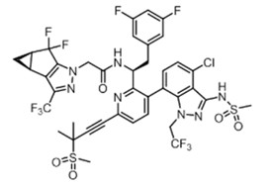
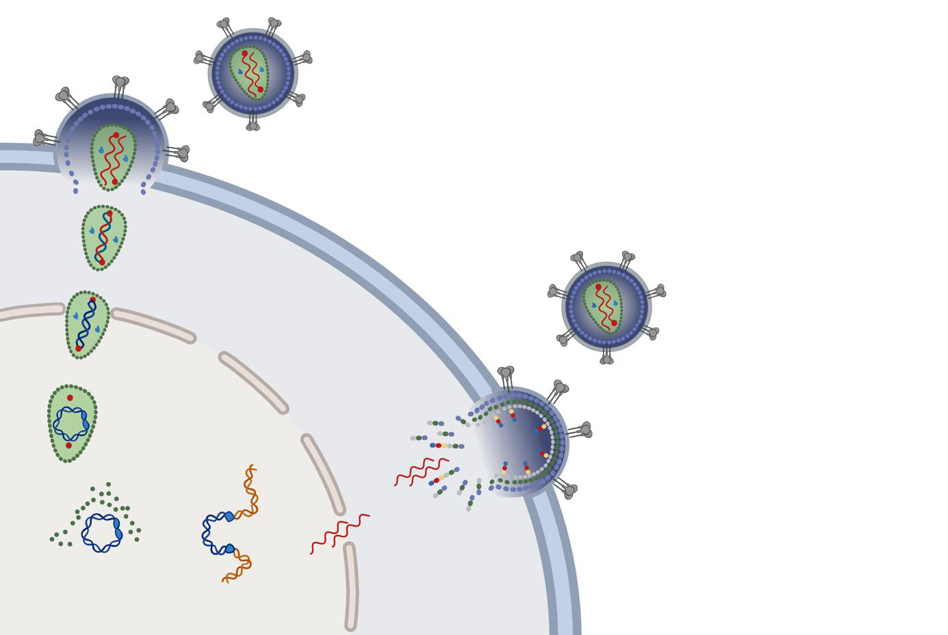
Background (cont’d)
HIV particle
Lenacapavir (LEN) is a first-in-class, small molecule capsid inhibitor with:
Multimodal mechanism, a long half-life and low potential for drug-drug interactions
Subcutaneous administration every 6 months
LEN plus an optimized background regimen has demonstrated clinical efficacy in highly treatment experienced patients with multidrug resistant HIV-1 infection failing antiretroviral regimen.
Virus Entry
LEN (GS-6207)
Reverse Transcription
CYTOPLASM
Nuclear Entry and Capsid Disassembly
Maturation
We investigated whether LEN in combination with TAB and ZAB can maintain HIV suppression for 6 months.
Assembly & Budding
NUCLEUS
Integration

Slide 5
Study Design
Randomized, blinded phase 1b study assessing safety and efficacy of a long-acting regimen LEN + TAB + ZAB administered in two different doses.¹ (NCT04811040)
Original Study Design
Key Inclusion Criteria
Adults living with HIV-1
Virologically suppressed ≥ 18 months²
Viral susceptibility to both TAB and ZAB³
CD4 nadir ≥ 350
CD4 at entry ≥ 500
Dosing
Week 0 26 52 …//… 104
Group 1: LEN + TAB 30 mg/kg + ZAB 10 mg/kg
Restart ART and Continued Follow-up
1:1
Group 2: LEN + TAB 30 mg/kg + ZAB 30 mg/kg
1◦ endpoint W26
HIV RNA measured at least every 4 weeks until Week 52.
¹ The same dose of LEN and TAB were administered to all participants without blinding.
² Previous virologic failure was allowed as long as participants had been suppressed for at least 18 months prior to screening.
³ Susceptibility defined as IC₉₀ ≤ 2 μg/mL to each antibody by PhenoSense mAb DNA assay (Monogram Biosciences).

Slide 6
Study Design
Randomized, blinded phase 1b study assessing safety and efficacy of a long-acting regimen LEN + TAB + ZAB administered in two different doses. (NCT04811040)
Study design was modified when LEN was unavailable due to temporary clinical hold (for storage vial compatibility).¹
Amended Study Design
Key Inclusion Criteria
Adults living with HIV-1
Virologically suppressed ≥ 18 months
Viral susceptibility to both TAB and ZAB
CD4 nadir ≥ 350
CD4 at entry ≥ 500
Dosing
Week 0 26 …//… 52
Group 1: LEN + TAB 30 mg/kg + ZAB 10 mg/kg
Restart ART and Continued Follow-up
1:1
Group 2: LEN + TAB 30 mg/kg + ZAB 30 mg/kg
 | Day 1 | Day 2
LEN oral 600 mg
LEN SC 927 mg |  | -
TAB IV 30 mg/kg |  | -
ZAB IV 10 mg/kg or 30 mg/kg |  | -
1◦ endpoint W26
HIV RNA measured at least every 4 weeks until Week 26.
¹ FDA lifts clinical hold on investigational lenacapavir for the treatment and prevention of HIV. Press release. May 16, 2022.

Slide 7
Participant Disposition
Screened (N = 124)
Met bNAb susceptibility criteria (N = 55)
Not enrolled (N = 34)
Clinical hold (N = 18)
Other eligibility criteria (N = 16)
Randomized (N = 21)
Assigned to
LEN + TAB + ZAB 10 mg/kg (N = 11)
Assigned to
LEN + TAB + ZAB 30 mg/kg (N = 10)
Withdrew¹ (N = 1)
Received full
treatment regimen (N = 10)
Received full
treatment regimen (N = 10)
All randomized participants were included in the safety analysis (N = 21); those who received the complete study regimens (oral LEN, SC LEN, and bNAbs) are included in the efficacy analyses (N = 20).
¹ Participant received oral LEN and then withdrew consent prior to injections or infusions; they continued their baseline ART and are included in the safety analyses.

Slide 8
Participant Disposition
See Poster 580, Selzer et al. for full screening susceptibility details. Poster session: Monday 2/20, 2:30 PM to 4:00 PM
Screened (N = 124)
Met bNAb susceptibility criteria (N = 55)
Not enrolled (N = 34)
Clinical hold (N = 18)
Other eligibility criteria (N = 16)
Randomized (N = 21)
Assigned to
LEN + TAB + ZAB 10 mg/kg (N = 11)
Assigned to
LEN + TAB + ZAB 30 mg/kg (N = 10)
Withdrew¹ (N = 1)
Received full
treatment regimen (N = 10)
Received full
treatment regimen (N = 10)
All randomized participants were included in the safety analysis (N = 21); those who received the complete study regimens (oral LEN, SC LEN, and bNAbs) are included in the efficacy analyses (N = 20).
¹ Participant received oral LEN and then withdrew consent prior to injections or infusions; they continued their baseline ART and are included in the safety analyses.

Slide 9
Enrolled Participant Demographics and Baseline Characteristics
 |  | LEN + TAB + ZAB 10 mg/kg (N = 11) | LEN + TAB + ZAB 30 mg/kg (N = 10) | Total (N = 21)
Age, median (range) |  | 46 (31 to 61) | 37 (25 to 59) | 44 (25 to 61)
Sex at birth, n | Male | 11 | 7 | 18
 | Female | 0 | 3 | 3
Race, n | Asian | 2 | 1 | 3
 | Black | 1 | 2 | 3
 | White | 7 | 5 | 12
 | Other | 1 | 2 | 3
Hispanic or Latino ethnicity, n |  | 4 | 3 | 7
Weight (kg), median (range) |  | 90.2 (58.9 to 150.0) | 92.9 (60.2 to 143.0) | 90.2 (58.9 to 150.0)
Body mass index (kg/m²), median (range) |  | 30.2 (21.6 to 42.9) | 30.2 (21.6 to 54.1) | 30.2 (21.6 to 54.1)
CD4 cell count (per mL), median (range) |  | 778 (547 to 1391) | 1024 (667 to 1644) | 909 (547 to 1644)
Duration of baseline ART (years), median (range) |  | 3.6 (2.4 to 4.8) | 2.6 (2.0 to 5.5) | 2.6 (2.0 to 5.5)
Time since HIV diagnosis (years), median (range) |  | 12.4 (6.4 to 26.3) | 5.3 (2.6 to 22.4) | 8.2 (2.6 to 26.3)

Slide 10
Virologic Efficacy Outcomes at Week 26 by FDA Snapshot Algorithm
18 out of 20 participants maintained viral suppression on study regimen through Week 26.
One participant withdrew¹ at Week 12 with HIV-1 RNA < 50 copies/mL.
One participant had a confirmed virologic rebound at Week 16 and was resuppressed on baseline oral ART.
¹ Participant withdrew due to personal decision.

Slide 11
Safety and Tolerability
 | LEN + TAB + ZAB 10 mg/kg (N = 11) | LEN + TAB + ZAB 30 mg/kg (N = 10) | Total (N = 21)
Any adverse event (AE), n | 9 | 10 | 19
AEs of any grade occurring in 3 or more study participants
Injection-site pain, n | 5 | 5 | 10
Injection-site erythema, n | 4 | 3 | 7
Injection-site nodule, n | 4 | 2 | 6
Injection-site induration, n | 2 | 4 | 6
Injection-site mass, n | 3 | 1 | 4
COVID-19, n | 3 | 0 | 3
Upper respiratory tract infection, n | 3 | 0 | 3
There were no serious AEs, Grade 4 AEs, or AEs that led to study treatment discontinuation.
There were two Grade 3 AEs:
One injection-site cellulitis on Day 1, resolved with antibiotics
One injection-site erythema on Day 3, resolved without intervention by Day 10
One participant experienced a Grade 1 infusion-related reaction of pyrexia with flushing, which resolved without treatment.
There were no clinically meaningful treatment-emergent lab abnormalities ≥ Grade 3.
n = number of participants.

Slide 12
Change From Baseline by Visit in CD4 Cell Count in All Participants
Max
Q3
Median
Q1
Min
Number of Participants: | 20 | 18 | 18
CD4 cell counts remained stable over the course of the study period.

Slide 13
Pharmacokinetics of Teropavimab, Zinlirvimab, and Lenacapavir
TAB
TAB 30 mg/kg, median (Q1,Q3)
1000
100
Serum levels (μg/mL)
10
2 μg/mL¹
1
0
4
8
12
16
20
24
26
Time (weeks) from first dose
Therapeutic concentrations of TAB, ZAB, and LEN were maintained through Week 26.
¹ 2 μg/mL was the level required for sensitivity in the screening assay.

Slide 14
Pharmacokinetics of Teropavimab, Zinlirvimab, and Lenacapavir
TAB and ZAB
TAB and ZAB
TAB 30 mg/kg, median (Q1,Q3)
1000
ZAB 10 mg/kg, median (Q1,Q3)
100
Serum levels (μg/mL)
10
2 μg/mL¹
1
0
4
8
12
16
20
24
26
Time (weeks) from first dose
Therapeutic concentrations of TAB, ZAB, and LEN were maintained through Week 26.
¹ 2 μg/mL was the level required for sensitivity in the screening assay.

Slide 15
Pharmacokinetics of Teropavimab, Zinlirvimab, and Lenacapavir
TAB and ZAB
TAB 30 mg/kg, median (Q1,Q3)
1000
ZAB 10 mg/kg, median (Q1,Q3)
ZAB 30 mg/kg, median (Q1,Q3)
100
Serum levels (μg/mL)
10
2 μg/mL¹
1
0
4
8
12
16
20
24
26
Time (weeks) from first dose
Therapeutic concentrations of TAB, ZAB, and LEN were maintained through Week 26.
¹ 2 μg/mL was the level required for sensitivity in the screening assay.

Slide 16
Pharmacokinetics of Teropavimab, Zinlirvimab, and Lenacapavir
TAB and ZAB
LEN
TAB 30 mg/kg, median (Q1,Q3)
100
1000
ZAB 10 mg/kg, median (Q1,Q3)
100
ZAB 30 mg/kg, median (Q1,Q3)
100
10
Serum levels (μg/mL)
10
Plasma LEN (ng/mL)
IQ = 5 ng/mL
10
2 μg/mL¹
1
LEN, median (Q1,Q3)
1
1
0
4
8
12
16
20
24
26
0
4
8
12
16
20
24
26
Time (weeks) from first dose
Time (weeks) from first dose
Therapeutic concentrations of TAB, ZAB, and LEN were maintained through Week 26.
¹ 2 μg/mL was the level required for sensitivity in the screening assay.

Slide 17
HIV-1 RNA by Study Week in Participant with Viral Rebound
Rebound participant had baseline phenotypic susceptibility to teropavimab and zinlirvimab, and no pre-existing LEN resistance mutations were detected.
Resistance testing of rebound samples resulted in assay failure.
Participant’s CD4 count remained above 500 through Week 26.
The limit of quantification (LOQ) is 20 copies/mL. For the rebound participant, except for Weeks 16 and 18, HIV-1 RNA levels were < 20 copies/mL.

Slide 18
Pharmacokinetics in Participant with Viral Rebound
TAB and ZAB
LEN
TAB 30 mg/kg, median (Q1,Q3)
100
1000
ZAB 10 mg/kg, median (Q1,Q3)
100
Viral rebound
100
10
Serum levels (μg/mL)
10
Plasma LEN (ng/mL)
IQ = 5 ng/mL
10
Viral rebound
2 μg/mL¹
1
LEN, median (Q1,Q3)
1
1
0
4
8
12
16
20
24
26
4
8
12
16
20
24
26
Time (weeks) from first dose
Time (weeks) from first dose
TAB, ZAB, and LEN PK for virologic rebound participant was consistent with others in their dosing group.
¹ 2 μg/mL was the level required for sensitivity in the screening assay.

Slide 19
Conclusions
This study demonstrates that a combination of the bNAbs teropavimab and zinlirvimab together with lenacapavir can sustain viral suppression for 6 months in selected people with HIV.
18 out of 20 participants maintained suppression for 26 weeks after a single administration of the study regimen.
One withdrew after Week 12 with suppressed HIV RNA.
One had viral rebound at Week 16 and resuppressed after restarting his baseline ART.
LEN + TAB + ZAB was safe and well tolerated, mild (Grade 1) injection-site reactions were the most common adverse event.
LEN + TAB + ZAB may enable a complete twice-yearly HIV treatment regimen.
Phase 2 study (NCT05729568)

