Slide 1
Phase 3 Study of Fostemsavir in Heavily Treatment-Experienced HIV-1-Infected Participants: Day 8 and Week 24 Primary Efficacy and Safety Results (BRIGHTE Study, Formerly 205888/AI438-047)
M. Kozal¹, J. Aberg², G. Pialoux³, P. Cahn⁴, M. Thompson⁵, J.-M. Molina⁶, B. Grinsztejn⁷, R. Diaz⁸, A. Lazzarin⁹, M. Gummel¹⁰, A. Pierce¹¹, P. Ackerman¹², C. Llamoso¹², M. Lataillade¹²
¹Yale University School of Medicine, New Haven, United States, ²Icahn School of Medicine at Mount Sinai, New York, United States, ³Hopital Tenon, Paris, France, ⁴Fundación Huesped, Buenos Aires, Argentina, ⁵AIDS Research Consortium of Atlanta, Atlanta, United States, ⁶Hôpital Saint Louis, Paris, France, ⁷Instituto de Pesquisa Clínica Evandro Chagas FIOCRUZ, Rio De Janeiro, Brazil, ⁸Federal University of São Paulo, São Paulo, Brazil, ⁹Ospedale San Raffaele, Milan, Italy, ¹⁰GlaxoSmithKline, Upper Providence, United States, ¹¹ViiV Healthcare, Research Triangle Park, Branford, United States, ¹²ViiV Healthcare, Branford, United States

Slide 2
Financial Disclosures
Max Lataillade
Vice President, Head Clinical Development
ViiV Healthcare employee and GSK shareholder
Kozal et al. EACS 2017; Milan, Italy. Oral PS8/5.

Slide 3
Overview of Fostemsavir
Conversion of fostemsavir to temsavir¹
Fostemsavir (FTR) is a prodrug metabolised to temsavir (TMR),¹ a first-in-class, investigational attachment inhibitor that is currently being evaluated in HIV-1-infected HTE patients
Active against CCR5-, CXCR4- and dual-tropic (R5X4) strains of HIV-1^{2–5}
Unique resistance profile with no in vitro cross-resistance to other classes of ARVs^{2,5}
In the Phase 2b study AI438011, FTR demonstrated:⁶
Median decreases in plasma HIV-1 RNA of 0.69–1.44 log₁₀ c/mL in a 7-day lead-in monotherapy substudy
Generally similar virologic (mITT and observed) and immunologic responses to the ritonavir-boosted atazanavir arm through Week 96
A generally well-tolerated safety profile with no FTR-related AEs leading to discontinuation
Here we present Day 8 and Week 24 efficacy and safety results from the ongoing BRIGHTE study (formerly 205888/AI438-047)
Gastrointestinal lumen
Fostemsavir
(prodrug)
Alkaline phosphatase
Temsavir
(active moiety)
Temsavir
Blood plasma
HTE, heavily treatment experienced; ARV, antiretrovirals; AEs, adverse events; mITT, modified intent to treat.
1. Brown J et al. J Pharm Sci 2013; 102:1742–1751; 2. Nowicka-Sans B et al. AAC 2012; 56:3498–3507; 3. Ray N et al. JAIDS 2013; 64:7–15; 4. Zhou N et al. JAC 2014; 69:573–581; 5. Li Z et al. AAC 2013; 57:4172–4180; 6. DeJesus E et al., CROI 2016: Poster 472.
Kozal et al. EACS 2017; Milan, Italy. Oral PS8/5.

Slide 4
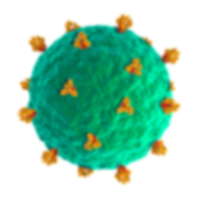
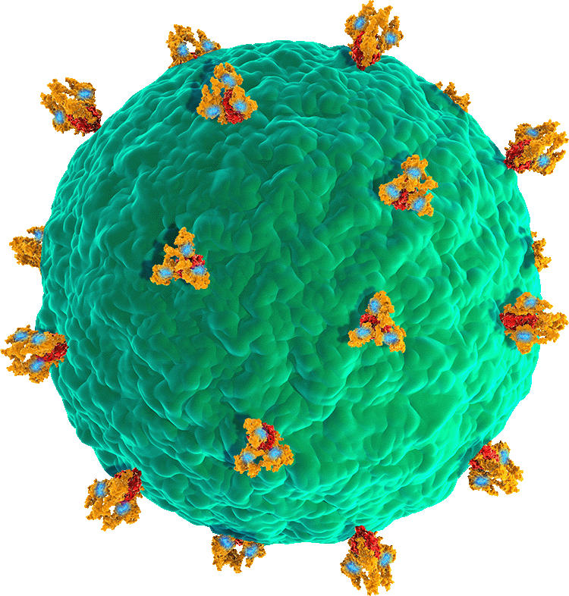
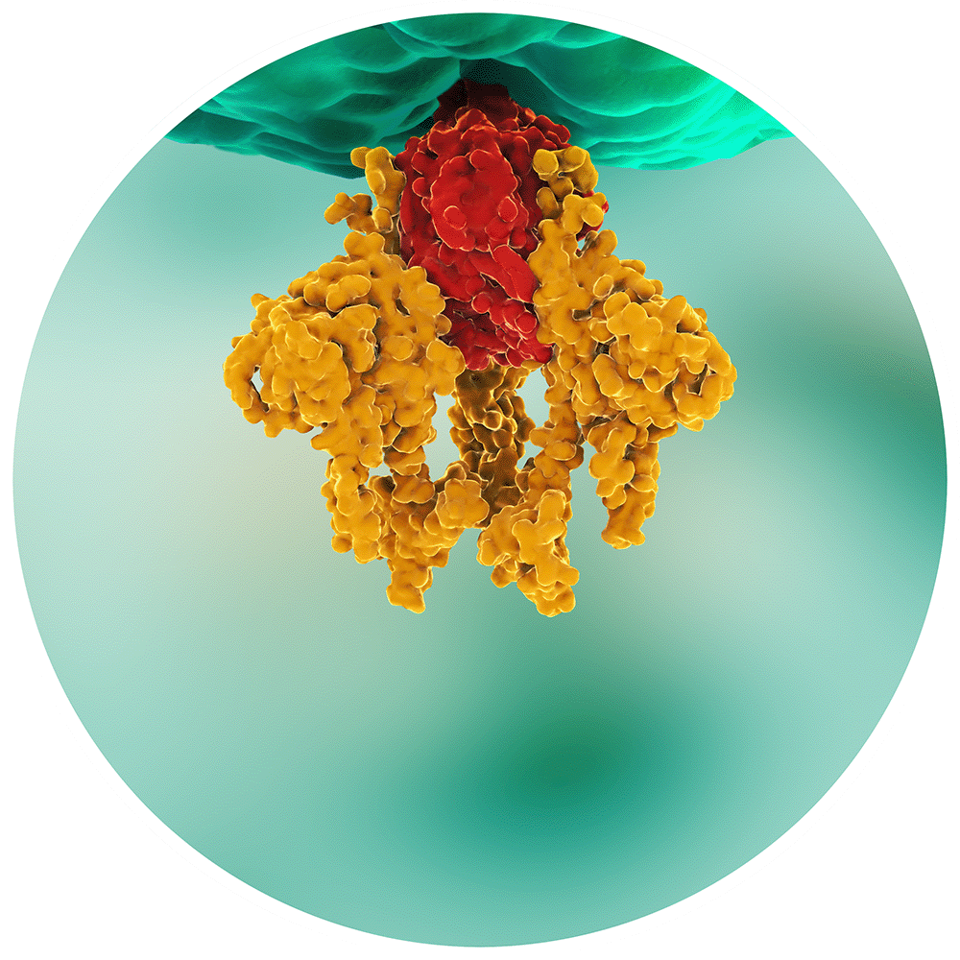
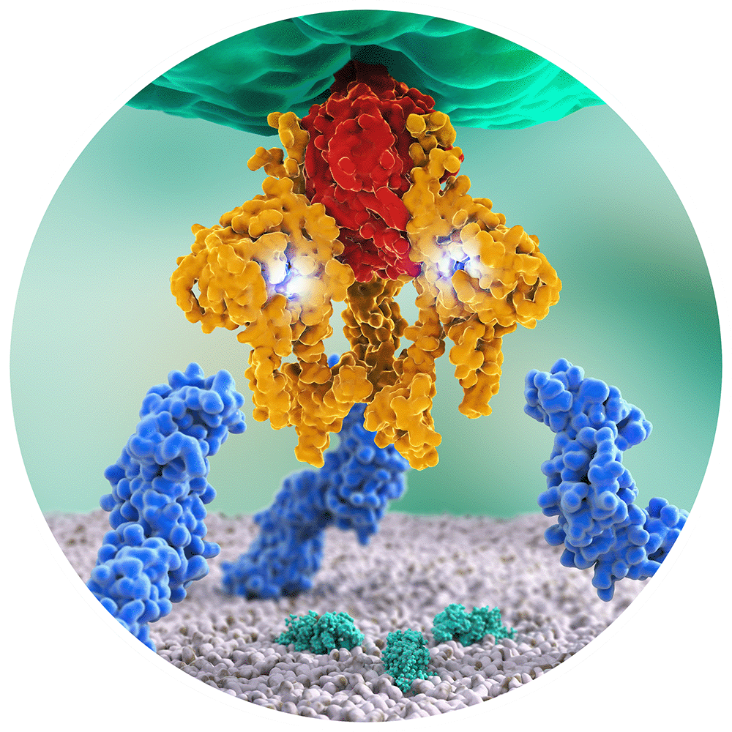
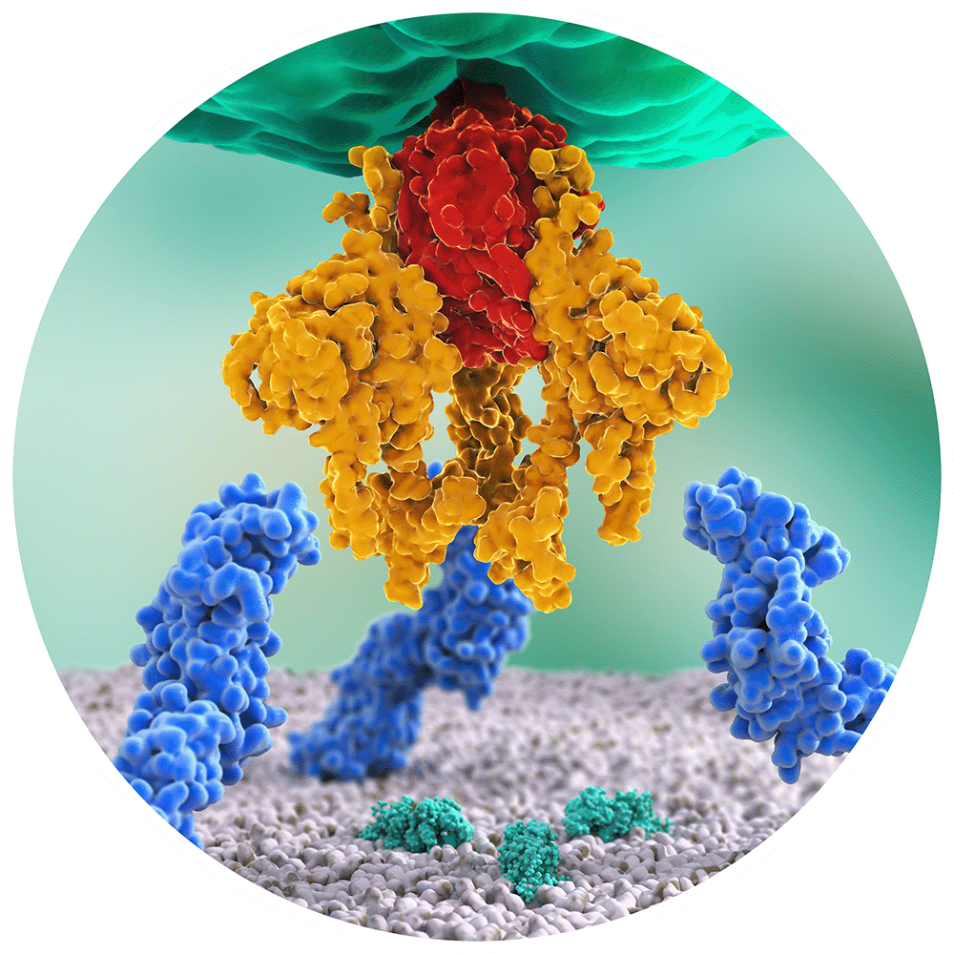
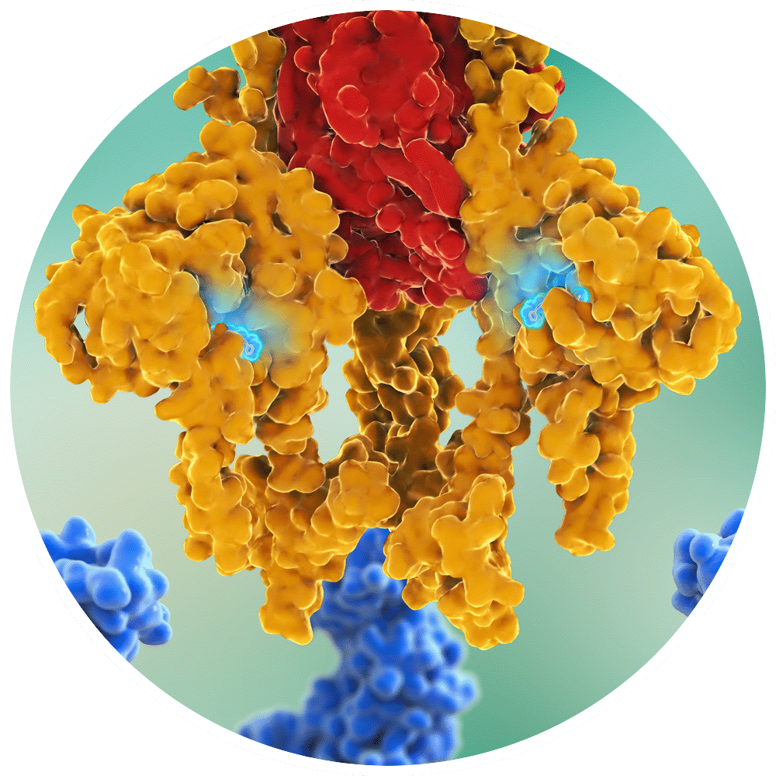
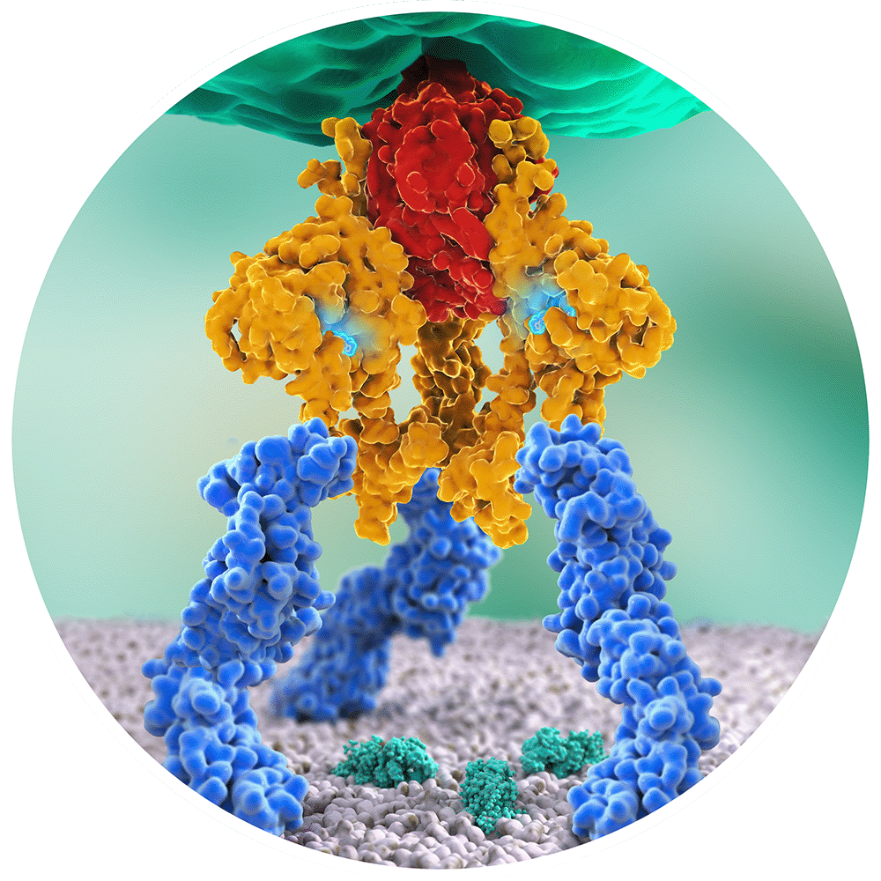
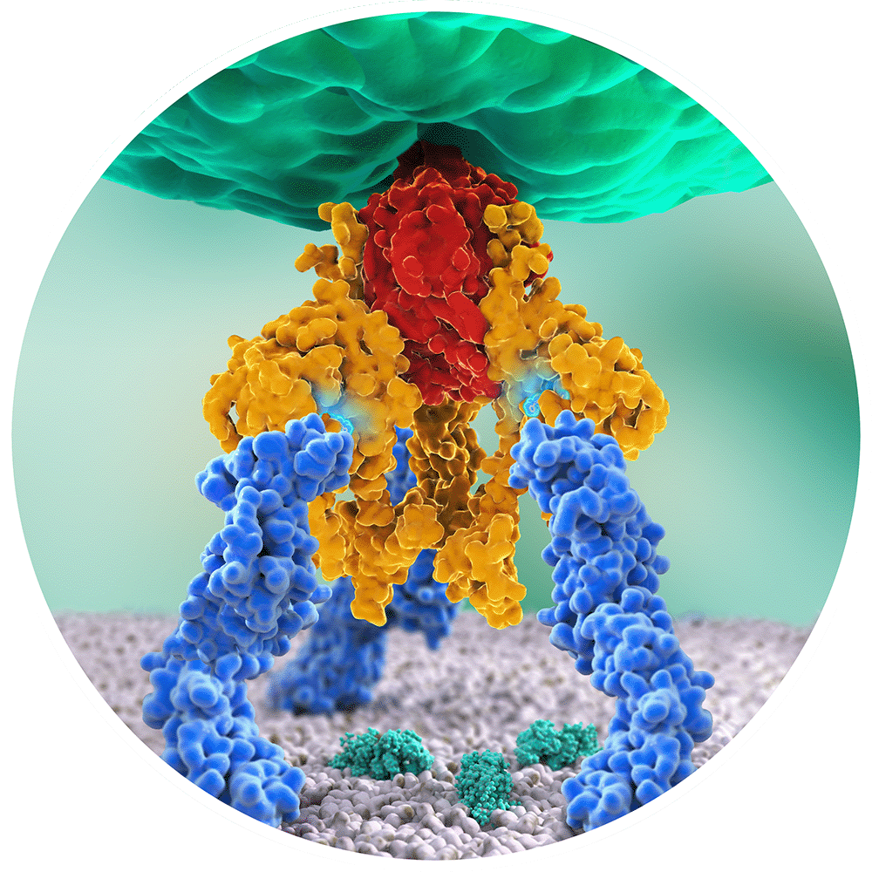
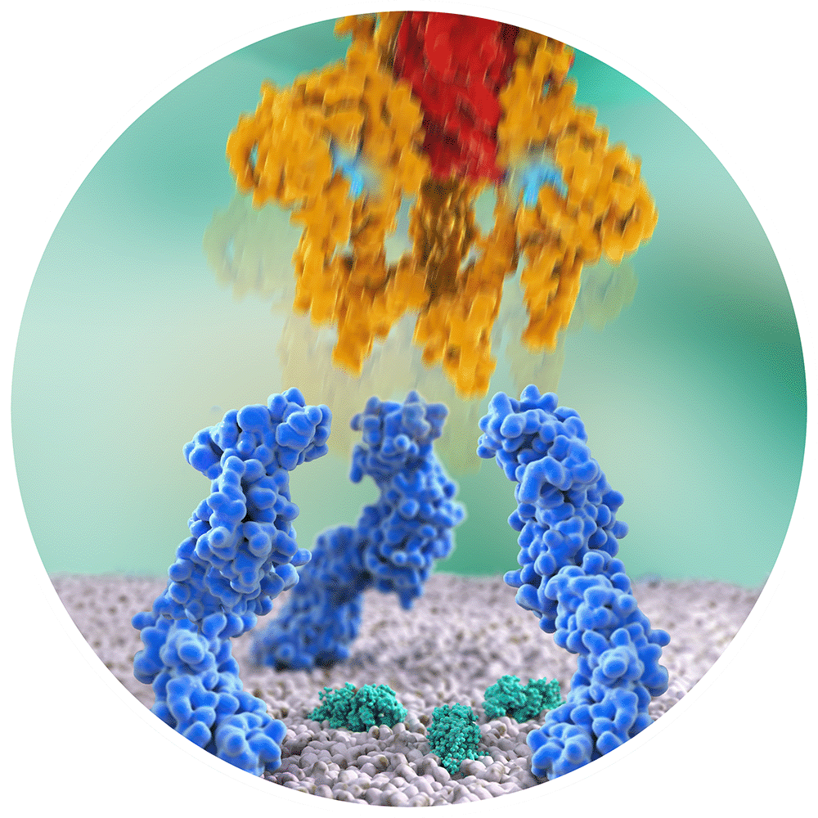
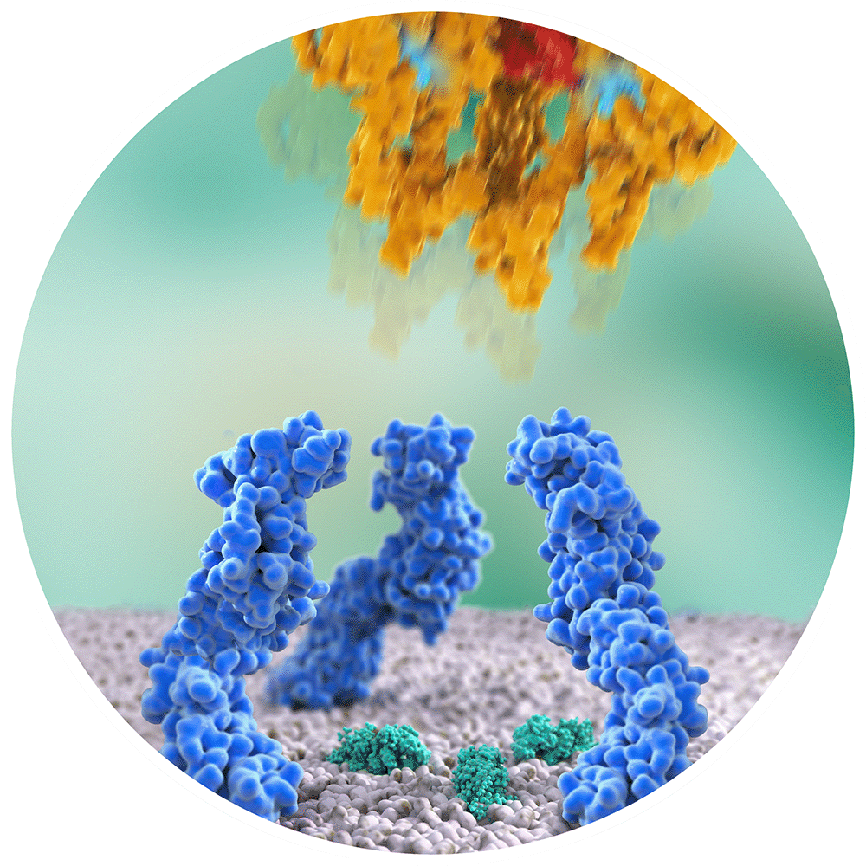
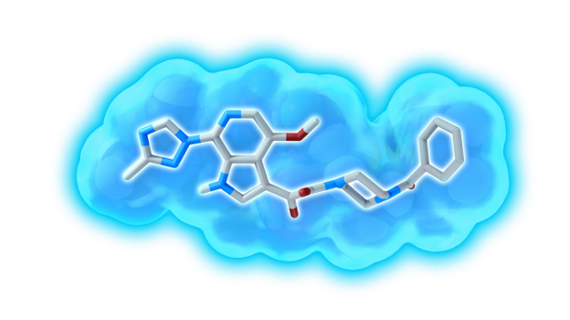
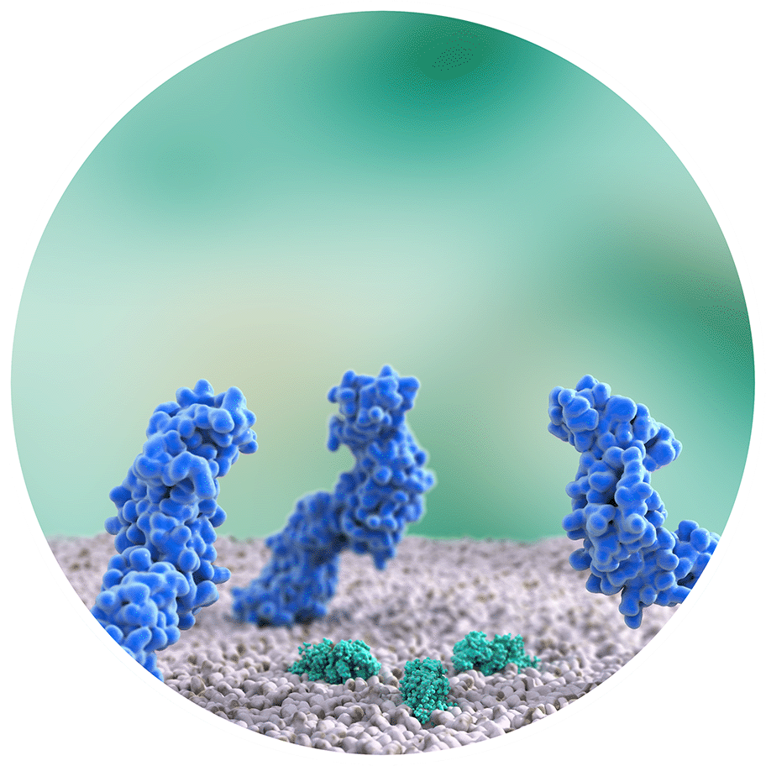
Temsavir Proposed Mode of Action
Temsavir prevents gp120
conformational
change,
inhibiting
HIV-1
attachment
CD4 binding
site
Attachment inhibited
Temsavir
Temsavir binds near the CD4 binding site
gp120 trimer
gp41 trimer
gp160
CD4 receptor
CCR5/CXCR4
Conceptualization and Design by Max Lataillade (ViiV Healthcare) and John Wong (Nucleus Global), funded by ViiV Healthcare

Slide 5
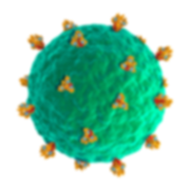
Viruses accumulate in extracellular space…
Viruses accumulate in extracellular space
and are subsequently removed by the host immune system
Conceptualization and Design by Max Lataillade (ViiV Healthcare) and John Wong (Nucleus Global), funded by ViiV Healthcare

Slide 6
Study Design
BRIGHTE is an ongoing Phase 3 randomised, placebo-controlled, double blind trial
Randomised Cohort §:
HTE participants failing current regimen with confirmed HIV-1 RNA ≥ 400 c/mL and:
1 or 2 ARV classes remaining & ≥1 fully active & available agent per class
Unable to construct viable regimen from remaining agents
Blinded
FTR 600 mg
BID + failing
regimen
Open Label FTR 600 mg BID + OBT
Randomised 3:1
Blinded
placebo +
failing
regimen
Day 1
End of
Study†
Day 8 –
Primary
Endpoint
Day 9 –
Open Label
FTR + OBT
Week 24*
Week 48*
Week 96*
Non-randomised Cohort §:
HTE participants, failing current regimen with confirmed HIV-1 RNA ≥ 400 c/mL and:
0 ARV classes remaining and no remaining fully active approved agents‡
Non-randomised
Open Label FTR 600 mg BID + OBT
Day 1
Week 24
Week 48
Week 96
End of
Study†
*Measured from the start of open label FTR 600 mg BID + OBT; †The study is expected to be conducted until an additional option,
rollover study or marketing approval, is in place; ‡Use of investigational agents as part of OBT was permitted; §There was no screening FTR IC₅₀ criteria.
BID, twice-daily; OBT, optimised background therapy.
Kozal et al. EACS 2017; Milan, Italy. Oral PS8/5.

Slide 7
Baseline Characteristics
Parameter | Randomised Cohort |  | Non-randomised Cohort | Total Treated Participants (N=371)
 | Placebo BID (N=69) | FTR 600 mg BID (N=203) | FTR 600 mg BID (N=99)
Age years, Median (range) <50 years, [n(%)] | 45 (19–66) 46 (67) | 48 (18–73) 116 (57) | 50 (17–72) 44 (44) | 49 (17–73) 206 (56)
Sex, [n(%)] Male | 57 (83) | 143 (70) | 89 (90) | 289 (78)
Race, [n(%)] White Black/African-American | 47 (68) 18 (26) | 137 (67) 42 (21) | 73 (74) 23 (23) | 257 (69) 83 (22)
HIV-1 RNA log₁₀ c/mL, Median (range) | 4.5 (1.6–6.9) | 4.7 (1.6–6.4) | 4.3 (1.6–6.6) | 4.6 (1.6–6.9)
HIV-1 RNA c/mL, [n(%)] <400 400 – <1000 1000 – <100,000 ≥100,000 | 7 (10) 3 (4) 35 (51) 24 (35) | 14 (7) 7 (3) 126 (62) 56 (28) | 4 (4) 5 (5) 75 (76) 15 (15) | 25 (7) 15 (4) 236 (64) 95 (26)
CD4+ cells/µL, Median (range) | 100 (0–915) | 99 (0–1160) | 41 (0–641) | 80 (0–1160)
CD4+ cells/µL, [n(%)] <50 50 – <200 | 23 (33) 26 (38) | 74 (36) 76 (37) | 54 (55) 25 (25) | 151 (41) 127 (34)
Kozal et al. EACS 2017; Milan, Italy. Oral PS8/5.

Slide 8
Prior ARV Exposure and Initial OBT
Prior Exposure to ARVs
Fully Active and Available ARV Agents
in Initial OBT
% of Participants
% of Participants
Baseline and emergent resistance analysis are currently ongoing; *13/19 received investigational ARV Ibalizumab. INI, integrase inhibitor; NRTI, nucleoside reverse transcriptase inhibitors; NNRTI, non-NRTI; PI, protease inhibitor.
Kozal et al. EACS 2017; Milan, Italy. Oral PS8/5.

Slide 9
Study Disposition through Week 24
Screened
N=732
Screening Failures
N=361
Randomised Cohort
N=272
Non-randomised Cohort
N=99
Ongoing
n=227 (83%)
Withdrawn*
n=45† (17%)
Ongoing
n=73 (74%)
Withdrawn
n=26‡ (26%)
*6 participants (FTR n=5; placebo n=1) discontinued during the double-blind period of the study.
† Withdrawal reasons (n, %): AEs (13, 5%), lack of efficacy (9, 3%), non-adherence (7, 3%), withdrawn consent (5, 2%), lost to follow-up (5, 2%), met stopping criteria (3, 1%), death (1, <1%), pregnancy (1, <1%) and other (1, <1%).
§ Withdrawal reasons (n, %): AEs (9, 9%), lack of efficacy (4, 4%), non-adherence (3, 3%), withdrawn consent (2, 2%), lost to follow-up (1, 1%), met stopping criteria (3, 3%), death (1, 1%) and other (3, 3%).
Kozal et al. EACS 2017; Milan, Italy. Oral PS8/5.

Slide 10
Primary Endpoint: Adjusted Mean HIV-1 RNA log₁₀ Change at Day 8
The primary endpoint was the adjusted mean plasma HIV-1 RNA log₁₀ change from Day 1 at Day 8* in the Randomised Cohort (ITT-E)
Adjusted Mean† (95% CI)
N=69
N=201§
FTR participants (ITT-E)
>0.5 log₁₀ decrease - 65%
>1 log₁₀ decrease - 46%
Subgroup: Baseline HIV-1 RNA >1000 c/mL (n=182), FTR demonstrated:
Median decrease of 1 log₁₀
Adjusted mean decrease of 0.9 log₁₀
>0.5 log₁₀ decrease - 68%
>1 log₁₀ decrease - 50%
Difference† (95% CI) = -0.625
(-0.810, -0.441) P<0.0001‡
*Day 8 window includes viral load between Day 6 to Day 10; participants who did not have a result in the Day 8 window had their last on treatment result carried forward (1 participant receiving FTR) or their Day 1 result carried forward (9 participants; 4 receiving placebo and 5 receiving FTR); †Mean adjusted by Day 1 log₁₀ HIV-1 RNA; ‡hypothesis test: µFTR - µ placebo; P from Levene’s test of homogeneity of variance 0.2082; §Two participants in the FTR arm, who had missing Day 1 HIV-1 RNA values, were not included in the analysis for the HIV-1 RNA log₁₀ least squares mean change at Day 8.
ITT-E, intent to treat-exposed.
Kozal et al. EACS 2017; Milan, Italy. Oral PS8/5.

Slide 11
Virologic Response at Week 24 (Snapshot Analysis)
Outcome | Randomised Cohort (N=272) | Non-Randomized Cohort (N=99)
Virologic Success (<40 c/mL), n (%) | 146 (54) | 36 (36)
Virologic Failure, (≥40 c/mL), n (%) | 108 (40) | 55 (56)
Data in window not below threshold | 87 (32) | 44 (44)
D/C for lack of efficacy | 1 (<1) | 0
D/C for other reason while not below threshold | 5 (2) | 2 (2)
Change in ART* | 15 (6) | 9 (9)
No Virologic Data | 18 (7) | 8 (8)
D/C study due to AE or Death | 11 (4) | 4 (4)
D/C study for Other Reasons | 4 (1) | 0
Missing data during window but on study | 3 (1) | 4 (4)
% of Participants
N=272
N = 99
*Change in OBT for efficacy reasons were considered virologic failures in this analysis.
ART, antiretroviral therapy; D/C, discontinued.
Kozal et al. EACS 2017; Milan, Italy. Oral PS8/5.

Slide 12
Virologic Response through Week 24 (Observed Analysis)*
Randomised Cohort
Non-randomised Cohort
% of Participants
% of Participants
n=272
n=262
n=256
n=248
n=248
n=247
n=99
n=98
n=93
n=92
n=90
n=89
*Change in OBT for efficacy reasons were not considered virologic failures in this analysis.
Kozal et al. EACS 2017; Milan, Italy. Oral PS8/5.

Slide 13
Mean Change in CD4+ T-cell Counts from Baseline through Week 24: Observed Analysis
Mean CD4+ T-cell count at baseline was 153 cells/µL (SD=182) for the Randomised Cohort and 99 cells/µL (SD=131) for the Non-randomised Cohort
Mean Change in CD4+ T-cell Counts from Baseline (cells/µL) ± SD
*The Non-randomised Cohort did not have a Day 8 visit.
SD, standard deviation.
Kozal et al. EACS 2017; Milan, Italy. Oral PS8/5.

Slide 14
Week 24* Safety Summary
Parameter, n (%) | Randomised Cohort (N=270)† | Non-randomised Cohort (N=99) | Total Treated Participants (N=371)†
Any Event | 243 (90) | 93 (94) | 338 (91)
Grade 2-4 Related AEs | 49 (18) | 19 (19) | 68 (18)
AEs leading to Discontinuation | 12 (4) | 9 (9) | 21 (6)
SAEs‡ | 73 (27) | 37 (37) | 112 (30)
Related SAEs | 6 (2) | 3 (3) | 9 (2)
Deaths§ | 8 (3) | 9 (9) | 17 (5)
*All safety data reflect cumulative results collected through the data cutoff data of 21 July 2017. All but 1 treated participant had the opportunity to complete the Week 48 study assessment prior to the current data lock; †Due to data entry errors related to container numbers, two randomised participants are not counted as part of the randomised cohort but are counted in the total column; ‡The majority (12%) of SAEs were from the infections/infestations system organ class; §12/17 deaths were due to AIDS-related events (1 case was recurrent atypical mycobacterial infection due to IRIS).
SAEs, serious adverse events.
Kozal et al. EACS 2017; Milan, Italy. Oral PS8/5.

Slide 15
Grade 2–4 Related AEs*
Parameter, n (%) | Randomised Cohort (N=270)† | Non-randomised Cohort (N=99) | Total Treated Participants (N= 371)†
Any Event | 49 (18) | 19 (19) | 68 (18)
Nausea | 10 (4) | 5 (5) | 15 (4)
Diarrhea | 6 (2) | 3 (3) | 9 (2)
Headache | 8 (3) | 1 (1) | 9 (2)
Vomiting | 4 (1) | 2 (2) | 6 (2)
Fatigue | 3 (1) | 2 (2) | 5 (1)
Asthenia | 2 (<1) | 2 (2) | 4 (1)
*Grade 2–4 related AEs occurring in ≥2% of participants in either arm. †Due to data entry errors related to container numbers, two randomised participants are not counted as part of the randomised cohort but are counted in the total column.
Kozal et al. EACS 2017; Milan, Italy. Oral PS8/5.

Slide 16
Conclusions
FTR achieved its primary endpoint of superior efficacy relative to placebo in HTE, HIV-1-infected participants, with an adjusted mean decline of 0.79 log₁₀ HIV-1 RNA through 8 days of FTR functional monotherapy (Treatment Difference = -0.625, P<0.0001)
In a subgroup of participants with baseline HIV-1 RNA >1000 c/mL, FTR demonstrated median decrease of 1 log₁₀ at Day 8
At Week 24
54% of randomised participants receiving FTR+OBT achieved HIV-1 RNA <40 c/mL (Snapshot)
71% and 77% achieved HIV-1 RNA <200 c/mL and <400 c/mL, respectively
36% of non‑randomised participants (81% of whom had FTR as the only fully active ARV) achieved HIV-1 RNA <40 c/mL (Snapshot)
41% and 45% achieved HIV-1 RNA <200 c/mL and <400 c/mL, respectively
FTR-containing regimens were generally well tolerated:
The most common safety events were consistent with those seen during Phase 2b study
Significant AEs were generally reflective of the advanced disease state in the study population
These results support continued development of FTR as an important treatment option for HTE patients
Kozal et al. EACS 2017; Milan, Italy. Oral PS8/5.

Slide 17
Acknowledgements
We would like to thank all of the BRIGHTE clinical trial participants and their families
ViiV Healthcare, GSK and BMS personnel: K Barker, M Baumgartner, A Clark, K Davis, M Drapeau, B McDade, M Fairfax, V Guellal, M Gummel, M Gunshenan, R Grove, C Ham, J Lim, B McCaughey, B Shepherd, M Soler, C Trezza, S Watson. PPD study team: M Benoffi, A Boswell, A-C Daussat, S Edwards, M Enslen, C Fernando de Oliveria, S Greenawald, T Jackson, H Jones, M Madhanagopal, M Okabe, A Sousa, C Stancu, E Straatsma, W Teets, P Vemula
Professional medical writing and editorial assistance was provided by Sharmin Bovill at MediTech Media and 3D graphics were developed by John Wong at Nucleus Global, both funded by ViiV Healthcare
Kozal et al. EACS 2017; Milan, Italy. Oral PS8/5.

Slide 18
BRIGHTE Investigators
J Aberg, J Andrade Neto, J Angel, A Antinori, K Arastéh, J Ballesteros, J Bartczak, A Baumgarten, PF Belaunzaran Zamudio, CJ Beltran Buendia, M Berhe, JL Blanco Arévalo, J Bogner, C Brites Alves, P Cahn, T Campbell, A Carr, W Casapia, L Cassetti, R Cauda, R Cecchini, C Chahin Anania, B Conway, C Creticos, DO David, C Davis, S De Wit, E DeJesus, M Della Negra, R Diaz, V Drelichman, M Dube, J Duque Rodriguez, C Durand, J Echevarria, J Eron, C Fichtenbaum, E Florence, J Fourie, PM Girard, D Goldstein, A Gori, B Grinsztejn, R Grossberg, S Gupta, F Haas, D Hagins, E Herieka, I Hoepelman, M Hower, SM Hsieh, M Jain, N Janeiro, C Katlama, W Kern, W King, B Knysz, M Kozal, V Kulagin, P Kumar, J Lalezari, R Landman, F Laplante, G Latiff, A Lazzarin, H Leal, J Lennox, M Lima, JM Llibre, R Loftus, E Loiza, JJ Lombaard, D Longpre, R Lubelchek, R Lucchetti, A Lucchetti Rodriguez, S Lupo, J Madruga, D Malan, P Mallon, F Maltez, M Martins, J McGowan, M McKellar, J McMahon, F Mendo, S Metallidis, A Mills, A Mitha, J-M Molina, J Morales-Ramirez, K Morejon, S Moreno Guillen, M Murray, C Mussini, R Nahass, D Neau, G Orofino, C Orrell, O Osiyemi, V Paparizos, M Parczewski, C Perez, G Pialoux, J Pineda, Y Pinedo, Y Plotnikova, I Poizot-Martin, A Pozniak, L Preotescu, P Pulik, F Raffi, N Ramgopal, M Rassool, F Ribeiro, G Rizzardini, R Romero-Cabello, A Sahota, D Salmon-Ceron, M Santoscoy-Gómez, R Sarmento e Castro, S Schrader, D Schürmann, J Sims, J Slim, E Sprinz, C Stephan, A Streinu-Cercel, O Sussmann, P Tebas, M Thompson, W Towner, SC Trevino, S Trottier, M van Schalkwyk, J Velez, S Walmsley, T Wilkin, S Win, M Wolff, A Wurcel, C Zala.
Kozal et al. EACS 2017; Milan, Italy. Oral PS8/5.

