Slide 1
ASSESSMENTS OF VERY-LOW-LEVEL HIV REPLICATION FOR DOLUTEGRAVIR + LAMIVUDINE (DTG + 3TC) VS DOLUTEGRAVIR + TENOFOVIR DISOPROXIL/EMTRICITABINE (DTG + TDF/FTC) IN THE GEMINI-1&-2 STUDIES THROUGH WEEK 96
Mark Underwood,¹ Rimgaile Urbaityte,² Ruolan Wang,¹ Allan Tenorio,¹ Brian Wynne,¹ Keith Pappa,¹ Justin Koteff,¹ Martin Gartland,¹ Jean van Wyk,³ Choy Man,¹ Jörg Sievers³
¹ViiV Healthcare, Research Triangle Park, NC, USA; ²GlaxoSmithKline, Stockley Park, UK; ³ViiV Healthcare, Brentford, UK

Slide 2
Presenter Disclosure Information
Mark Underwood is an employee of ViiV Healthcare and owns GSK stock
Underwood et al. EACS 2019; Basel, Switzerland. Slides PS8/2.

Slide 3
Introduction
Two-drug regimens (2DRs) reduce the number of drugs for PLWHIV who need lifelong ART¹
In the primary analysis of the GEMINI-1 and GEMINI-2 studies at Week 48, DTG + 3TC was non-inferior to DTG + TDF/FTC in the treatment of HIV-1–infected treatment-naive adults,² with non-inferiority of the 2DR maintained in a preplanned analysis at Week 96³
DTG/3TCª is currently approved as a once-daily, single-tablet 2DR by the US Food and Drug Administration and the European Medicines Agency
The goal of this analysis is to assess differences in very-low-level viremia for DTG + 3TC 2-drug regimen vs DTG + TDF/FTC 3-drug regimen
ªDOVATO. 1. Kelly et al. Drugs. 2016;76:523-531. 2. Cahn et al. Lancet. 2019;393:143-155. 3. Cahn et al. IAS 2019; Mexico City, Mexico. Slides WEAB0404LB.
Underwood et al. EACS 2019; Basel, Switzerland. Slides PS8/2.
Download Slides: Bit.ly/geminitnd

Slide 4
GEMINI-1 and GEMINI-2 Phase III Study Design
Identically designed, randomized, double-blind, parallel-group, multicenter, non-inferiority studies
Screening (28 days)
1:1
Double-blind phase
Open-label phase
Continuation
phase
ART-naive adults
DTG + 3TC (N=716)
DTG + 3TC
DTG + TDF/FTC (N=717)
Day 1
Week 24
Week 48
Week 96
Week 144
Eligibility criteria
VL 1000-500,000 c/mL at screening
≤10 days of prior ART
No major RT or PI resistance mutation
No HBV infection or need for HCV therapy
Primary endpoint at Week 48: participants with HIV-1 RNA <50 c/mL
(ITT-E Snapshot)ª
Countries Argentina Australia Belgium
Canada France Germany
Italy Republic of Korea Mexico
Netherlands Peru Poland Portugal Romania Russian Federation South Africa Spain Switzerland
Taiwan United Kingdom United States
Baseline stratification factors: plasma HIV-1 RNA (≤100,000 vs >100,000 c/mL) and CD4+ cell count (≤200 vs >200 cells/mm³)
DTG + 3TC is non-inferior to DTG + TDF/FTC with respect to proportion of participants with HIV-1 RNA <50 c/mL at Week 48 and Week 96 (Snapshot, ITT-E population) in both studies^{1,2}
ª−10% non-inferiority margin for individual studies. GEMINI-1: https://clinicaltrials.gov/ct2/show/NCT02831673; GEMINI-2: https://clinicaltrials.gov/ct2/show/NCT02831764. 1. Cahn et al. Lancet. 2019;393:143-155. 2. Cahn et al. IAS 2019; Mexico City, Mexico. Slides WEAB0404LB.
Underwood et al. EACS 2019; Basel, Switzerland. Slides PS8/2.
Download Slides: Bit.ly/geminitnd

Slide 5
DTG + 3TC Is Non-Inferior to DTG + TDF/FTC in Snapshot HIV-1 RNA <50 c/mL at Week 96
Snapshot
Treatment | Responders, n (%) | Adjusted difference, % (95% CI)ª
DTG + 3TC | 616/716 (86.0) | −3.4 (−6.7, 0.0)
DTG + TDF/FTC | 642/717 (89.5)
Snapshot
0
4
8
12
16
24
36
48
60
72
84
96
Non-inferiority criteria were met for GEMINI-1, GEMINI-2, and the pooled analysis^{b}
ªBased on Cochran-Mantel-Haenszel stratified analysis adjusting for the following baseline stratification factors: plasma HIV-1 RNA (≤100,000 vs >100,000 c/mL), CD4+ cell count (≤200 vs >200 cells/mm³), and study (GEMINI-1 vs GEMINI-2). The upper limit of the 95% CI for the pooled analysis was 0.0007%. ^{b}In GEMINI-1, HIV-1 RNA <50 c/mL (95% CI) was achieved in 300/356 participants (84.3% [80.5-88.1]) in the DTG + 3TC group and 320/358 (89.4% [86.2-92.6]) in the DTG + TDF/FTC group (adjusted treatment difference [95% CI], −4.9% [−9.8, 0.03]). In GEMINI-2, the corresponding values were 316/360 (87.8% [84.4-91.2]) and 322/359 (89.7% [86.5-92.8]), respectively (adjusted treatment difference [95% CI], −1.8% [−6.4, 2.7]). Cahn et al. IAS 2019; Mexico City, Mexico. Slides WEAB0404LB.
Underwood et al. EACS 2019; Basel, Switzerland. Slides PS8/2.
Download Slides: Bit.ly/geminitnd

Slide 6
HIV-1 RNA VL Data and Ad Hoc Analyses
Abbott HIV-1 RealTime Assay
Generates quantitative HIV-1 RNA viral load (VL) from 40 to 10,000,000 c/mL
Generates qualitative data for VL <40 c/mL
HIV-1 RNA present → TD (target detected)
HIV-1 RNA not present → TND (target not detected)
Includes Additional Virological-Focused Analyses
LOCF (last observation carried forward) – Includes all last on-treatment VLs up to the Week 96 analysis window while on IP
“Observed” – Defined as virologically suppressed at Week 96 and thereby censors earlier failures including those unrelated to efficacy
Underwood et al. EACS 2019; Basel, Switzerland. Slides PS8/2.
Download Slides: Bit.ly/geminitnd

Slide 7
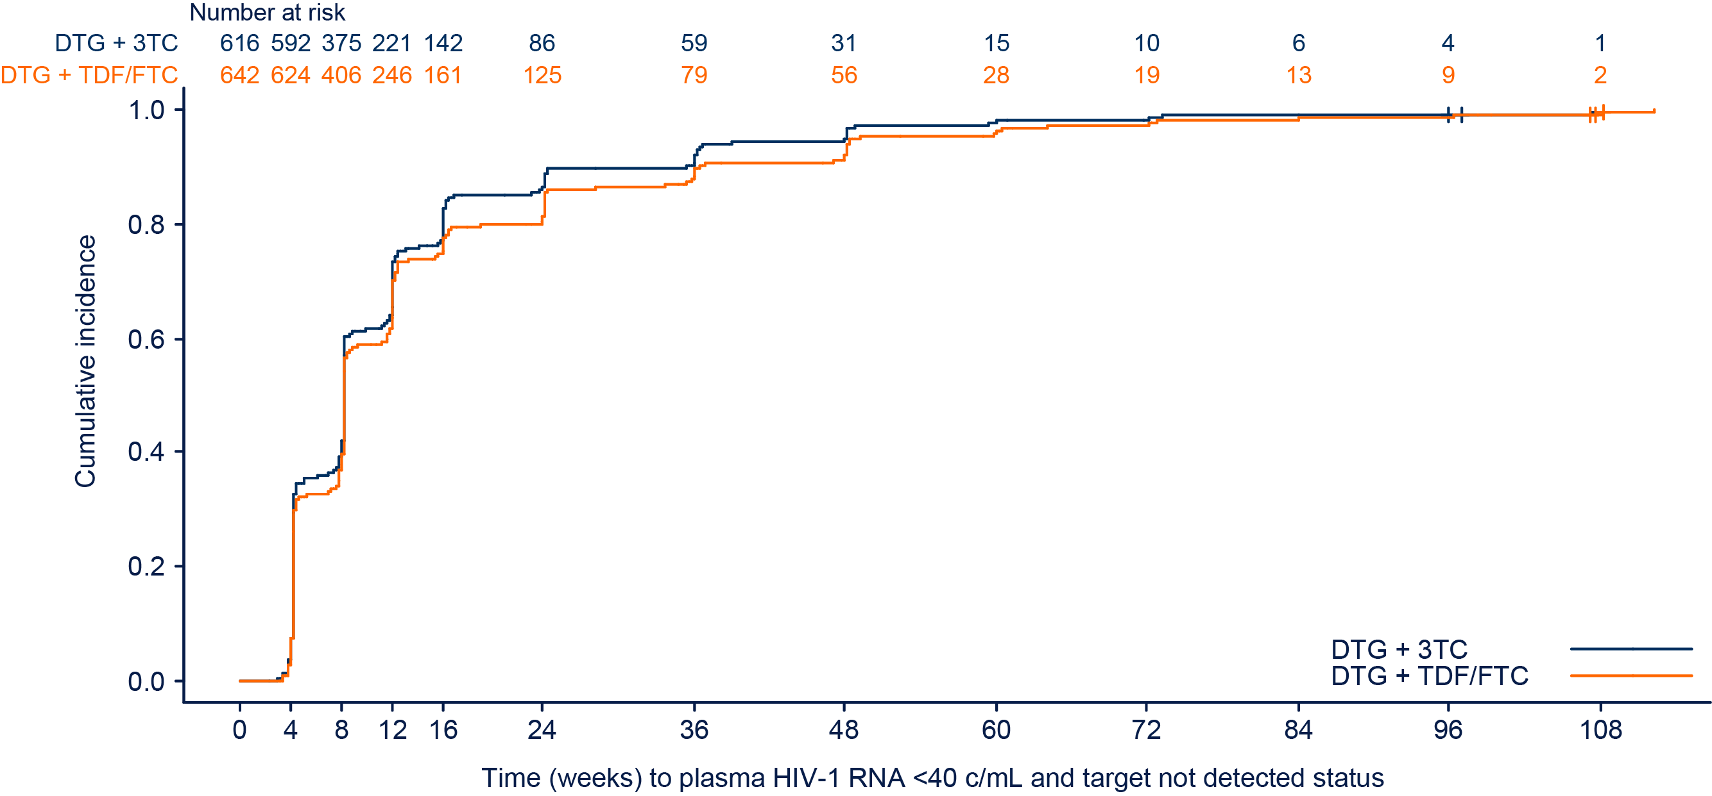
Similar Median Weeks to TND Across Groups in Observed Analysis
Median 8 weeks to TND across groups was also seen by Snapshot analysis at Week 96 and was previously demonstrated for Week 48¹
N | Group | Median weeks to TND | 95% CI
616 | DTG + 3TC | 8 | NE, NE
642 | DTG + TDF/FTC | 8 | NE, NE
NE, not evaluable. 1. Underwood et al. CROI 2019; Seattle, WA. Poster 490.
Underwood et al. EACS 2019; Basel, Switzerland. Slides PS8/2.
Download Slides: Bit.ly/geminitnd

Slide 8
Proportions With TND Were Similar Between Groups at All Visits
Proportion of Participants With TND by Visit (Snapshot Analysis, ITT-E Population)
Number at base of bars is number of participants reaching TND at week visit
246
228
375
351
428
410
425
402
466
453
465
484
553
525
525
505
492
487
494
472
474
484
Underwood et al. EACS 2019; Basel, Switzerland. Slides PS8/2.
Download Slides: Bit.ly/geminitnd

Slide 9
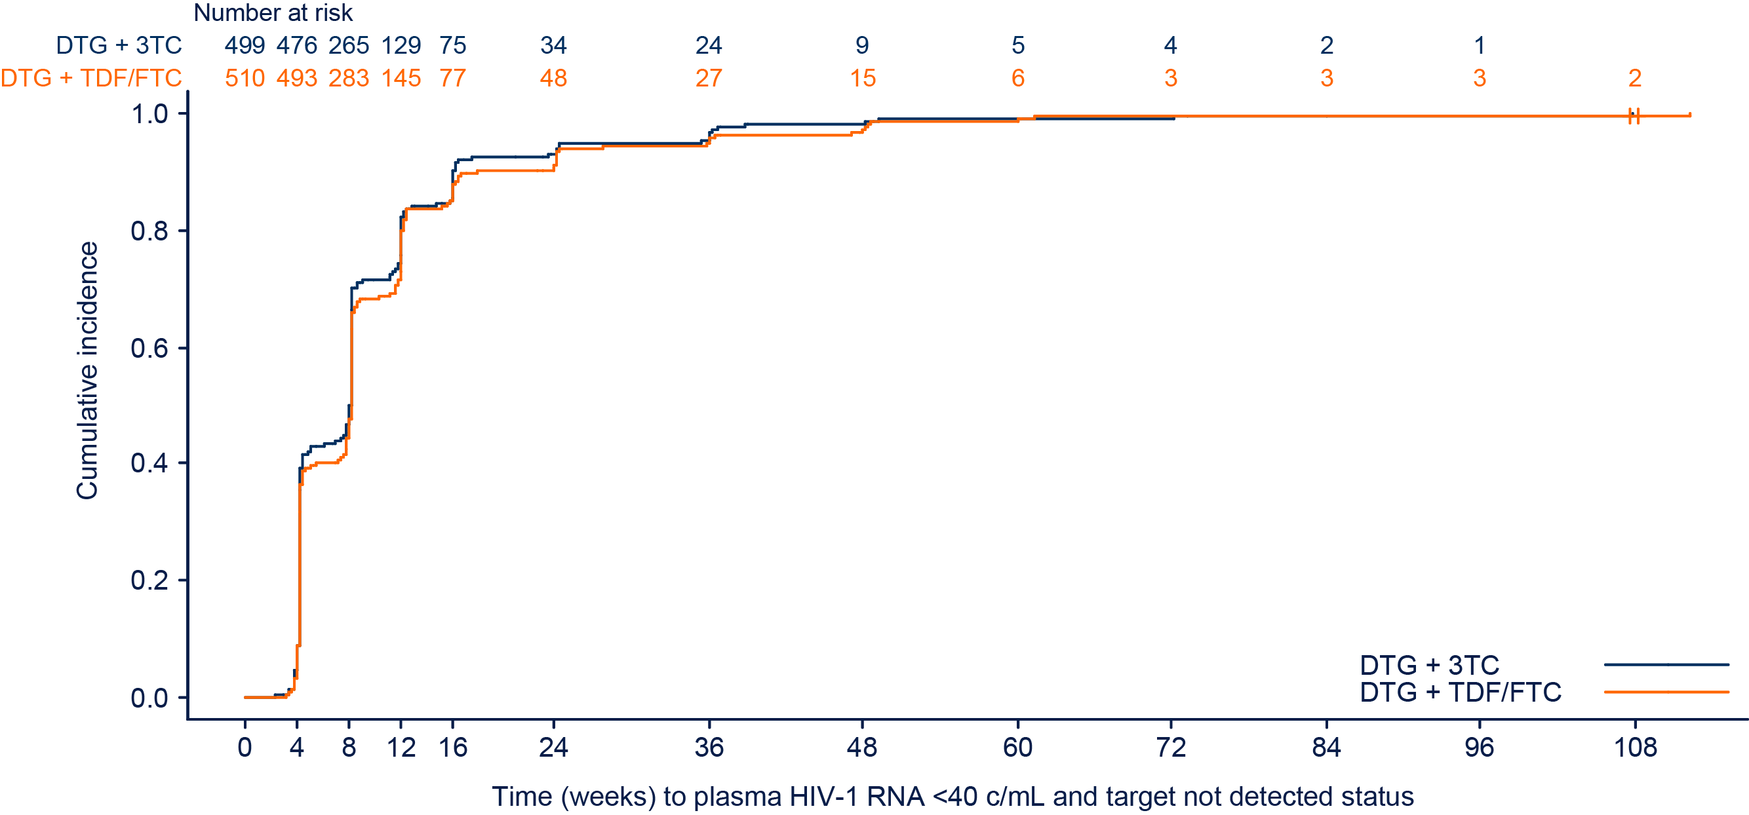
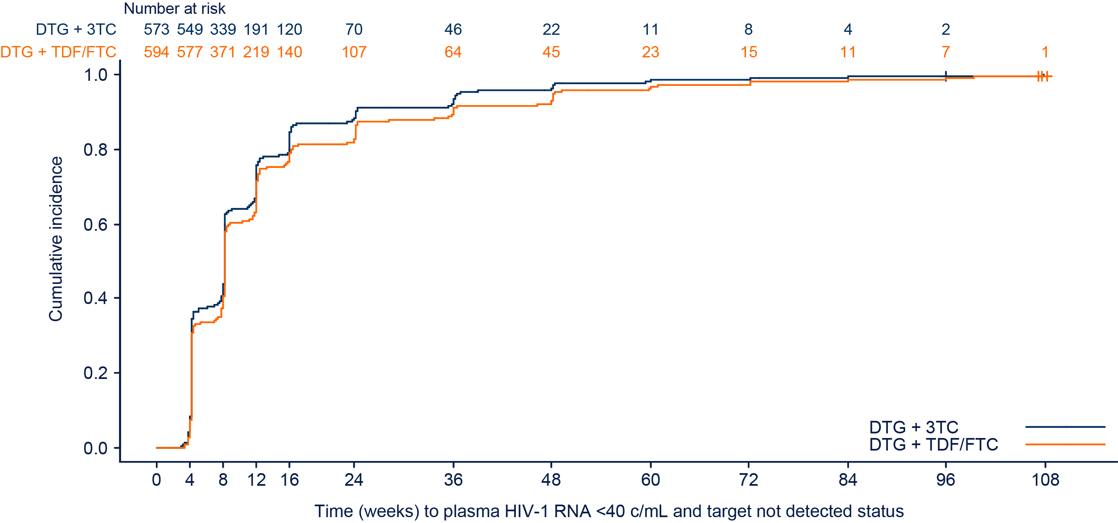
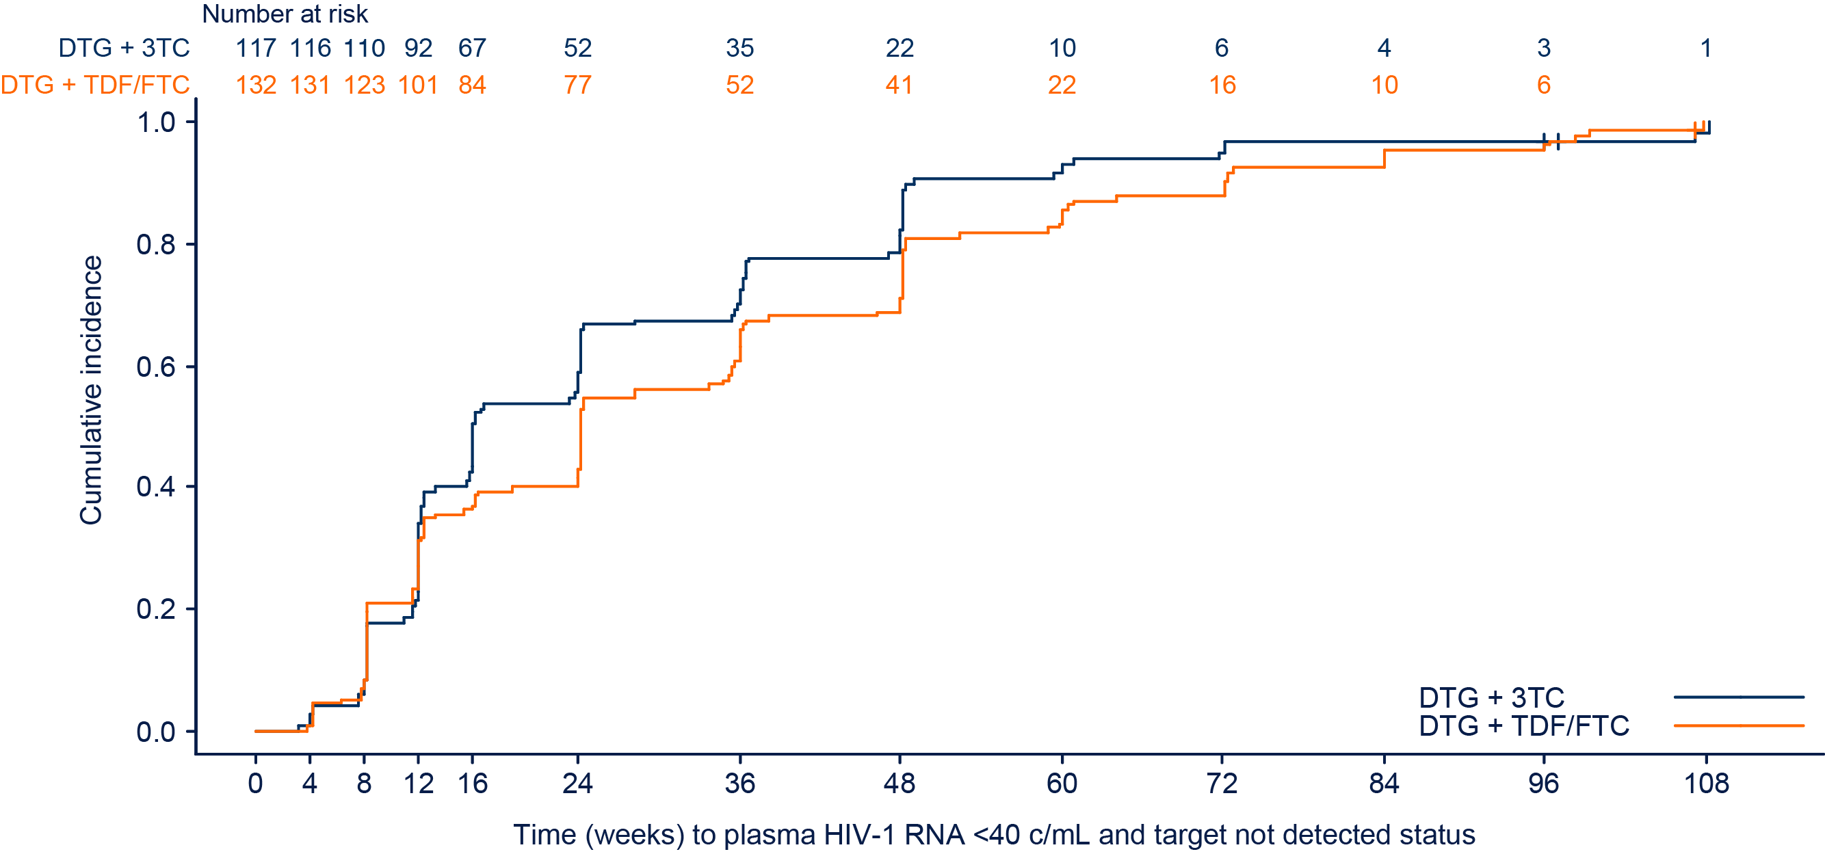
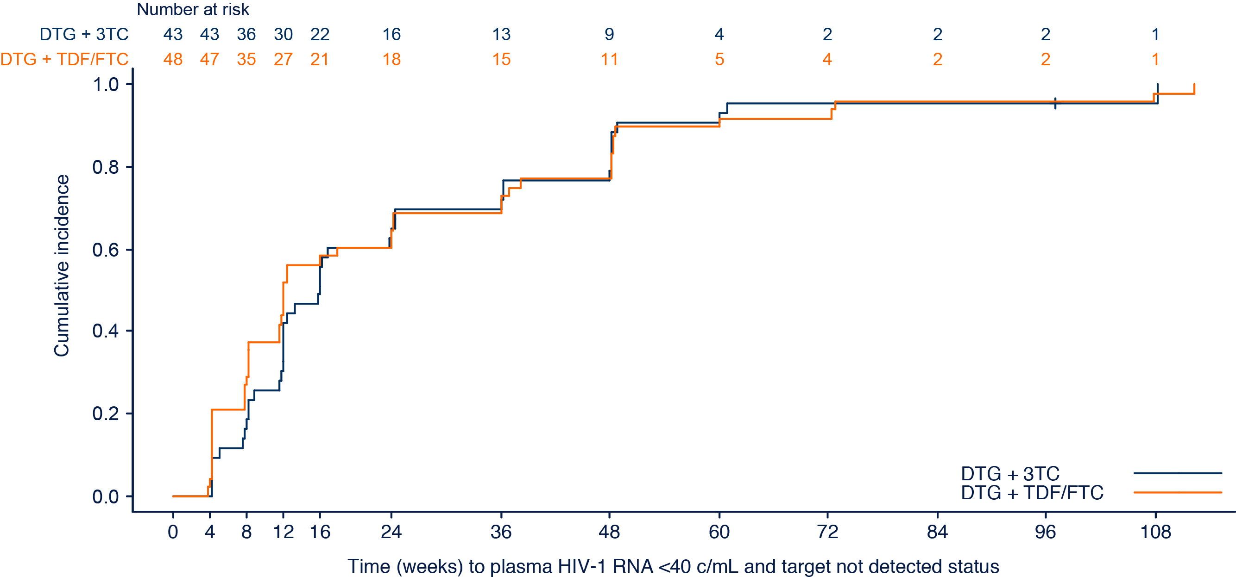
Median Time to TND in Subgroups for Observed Analysis
VL ≤100,000 c/mL
CD4+ cells >200 cells/mm³
At Week 96, median times to TND were comparable in the DTG + 3TC and DTG + TDF/FTC groups, regardless of BL VL or CD4+ cell count
N | Group | Weeks | 95% CI
499 | DTG + 3TC | 8 | (~8, ~8)
510 | DTG + TDF/FTC | 8 | (~8, ~8)
N | Group | Weeks | 95% CI
573 | DTG + 3TC | 8 | (NE, NE)
594 | DTG + TDF/FTC | 8 | (NE, NE)
VL >100,000 c/mL
CD4+ cells ≤200 cells/mm³
N | Group | Weeks | 95% CI
117 | DTG + 3TC | 16 | (~16, ~24)
132 | DTG + TDF/FTC | 24 | (~24, ~36)
N | Group | Weeks | 95% CI
43 | DTG + 3TC | 16 | (~12, ~24)
48 | DTG + TDF/FTC | 12 | (~8, ~24)
Underwood et al. EACS 2019; Basel, Switzerland. Slides PS8/2.
Download Slides: Bit.ly/geminitnd

Slide 10
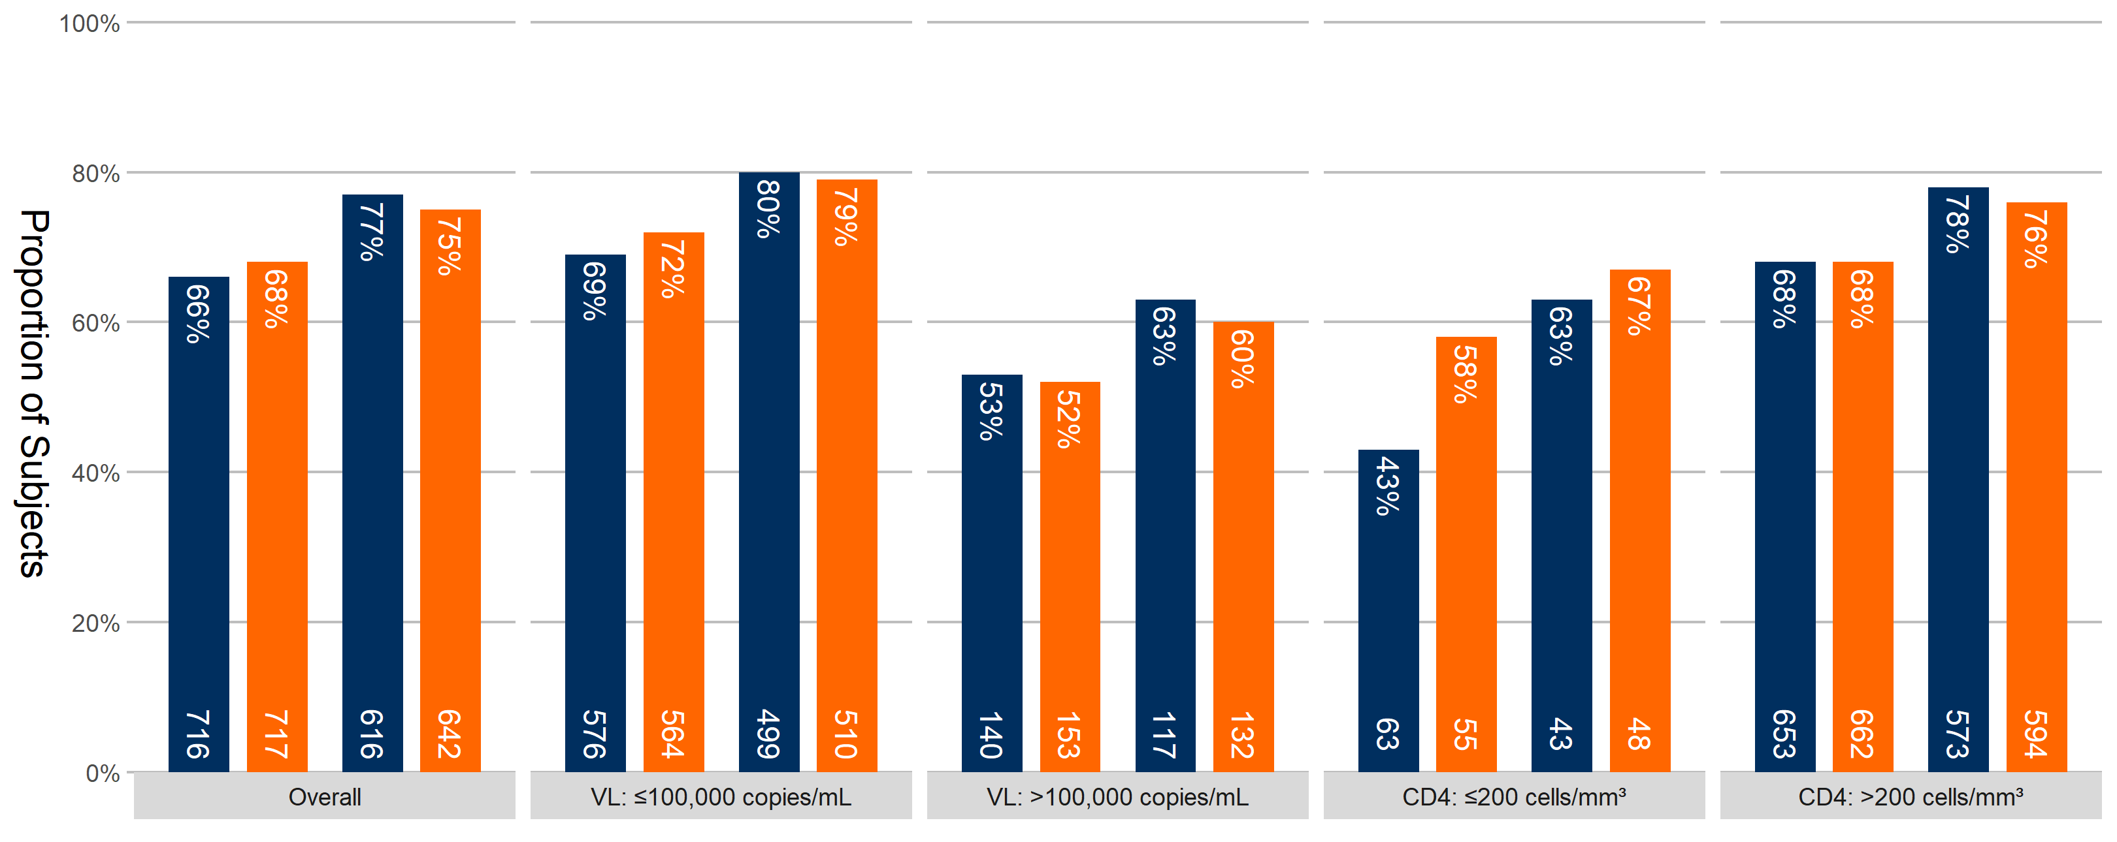
Proportions With TND by Snapshot and Observed Analyses at Week 96 by BL VL and CD4+ Cell Count
At Week 96, similar proportionsª had TND in each group regardless of BL VL, and regardless of CD4+ cell count in the observed analysis
DTG + 3TC
DTG + TDF/FTC
Proportion of participants
Snapshot
Observed
474/ 716
484/ 717
474/
616
484/
642
400/
576
405/
564
400/ 499
405/ 510
74/ 140
79/ 153
74/
117
79/
132
27/ 63
32/ 55
27/
43
32/
48
447/
653
452/
662
447/
573
452/
594
ªThe proportion of participants with VL<40 c/mL and TND status at Week 96 was analyzed using a Cochran-Mantel-Haenszel test stratified by VL (≤100,000 vs >100,000 c/mL) and CD4+ cell count (≤200 vs >200 cells/mm³) at BL.
Underwood et al. EACS 2019; Basel, Switzerland. Slides PS8/2.
10
Download Slides: Bit.ly/geminitnd

Slide 11
Conclusions
Through Week 96, the proportions of participants with TND were similar at all visits in the DTG + 3TC and DTG + TDF/FTC groups
This supports previous results based on Snapshot <50 c/mL at Week 48 and Week 96
At Week 96, proportions of participants with TND were comparable in the DTG + 3TC and DTG + TDF/FTC groups, regardless of BL VL or CD4+ cell count in the observed analysis
These data, utilizing a more stringent VL measure, further reinforce the efficacy and potency of DTG + 3TC in treatment-naive individuals with HIV-1 infection
Underwood et al. EACS 2019; Basel, Switzerland. Slides PS8/2.
Download Slides: Bit.ly/geminitnd

Slide 12
Acknowledgments
This study was funded by ViiV Healthcare
We thank everyone who has contributed to the success of these studies, including
All study participants and their families
The GEMINI-1 and GEMINI-2 clinical investigators and their staff
ViiV Healthcare, PPD, Parexel, and GSK teams
Editorial assistance and graphic design support for this presentation were provided under the direction of the authors by MedThink SciCom and funded by ViiV Healthcare
Underwood et al. EACS 2019; Basel, Switzerland. Slides PS8/2.
Download Slides: Bit.ly/geminitnd

