Slide 1
Uptake and discontinuation of integrase inhibitors (INSTIs) in a large cohort setting
Lauren Greenberg, L Ryom, G Wandeler, K Grabmeier-Pfistershammer, A Öllinger, B Neesgaard, C Stephan, A Calmy, A Rauch, A Castagna, V Spagnuolo, M Johnson, C Stingone, C Mussini, S De Wit, C Necsoi, AA Campins, C Pradier, M Stecher, J-C Wasmuth, A d’Arminio Monforte, M Law, R Puhr, N Chkhartishvilli, T Tsertsvadze, H Garges, D Thorpe, JD Lundgren, L Peters, L Bansi-Matharu and A Mocroft on behalf of the RESPOND study group
EACS, Basel, 08/11/19
Email: l.greenberg@ucl.ac.uk

Slide 2
Presenter Disclosure Information
Lauren Greenberg
disclosed no conflict of interest.

Slide 3
Background
INSTIs are recommended as part of initial antiretroviral therapy (ART) regimens for adults living with HIV
Clinical trials and small observational studies have shown:
good virological efficacy
fewer adverse events
lower rates of discontinuation
with INSTIs vs non-nucleoside reverse transcriptase inhibitors and boosted protease inhibitors [1-4]
However, limited data exists on the choice of INSTIs and discontinuation of INSTIs in large, heterogeneous real-world settings
[1] Steigbigel RT, et al. N Engl J Med 2008; [2] Sax PE, et al. Lancet 2012; [3] Raffi F, et al. Lancet 2013; [4] Peñafiel J, et al. J Antimicrob Chemother 2017

Slide 4
Aims
Identify characteristics associated with initiating:
dolutegravir (DTG)
cobicistat boosted elvitegravir (EVG/c)
raltegravir (RAL)
Describe time to and reasons for discontinuation of initial INSTI regimens
Identify characteristics associated with discontinuing INSTIs

Slide 5
RESPOND
The International Cohort Consortium of Infectious Diseases (RESPOND):
collaboration of 17 observational cohort studies
across Europe and Australia
including >28,000 individuals living with HIV-1
Enrolment into RESPOND began in 2017:
data was retrospectively collected back to 2012
data is prospectively collected from enrolment

Slide 6
Inclusion criteria
Started DTG, EVG/c or RAL after the latest of:
date enrolled into local cohort, or
1/1/2012
Age ≥ 16
CD4 cell count and viral load (VL) measurement prior to or within 6 months after starting an INSTI

Slide 7
Outcomes/statistical methods
1. Uptake of DTG, EVG/c, or RAL

Slide 8
Outcomes/statistical methods
1. Uptake of DTG, EVG/c, or RAL
Multinomial logistic regression was used to assess associations between baseline* characteristics and the likelihood of starting:
RAL vs DTG
EVG/c vs DTG
*baseline - date of INSTI start

Slide 9
Outcomes/statistical methods
2. Discontinuation of first INSTI regimen during follow-up

Slide 10
Outcomes/statistical methods
2. Discontinuation of first INSTI regimen during follow-up
≤ 6 months of INSTI initiation
> 6 months of INSTI initiation

Slide 11
Outcomes/statistical methods
2. Discontinuation of first INSTI regimen during follow-up
Cox proportional hazards models was used to assess factors associated with time to discontinuation

Slide 12
Baseline characteristics
Demographics
Age
Gender
Ethnicity
Smoking status
Geographical region
HIV related
Year of starting INSTI
HIV risk category
CD4 cell count nadir
CD4 cell count at INSTI initiation
ART experience and viral suppression status
Cohort
For discontinuation models, INSTI type was also included
Comorbidities
Viral hepatitis B and C status (HBV/HCV)
Hypertension
Diabetes
AIDS defining event (ADE)
Non-AIDS defining malignancy (NADM)
End stage liver disease
Cardiovascular disease (CVD)
Fracture
Chronic kidney disease

Slide 13
Characteristics at INSTI start
INSTI (N=9702), n (%) |  | DTG 5051 (52.1) | RAL 2718 (28.0) | EVG/c 1933 (19.9)
%
Gender | Male | 74.5 | 73.5 | 80.7
Ethnicity* | White | 84.1 | 81.2 | 80.6
ART experience | Naïve | 23.5 | 20.5 | 30.4
 | Experienced, VL < 400 cps/mL | 69.9 | 66.2 | 62.8
HIV risk* | MSM | 47.0 | 43.3 | 54.7
Geographical region | Western Europe | 59.9 | 38.5 | 55.6
 | Southern Europe | 26.1 | 26.8 | 32.7
 | Northern Europe/Australia | 10.0 | 27.0 | 7.9
 | Eastern/Eastern Central Europe | 5.1 | 9.1 | 5.2
Prior AIDS* |  | 21.0 | 28.3 | 13.2
Any prior/current comorbidity |  | 37.6 | 33.1 | 27.7
INSTI start date (median (IQR)) |  | Jan 16 (May 15, Oct 16) | Feb 14 (Jan 13, Apr 15) | Dec 15 (Oct 14, Nov 16)
Age, years (median (IQR)) |  | 48 (39, 55) | 48 (41, 54) | 45 (36, 53)
CD4 at INSTI start, cells/mm³ (median (IQR)) |  | 578 (369, 788) | 507 (297, 714) | 560 (386, 756)
*Denominator for percentages is all participants with non-missing data. Total unknown n (%): Ethnicity 1454 (14.8) HIV risk 535 (5.4), prior AIDS 1143 (11.78)

Slide 14
Characteristics at INSTI start
INSTI (N=9702), n (%) |  | DTG 5051 (52.1) | RAL 2718 (28.0) | EVG/c 1933 (19.9)
%
Gender | Male | 74.5 | 73.5 | 80.7
Ethnicity* | White | 84.1 | 81.2 | 80.6
ART experience | Naïve | 23.5 | 20.5 | 30.4
 | Experienced, VL < 400 cps/mL | 69.9 | 66.2 | 62.8
HIV risk* | MSM | 47.0 | 43.3 | 54.7
Geographical region | Western Europe | 59.9 | 38.5 | 55.6
 | Southern Europe | 26.1 | 26.8 | 32.7
 | Northern Europe/Australia | 10.0 | 27.0 | 7.9
 | Eastern/Eastern Central Europe | 5.1 | 9.1 | 5.2
Prior AIDS* |  | 21.0 | 28.3 | 13.2
Any prior/current comorbidity |  | 37.6 | 33.1 | 27.7
INSTI start date (median (IQR)) |  | Jan 16 (May 15, Oct 16) | Feb 14 (Jan 13, Apr 15) | Dec 15 (Oct 14, Nov 16)
Age, years (median (IQR)) |  | 48 (39, 55) | 48 (41, 54) | 45 (36, 53)
CD4 at INSTI start, cells/mm³ (median (IQR)) |  | 578 (369, 788) | 507 (297, 714) | 560 (386, 756)
*Denominator for percentages is all participants with non-missing data. Total unknown n (%): Ethnicity 1454 (14.8) HIV risk 535 (5.4), prior AIDS 1143 (11.78)

Slide 15
Characteristics at INSTI start
INSTI (N=9702), n (%) |  | DTG 5051 (52.1) | RAL 2718 (28.0) | EVG/c 1933 (19.9)
%
Gender | Male | 74.5 | 73.5 | 80.7
Ethnicity* | White | 84.1 | 81.2 | 80.6
ART experience | Naïve | 23.5 | 20.5 | 30.4
 | Experienced, VL < 400 cps/mL | 69.9 | 66.2 | 62.8
HIV risk* | MSM | 47.0 | 43.3 | 54.7
Geographical region | Western Europe | 59.9 | 38.5 | 55.6
 | Southern Europe | 26.1 | 26.8 | 32.7
 | Northern Europe/Australia | 10.0 | 27.0 | 7.9
 | Eastern/Eastern Central Europe | 5.1 | 9.1 | 5.2
Prior AIDS* |  | 21.0 | 28.3 | 13.2
Any prior/current comorbidity |  | 37.6 | 33.1 | 27.7
INSTI start date (median (IQR)) |  | Jan 16 (May 15, Oct 16) | Feb 14 (Jan 13, Apr 15) | Dec 15 (Oct 14, Nov 16)
Age, years (median (IQR)) |  | 48 (39, 55) | 48 (41, 54) | 45 (36, 53)
CD4 at INSTI start, cells/mm³ (median (IQR)) |  | 578 (369, 788) | 507 (297, 714) | 560 (386, 756)
*Denominator for percentages is all participants with non-missing data. Total unknown n (%): Ethnicity 1454 (14.8) HIV risk 535 (5.4), prior AIDS 1143 (11.78)

Slide 16
Characteristics at INSTI start
INSTI (N=9702), n (%) |  | DTG 5051 (52.1) | RAL 2718 (28.0) | EVG/c 1933 (19.9)
%
Gender | Male | 74.5 | 73.5 | 80.7
Ethnicity* | White | 84.1 | 81.2 | 80.6
ART experience | Naïve | 23.5 | 20.5 | 30.4
 | Experienced, VL < 400 cps/mL | 69.9 | 66.2 | 62.8
HIV risk* | MSM | 47.0 | 43.3 | 54.7
Geographical region | Western Europe | 59.9 | 38.5 | 55.6
 | Southern Europe | 26.1 | 26.8 | 32.7
 | Northern Europe/Australia | 10.0 | 27.0 | 7.9
 | Eastern/Eastern Central Europe | 5.1 | 9.1 | 5.2
Prior AIDS* |  | 21.0 | 28.3 | 13.2
Any prior/current comorbidity |  | 37.6 | 33.1 | 27.7
INSTI start date (median (IQR)) |  | Jan 16 (May 15, Oct 16) | Feb 14 (Jan 13, Apr 15) | Dec 15 (Oct 14, Nov 16)
Age, years (median (IQR)) |  | 48 (39, 55) | 48 (41, 54) | 45 (36, 53)
CD4 at INSTI start, cells/mm³ (median (IQR)) |  | 578 (369, 788) | 507 (297, 714) | 560 (386, 756)
*Denominator for percentages is all participants with non-missing data. Total unknown n (%): Ethnicity 1454 (14.8) HIV risk 535 (5.4), prior AIDS 1143 (11.78)

Slide 17
INSTI Uptake

Slide 18
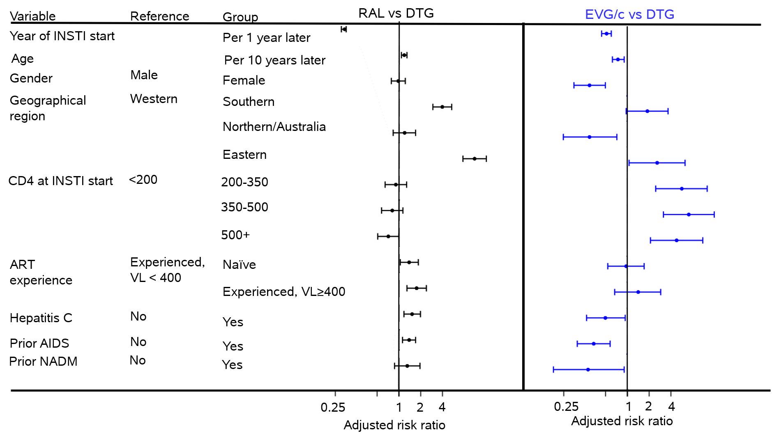
Choice of INSTI
Results from a multinomial logistic regression model, additionally adjusted for ethnicity, HIV risk group, CD4 nadir, smoking status, hepatitis B, hypertension, diabetes, end stage liver disease, cardiovascular disease, fracture, chronic kidney disease and all other factors in the figure. Missing data was fitted using unknown categories (data not shown)

Slide 19
Discontinuation of INSTIs

Slide 20
Discontinuation
 | Overall (n=9702) | DTG (n=5051) | RAL (n=2718) | EVG/c (n=1933)
Median (IQR) follow-up, months | 20.0 (9.9-32.4) | 17.1 (8.5-26.2) | 33.4 (16.7-48.3) | 17.7 (7.6-31.7)

Slide 21
Discontinuation
 | Overall (n=9702) | DTG (n=5051) | RAL (n=2718) | EVG/c (n=1933)
Median (IQR) follow-up, months | 20.0 (9.9-32.4) | 17.1 (8.5-26.2) | 33.4 (16.7-48.3) | 17.7 (7.6-31.7)
Number (%) who discontinued during follow-up | 2105 (21.7%) | 619 (12.3%) | 1145 (42.1%) | 341 (17.6%)

Slide 22
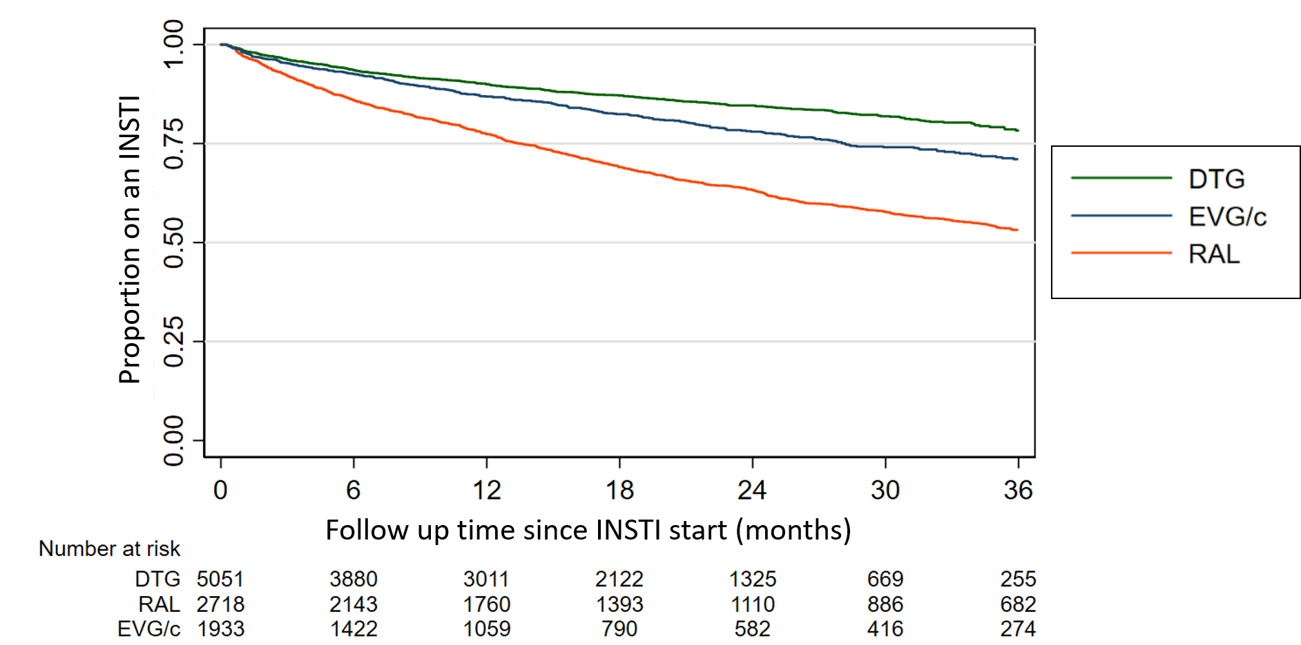
Discontinuation

Slide 23
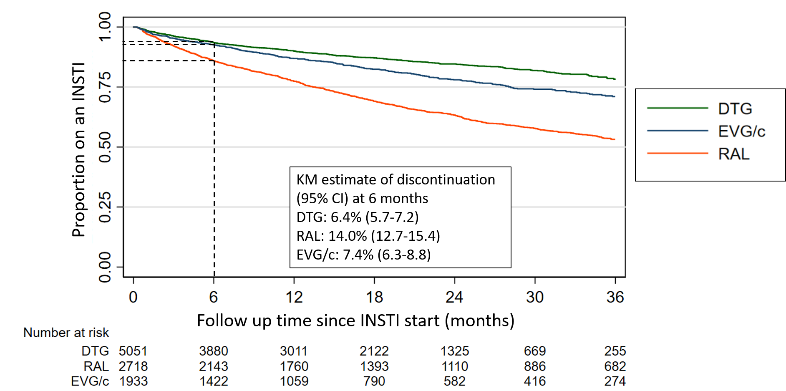
Discontinuation

Slide 24
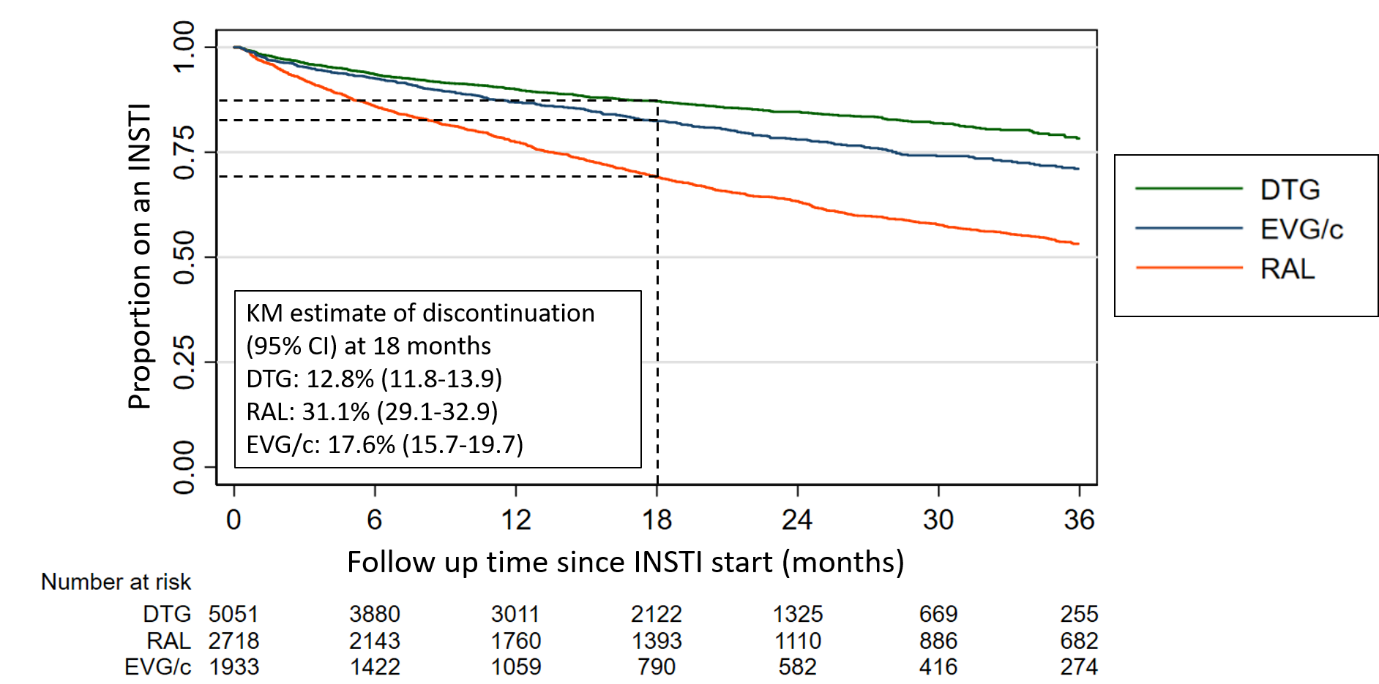
Discontinuation

Slide 25
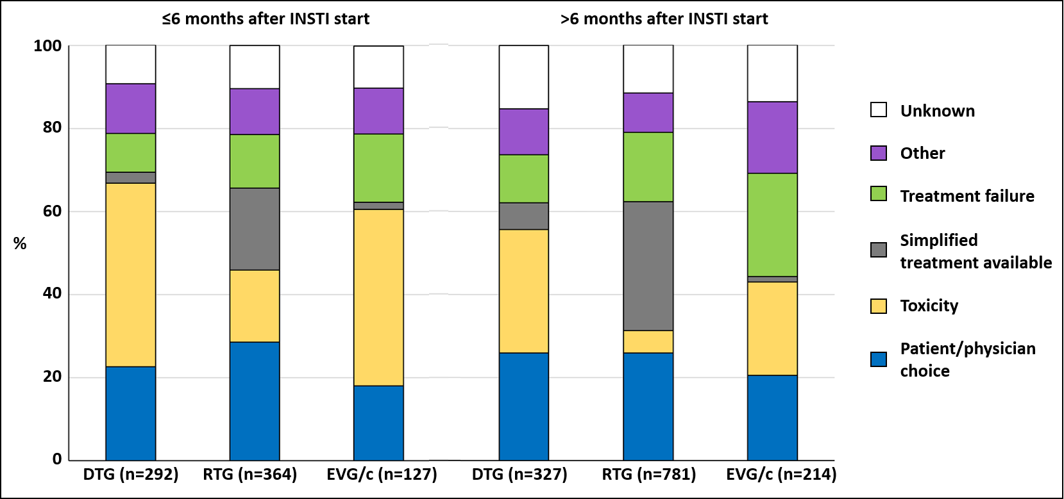
Reasons for discontinuation
Toxicity includes abnormal fat redistribution, concern of cardiovascular disease, hypersensitivity reaction, abdomen/gastrointestinal tract, nervous system, kidney, or endocrine system toxicities, unspecified side effects

Slide 26
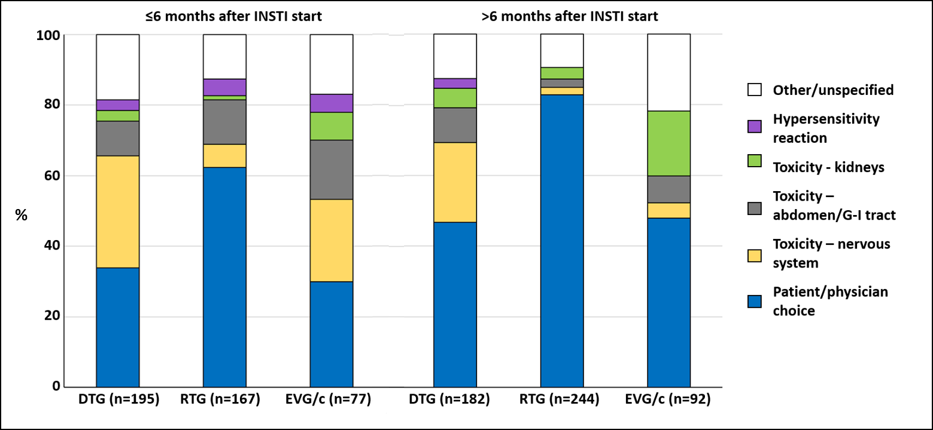
Reasons for discontinuation due to toxicity

Slide 27
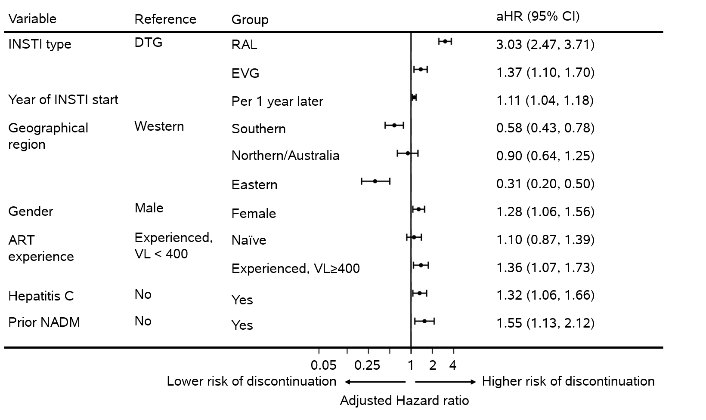
Factors associated with INSTI discontinuation within 6 months
Significant results (p<0.05) from a Cox proportional hazards model, additionally adjusted for age, ethnicity, HIV risk group, CD4 nadir, CD4 at INSTI start, smoking status, hepatitis B, hypertension, diabetes, prior AIDS, end stage liver disease, cardiovascular disease, fracture, chronic kidney disease and all other factors in the figure. Missing data for hepatitis C and prior NADM were fitted using unknown categories (data not shown)

Slide 28
Limitations
Individuals in RESPOND were not randomly selected as we pre-specified the minimum number on INSTIs to be included
Not possible to rule out residual confounding
Completeness of data varies between cohorts
Only one reason for discontinuation per antiretroviral was collected, without further detail.

Slide 29
Conclusion (I)
Uptake of DTG vs EVG/c or RAL has increased:
over calendar time
more in Western Europe compared to other European regions

Slide 30
Conclusion (II)
INSTI discontinuation was mainly due to toxicity in the first 6 months and patient/physician choice thereafter, but was low overall
Discontinuation was significantly higher for RAL, mainly due to treatment simplification
Discontinuation due to nervous system toxicities was highest on DTG
Our findings highlight the need for further research to better understand adverse effects on INSTIs

Slide 31
Acknowledgements
Cohort principal investigators:.
De Wit (St. Pierre, Brussels), R. Zangerle (AHICOS), M. Law (AHOD), F. Wit (ATHENA) G. Wandeler (EuroSIDA), C. Stephan (Frankfurt), N. Chkhartishvili (IDACIRC), C. Pradier (Nice HIV cohort), A. d’Arminio Monforte (ICoNA), C. Mussini (Modena), J. Casabona & J.M. Miro (PISCIS ), H. Günthard (SHCS), A. Sönnerborg (Swedish InfCare), C. Smith (Royal Free HIV cohort), A. Castagna (St. Rafael, Milano), J.C. Wasmuth (Bonn, HIV Cohort) and J.J. Vehreschild (Cologne, HIV cohort).
Cohort Coordinator, operational team members and data management:
C. Necsoi, M. Delforge (st. Pierre, Brussels), H. Appoyer, U. Dadogan, G. Leierer (AHIVCOS), J. Hutchinson, R. Puhr (AHOD), P. Reiss, M. Hillebregt, T. Rutkens, D. Bergsma (ATHENA), F. Ebeling, M. Bucht, (Frankfurt), O. Chokoshvili, E. Karkashadze (IDACIRC), E. Fontas, K. Dollet, C. Caissotti (NICE, HIV cohort), J. Fanti, A. Tavelli, A. Rodanò (ICoNA), V. Borghi (Modena), A.Bruguera, J. Reyes-Urueña, A. Montoliu (PISCIS), H. Bucher, A. Scherrer, J. Schuhmacher, A. Traytel (SHCS), V. Svedhem-Johansson, L. Mattsson, K. Alenadaf, (Swedish InfCare), F. Lampe, C. Chaloner (Royal Free, HIV cohort), A. Lazzarin, A. Poli, S. Nozza (St. Rafael, Milano), K. Mohrmann, J. Rockstroh (Bonn, HIV cohort), G. Fätkenheuer, N. Schulze, B. Frank, M. Stecher and H. Weiler (Cologne HIV cohort).
RESPOND Scientific Steering committee: J. Lundgren (co-chair), H. Günthard (Co-Chair), C. Mussini, R. Zangerle, A. Sönnerborg, V. Vannappagari, J.C. Wasmuth, M. Law, F. Wit, R. Haubrich, H. Bucher, C. Pradier, H. Garges, C. Necsoi, G. Wandeler, C. Smith, J.J. Vehreschild, F. Rogatto, C. Stephan, N. Chkhartishvili, A. d’Arminio Monforte, A. Bruguera and A. Castagna.
RESPOND Executive committee:
A. Mocroft (Chair), J. Lundgren, R. Zangerle, H. Günthard, G. Wandeler, M. Law, F. Rogatto, C. Smith, V. Vannappagari and S. De Wit.
RESPOND coordination office, date management and quality assurance:
B. Neesgaard, J.F. Larsen, A. Bojesen, M.L. Jacobsen, T. Bruun, E. Hansen. D. Kristensen, T. Elsing, S. Thomsen T. Weide, P. Iversen, L. Peters and L.Ryom.
Scientific interest group moderators:
L. Ryom, A. Mocroft (Outcomes with antiretroviral treatment), L. Peters, J. Rockstroh (Hepatitis), D. Raben and J. Kowalska (Public Health), O. Kirk, A. Philips, V. Cambiano and Jens Lundgren (PrEP)
Members of the scientific interest group:
Hepatis, Public Health, Outcomes with antiretroviral treatment, PrEP, Resistance. Details at: https://www.chip.dk/Studies/RESPOND/Scientific-Interest-Groups
Statisticians:
A. Mocroft and L. Greenberg
Funding:
The International Cohort Consortium of Infectious Disease (RESPOND) has received funding from ViiV Healthcare LLC and Gilead Sciences. Additional support has been provided by participating cohorts contributing data in-kind: Austrian HIV Cohort Study (AHIVCOS), The Australian HIV Observational Database (AHOD), CHU Saint-Pierre, University Hospital Cologne, The EuroSIDA cohort, Frankfurt HIV Cohort Study, Georgian National AIDS Health Information System (AIDS HIS), Modena HIV Cohort, San Raffaele Scientific Institute, Swiss HIV Cohort Study (SHCS), Royal Free HIV Cohort Study.
We thank the participants of this study and the staff involved at the participating sites

