Slide 1
A simple tool to evaluate the effectiveness of HIV care for settings with gaps in data availability
Amanda Mocroft, University College London, UK
for Dorthe Raben, J Trajanovska, J Kowalska, A Vassilenko, N Chkhartishvili, S Dragas, A Harxhi, GJ Dragovic, H Garges, J Gallant, J Lundgren, A Phillips, A Pharris, Y Yazdanpanah, ML Jakobsen, A Mocroft and the International Cohort Consortium of Infectious Diseases RESPOND
17th European AIDS Conference, Basel, 8 November 2019

Slide 2
Presenter Disclosure Information
Amanda Mocroft
Honoraria and consultancy fees from Gilead,
ViiV and A. Craig Eiland

Slide 3
Background
The continuum of care (or the 90-90-90 goals) can help identify strengths or weaknesses in the ability to diagnose and link people with HIV to care and monitor treatment programs
Data on people on ART and with viral suppression (VS) rely on good clinical data and reporting mechanisms between national surveillance institutions and clinical cohorts that are not in place in all countries across Europe
Many HIV clinics do not have the IT infrastructure or resources to routinely report information on all patients in care
Source: Raymond et al., 2014 & ECDC, 2015

Slide 4
Objectives
To investigate data required to estimate the ‘right-hand side’ of the HIV continuum in a clinic setting by using different sampling techniques and random samples from participating clinics
To develop a simple accessible online tool to enable clinics to calculate aggregated prevalence estimates for people on ART and with VS

Slide 5
Methods
Data collected on all with HIV seen >1 during 2017 at 7 clinics participating in RESPOND
The % on ART and VS (VL<200 copies/ml [<500 copies/ml in Belarus]) calculated using the total number under care in the clinic as the denominator
Persons with missing VL assumed to be not VS
Note
Analyses focus on ‘clinic specific 2nd 90’ - % seen in clinic who are still under FU and on ART (excluding drop-outs included in UNAIDS 90-90-90).
Notes:
the % VS is of the total under FU, not those on ART, but it limited to those on ART!
exclude people off ART and VS in the N VS.
Eg 10000 under FU, 9000 on ART – 90% on ART
Of 9000 on ART, 8000 are VS – 80% VS
This was because there were quite a few (from Poland) who were VS but not on ART – so you would get a bit of a different answer if you did 10000 under FU, 9000 on ART – 90% on ART – of 10,000 9500 were suppressed – 95% suppressed.

Slide 6
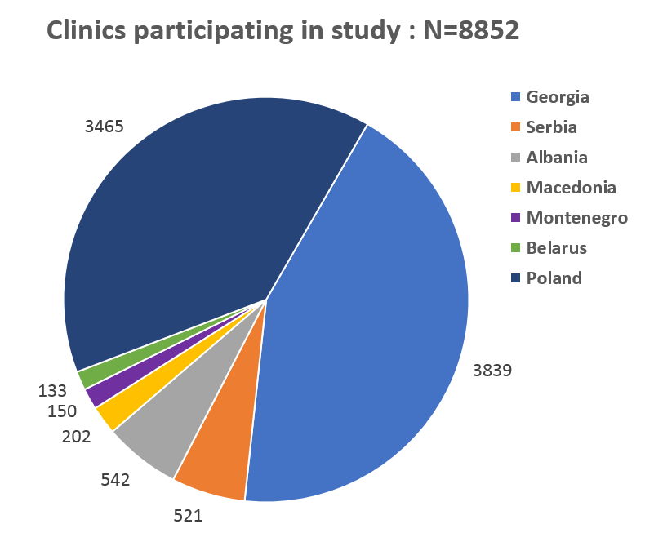
Results
All | N=8852 | N | %
Age | <=30 | 1255 | 14.2
 | 30-40 | 3046 | 34.4
 | >40 | 4550 | 51.4
 | Missing | 1 | 0.0
Last CD4 | <=500 | 3833 | 43.3
 | >500 | 4900 | 55.4
 | Missing | 119 | 1.3
Gender / risk | MSM | 3157 | 35.7
 | M heterosexual | 1470 | 16.6
 | F heterosexual | 1544 | 17.4
 | M IDU | 1648 | 18.6
 | F IDU | 197 | 2.2
 | M Other | 669 | 7.6
 | F Other | 165 | 1.9
Years since | <=1 | 1180 | 13.3
HIV+ | 1-3 | 1922 | 21.7
 | >3 | 5719 | 64.6
 | Unknown | 31 | 0.4
93.8% on ART (95% CI 93.3–94.2)
76.7% were VS* (95% CI 75.8–77.6%)
*people without VL data were assumed to be unsuppressed
Notes:
Data from 8852 persons were included; Georgia (N=3839), Albania (N=542), Macedonia (N=202), Montenegro (N=150), Serbia (N=521), Belarus (N=133) and Poland (N=3465).
Median age was 40 (IQR 34–48) and median CD4 count was 548 (IQR 360-753/mm³).

Slide 7
Continuum of care 2017 (at last visit)
Percentage

Slide 8
Continuum of Care - showing missing VL
Percentage

Slide 9
Sampling methods: Why chose a sample?
Most clinics have limited resources and many individuals under follow-up
Practically not realistic to input complete clinic population into online tool to get continuum (approx. 10-15 mins per individual)
Interested in required sample size needed from clinic to reliably estimate continuum for whole of clinic population

Slide 10
Continuum of care 2017 (at last visit)
Percentage (95% confidence intervals)

Slide 11
Sampling methods: How to choose a sample?
Possible methods:
Different random samples (ie 5%, born in January)
Bootstrapping techniques¹ using 500 or 1000 repetitions to identify 2.5 and 97.5 percentiles for the percentage on ART/VS
Application of WHO HIV drug resistance (HIVDR) Early Warning Indicators (EWI) – sampling²
¹Bootstrapping is a resampling technique used to obtain estimates of summary statistics using random sampling with replacement
²WHO consolidated guidelines on person-centred HIV patient monitoring and vase surveillance annex 2.4.6

Slide 12
1. Different random samples in one center
Sample
5% random sample
10% random sample
20% random sample
25% random sample
50% random sample
Born first week of each month
Born 5,10,15,20,25,30 of month
Born in Jan
Born in Jan/June
Born in Jan/April/July/Oct
Sample

Slide 13
A: sample size 50; 1,000 repetitions
2. Bootstrapping
Percentage
Centre
Centre
B: sample size 100; 1,000 repetitions
2.5 and 97.5 percentiles from boostrapping samples

Slide 14
3. Random sampling
Sample sizes calculated to achieve 95% confidence intervals of +7% for clinic specific results assuming 81% on ART are VS¹
Annual number of patients in clinic | Number to be sampled | Estimated hours work (10-15 mins per patient)
1500-9000 | 115-120 | 20 - 30
450-1500 | 100-115 | 16.7 - 28.75
200 | 75 | 12.5 - 18.75
100 | 55 | 9.2 - 13.75
50 | 35 | 5.8 - 8.75
¹WHO consolidated guidelines on person-centred HIV patient monitoring and vase surveillance annex 2.4.6

Slide 15
Functions of the tool
Calculator to define required sample size
Importance and directions for ensuring random selection of patients
Patient data entry form with core data items¹
Outcome: user friendly aggregate data presenting % on ART and VL suppressed – in excel, pdf, ppt etc
¹At last visit : on ART, VL, gender, HIV exposure, CD4, (race)

Slide 16
Conclusions
7 clinics in RESPOND provided data for testing ‘proof of concept’ and constructing the RHS of the continuum
Different sampling techniques investigated for impact on estimates of the clinic continuum
We propose random sample based on statistical formula¹ with sample required dependent on clinic size and precision of required estimate
Development and validation of tool as next stage
¹WHO consolidated guidelines on person-centred HIV patient monitoring and vase surveillance annex 2.4.6

Slide 17
Usability
The tool will support clinics to estimate clinic specific % on ART and VS for:
Quality control/benchmarking (self-applied auditing tool)
Support surveillance data in countries with fragmented data on VS (reporting purposes)
If interested in taking part in the development, testing and use of the tool, please contact: respond.rigshospitalet@regionh.dk or dorthe.raben@regionh.dk

Slide 18
Acknowledgements
Cohort principal investigators:.
De Wit (St. Pierre, Brussels), R. Zangerle (AHICOS), M. Law (AHOD), F. Wit (ATHENA) G. Wandeler (EuroSIDA), C. Stephan (Frankfurt), N. Chkhartishvili (IDACIRC), C. Pradier (Nice HIV cohort), A. d’Arminio Monforte (ICoNA), C. Mussini (Modena), J. Casabona & J.M. Miro (PISCIS ), H. Günthard (SHCS), A. Sönnerborg (Swedish InfCare), C. Smith (Royal Free HIV cohort), A. Castagna (St. Rafael, Milano), J.C. Wasmuth (Bonn, HIV Cohort) and J.J. Vehreschild (Cologne, HIV cohort).
Cohort Coordinator, operational team members and data management:
C. Necsoi, M. Delforge (st. Pierre, Brussels), H. Appoyer, U. Dadogan, G. Leierer (AHIVCOS), J. Hutchinson, R. Puhr (AHOD), P. Reiss, M. Hillebregt, T. Rutkens, D. Bergsma (ATHENA), F. Ebeling, M. Bucht, (Frankfurt), O. Chokoshvili, E. Karkashadze (IDACIRC), E. Fontas, K. Dollet, C. Caissotti (NICE, HIV cohort), J. Fanti, A. Tavelli, A. Rodanò (ICoNA), V. Borghi (Modena), A.Bruguera, J. Reyes-Urueña, A. Montoliu (PISCIS), H. Bucher, A. Scherrer, J. Schuhmacher, A. Traytel (SHCS), V. Svedhem-Johansson, L. Mattsson, K. Alenadaf, (Swedish InfCare), F. Lampe, C. Chaloner (Royal Free, HIV cohort), A. Lazzarin, A. Poli, S. Nozza (St. Rafael, Milano), K. Mohrmann, J. Rockstroh (Bonn, HIV cohort), G. Fätkenheuer, N. Schulze, B. Frank, M. Stecher and H. Weiler (Cologne HIV cohort).
RESPOND Scientific Steering committee: J. Lundgren (co-chair), H. Günthard (Co-Chair), C. Mussini, R. Zangerle, A. Sönnerborg, V. Vannappagari, J.C. Wasmuth, M. Law, F. Wit, R. Haubrich, H. Bucher, C. Pradier, H. Garges, C. Necsoi, G. Wandeler, C. Smith, J.J. Vehreschild, F. Rogatto, C. Stephan, N. Chkhartishvili, A. d’Arminio Monforte, A. Bruguera and A. Castagna.
.
RESPOND Executive committee:
Mocroft (Chair), J. Lundgren, R. Zangerle, H. Günthard, G. Wandeler, M. Law, F. Rogatto, C. Smith, V. Vannappagari and S. De Wit.
RESPOND coordination office, date management and quality assurance:
B. Neesgaard, J.F. Larsen, A. Bojesen, M.L. Jacobsen, T. Bruun, E. Hansen. D. Kristensen, T. Elsing, S. Thomsen T. Weide and P. Iversen.
Scientific interest group moderators:
L. Ryom, A. Mocroft (Outcomes with antiretroviral treatment), L. Peters, J. Rockstroh (Hepatitis), D. Raben and J. Kowalska (Public Health), O. Kirk, A. Philips, V. Cambiano and Jens Lundgren (PrEP)
Members of the scientific interest group:
Hepatis, Public Health, Outcomes with antiretroviral treatment, PrEP, Resistance
https://www.chip.dk/Studies/RESPOND/Scientific-Interest-Groups/Public-Health
Statisticians:
A. Mocroft and L. Greenberg
Funding:
The International Cohort Consortium of Infectious Disease (RESPOND) has received funding from ViiV Healthcare LLC and Gilead Sciences. Additional support has been provided by participating cohorts contributing data in-kind: Austrian HIV Cohort Study (AHIVCOS), The Australian HIV Observational Database (AHOD), CHU Saint-Pierre, University Hospital Cologne, The EuroSIDA cohort, Frankfurt HIV Cohort Study, Georgian National AIDS Health Information System (AIDS HIS), Modena HIV Cohort, San Raffaele Scientific Institute, Swiss HIV Cohort Study (SHCS), Royal Free HIV Cohort Study.

