Slide 1
In Vitro Forgiveness of Oral and Long-Acting INSTI-Containing Regimens at Drug Concentrations Simulating Variable Adherence
Rima K. Acosta, Michelle L. D’Antoni, Andrew Mulato, Stephen R. Yant, Tomas Cihlar, Kirsten White
Gilead Sciences, Inc., Foster City, CA
18th European AIDS Conference, October 27–30, 2021, London, UK: Poster PE1/10

Slide 2
Introduction
EACS guidelines for initial treatment of HIV-1 infection recommend daily oral regimens anchored by an INSTI plus 1 or 2 NRTIs, including the STR of BIC/FTC/TAF, the combination of DTG+FTC/TAF, and the STR of DTG/3TC¹
The 2-drug daily oral STR of DTG/RPV is approved for PWH switching ARV regimens
Recently, the LA INJ regimen CAB+RPV was approved for monthly and 2-month dosing in some countries
Lapses in adherence to daily ARV drugs can lead to virologic failure and development of drug resistance, but regimens will have distinct durations of “forgiveness” (avoiding viral rebound and resistance in the setting of suboptimal adherence)
  Long-acting regimens may be beneficial for those who want alternatives to daily oral medications, but they cannot be self-administered and there is potential for resistance development associated with low drug exposure, inconsistent dosing, preexisting drug resistance, or HIV-1 subtype²
  Previous in vitro experiments have shown that when using an inoculum of wild-type or M184V virus, BIC+FTC+TAF was better at preventing viral breakthrough and emergent drug resistance than DTG+3TC³
    In vitro viral breakthrough experiments should be analyzed comparatively; clinical trials assessing the impact of missed doses of these ARV combinations have not been conducted
3TC, lamivudine; ARV, antiretroviral; BIC, bictegravir; CAB, cabotegravir; DTG, dolutegravir; FTC, emtricitabine; INSTI, integrase strand transfer inhibitor; LA INJ, long-acting injectable; NNRTI, nonnucleoside reverse transcriptase inhibitor; NRTIs, nucleoside reverse transcriptase inhibitors; PWH, people with HIV; RPV, rilpivirine; STR, single-tablet regimen; TAF, tenofovir alafenamide.

Slide 3
Antiviral Pharmacokinetics of Daily Oral Regimens
Optimal Adherence
With 1–4 Consecutive Missed Doses
C_{min}
C_{min}
Constant, established C_{min}
C_{min} − 1 dose
C_{min} − 2 doses
C_{min} − 3 doses
C_{min} − 4 doses
ARV
dose
ARV
dose
Missed dose
Missed dose
Missed dose
Missed dose
0
1
2
3
4
5
0
1
2
3
4
5
Time, d
Time, d
Missing daily oral ARV doses results in a predictable decrease of systemic exposures to each drug in the regimen based on its established clinical half-life (t_{1/2})
C_{min}, trough concentration.

Slide 4
Objectives
To understand relative time to in vitro viral breakthrough and resistance barrier using simulated human drug exposures at either full or suboptimal treatment adherence to BIC+FTC+TAF, DTG+FTC+TAF, DTG+3TC, DTG+RPV, and CAB+RPV LA INJ

Slide 5
Methods: Figure 1. In Vitro Viral Breakthrough Selections*
+
Every 3–4 d:
MT-2 cells
HIV-1 IIIb
CPE scoring
Plating
BIC+FTC+TAF
Maintain culture for 5 wk
or
DTG+FTC+TAF
or
DTG+3TC
or
DTG+RPV
Deep sequence supernatant virus at time of breakthrough
or
CAB+RPV LA INJ
Drug combinations; replicates for each condition in 24-well plate
Split culture into new plate with fresh media/drug
*MT-2 cells were infected with HIV-1 IIIb; infected cells were cultured in presence of fixed concentrations of BIC+FTC+TAF, DTG+FTC+TAF, DTG+3TC, DTG+RPV, and CAB+RPV, split every 3–4 d with fresh media containing drug, and monitored for viral breakthrough by cytopathic effect (CPE) for up to 5 wk; supernatants containing breakthrough virus were collected and stored.

Slide 6
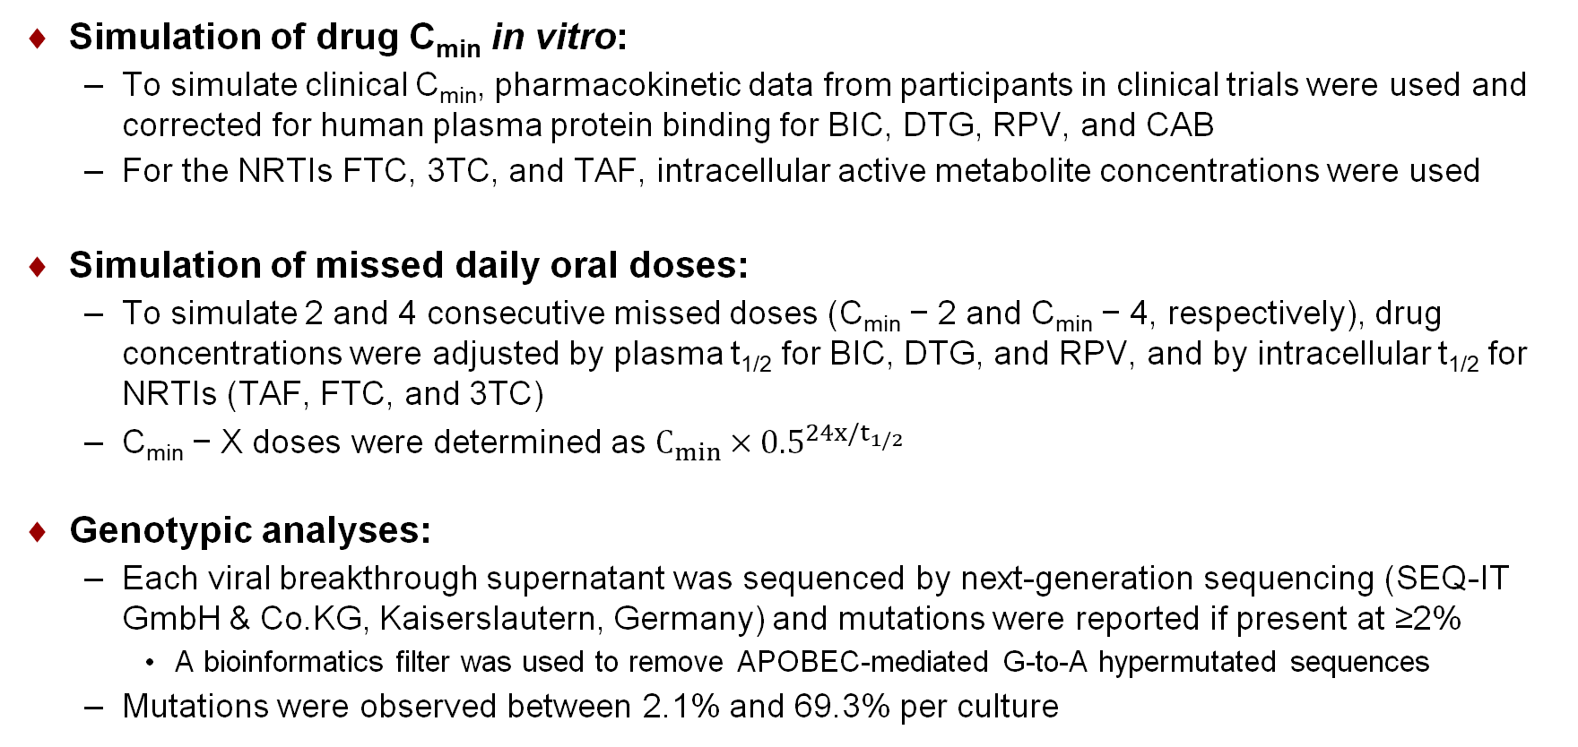
Methods
Simulation of drug C_{min} in vitro:
  To simulate clinical C_{min}, pharmacokinetic data from participants in clinical trials were used and corrected for human plasma protein binding for BIC, DTG, RPV, and CAB
  For the NRTIs FTC, 3TC, and TAF, intracellular active metabolite concentrations were used
Simulation of missed daily oral doses:
  To simulate 2 and 4 consecutive missed doses (C_{min} − 2 and C_{min} − 4, respectively), drug concentrations were adjusted by plasma t_{1/2} for BIC, DTG, and RPV, and by intracellular t_{1/2} for NRTIs (TAF, FTC, and 3TC)
  C_{min} − X doses were determined as $C_{min}×{0.5}^{24x/t_{1/2}}$
Genotypic analyses:
  Each viral breakthrough supernatant was sequenced by next-generation sequencing (SEQ-IT GmbH & Co.KG, Kaiserslautern, Germany) and mutations were reported if present at ≥2%
    A bioinformatics filter was used to remove APOBEC-mediated G-to-A hypermutated sequences
  Mutations were observed between 2.1% and 69.3% per culture

Slide 7
Results: Table 1. Drug Concentrations for Cell Culture Equivalents
 |  |  |  |  |  |  | LA INJ Regimen
 | Components of Daily Oral Regimens |  |  |  |  |  | q4wk (q1mo) |  | q8wk (q2mo)
 | BIC | FTC | TAF | DTG | 3TC | RPV | CAB | RPV | CAB | RPV
Clinical dose, mg* | 50 | 200 | 25 | 50 | 300 | 25 | 400 | 600 | 600 | 900
Molecular weight, g/mol | 449.4 | 247.2 | 534.5 | 419.4 | 229.3 | 366.4
Clinical C_{min}, µg/mL | 2.61 | 0.096 | 0.008 | 1.11 | 0.042 | 0.08
Clinical C_{min}, nM | 5808 | 388 | 15 | 2515 | 265 | 218 | 6365 | 258 | 3602 | 176
Human serum shift† | 43.6 | 1.0 | 1.0 | 27.5 | 1.0 | 32 | 74 | 32 | 74 | 32
t_{1/2}, h‡ | 17 | 37 | 116 | 14 | 17.5 | 50
CCE C_{min}, nM§ | 133 | 388 | 15 | 91 | 265 | 6.8 | 86 | 8.1 | 49 | 5.5
C_{min} − 2 | 19 | 158 | 11 | 8.5 | 40 | 3.5
C_{min} − 4 | 2.7 | 64.2 | 8.5 | 0.8 | 5.9 | 1.8
*Clinical doses of BIC, FTC, and TAF in STR of B/F/TAF; DTG, 3TC, and RPV in STRs of DTG/3TC and DTG/RPV⁴⁻⁶; and CAB and RPV in CAB/RPV injectables⁷; †BIC, DTG and CAB data generated by standard equilibrium dialysis shift in human serum vs cell culture media^{8,9}; RPV data generated internally and comparable to reported serum shift¹⁰; ‡Drug t_{1/2} for BIC, DTG, FTC-triphosphate (FTC-TP), tenofovir-diphosphate (TFV-DP), 3TC-triphosphate (3TC-TP), and RPV^{4-8,11-13}; §Cell culture equivalent (CCE) dose is clinical C_{min}/human serum shift ratio.
BIC, DTG, RPV, and CAB concentrations were calculated using their human plasma clinical C_{min} according to their prescribing information, and adjusted for human plasma protein binding (Table 1)⁴⁻¹⁰
TAF C_{min} used the active metabolite TFV-DP at its physiologic concentration in peripheral blood mononuclear cells from TAF-treated individuals^{14,15}
FTC and 3TC concentrations were set at their human plasma-free adjusted C_{min}¹¹⁻¹³

Slide 8
Table 2. Mechanisms of Forgiveness and Barrier to Resistance for Daily Oral Combinations
 | Mechanisms | BIC+FTC+TAF | DTG+FTC+TAF | DTG+3TC | DTG+RPV
Drug Levels | Long plasma or intracellular t_{1/2}, h
 | BIC or DTG | 17 | 14 | 14 | 14
 | FTC-TP or 3TC-TP | 37 | 37 | 17.5 | na
 | TFV-DP | 116 | 116 | na | na
 | RPV | na | na | na | 50
 | IN/DNA dissociation t_{1/2} for BIC or DTG | 132 | 71–78 | 71–78 | 71–78
Synergy and Mechanisms of Synergy | Combination antiviral activity
 | BIC or DTG + FTC or 3TC | Synergy | Synergy | Synergy | na
 | BIC+TAF or DTG+TAF | Synergy | Synergy | na | na
 | TFV+FTC | Synergy | Synergy | na | na
 | DTG+RPV | na | na | na | Synergy
 | TFV-chain-termination stabilized by dead-end complex with FTC-TP | Increased TFV activity | Increased TFV activity | na | na
Resistance Profile | Phenotype of M184V
 | BIC, DTG, or RPV | Sensitive | Sensitive | Sensitive | Sensitive
 | FTC or 3TC | Resistant | Resistant | Resistant | na
 | TFV (TAF) | Hypersensitive | Hypersensitive | na | na
Genetic Barrier to Resistance | No. of mutations required to confer resistance
 | BIC, DTG, or TAF | High | High | High | High
 | RPV | na | na | na | Low–medium
 | FTC or 3TC | Low | Low | Low | na
IN, integrase; na, not applicable.

Slide 9
Figure 2. Time to Viral Breakthrough
CAB+RPV q1mo
CAB+RPV q2mo
DTG+3TC
DTG+FTC+TAF
DTG+RPV
BIC+FTC+TAF
Long-Acting Injectable
Oral Daily
C_{min}
C_{min}
C_{min} − 2
C_{min} − 4
36/36 (100%)
41/60 (68%)
48/48 (100%)
45/48 (94%)
18/36 (50%)
0/48
0/24
0/48
0/48
0/24
0/48
0/48
0/60
0/60
20/48
(42%)
13/60
(22%)
6/48
(13%)
2/36
(6%)
3/36
(8%)
Emergent Resistance Substitutions
4 | M184V/I
3 | V75I
1 | K219R
2 | M230I
3 | K101E
1 | H221Y
4 | E138K
1 | V90I
1 | V90I+V106I+E138K
2 | M184I
RT
IN
1 | L74M
2 | G140E/R
1 | S153F
2 | E157K
1 | R263K
1 | L74M +R263K
1 | H51Y
1 | S153F
2 | Q148R
1 | R263K
1 | M50I
1 | S153F
1 | G163R
1 | G163R
RT+IN
1 | M184V(RT) +Q95R(IN)
1 | Y181C(RT)+H51Y(IN)
1 | E138K(RT)+H51Y(IN)
1 | E138K(RT)+Q95R(IN)
1 | E138K(RT)+A128T(IN)
*Contained ≥1 known resistance-associated substitution. RT, reverse transcriptase.
The LA INJ combination CAB+RPV prevented viral breakthrough at drug Cmin (monthly and 2-month dosing; Fig 2)

Slide 10
Conclusions
The INSTI-containing combinations of BIC+FTC+TAF, DTG+FTC+TAF, DTG+3TC, and DTG+RPV had no viral breakthrough with concentrations simulating high adherence
  Regimen differentiation occurred when multiple missed doses were simulated in vitro; BIC+FTC+TAF had the highest forgiveness and barrier to resistance
    In vitro viral breakthrough experiments should be analyzed comparatively; controlled clinical trials assessing the impact of missed doses of these ARV combinations have not been conducted
The long-acting injectable combination of CAB+RPV had no viral breakthrough at concentrations simulating C_{min} for both monthly and 2-month dosing; further studies with CAB+RPV are needed to understand forgiveness during the pharmacokinetic tail of this regimen

Slide 11
References
1. EACS. Guidelines Version 10.1; October 2020; 2. Cutrell A, et al. AIDS 2021;35:1333-42; 3. Mulato A, et al. JAIDS 2021;86:369-77; 4. Biktarvy [package insert]. Foster City, CA: Gilead Sciences, Inc.; revised 9/21; 5. Dovato [package insert]. Research Triangle Park, NC: ViiV Healthcare; 3/21; 6. Juluca [package insert]. Research Triangle Park, NC: ViiV Healthcare; 3/21; 7. Cabenuva [package insert]. Research Triangle Park, NC: Viiv Healthcare; 1/21; 8. Margolis D, et al. Lancet 2017;390:1499-510; 9. Tsiang M, et al. Antimicrob Agents Chemother 2016;60:7086-97; 10. European Medicines Agency. CHMP assessment report: Edurant; 9/22/11; 11. Dickinson L, et al. Antimicrob Agents Chemother 2015;5910:6080-6; 12. Else LJ, et al. Antimicrob Agents Chemother 2011;56:1427-33; 13. Yuen GJ, et al. Antimicrob Agents Chemother 2004;48:176-82; 14. Callebaut C, et al. PLoS One 2017;12:e0169948; 15. Custodio JM, et al. Antimicrob Agents Chemother 2016;60:5235-4.

Slide 12
Acknowledgments
The authors thank Alex Thielen and Martin Daeumer at Seq-IT, and Ross Martin and Silvia Chang at Gilead for deep-sequence analyses. This study was funded by Gilead.

