Slide 1
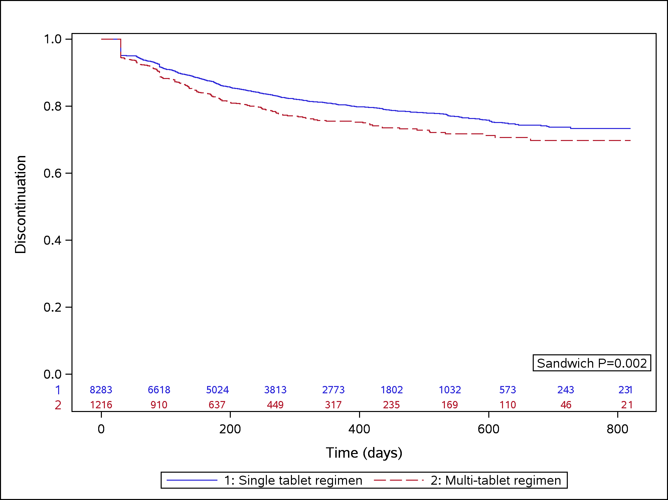
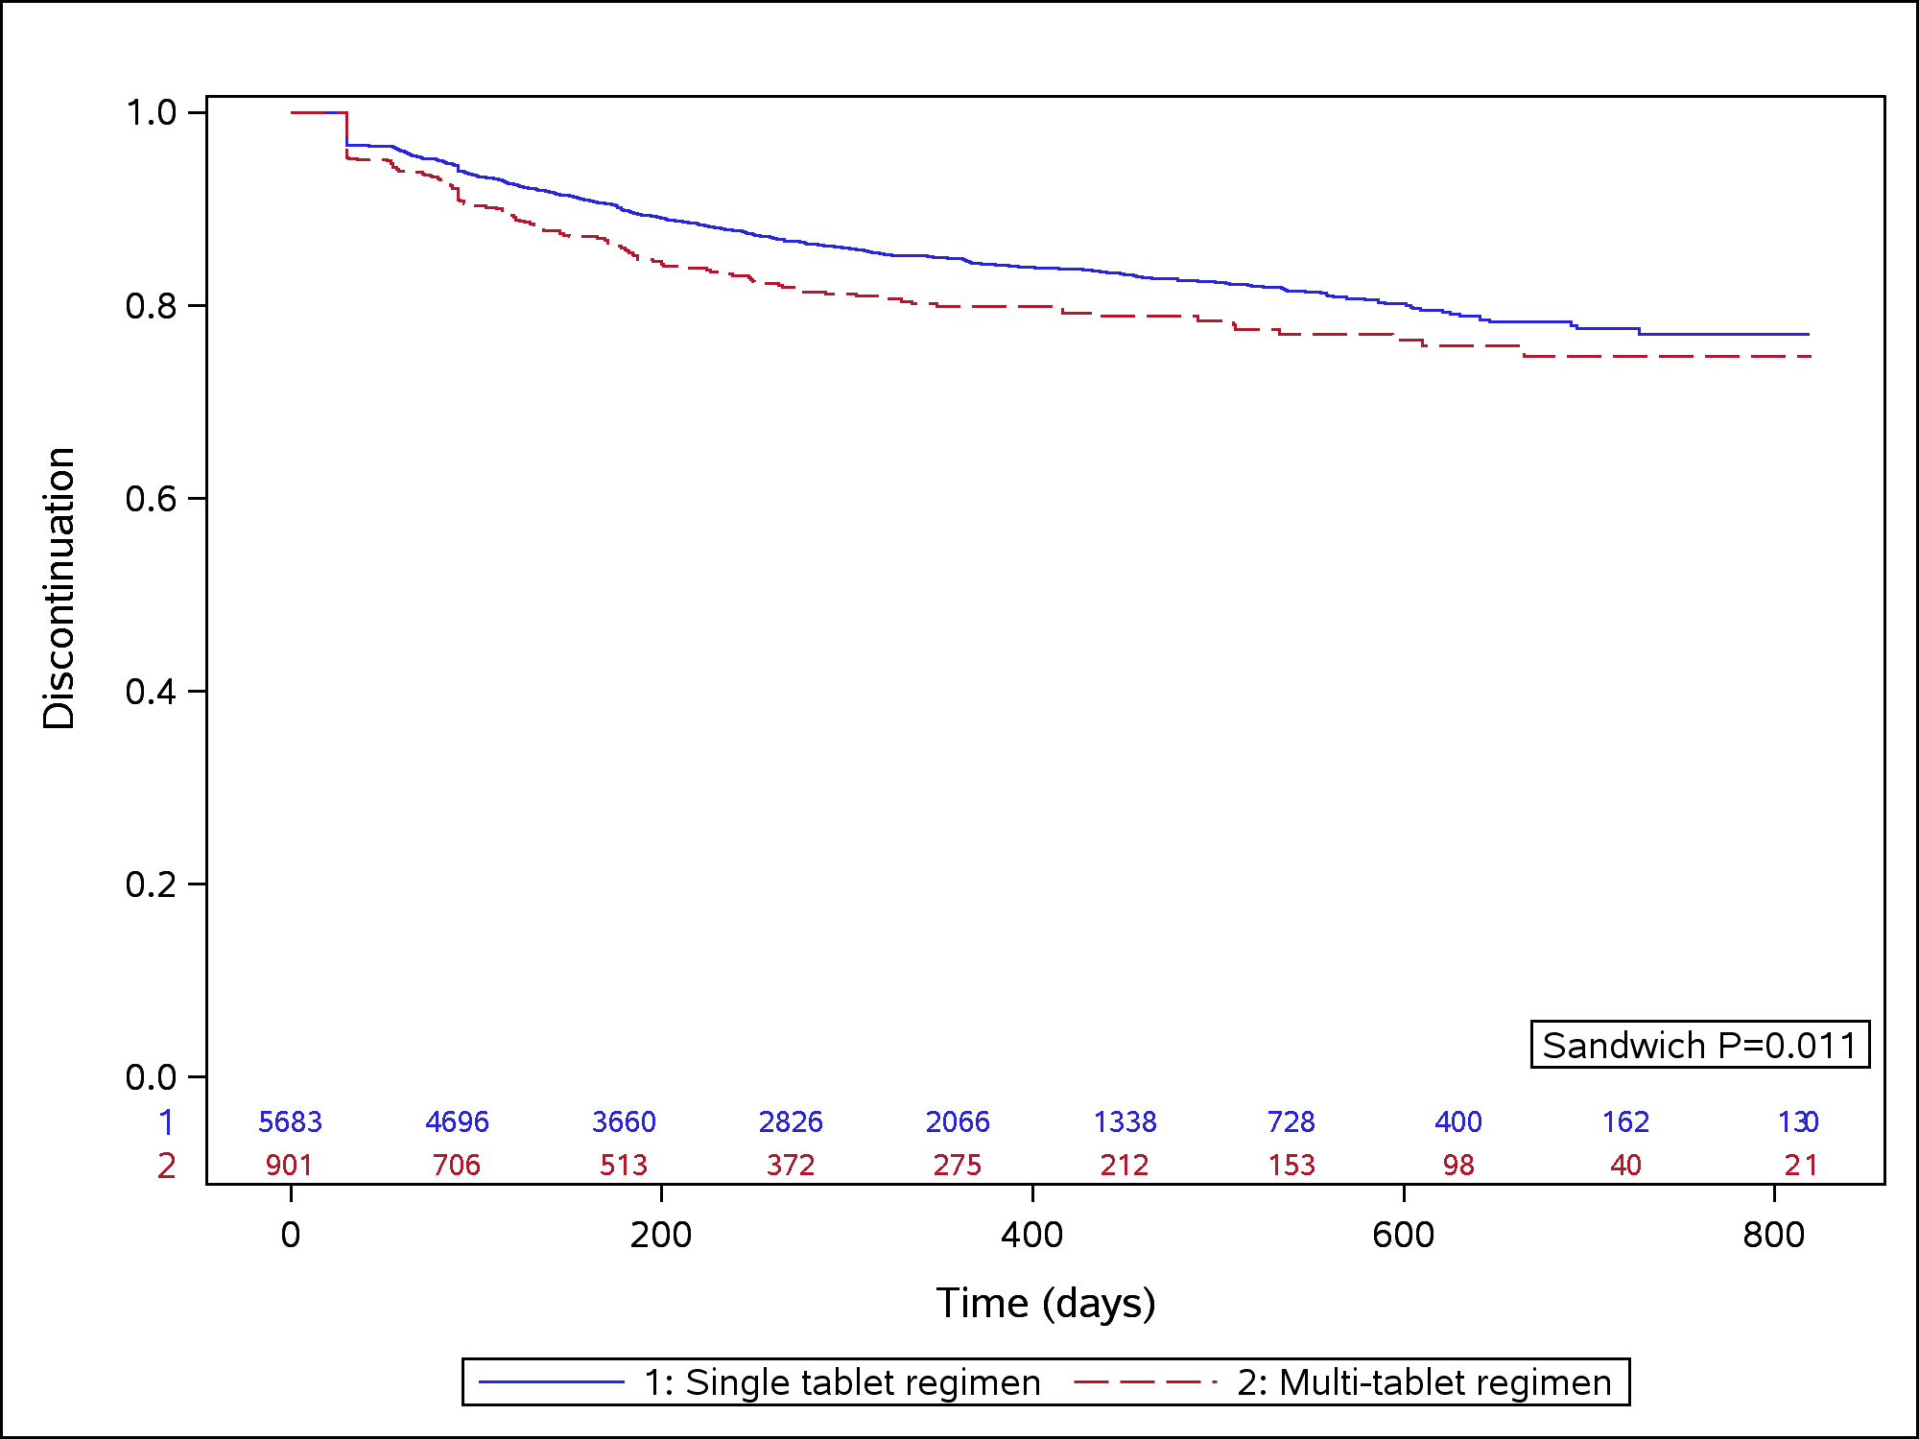
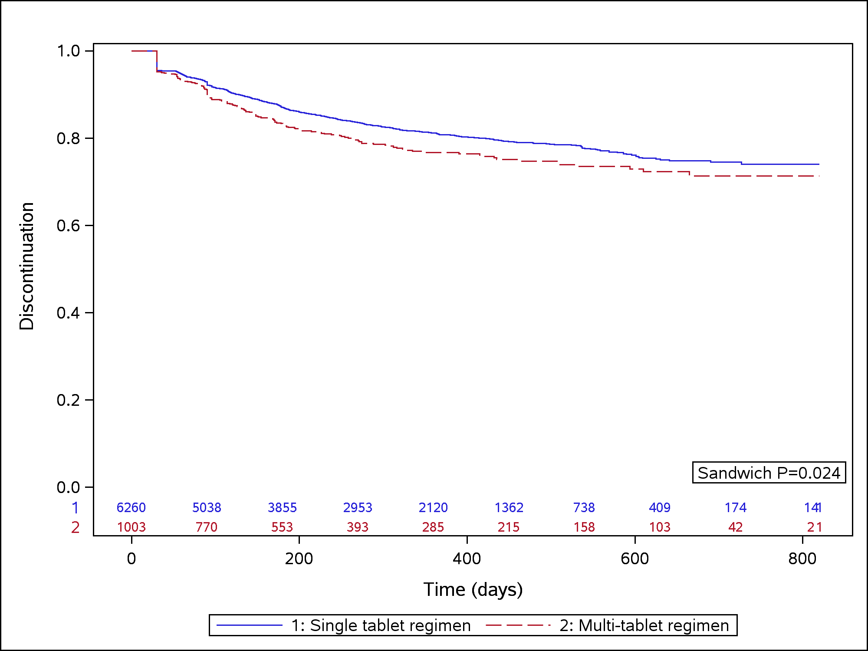
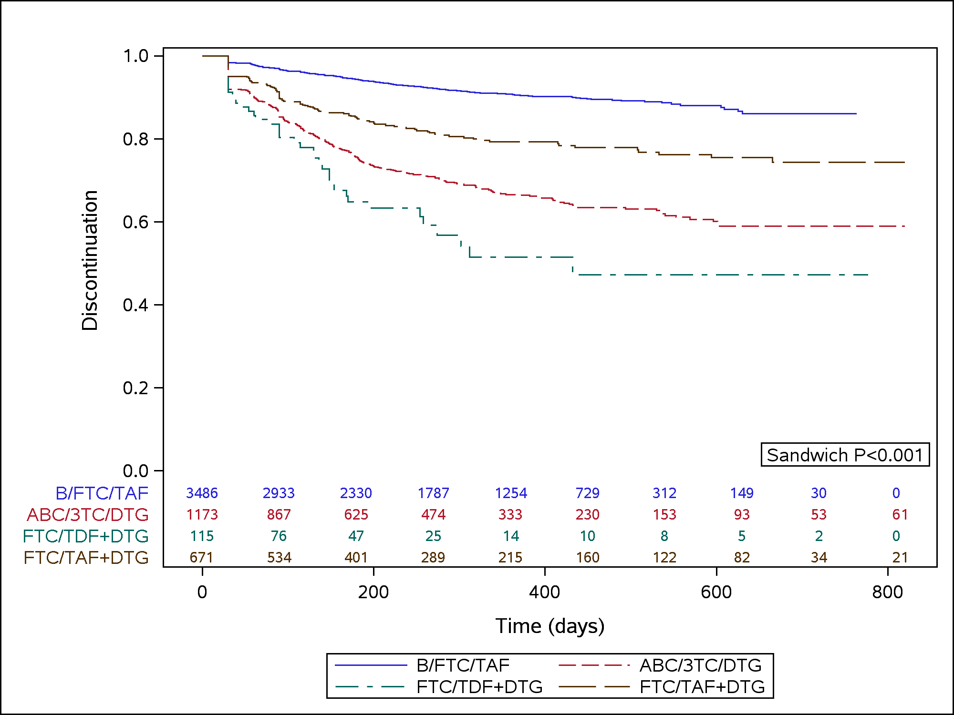
Characteristics, Treatment Patterns, and Virologic Outcomes for Treatment-experienced People Living with HIV Switching to MTR or STR ART since 2018
Ben Chastek¹, Amy Anderson¹, Joshua Gruber², Sunil Majethia², Woodie Zachry², Dylan Mezzio², Amy Colson³
¹Optum, Eden Prairie, MN; ²Gilead Sciences, Foster City, CA; ³Community Research Initiative (CRI), Boston, MA
Introduction
Results
Discontinuation of antiretroviral therapy (ART) is associated with increased morbidity and mortality as well as increased risk of HIV transmission^{1,2}
Understanding persistence patterns of different antiretroviral regimens could assist with selection of optimal treatment for people living with HIV (PLWH).
Table 1. Baseline Demographic and Clinical Characteristics
Figure 4. Kaplan Meier Time to Discontinuation of LOT¹
Follow-up VL data was available for n=1681 LOTs (17%) among LOTs with suppressed VL at start
Proportion of VF among those with suppressed VL at LOT start: All LOTS (STR: 7%, MTR: 10%); INSTI-based regimens (B/FTC/TAF: 6%, ABC/3TC/DTG: 10%; F/TDF+DTG: 9%; F/TAF+DTG: 8%)
Rates of VF were similar for STR, MTR and INSTI-based regimens, after adjusting for baseline covariates (Figure 6).
 |  | All Lines† |  | INSTI-Based Triple |  | TAF-Based |  | INSTI-based Regimens‡
 | Total (N=9,499) | STR (N=8,283) | MTR (N=1,216) | STR (N=6,260) | MTR (N=1,003) | STR (N=5,683) | MTR (N=901) | B/FTC/TAF (N=3,486) | ABC/3TC/ DTG (N=1,173) | FTC/TDF+ DTG (N=115) | FTC/TAF+ DTG (N=671)
Age: Mean(SD) | 51.7 (12.9) | 51.6 (13.0) | 52.1 (12.4) | 51.2 (13.0) | 51.7 (12.6) | 51.6 (12.7) | 52.4 (12.4) | 52.8 (12.5) | 49.9 (14.0**) | 48.8 (12.3**) | 51.7 (12.7*)
Female: % | 18.90 | 18.3 | 23.1** | 17.3 | 22.3** | 17.9 | 22.1* | 16.4 | 17.1 | 20.9 | 21.6**
Region: %
Northeast | 12.64 | 12.4 | 14.6* | 12.3 | 15.1* | 13.1 | 13.8 | 13.7 | 9.8** | 20.9 | 13.6
Midwest | 12.90 | 13.0 | 12.0 | 13.6 | 12.9 | 13.6 | 13.3 | 13.6 | 13.0 | 7.0 | 13.6
South | 61.75 | 62.3 | 58.1* | 61.7 | 56.2** | 60.6 | 55.5* | 58.9 | 67.1** | 63.5 | 54.8
West | 12.68 | 12.3 | 15.3* | 12.4 | 15.9** | 12.7 | 17.4** | 13.8 | 10.1** | 8.7 | 18.0*
Commercial insurance: % | 66.4 | 66.9 | 63.5* | 67.4 | 65.4 | 66.3 | 64.6 | 64.4 | 69.3** | 69.6 | 67.1
Number of baseline LOTs: Mean(SD) | 2.9 (2.6) | 2.8 (2.5) | 3.6** (3.3) | 2.8 (2.5) | 3.3* (2.8) | 2.7 (2.4) | 3.5** (3.3) | 2.7 (2.4) | 3.0* (2.8) | 3.4* (2.8) | 3.3** (2.7)
Baseline duration of ART (days): Mean(SD) | 1469 (918) | 1476 (914) | 1420 (943) | 1468 (910) | 1398 (937) | 1491 (913) | 1408* (941) | 1568 (923) | 1375* (902) | 1415 (977) | 1348** (942)
Had Baseline Viral Load: N (%) | 3208 (33.8) | 2845 (34.4) | 363 (29.9**) | 2146 (34.3) | 298 (29.7*) | 2006 (35.3) | 278 (30.9*) | 1289 (37.0) | 360 (30.7**) | 34 (29.6) | 207 (30.9**)
Baseline Viral Load Suppressed: N (%) | 2631 (82.0) | 2348 (82.5) | 283 (78) | 1728 (80.5) | 234 (78.5) | 1673 (83.4) | 216 (77.7*) | 1075 (83.4) | 253 (70.3**) | 26 (76.5) | 162 (78.3)
All STR vs. MTR
TAF STR vs. MTR
Objective
Describe demographic characteristics, treatment patterns and persistence as well as virologic outcomes among PLWH after switching to guideline recommended single-tablet (STR) or multi-tablet (MTR) regimens
Ref. = B/FTC/TAF (n=720) Ref. = STR*
Figure 6. Adjusted HR (95% CI) of Virologic Failure vs. STR; B/FTC/TAF (Among LOTs with Virologic Suppression at Baseline)
Methods
All - MTR (n=167)
A retrospective study was performed using commercial and Medicare Advantage claims data from Optum Research Database.
Lines of therapy (LOTs) were included for treatment-experienced adults who switched to guideline recommended therapies that lasted ≥30 days and started on or after 01/01/2018; individuals were followed through 03/31/2020 and could contribute multiple LOTs to analyses
Up to 14-days was allowed to fill all ART components (MTR LOTs)
Reasons for end of LOT included: switch to a new regimen (no gap in therapy), treatment discontinuation (gap in therapy of ≥60 days), end of observation (study period, or disenrolled from health plan).
STR v. MTR outcomes were evaluated for All, INSTI-based, and TAF-based regimens.
LOT level comparisons were conducted for DHHS 2021 recommended INSTI-based regimens³ (B/FTC/TAF v. ABC/3TC/DTG, FTC/TDF+ DTG, and FTC/TAF+ DTG); DTG/3TC was not included in this analysis due to limited follow-up time within study period.
Baseline demographics, prior LOTs, and virologic data closest to LOT start (-90 to +29 days of switch) were assessed.
Outcomes included: LOT duration (persistence), reason for the observable end of LOT, risk of treatment discontinuation, and virologic failure (≥50 copies/mL) in LOTs with virologic suppression at LOT start (<50 copies/mL).
Unadjusted and adjusted (baseline covariates) hazard ratios were calculated using Cox proportional hazard models to estimate risk of discontinuation and virologic failure over time.
Robust standard errors, with clustering at the individual level, were used to account for individuals that contributed multiple LOTs to analyses.
STR and B/FTC/TAF were comparators for MTR and guideline recommended INSTI regimens, respectively.
INSTI-MTR (n=142)
INSTI-Based STR vs. MTR
INSTI-Based Regimens
TAF-MTR (n=135)
ABC/3TC/DTG (n=154)
F/TDF+DTG (n=13)
*P<0.05 vs STR; B/FTC/TAF
** P<0.01 vs STR; B/FTC/TAF
†All Lines" : "1596 participants contributed 2 or more LOTs to analysis
‡INSTI-based Regimens": "1041 participants contributed 2 or more LOTs to analysis"
F/TAF +DTG (n=108)
*P<0.05 vs STR; B/FTC/TAF
** P<0.01 vs STR; B/FTC/TAF
Favors STR; B/FTC/TAF
A significantly higher percentage of MTR LOTs ended in a switch to a new ART, while STR LOTs were more likely to persist to the end of study period (All, INSTI-, and TAF-based regimens; Figure 2)
Persistence on each regimen, expressed as mean length of continuous treatment per 100 days of observation, was higher for STR (v. MTR) and higher for B/FTC/TAF (v. other DHHS recommended INSTI-based regimens; Figure 3).
Time to discontinuation of treatment was longer for B/FTC/TAF (v. INSTI-based regimens) & STR (v. All, INSTI- and TAF-based MTR; Figure 4)
After adjusting for baseline covariates (Figure 5) the rate of discontinuation of treatment was lower for STR LOTs relative to MTR and for B/FTC/TAF relative to other INSTI-based LOTs
Covariates included: Age group, gender, region, insurance type, Charlson comorbidity index, and 10 most prevalent baseline AHRQ comorbidities *Sample for STR comparators: All-STR (n=1541), INSTI-MTR (n=1111); TAF-STR (n=1096)
B/FTC/TAF was most common subsequent regimen among LOTs that ended due to switch
¹Discontinuation was defined as a gap in therapy of at least 60 days. PLWH were considered censored at end of the study period, disenrolled, or at switched therapy
Table 3. Subsequent Regimen Among LOTs Ending due to Switchª
Figure 5. Adjusted HR (95% CI) of Discontinuation vs. STR; B/FTC/TAF
Subsequent LOT
 | B/FTC/TAF | DTG/3TC | EVG/COBI/FTC/TAF | FTC/TAF+ DTG | DTG/RPV | ABC/3TC/ DTG | RPV/FTC/ TAF | F/TAF + RAL
Total (N=882) | 461(56.1) | 60(7.3) | 54(6.6) | 48(5.8) | 42(5.1) | 38(4.6) | 37(4.5) | 19(2.3)
All: STR (N=891) | 332(54.4) | 54(8.9) | 42(6.9) | 27(4.4) | 38(6.2) | 37(6.1) | 34(5.6) | 6(1)
All: MTR (N=374) | 129(60.8) | 6(2.8) | 12(5.7) | 21(9.9) | 4(1.9) | 1(0.5) | 3(1.4) | 13(6.1)
INSTI: STR (N=584) | 218(54.4) | 39(9.7) | 28(7) | 19(4.7) | 26(6.5) | 20(5) | 12(3) | 6(1.5)
INSTI : MTR (N=271) | 114(65.5) | 6(3.4) | 7(4) | 18(10.3) | 2(1.1) | 1(0.6) | 2(1.1) | 13(7.5)
TAF: STR (N=482) | 178(54.4) | 29(8.9) | 14(4.3) | 20(6.1) | 21(6.4) | 21(6.4) | 11(3.4) | 4(1.2)
TAF: MTR (N=235) | 100(70.4) | 4(2.8) | 5(3.5) | 10(7) | 2(1.4) | 0(0) | 2(1.4) | 9(6.3)
Ref. = B/FTC/TAF Ref. = STR
Current LOT
INSTI-Based Regimens
Figure 2. Reason for End of LOT
STR vs. MTR
Results
^{aA}mong LOTs that switched to guideline recommended regimens that met study inclusion criteria. Regimens not presented represent less than 5% in each cohort (EFV/FTC/TDF; DRV/c/r/FTC/TAF; EVG/COBI/FTC/TDF; RPV/FTC/TDF; F/TDF + RAL; FTC/TDF + DTG; FTC/TDF+DRV/r,c; FTC/TAF+DRV/r,c; FTC/TDF+ATV/r,c; FTC/TAF+ATV/r,c; ABC/3TC+DRV/r,c)
A total of 9,499 LOTs were identified from 7,456 eligible treatment-experienced PLWH (n=7,263 INSTI-based; n=6584 TAF-based LOTs). (See Figure 1 for regimen specific LOTs)
STR and MTR cohorts had similar distributions of age, region and insurance type. (Table 1)
Compared to MTR, individuals on STR were more likely to be male and virologically suppressed at switch (among those with available data; Table 1)
*P<0.05 vs STR; B/FTC/TAF
** P<0.01 vs STR; B/FTC/TAF
Favors STR; B/FTC/TAF
Limitations
PLWH were primarily covered by commercial insurance, and results may differ for Medicaid and Medicare populations.
The geographic spread of PLWH is skewed towards the South.
Viral load data are only available for a subset of sample.
*P<0.05 vs STR; B/FTC/TAF
** P<0.01 vs STR; B/FTC/TAF
Covariates included: Age group, gender, region, insurance type, Charlson comorbidity index, and 10 most prevalent baseline AHRQ comorbidities
STR/MTR (ALL) included LOTs with PI, NNRTI and INSTI as described in Figure 1.
Figure 1. Cohort Sample Size
Figure 3. Mean Number of Days on Continuous Treatment per 100 Days of Observation
Conclusions
All LOTsª
(N = 9499; 100%)
STR vs. MTR
INSTI-Based Regimens
STR LOTs had longer durations of therapy & were more likely to persist until end of observation (v. All, INSTI-, TAF-based MTR).
MTR LOTs had significantly higher risk of discontinuation compared to STR LOTs (All, INSTI-, TAF-based).
PLWH on B/FTC/TAF were less likely to discontinue therapy compared to other DHSS recommended INSTI-based regimens.
B/FTC/TAF numerically had the lowest risk of VF; no differences in the rate of VF were found between LOTs after adjusting for covariates.
B/FTC/TAF was the subsequent regimen for >50% of LOTs that ended in a switch, for all of LOT types (STR, MTR, INSTI, TAF).
MTR
(N = 1216; 13%)
STR
(N = 8283; 87%)
INSTI-Based⁺
(N = 1003; 11%)
TAF⁺
(N = 901; 9%)
TAF⁺
(N = 5683; 60%)
INSTI-Based⁺
(N = 6260; 66%)
FTC/TDF+DTG
(N = 115; 1%)
FTC/TAF+DTG
(N = 671; 7%)
B/FTC/TAF
(N = 3486; 37%)
ABC/3TC/DTG
(N = 1173; 12%)
DTG/3TC⁺⁺
(N = 210, 2%)
References: ¹El-Sadr WM, Lundgren JD, Neaton JD, et al. CD4+ count-guided interruption of antiretroviral treatment. N Engl J Med. Nov 30 2006;355(22):2283-2296). ²Rodger AJ, Cambiano V, Bruun T, et al. Sexual Activity Without Condoms and Risk of HIV Transmission in Serodifferent Couples When the HIV-Positive Partner Is Using Suppressive Antiretroviral Therapy. JAMA. 2016;316(2):171-181 ³DHHS 2021: Recommended Initial Regimens for Most People with HIV: https://clinicalinfo.hiv.gov/sites/default/files/guidelines/documents/AdultandAdolescentGL.pdf. Accessed on Oct 8, 2021. Abbreviations: 95% confidence interval (95% CI%); antiretroviral therapy (ART); line of therapy (LOT); multiple tablet regimens (MTR); persons living with HIV (PLWH); single tablet regimen (STR); abacavir (ABC); bictegravir (B); cobicistat (COBI); dolutegravir (DTG); elvitegravir (EVG); emtricitabine (FTC); lamivudine (3TC); tenofovir alafenamide (TAF); tenofovir disoproxil fumarate(TDF); raltegravir (RAL); rilpivirine (RPV) Disclosures: Chastek B and Anderson A are employees of Optum; Gruber J, Majethia S, Zachry W, Mezzio D are employees of Gilead; Colson A is principal investigator for clinical trials sponsored by Gilead Sciences, Janseen & ViiV/GSK Speakers Bureau member for (ViiV/GSK), and a presenter of a product specific educational / user-experience video for ViiV/GSK
ªRegimens included: INSTI: EVG/COBI/FTC/TAF, EVG/COBI/FTC/TDF, ABC/3TC/DTG, B/FTC/TAF, DTG/3TC, DTG/RPV, FTC/TDF+DTG, FTC/TAF+DTG, F/TDF+RAL, F/TAF+RAL; PI: DRV/c/r/FTC/TAF, FTC/TDF+DRV/r,c, FTC/TAF+DRV/r,c, FTC/TDF+ATV/r,c, FTC/TAF+ATV/r,c, ABC/3TC+DRV/r,c; NNRTI: RPV/FTC/TAF, RPV/FTC/TDF, EFV/FTC/TDF, DTG/RPV
⁺LOTs containing TAF and INSTI-based therapy are not mutually exclusive. Direct regimens analysis limited to DHSS guideline recommended regimens
⁺ ⁺ DTG/3TC was not included in regimen level analysis due to limited follow up time within study period (median 150 days v. >315 days for other regimens).
18th European AIDS Conference (EACS), October 27-30, 2021, Virtual & London, United Kingdom

