Slide 1
Resistance Analysis of Long-Acting Lenacapavir in Highly Treatment-Experienced People with HIV after 26 Weeks of Treatment
Nicolas Margot, Laurie VanderVeen, Vidula Naik, Silvia Chang, PC Parvangada, Ross Martin, Hadas Dvory-Sobol, Martin S. Rhee, and Christian Callebaut
Gilead Sciences, Inc., Foster City, USA
18th European AIDS Conference (EACS) London UK, October 27-30, 2021 : Oral OS1/1

Slide 2
Disclosures
Nicolas Margot is an employee of Gilead Sciences, Inc.

Slide 3
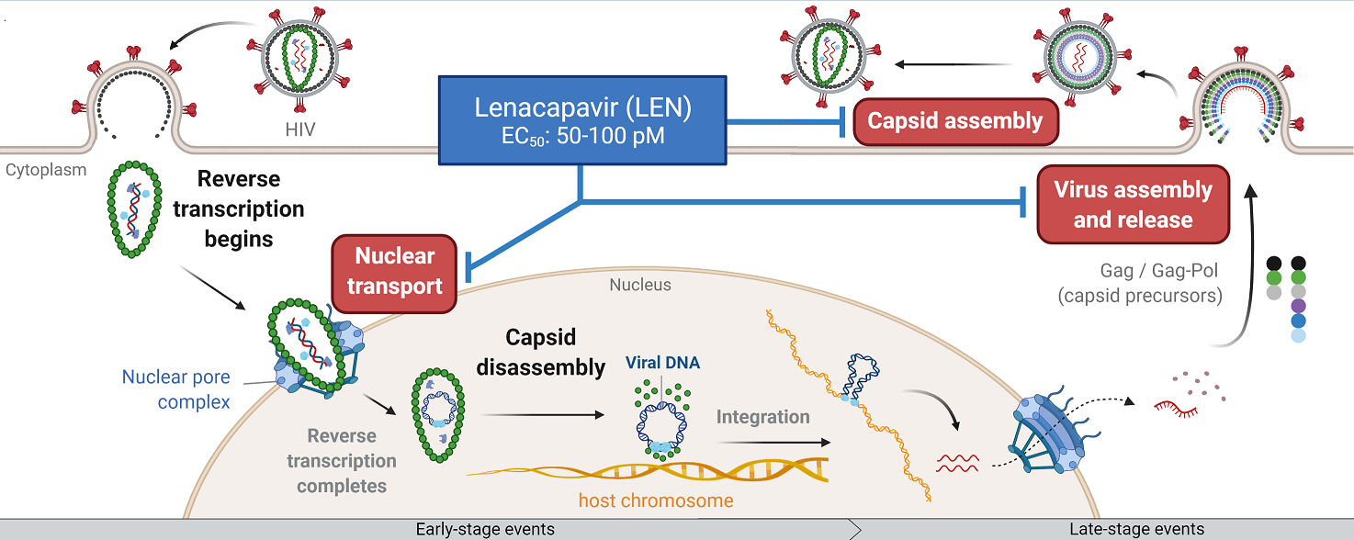
Lenacapavir targets multiple stages of HIV replication cycle
EC₅₀, half-maximal effective concentration.
Link JO, et al. Nature 2020;584:614-8; Zila V, et al. Cell 2021;184:1032-46.

Slide 4
LEN: Long-Acting Inhibitor of HIV-1 Capsid
Fully active against HIV with resistance to existing drug classes¹⁻³
  NRTI, NNRTI, INSTI, PI
PK of SC LEN supports its use once every 6 months⁴
Potent antiviral activity in PWH
  In Phase 1 proof-of-concept study:
    Up to 2.3 log₁₀ HIV-1 RNA decline after 9 days of a single-dose monotherapy⁵
  In Phase 2 study in treatment-naïve PWH (CALIBRATE)
    High rates of viral suppression (94%) at Week 28 when given SC or PO in combination with F/TAF ⁶
  In Phase 2/3 study in viremic, heavily treatment-experienced PWH with MDR (CAPELLA)
    High rates of viral suppression (81%) at Week 26 in combination with an optimized background regimen ^{7,8}
Lenacapavir
INSTI, integrase strand-transfer inhibitor; MDR: multidrug resistance; NRTI, nucleos(t)ide reverse transcriptase inhibitor; PI, protease inhibitor; PK: pharmacokinetics; PWH, people with HIV; SC, subcutaneous.
1. Yant SR, et al. CROI 2019; 2. Margot N, et al. CROI 2020; 3. VanderVeen L, et al. CROI 2021; 4. Begley R, et al. AIDS 2020; 5. Daar, et al. CROI 2020;
6. Gupta S, et al. IAS 2021; 7. Segal-Maurer S, et al. CROI 2021; 8. Molina J-M, et al. IAS 2021

Slide 5
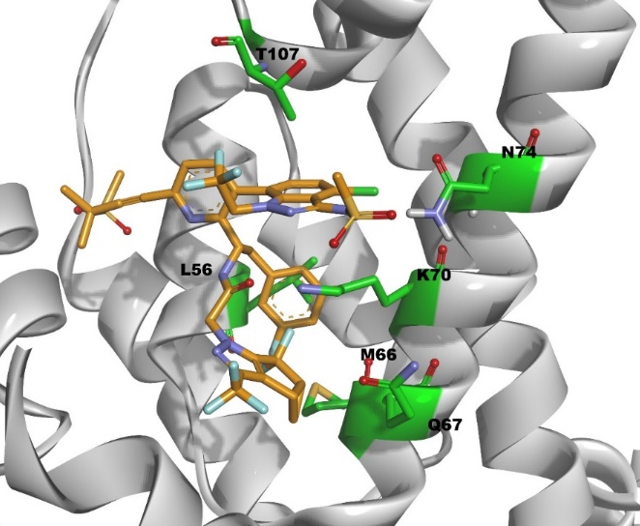
LEN In Vitro Resistance Characterization
In vitro resistance selections in MT-2 cells and human PBMCs identified 7 mutations arising at 6 amino acids in capsid¹
  L56I, M66I, Q67H, K70N, N74S/D, T107N
  All mutations map to LEN binding site
Resistance mutations correlated with low replication capacity for all mutants in vitro, except Q67H
LEN mutations not found in analysis of 1500 HIV clinical isolates²
  Treatment-naïve or -experienced, with or without PI-treatment failure
  Lack of pre-existing genotypic resistance to LEN
1. Link JO, et al. Nature 2020; 584:614-618; 2. Marcelin A, et al. J Antimicrob Chemother 2020 Jun 1;75:1588-1590.

Slide 6

CAPELLA Study Design
Key eligibility criteria:
HIV-1 RNA ≥400 copies/mL
Resistance to ≥2 agents
from 3 of 4 main ARV classes
Functional monotherapy
(14-d)
Maintenance
1A-Oral LENª
SC LENª Q6M for 52 weeks
n=24
Failing regimen
OBR
1- Randomised cohort
(Double blind)
NO
n=12
1B-Placebo
Oral LENª
SC LENª Q6M for 52 weeks
Screening period
Pre-randomisation repeat HIV-1 RNA
Decline of ≥0.5 log₁₀ copies/mL
(vs screening) or <400 copies/mL
Or if Cohort 1 is fully enrolled
Failing regimen
OBR
YES
2- Non-randomised cohort (Open label)
Oral LENª
SC LENª Q6M for 52 weeks
n=36
OBR
OBR
Segal-Maurer S, et al. CROI 2021; Molina J-M, et al. IAS 2021
ª Oral LEN administered as 600 mg on Days 1 and 2, 300 mg on Day 8 (600 mg on Days 15 and 16, 300 mg on Day 22, for placebo participants); SC LEN administered as 927 mg (2 x 1.5 mL) in the abdomen on Day 15. OBR, (investigational agents, such as fostemsavir, were allowed; atazanavir (ATV), ATV/cobicistat, ATV/ritonavir, efavirenz, entecavir, nevirapine, tipranavir were not allowed). OBR, optimised background regimen; Q6M: once every 6 months.

Slide 7
Efficacy at Week 26: Randomised Cohort (n=36)
HIV-1 RNA (FDA-Snapshot) and CD4 Responses
+81
cells/μL
Participants, %
Mean Change in CD4 cells/μL (95% CI)
<50
<200
≥50
≥200
No
Virologic
Data
HIV-1 RNA,
copies/mL
HIV-1 RNA,
copies/mL
Day
Week
Oral lead-in
SC Maintenance
n= 29 32 7 4 0 0
n = 36 35 35 36 35 36 34 34
Median CD4 = 127 - - - - - - 197
Molina J-M, et al. IAS 2021

Slide 8
Resistance Analyses
Baseline Resistance Analyses
Confirm Baseline resistance criteria are met
  Resistance to ≥2 ARVs in ≥ 3 of 4 main ARV classes
    Monogram Biosciences Assays (45 of 72)
    Historical resistance reports (27 of 72)
Test susceptibility to entry inhibitors² (61 of 72)
Post-Baseline Resistance Analyses
Suboptimal Virologic Response (SVR)
  Confirmed HIV-1 RNA ≥ 50 c/mL and < 1 log₁₀ ↓ from LEN start (assessed at Week 4)
Virologic Rebound (VR)
  After suppression, confirmed HIV-1 RNA ≥ 50 c/mL or >1 log₁₀ ↑ from nadir
Viremia at Last Visit
Resistance assessment based on
Overall Susceptibility Scores (OSS)¹
for each ARV
1 OSS is based on both genotypic and phenotypic data
2 Entry inhibitors are enfuvirtide, fostemsavir, ibalizumab and maraviroc.

Slide 9
Baseline Resistance-Associated Mutations
Main ARV Classes
% Participants with RAMs per ARV class
Mean # RAMs per ARV class
N=72
99%
94%
83%
65%
4.1
3.8
% of Participants
Number of RAMs
2.4
1.3
ARV = antiretroviral; INSTI = integrase strand-transfer inhibitor; NRTI = nucleoside RT inhibitor; NNRTI = non-nucleoside RT inhibitor; PI = protease inhibitor; R = resistance; RAM: resistance-associated mutation (primary); . Number of RAMs tallied: NRTI = 16; NNRTI = 14; PI = 15; INSTI = 10

Slide 10

Baseline Class Resistance
4 Main ARV Classes
Entry Criteria: Resistance to ≥2 ARVs in ≥ 3 of 4 main ARV classes
Resistance Class |  |  |  | Number (%) of Participants
NRTIª | NNRTI | PI | INSTI | Cohort 1 (n = 36) | Cohort 2 (n = 36) | All (N = 72)
 |  |  |  | 17 (47%) | 16 (44%) | 33 (46%)
 |  |  |  | 9 (25%) | 13 (36%) | 22 (31%)
 |  |  |  | 8 (22%) | 5 (14%) | 13 (18%)
 |  |  |  | 2 6%) | 0 | 2 (3%)
 |  |  |  | 0 | 1 (3%) | 1 (1%)
 |  |  |  | 0 | 1 (3%) | 1 (1%)
NNRTI-R
n=72
0
1
0
1
INSTI-R
0
13
33
22
0
PI-R
2
0
0
NNRTI-R
0
PI-R
INSTI-R
NRTI-R
NRTI-R
ª M184V/I alone was not sufficient to fulfill the NRTI resistance criteria in the study.
ARV = antiretroviral; INSTI = integrase strand-transfer inhibitor; NRTI = nucleoside RT inhibitor; NNRTI = non-nucleoside RT inhibitor; PI = protease inhibitor.

Slide 11
Baseline Resistance to Lenacapavir
Genotypic Analysis
Phenotypic Analysis
LEN RAMª | L56I | M66I | Q67H | K70N | N74D/S | T107N
# Participant with RAM^{b} | 0 | 0 | 0 | 0 | 0 | 0
LEN Fold Change^{c}
n = 62
Evaluated with Gag-Pro assay (Monogram)
  No LEN resistance mutations detected
  Wild-type LEN phenotypic susceptibility: mean fold-change = 1.0 (0.3–1.7)
RAM, resistance associated mutation; mutations identified during in vitro resistance selections (Link JO, et al. Nature 2020;584:614-8).
Data available for 62 participants
Fold change from wild-type control

Slide 12
Post-Baseline Resistance Analysis
Through Week 26
Study Phase/Treatment | Cohort 1A (n = 24) | Cohort 1B (n = 12) | All (N = 36)
Functional Monotherapy | Oral LEN + Failing Regimen | Placebo + Failing Regimen | N/A
Maintenance Therapy | LEN¹ + OBR | LEN² + OBR | LEN + OBR
Resistance Categories | Cohort 1A (n = 24) | Cohort 1B (n = 12) | All (N = 36)
Resistance Analysis Population (RAP) | 6 (25%) | 5 (42%) | 11 (31%)
With CA-R Emerging | 1 (4%) | 3 (25%) | 4 (11%)
M66I | 1 (4%) | 3 (25%) | 4 (11%)
Others³ | 1 (4%) | 2 (17%) | 3 (8%)
No CA-R Emergence | 5 (21%) | 2 (17%) | 7 (19%)
➔
11 of 36 participants were analyzed for resistance
4 of 36 participants had CA resistance emerging by week 26
1- Subcutaneous LEN; 2- Oral LEN followed by SC LEN; 3- Other mutations include Q67Q/H, K70R/S/H, N74D, A105S/T, and T107N
CA: capsid protein; OBR: optimized background regimen; -R: resistance; RAP: resistance analysis population; SC: subcutaneous

Slide 13
Participant 1
Viral Response and Resistance
DRV/c FTC TAF
Incoming ARVs
OBR
LEN
DRV/c DTG-bid RPV
P
O
SC LEN
SC LEN
  Poor adherence by drug levels
    DTG<LLOQ
    Inconsistent DRV level
  Effective LEN monotherapy
CA Emerging
M66I
LEN FC = 138
HIV-1 RNA (copies/mL)
50 copies/mL
Time (weeks)
Drugs in red are not active (OSS = 0); drugs in orange are partially active (OSS = 0.5); drugs in black are fully active (OSS = 1); 3TC = lamivudine; c = cobicistat boosting; CA = Capsid protein; DRV = darunavir; DTG = dolutegravir; FC = fold-change compared to wild-type control; FTC = emtricitabine; IBA = ibalizumab; LEN = lenacapavir; LLOQ = lower limit of quantification; MVC = maraviroc; O = oral LEN; OBR = optimized background regimen; OSS = overall susceptibility score; P = placebo;
PK = pharmacokinetics; r = ritonavir boosting; T20 = enfuvirtide; TAF = tenofovir alafenamide; TDF = tenofovir disoproxil fumarate;
↓: SC LEN injection

Slide 14
Participant 2
Viral Response and Resistance
3TC DRV/c DTG-bid MVC T20
Incoming ARVs
OBR
LEN
3TC DRV/c DTG-bid MVC T20 3TC ➔ FTC/TAF
P
O
SC LEN
SC LEN
CA Emerging
M66I, N74D, A105T
LEN FC >1445
  No fully active ARV in OBR
  Effective LEN monotherapy
HIV-1 RNA (copies/mL)
CA Emerging
M66I, Q67Q/H,
N74D, A105T
LEN FC AF
CA Emerging
M66I, N74D, A105T
LEN FC >884
50 copies/mL
Time (weeks)
Drugs in red are not active (OSS = 0); drugs in orange are partially active (OSS = 0.5); drugs in black are fully active (OSS = 1); 3TC = lamivudine; c = cobicistat boosting; CA = Capsid protein; DRV = darunavir; DTG = dolutegravir; FC = fold-change compared to wild-type control; FTC = emtricitabine; IBA = ibalizumab; LEN = lenacapavir; LLOQ = lower limit of quantification; MVC = maraviroc; O = oral LEN; OBR = optimized background regimen; OSS = overall susceptibility score; P = placebo;
PK = pharmacokinetics; r = ritonavir boosting; T20 = enfuvirtide; TAF = tenofovir alafenamide; TDF = tenofovir disoproxil fumarate;
↓: SC LEN injection

Slide 15
Participant 3
Viral Response and Resistance
FTC IBA TAF
Incoming ARVs
OBR
LEN
FTC IBA TAF DRV/r DTG
P
O
SC LEN
SC LEN
  No fully active ARV in OBR
  Effective LEN monotherapy
HIV-1 RNA (copies/mL)
CA Emerging
M66M/I
LEN FC AF
CA Emerging
M66M/I, A105A/T
LEN FC = 46
50 copies/mL
Time (weeks)
Drugs in red are not active (OSS = 0); drugs in orange are partially active (OSS = 0.5); drugs in black are fully active (OSS = 1); 3TC = lamivudine; c = cobicistat boosting; CA = Capsid protein; DRV = darunavir; DTG = dolutegravir; FC = fold-change compared to wild-type control; FTC = emtricitabine; IBA = ibalizumab; LEN = lenacapavir; LLOQ = lower limit of quantification; MVC = maraviroc; O = oral LEN; OBR = optimized background regimen; OSS = overall susceptibility score; P = placebo;
PK = pharmacokinetics; r = ritonavir boosting; T20 = enfuvirtide; TAF = tenofovir alafenamide; TDF = tenofovir disoproxil fumarate;
↓: SC LEN injection

Slide 16
Participant 4
Viral Response and Resistance
3TC
Incoming ARVs
OBR
LEN
DRV/r-bid DTG-bid TDF
O
SC LEN
SC LEN
CA Emerging
M66M/I, K70K/S
LEN FC AF
  Poor adherence by drug levels
    DTG<LLOQ
    DRV<LLOQ
  Effective LEN monotherapy
HIV-1 RNA (copies/mL)
CA Emerging
M66M/I
LEN FC AF
50 copies/mL
Time (weeks)
Drugs in red are not active (OSS = 0); drugs in orange are partially active (OSS = 0.5); drugs in black are fully active (OSS = 1); 3TC = lamivudine; c = cobicistat boosting; CA = Capsid protein; DRV = darunavir; DTG = dolutegravir; FC = fold-change compared to wild-type control; FTC = emtricitabine; IBA = ibalizumab; LEN = lenacapavir; LLOQ = lower limit of quantification; MVC = maraviroc; O = oral LEN; OBR = optimized background regimen; OSS = overall susceptibility score; P = placebo;
PK = pharmacokinetics; r = ritonavir boosting; T20 = enfuvirtide; TAF = tenofovir alafenamide; TDF = tenofovir disoproxil fumarate;
↓: SC LEN injection

Slide 17
Summary of Participants with CA Resistance
Part. ID | 1st Visit with CA-R | CA RAMs | LEN FCª | # of Fully Active Drugs | Comments
1 | Week 26 | M66I | 138 | 3 | Effective LEN monotherapy (OBR adherence issue)
2 | Week 10 | M66I, N74D, A105T | >1445 | 0 | Effective LEN monotherapy (no active ARVs in OBR)
3 | Week 4 | M66M/I | 46 | 0 | Effective LEN monotherapy (no active ARVs in OBR)
4 | Week 4 | M66M/I, K70K/S | ND | 2 | Effective LEN monotherapy (OBR adherence issue)
Emergence of M66I (± others) in all 4 participants with CA resistance
  LEN susceptibility ranging from 46 to >1445-fold above wild-type control
Effective LEN monotherapy at the time of CA-R emergence
  Inadequate OBR drug levels
  Lack of active agents in OBR
ª Fold change from Wild-type control
ARV: antiretroviral drug; BL: baseline; CA: capsid; CA-R: capsid resistance; OBR: optimized background regimen; RB: viral load rebound; RAM: resistance associated mutation

Slide 18
Conclusions
In heavily treatment-experienced PWH with multidrug resistance
  LEN + OBR led to high rates of virologic suppression (81%) and increases in CD4 cells by Week 26
  LEN was well tolerated with no AEs leading to discontinuation
Overall, the level of baseline resistance to the main ARV classes was high and consistent with the enrollment criteria defined in concert with FDA
Post-baseline Cohort 1: 4 of 36 participants with emergence of LEN-associated mutations
  no emerging resistance to OBR
Viral rebound cases associated with effective LEN monotherapy at the time of resistance emergence

Slide 19

Acknowledgments
We are grateful to all the individuals who participated in this trial, their partners, and families
Participating study investigators and their study teams:
Canada J Brunetto, B Trottier; Dominican Republic E Koenig; France J-M Molina, S Ronot-Bregigeon, Y Yazdanpanah; Germany H-J Stellbrink; Italy A Antinori, A Castagna, F Castelli; Japan T Shirasaka, Y Yokomaku; South Africa M Rassool; Spain J Mallolas; Taiwan C-C Hung; Thailand A Avihingsanon, P Chetchotisakd, K Siripassorn, W Ratanasuwan; United States DS Berger, M Berhe, C Brinson, CM Creticos, GE Crofoot, E DeJesus, D Hagins, T Hodge, K Lichtenstein, JP McGowan, O Ogbuagu, O Osiyemi, GJ Richmond, MN Ramgopal, PJ Ruane, W Sanchez, S Segal-Maurer, J Sims, GI Sinclair, DA Wheeler, A Wiznia, K Workowski, C Zurawski
Monogram Biosciences for resistance analyses
Seq-IT for sequence analyses
This study was funded by Gilead Sciences, Inc.
Scan for plain
language summary

