Slide 1
Investigating Zero Transmission of HIV in the MSM Population: A UK Modelling Study
K. Massey,¹ V. Vardanega,² M. Chaponda,³ L.A. Eddowes,¹ N. Hearmon²
Additional Palettes – Recruitment
Tints
¹Costello Medical, Cambridge, UK; ²Costello Medical, London, UK; ³Royal Liverpool University Hospital, Liverpool, UK.

Slide 2
Presenter disclosure information
Mas Chaponda has received educational grants from AbbVie, Gilead, Merck, Sharpe and Dohme and ViiV
Katherine Massey, Vittoria Vardanega, Lucy A. Eddowes and Natalie Hearmon are employees of Costello Medical Consulting Ltd., which was funded by Gilead to conduct this study
Model development was funded by Gilead. Gilead contributed to model design, specification and final draft and participated in data analysis and interpretation. Gilead participated in the writing, review and approval of this presentation

Slide 3
Targeting zero transmission
The UK has met the UNAIDS 90-90-90 goals and has now targeted zero transmission of HIV by 2030; how can this ambitious goal be reached?
94%
of people living with HIV (PLWH; 98,600) are aware of their status
98%
of PLWH (96,866) are aware of their HIV status are on HIV treatment
97%
of PLWH (93,960) on HIV treatment are virologically suppressed
UK 90-90-90 Status (2019 data)
Source: Public Health England 2020. Available at https://assets.publishing.service.gov.uk/government/uploads/system/uploads/attachment_data/file/939478/hpr2020_hiv19.pdf

Slide 4
Model methodology
Key model characteristics | Key model characteristics
Model design | State transition Markov model
Zero transmission definition | 60% incidence reduction compared with 2010 incidence
Key parameters | Rate of pre-exposure prophylaxis (PrEP) uptake Proportion of PLWH diagnosed within 3 months of infection Annual probability of having a HIV test Probability of starting treatment within 6 months of diagnosis Probability of starting treatment within 3 months of diagnosis Proportion of patients on antiretroviral therapy (ART) who are virologically suppressed

Slide 5
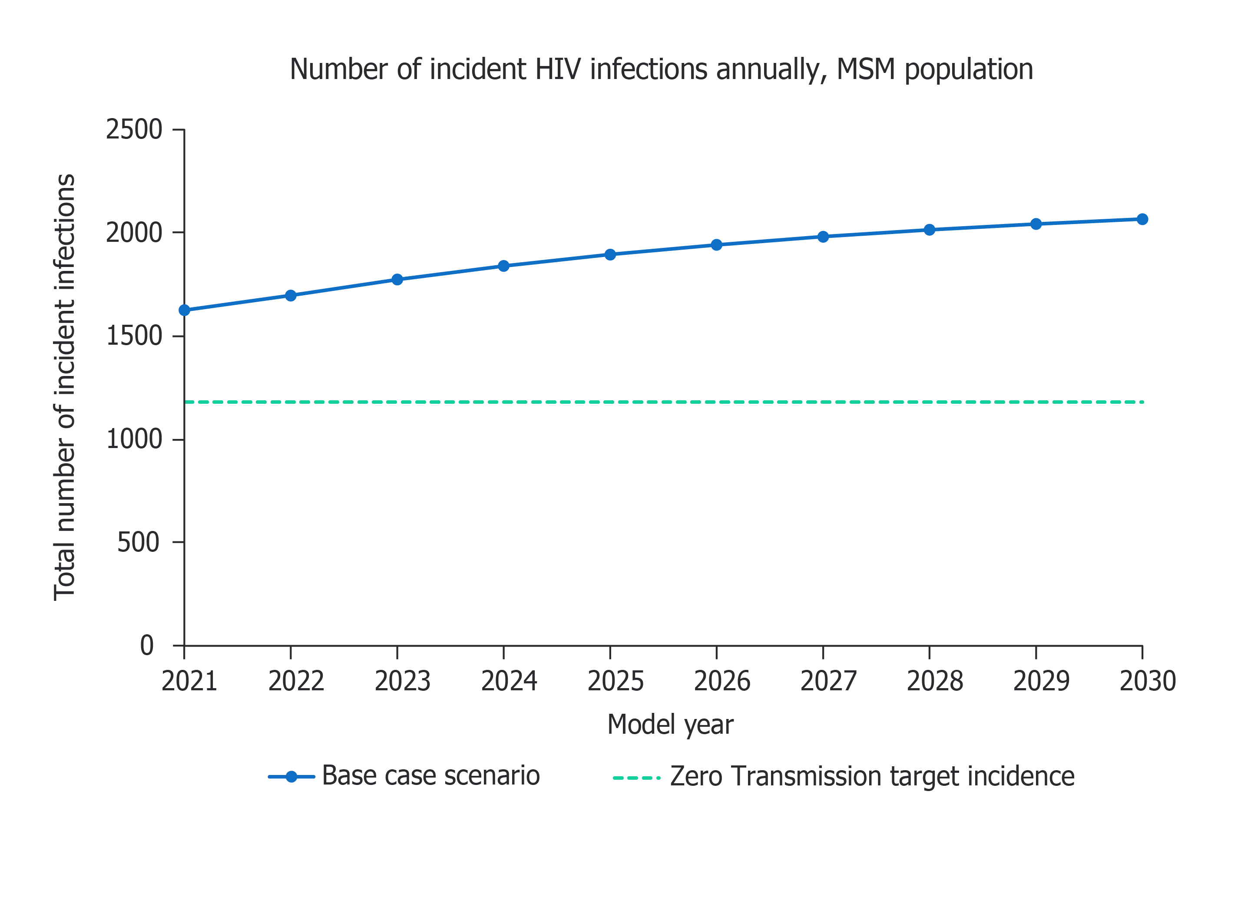
Results: Given the current trajectory of the HIV epidemic, zero transmission will not be reached in UK MSM by 2030

Slide 6
Results: Individual changes to key screening, treatment or prevention parameters are not a realistic route to zero
Making individual changes to key screening, treatment or prevention parameters individually allows zero transmission to be reached by 2030 in some cases, however, unrealistic increases in these parameters are required
Parameter | Input value required (2020 value) | Zero transmission year
Rate of PrEP uptake | 9.08% (0.08%) | 2030
Annual probability of having a HIV test | 96.85% (22.35%) | 2030
Probability of starting treatment within three months of HIV diagnosis | 100% (78%) | 2032

Slide 7
Results: A combination approach to screening, treatment and prevention is needed to achieve zero by 2030 (1)
Parameter | Input value (2020 value)
Rate of PrEP uptake | 0.25% (0.08%)
Proportion of PLWH diagnosed within 3 months of infection | 40% (26%)
Annual probability of having a HIV test | 40% (22.35%)
Probability of starting treatment within 6 months of diagnosis | 98% (95.17%)
Probability of starting treatment within three months of HIV diagnosis | 90% (78%)
Proportion of patients on ART who are virologically suppressed | 99% (97%)

Slide 8
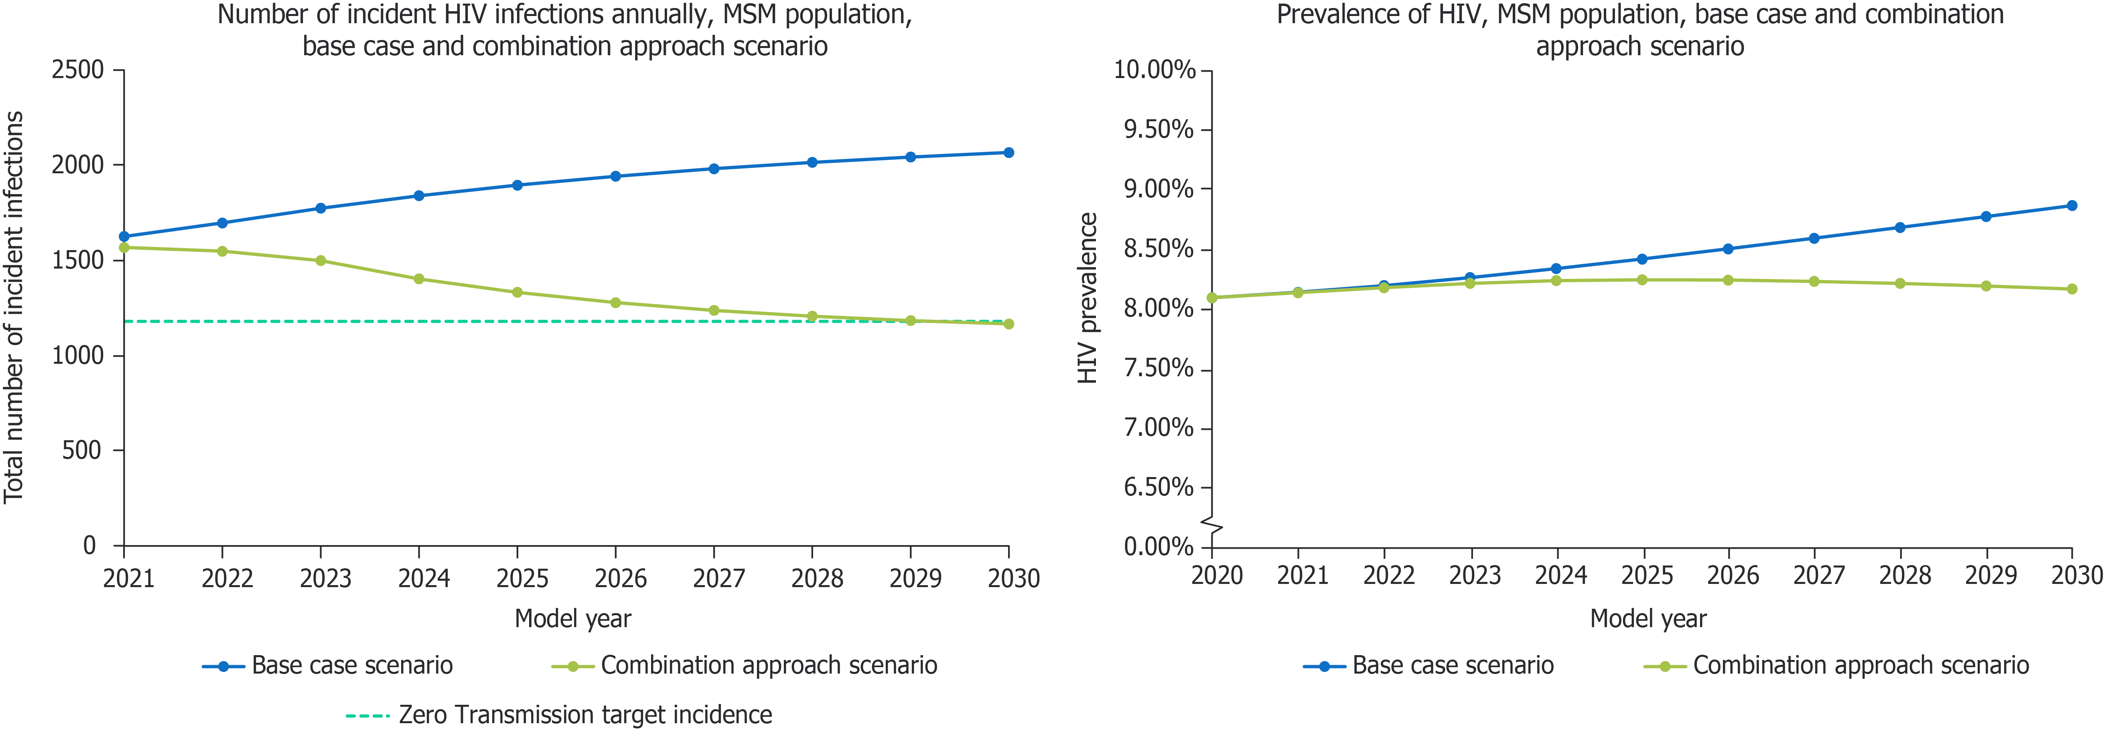
Results: A combination approach to screening, treatment and prevention is needed to achieve zero by 2030 (2)
Zero transmission can be reached in UK MSM by 2030 using a combination approach to screening, treatment and prevention, increasing all six key parameters to achievable levels

Slide 9
Conclusions
A combination approach, increasing HIV screening, treatment and prevention parameters, is the most feasible way for the UK to reach its goal of zero HIV transmission by 2030
Study design and results align with other HIV modelling studies and with the independent UK HIV Commission targets and recommendations
The impact of COVID-19 on HIV transmission in the UK was not taken into account as the impact is not yet known; policy changes aimed at reaching zero transmission will need to account for the impact of COVID-19

