Slide 1
Persistence on Guideline-Recommended HIV Treatment: Comparison Among US Medicaid Beneficiaries Newly Initiating Treatment with Single- versus Multiple-Tablet Regimens
Dylan Mezzio,¹ Joshua Gruber,¹ Woodie Zachry,¹ Ishveen Chopra,² Qiao Mu,² Vasantha Pedarla,² Joshua Cohen³
¹Gilead Sciences, Inc., Foster City, CA, USA; ²StatInMed, Plano, TX, USA; ³Tufts University, Boston, MA, US

Slide 2
Introduction
There is a paucity of persistence data on adult US Medicaid beneficiaries living with HIV that detail the Department of Health & Human Services (DHHS) guideline-recommended antiretroviral treatment (ART) regimens.¹

Slide 3
Objective
The purpose of this study is to compare the persistence newer DHHS guideline-recommended single- and multiple-tablet regimens (STRs and MTRs) for treatment-naïve patients.

Slide 4
Methods
A retrospective analysis was conducted using the All-Payer Claims Database (APCD) for persons living with HIV initiating ART between Jan 1, 2017, and Mar 31, 2020, with 12 months continuous capture pre- and post- index date.
APCD provides insight into nearly 80% of the US health care system; 300 million unique patients across all payers.
APCD is nationally representative of the US population and includes patients from all geographic regions, providing comprehensive insight into treatment patterns among the Medicaid population.
Index date was defined as the date of the first ART claim
For STRs, the date of the first ART claim within the period Jan 1, 2017 – March 31, 2020, was the index date
For MTRs, the fill date for the last medication in the regimen was the index date (±5-day window between fills for components comprising the regimen was allowed).
Persistence was measured from the index date until treatment discontinuation (≥90-day gap between fills of index regimen) or the end of the study period, whichever occurred first.
For MTRs, patients must remain on all therapies in the initial regimen to be counted as persistent.
Patient selection criteria presented in Figure 1.

Slide 5
Figure 1: Sample Selection
≥2 prescription claims for an ART of interest during the identification period [Jan 1, 2017 – Mar 31, 2020] (N= 111,035)
Alive at any point during the 12-month pre and post index period (N= 110,614)
12 months continuous capture pre- and post-index date; ≥1 pharmacy or medical claim at any point during the 12-month period
(N= 97,091)
Aged ≥18 years as of the index date (N= 96,360)
Only 1 regimen at index date (N=3,296)
ART use in the 12 months prior to the index date (N=47,201)
HIV-2 diagnosis claim during baseline period (on or 12 months prior to index date) (N=196)
ART use other than index drugs on the index date (N=203)
Excluded (N=51,596)
Patients remaining in sample (N=44,764)
Patients who received STR as index regimen (N=34,787)
Patients who received MTR as index regimen (N=9,977)

Slide 6
Table 1: Patient Distribution STRs & MTRs
STRs (N=34,787) |  |  | MTRs (N=9,977)
Regimen | N | % | Regimen | N | %
B/F/TAF | 9052 | 26.02% | FTC/TDF+DTG | 2122 | 21.27%
DTG/3TC | 157 | 0.45% | FTC/TAF+DTG | 5487 | 55.00%
DTG/RPV | 424 | 1.22% | 3TC/TDF+DTG | 1 | 0.01%
DTG/ABC/3TC | 7384 | 21.23% | FTC/TDF+RAL | 1697 | 17.01%
EVG/COBI/FTC/TAF | 9500 | 27.31% | FTC/TAF+RAL | 657 | 6.59%
EVG/COBI/FTC/TDF | 1569 | 4.51% | FTC/TDF+DRV/r,c* | 3 | 0.03%
RPV/FTC/TAF | 2699 | 7.76% | FTC/TAF+DRV/r,c* | 7 | 0.07%
RPV/FTC/TDF | 1112 | 3.20% | FTC/TDF+ATV/r,c* | 2 | 0.02%
EFV/FTC/TDF | 1986 | 5.71% | FTC/TAF+ATV/r,c* | 1 | 0.01%
EFV/3TC/TDF | 9 | 0.03%
DRV/c/r/FTC/TAF | 873 | 2.51%
DOR/3TC/TDF | 22 | 0.06%
ABC: Abacavir, ATV: Atazanavir, B: Bictegravir, COBI or /c: Cobicistat, DOR: doravirine, DRV: Darunavir, DTG: Dolutegravir, EFV: Efavirenz, EVG: Elvitegravir, F: Emtricitabine, FTC: Emtricitabine, MTR: multiple-tabled regimen, RAL: Raltegravir, RPV: Rilpivirine, r: Ritonavir, STR: single-tablet regimen, TAF: Tenofovir alafenamide fumarate, 3TC: Lamivudine, TDF: Tenofovir disoproxil fumarate
Boosted with cobicistat or ritonavir.
Patient distribution by DHHS-recommended Initial ART regimens

Slide 7
Results: Baseline Demographics and Clinical Characteristics (Table 2)
We identified 44,764 (STRs=34,787; MTRs=9,977) Medicaid beneficiaries who newly initiated ART.
Sample average age was 44±12 years, was predominantly male (65%), and resided in the southern US (37%).
In the 12-month pre-index period, the most used drug classes were respiratory drugs (6%), antibiotics (5%), antipsychotics (5%), and antihypertensives (5%).
†
‡
§

Slide 8
Table 2: Baseline Demographics and Clinical Characteristics
Demographics and Clinical Characteristics | Total (N=44,764) |  | STR (N=34,787) |  | MTR (N=9,977)
Age, mean (SD) | 43.5 (12.4) |  | 43.7 (12.3) |  | 42.6 (12.8)
18-34 years | 13,031 | 29.1% | 9,825 | 28.2% | 3,206 | 32.1%
35-49 years | 14,615 | 32.6% | 11,482 | 33.0% | 3,133 | 31.4%
50-64 years | 16,377 | 36.6% | 12,883 | 37.0% | 3,494 | 35.0%
≥65 years | 741 | 1.7% | 597 | 1.7% | 144 | 1.4%
Gender (n,%)
Male | 29,162 | 65.1% | 23,259 | 66.9% | 5,903 | 59.2%
Female | 15,602 | 34.9% | 11,528 | 33.1% | 4,074 | 40.8%
US Geographic Region (n, %)
Northeast | 10,958 | 24.5% | 8,628 | 24.8% | 2,330 | 23.4%
North Central | 7,189 | 16.1% | 5,652 | 16.2% | 1,537 | 15.4%
South | 16,742 | 37.4% | 13,060 | 37.5% | 3,682 | 36.9%
West | 8,917 | 19.9% | 6,814 | 19.6% | 2,103 | 21.1%
Other | 958 | 2.1% | 633 | 1.8% | 325 | 3.3%
Pre-index medication use (n, %)
Antihypertensives | 2,205 | 4.9% | 1,709 | 4.9% | 496 | 5.0%
Antidiabetics | 1,980 | 4.4% | 1,509 | 4.3% | 471 | 4.7%
Anticoagulants | 189 | 0.4% | 37 | 0.1% | 152 | 1.5%
Lipid-lowering therapy | 62 | 0.1% | 53 | 0.2% | 9 | 0.1%
Antibiotics | 2,022 | 4.5% | 1,523 | 4.4% | 499 | 5.0%
Respiratory drugs | 2,583 | 6.0% | 1,928 | 6.0% | 655 | 7.0%
Antipsychotics | 2,111 | 4.7% | 1,467 | 4.2% | 644 | 6.5%
Number of unique medications on index date (n, %)
Patients with only ART on the index date | 40,880 | 91.0% | 31,859 | 92.0% | 9,021 | 90.0%
Patients with ≥1 non-ART on the index date | 3,004 | 7.0% | 2,269 | 7.0% | 735 | 7.0%
Post-index observation days, mean (SD) | 966.6 (338.8) |  | 957.9 (341.8) |  | 996.8 (326.5)
Quan-Charlson Comorbidity Index (CCI) Score, mean (SD) | 1.4 (2.3) |  | 1.4 (2.3) |  | 1.4 (2.4)
Baseline Individual Clinical Comorbidities (n, %)*
Central Nervous System Toxicity | 11,650 | 26.0% | 8,794 | 25.3% | 2,856 | 28.6%
Lipid Disorders | 5,398 | 12.1% | 4,382 | 12.6% | 1,016 | 10.2%
Hypertension | 9,476 | 21.2% | 7,478 | 21.5% | 1,998 | 20.0%
†
‡
§
ART: antiretroviral treatment, MTR: multiple-tablet regimen, STR: single-tablet regimen, SD: standard deviation, US: United States
* Presented top 3 baseline individual comorbidities prevalent in at least 10% of patients on ART

Slide 9
Results: Persistent Outcomes
At 6 months, 62% of patients on STRs were persistent, compared to 41% for MTRs (Table 3)
Among all patients, persistence was highest with B/F/TAF 68% at 6 months; 44% at 12 months

Slide 10
Table 3: Mean and Median Persistence by Treatment Regimen
Regimen* | N | Mean** | Median** | Patients with 6-month persistence (n, %) | Patients with 12-month persistence (n, %)
STR Overall | 34,787 | 239 | 282 | 62% | 36%
B/F/TAF | 9,052 | 259 | 341 | 68% | 44%
DTG/ABC/3TC | 7,384 | 239 | 282 | 62% | 36%
EVG/COBI/FTC/TAF | 9,500 | 234 | 268 | 60% | 34%
EVG/COBI/FTC/TDF | 1,569 | 185 | 152 | 44% | 20%
RPV/FTC/TAF | 2,699 | 254 | 330 | 66% | 43%
RPV/FTC/TDF | 1,112 | 202 | 184 | 50% | 24%
EFV/FTC/TDF | 1,986 | 207 | 196 | 52% | 27%
DRV/c/r/FTC/TAF | 873 | 237 | 272 | 62% | 35%
MTR Overall | 9,977 | 168 | 115 | 41% | 22%
FTC/TDF+DTG | 2,122 | 107 | 30 | 23% | 9%
FTC/TAF+DTG | 5,487 | 207 | 201 | 52% | 30%
FTC/TDF+RAL | 1,697 | 95 | 30 | 19% | 8%
FTC/TAF+RAL | 657 | 233 | 283 | 60% | 39%
†
‡
§
ABC: Abacavir, B: Bictegravir, COBI: Cobicistat, DRV: Darunavir, DTG: Dolutegravir, EFV: Efavirenz, EVG: Elvitegravir, F: Emtricitabine, FTC: Emtricitabine, RAL: Raltegravir, RPV: Rilpivirine, TAF: Tenofovir alafenamide fumarate, TDF: Tenofovir disoproxil fumarate, 3TC: Lamivudine
* Mean and median number of days persistent assessed during 12 months follow-up
** Regimens only with sample size >=500 were assessed for persistence outcomes

Slide 11
Results: Persistent Outcomes
Kaplan-Meier analyses demonstrated that patients on STRs had more days on therapy than those on MTRs, that is, were more persistent.
STR had more days on therapy than those on MTR (Figure 2)
Patients on B/F/TAF had more days on therapy than those on DTG/ABC/3TC, FTC/TDF+DTG, and FTC/TAF+DTG (Figure 3)

Slide 12
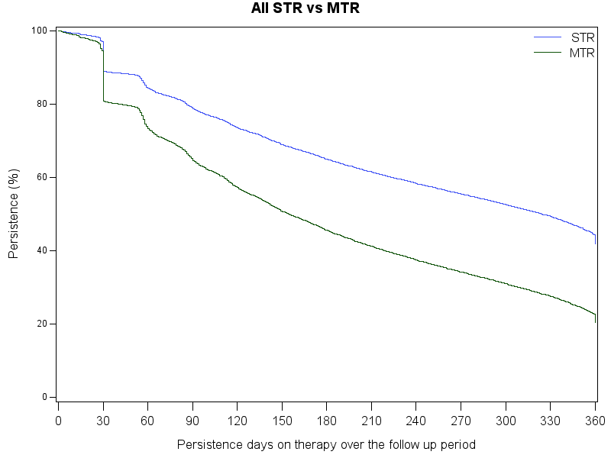
Figure 2: Persistence STR vs MTR
†
‡
§

Slide 13
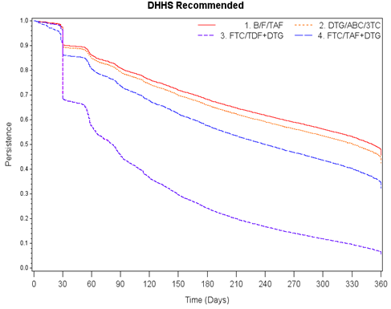
Figure 3: Treatment Persistence Among Regimens
DHHS Recommended Initial Regimens for Most People with HIV
†
ABC: Abacavir, B: Bictegravir, 3TC: Lamivudine, DHHS: Department of Health and Human Services, DTG: Dolutegravir, F: Emtricitabine, FTC: Emtricitabine, MTR: multiple-tablet regimen, STR: single-tablet regimen, TAF: Tenofovir alafenamide fumarate, TDF: Tenofovir disoproxil fumarate,

Slide 14
Results: Persistence Outcomes
After controlling for baseline characteristics, Figure 4 shows the adjusted results:
MTRs were associated with 1.71 greater risk of treatment discontinuation compared to STRs (p<0.001)
When compared to B/F/TAF, the risks of treatment discontinuation based on hazard ratios were:
1.25 times higher for DTG/ABC/3TC (p<0.001)
3.75 times higher for FTC/TDF+DTG (p<0.001)
1.57 times higher for FTC/TAF+DTG (p<0.001)

Slide 15
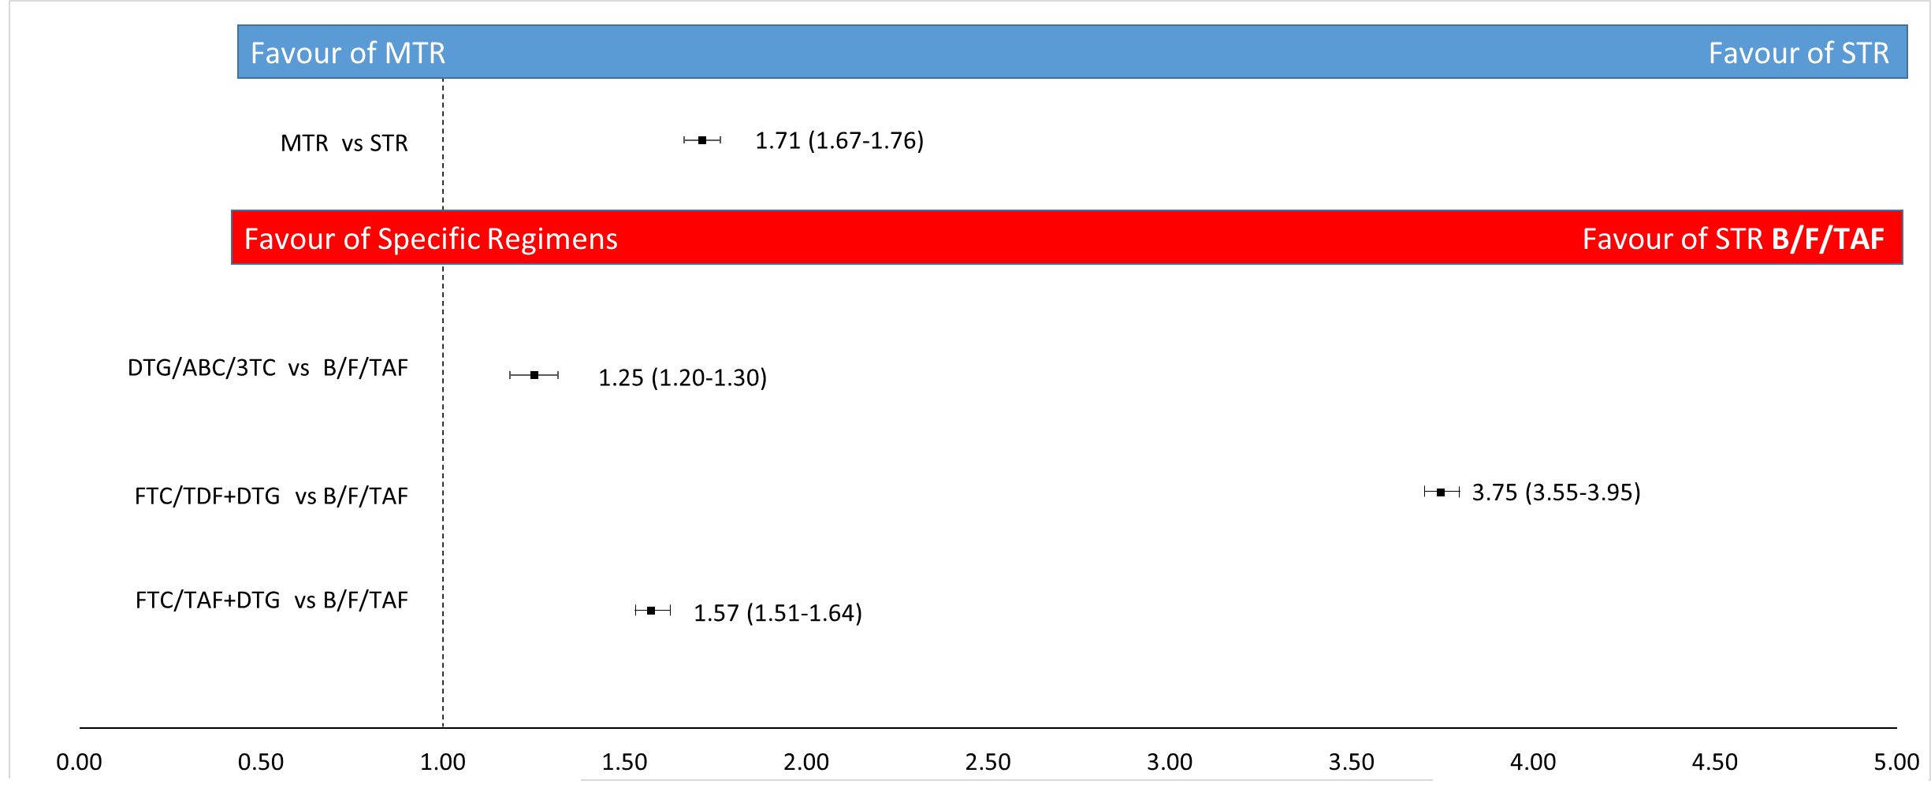
Figure 4: Adjusted Hazard Ratio for Treatment Discontinuation
†
‡
§
ABC: Abacavir, B: Bictegravir, 3TC: Lamivudine, DTG: Dolutegravir, F: Emtricitabine, FTC: Emtricitabine, MTR: multiple-tablet regimen, STR: single-tablet regimen, TAF: Tenofovir alafenamide fumarate, TDF: Tenofovir disoproxil fumarate

Slide 16
Limitations
This analysis focused on those covered by Medicaid insurance, and results may differ for commercial insurance populations
The geographic spread of Medicaid beneficiaries in the analysis is skewed towards the South.
†
‡
§

Slide 17
Conclusion
Among adult US Medicaid beneficiaries living with HIV, STRs were associated with longer persistence on a first-line therapy compared to MTRs.
Among adult US Medicaid beneficiaries living with HIV, B/F/TAF had the highest persistence rate compared to DTG/ABC/3TC, FTC/TDF+DTG, and FTC/TAF+DTG.
†
‡
§

Slide 18
References
DHHS Panel on Antiretroviral Guidelines for Adults and Adolescents – A Working Group of the Office of AIDS Research Advisory Council. Guidelines for the Use of Antiretroviral Agents in Adults and Adolescents with HIV. 2021. Available at: https://clinicalinfo.hiv.gov/sites/default/files/guidelines/documents/AdultandAdolescentGL.pdf
†
‡
§

Slide 19
Disclosures
Ishveen Chopra, Qiao Mu, Vasantha Pedarla, of StatInMed Research; Joshua Gruber, Woodie Zachry, Dylan Mezzio are employees of Gilead; Joshua Cohen is an employee of Tufts University.
†
‡
§

