Slide 1
The potential clinical impact of the observed differences in IL-6, a marker of inflammation, associated with some antiretroviral regimens
S Serrano Villar,¹ C Cohen,² J Baker,³ M João Janeiro,⁴ F Aragao,⁴ K Melbourne,² J Gonzalez,⁶ L Lara,⁶ C Kim,² S Moreno¹
¹Hospital Universitario Ramón y Cajal, Infectious Diseases, Madrid, Spain; ²Gilead Sciences Inc., HIV Medical Affairs, Foster City, United States; ³University of Minnesota, Minneapolis, United States; ⁴Maple Health Group, New York, United States; NOVA National School of Public Health, Public Health Research Centre, Universidade NOVA de Lisboa, Lisboa, Portugal, ⁶Gilead Sciences Inc., HIV Medical Affairs, Madrid, Spain

Slide 2
Introduction (1 of 3)
Guidelines recommend a variety of two- or three-drug antiretroviral (ARV) regimens (2DRs/3DRs) for treating people living with HIV (PLWH)^{1,2}
Although guideline-recommended 2DRs and 3DRs are virologically effective, further information is warranted about possible differentiating factors
In some instances, inflammatory markers, including interleukin-6 (IL-6), differ among some oral 2DRs and 3DRs^{3–5} (Table 1)
Table 1. IL-6 Levels in 2DRs and 3DRs in the TANGO and SALSA Studies
Study | Switch | Change in IL-6 level after switching from 3DR to 2DR
TANGO | Switch to DTG/3TC vs. continuing a TAF-based regimen | Week 48: Statistically significant difference favoring 3DR (P = 0.006)³ Week 96: Numerical difference but not statistically significant⁴ Week 144: Statistically significant difference favoring 3DR (P = 0.039)⁵
SALSA | Switch to DTG/3TC vs. continuing a variety of 3DRs | No difference over 48 weeks of treatment⁶

Slide 3
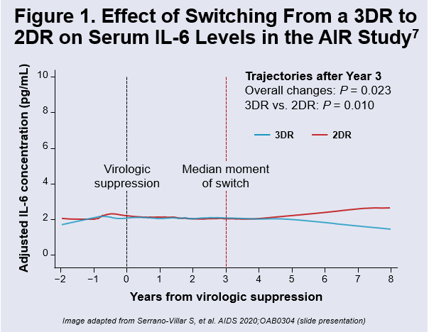
Introduction (2 of 3)
In the AIR study, significant differences between oral 2 and 3DR in IL-6 levels, favoring lower levels on 3DR, increased over years⁷ (Figure 1)
Similar findings were seen with D-dimer and C-reactive protein
Changes in inflammatory markers may depend on the antiretrovirals used^{8,9}
SALSA included changes from multiple third agents to DTG which may reduce IL-6 levels¹¹, as well as changes from a 3DR to a 2DR, which may increase IL-6 levels
These opposing directions of change may have contributed to the observed results

Slide 4
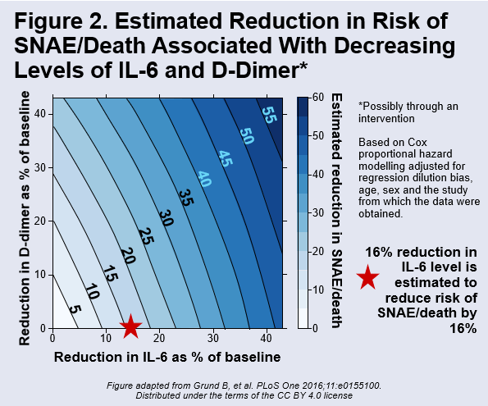
Introduction (3 of 3)
Previous analysis of PLWH on suppressive oral ART in three studies performed by the INSIGHT trials network showed that elevated inflammatory markers, in particular IL-6 and D-dimer, are associated with a higher risk of serious non-AIDS events (SNAEs: cardiovascular, hepatic or renal event, malignancy) and death¹⁰
Modelling¹⁰ predicts that a 16% increase in IL-6 level may increase the risk of SNA/death by about 16% (Figure 2)
TANGO week 48³ reported a 16% difference in IL-6 between the arms favoring 3DR

Slide 5
Aims
To mathematically model whether the differences in IL-6 levels associated with remaining on a 3DR, versus switching to a regimen with a higher IL-6, as seen with data from some current oral 2DRs, may affect clinical outcomes (SNAE/death) in virologically suppressed PLWH
The model inputs for IL-6 differences uses data from the TANGO and AIR studies

Slide 6
Methods (1 of 4)
A Markov model was created using observed differences of higher IL-6 levels in the TANGO³ and AIR⁶ studies in virologically suppressed PLWH switching from a 3DR to a 2DR
We developed a model based on observed variation in IL-6 (trajectories over time)
The model used TANGO data for the first 3 years and AIR data for > 3 years
This is updated from the model reported in our abstract, which did not have access to TANGO data after week 48
At entry in the model, age was set at 39 years¹⁰ and baseline IL-6 levels were divided by quartiles based on the distribution in the AIR study⁷ cohort
The model output was based on published analyses from the INSIGHT trials network, which defined the predicted change in risk of SNAE/death by changes in IL-6 concentration based on data from 3,766 individuals from the virologically suppressed arms of the SMART, ESPRIT and SILCAAT studies¹⁰

Slide 7
Methods (2 of 4)
Markov modelling provides a standard framework for predicting clinical outcomes in terms of transitions between states based on the current state occupied by an individual. Per year, an individual can cycle through the model with no events, a SNAE, and/or death
IL-6 categories (quartiles)
Low
Low-med
Med-high
High
SNAE/ death
Death

Slide 8
Methods (3 of 4)
Approximate time course of changes in IL-6 concentration that went into the Markov model (based on changes in IL-6 seen in TANGO Week 48, 96, 144 and AIR data)
2DR
IL-6
3DR
Week 48
Week 96
Week 144
Time
Note: Graph is illustrative only of the overall trends inputted into the model, and not intended to reflect the exact data points that were inputted

Slide 9
Methods (4 of 4)
The primary endpoint of our study was the number needed to treat (NNT) that the model predicts would result in one additional SNAE/death based on the observed changes to IL-6
We also estimated the size of a clinical cohort, including a randomized clinical trial, that would be needed to support or refute this effect

Slide 10
Results
PLWH maintained on a 3DR spend 22% more time in the "low" IL-6 quartile
Those on a 2DR spend 16% more time in the "high" IL-6 category
As a result, the mean number of SNAE/death events that are expected to occur for every 100 PLWH over 144 weeks was 5.6 (3DR) vs 6.8 (2DR)

Slide 11
Results: Number Needed to Treat (NNT)
Based on the model, for every 43 PLWH 30–50 years old treated for 5 years with a regimen associated with higher IL-6, there would be one additional SNAE/death outcome (Figure 3)
: NNT=43
NNT of 43: for every 43 PLWH treated with a regimen that has a higher IL-6 for five years, the model predicts there would be one additional SNA/death event

Slide 12
Results
The NNT varies with years on treatment (Table 2)
Table 2. NNT to Observe One Additional SNA/Death Outcome on a 2DR vs. 3DR by Time on ART, Based on the Observed Higher IL-6 Levels With 2DRs
Time (years) | NNT
3 | 106
5 | 43
10 | 13
Estimates from Markov modeling considered participant age range of 30-50 years

Slide 13
Results
Given that these model data suggest an important clinical impact of the elevated IL-6 levels, we estimated the cohort size required to support or refute an effect of this magnitude (Figure 4)
Figure 4. Clinical Study Design and Study Size Required to Test the Hypothesis
Study design
2DR vs. 3DR (1:1) over time
Two-sided; significance: 0.05; power: 80%
Outcome: Incidence of SNAE/death
Study size required
144-week study: N = 13,149
240-week study: N = 2,906
528-week study: N = 324
Note: If unequal sample sizes were used in the study (i.e., not 1:1), then different study sizes are required. For example, for a study including 9,000 PLWH taking a 3DR over 144 weeks, the distribution of patients would need to be about 2:1, i.e., around 5,000 PLWH taking 2DR would need to be included in the study to achieve a power of 0.8.

Slide 14
Limitations
Only changes to IL-6 were modeled
These results are not generalizable beyond the ARV regimens studied in TANGO and AIR
More recent two drug regimens, e.g., long acting injectables, have longer half-lives and other differences which may affect the risk of inflammation over time
While guidelines^{1,2} acknowledge the importance of inflammation in PLWH, they cannot provide specific recommendations for the measurement, prevention or treatment of inflammation given a lack of adequately powered trials which address this question

Slide 15
Guidelines
Current guidelines on inflammation are summarized in Table 3
Table 3. International Guidelines on Inflammation and Immune activation
DHHS 2021¹ | EACS 2020²
“Persistently low CD4 cell counts and immune activation are each associated with increased AIDS- and non–AIDS-related morbidity and mortality among individuals with ART-mediated viral suppression” | “Potential contributors to comorbidity pathogenesis include a higher prevalence of recognised risk factors, potential toxicities from ART exposure, and HIV infection (or coinfections with CMV and HCV) contributing to immune dysfunction/dysregulation, chronic immune activation and inflammation”
“Interventions designed to increase CD4 cell counts and/or decrease immune activation are not recommended outside of a clinical trial, because no current interventions have been proven to decrease morbidity or mortality during ART‐mediated viral suppression” | “CD4/CD8 ratio is a stronger predictor of serious outcomes vs. CD4 count”

Slide 16
Conclusions
Over the long term, higher inflammation may negatively impact clinical outcomes for PLWH
Levels of inflammatory markers, including IL-6, have been reported to differ after a switch between antiviral classes as well as from some current 3DRs to some current oral 2DRs
Our Markov model suggests that the IL-6 elevation observed with the switch from some 3DRs to some 2DRs may increase the risk of serious non-AIDS events and/or death in PLWH
The IL-6 differences observed with the switch would be expected to result in one additional SNAE/death event for every 43 people (age 30-50) treated for 5 years
Further studies are warranted to confirm the observed differences
If confirmed, long-term clinical studies may help optimize care given the concerns raised here
A 240-week study with approximately 2900 participants would be required to evaluate this clinically

Slide 17
References
DHHS Guidelines for the Use of Antiretroviral Agents in Adults and Adolescents with HIV. June 2021. https://clinicalinfo.hiv.gov/sites/default/files/guidelines/documents/AdultandAdolescentGL.pdf (accessed Sep 2021)
EACS Guidelines version 10.1, Oct 2020. https://www.eacsociety.org/media/guidelines-10.1_30032021_1.pdf (accessed Sep 2021)
van Wyk JJ, et al. Clin Infect Dis 2020;71:1920-1929
Wang R, et al. IAS 2021;OAB0301
Osiyemi O, et al. ID Week 2021; 900
Llibre JM, et al. IAS 2021;OALB0303
Serrano-Villar S, et al. AIDS 2020;OAB0304
Martínez E, et al. AIDS 2012;26:2315-2326
Trottier B, et al. Antivir Ther 2017;22:295-305
Grund B, et al. PLoS One 2016;11:e0155100
Hileman CO et al. Curr HIV/AIDS Rep (2017) 14:93–100

Slide 18
Acknowledgements
This is a collaborative work, funded by Gilead Sciences. We thank the investigators and participants who provided data for the original studies.
Medical writing support was provided by Emma McConnell, PhD (Aspire Scientific Limited), and funded by Gilead

