Slide 1
Pre-ATI Immune Biomarkers Associated With Time to HIV Rebound in HIV Controllers
Elena Vendrame, Gesham Magombedze, Yanhui Cai, Steven G. Deeks, Liao Zhang, Susan Guo, Zongbo Shang, Devi SenGupta, Jeffrey J. Wallin
Gilead Sciences, Inc., Foster City, California, USA
18th European AIDS Conference, October 27–30, 2021, London, UK: Poster PE2/1

Slide 2
Introduction
HIV post-treatment controllers (PTCs) are people with HIV who can maintain low levels of viremia after antiretroviral therapy (ART) cessation
Identifying biomarkers of post-treatment control could greatly aid the development of a cure for HIV, as it may decrease the need to interrupt ART to assess the efficacy of an intervention
Vesatolimod (VES) is a toll-like receptor 7 (TLR7) agonist that is being developed as part of an HIV cure strategy; TLR7 agonists can enhance immune responses and potentially lead to improved HIV control in combination with other agents
Study GS-US-382-3961 (ClinicalTrials.gov NCT03060447) was a randomized, double-blind, placebo-controlled, Phase 1b clinical trial of VES in ART-suppressed “HIV viremic controllers”, a subset of people with HIV with history of maintaining low plasma HIV-1 RNA in the absence of ART; in this study, VES treatment resulted in a modest delay in time to HIV rebound¹
1. SenGupta D, et al. Science Transl Med. 2021;13:eabg3071.

Slide 3
Objective
To identify immune biomarkers that are associated with time to HIV rebound or PTC from Study GS-US-382-3961

Slide 4
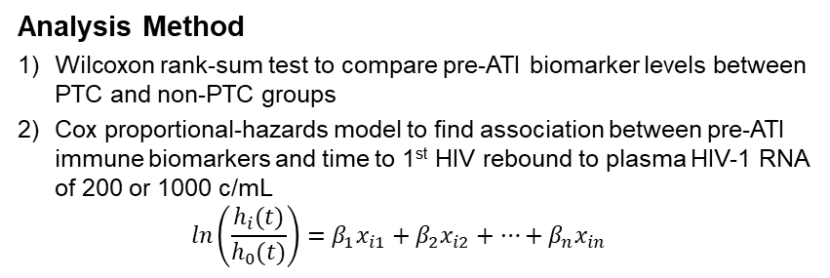
Methods: Study Design
Day 1
Week 20
24
48
+24
HIV viremic controllers on ART ≥6 mo
N=25
Pre-ART plasma HIV-1 RNA of 50–5000 c/mL
Placebo
ATI
(24+ wk)
Optional 24-wk ATI extension if low viral set point was seen after first 24 wk
2:1
VES 4–8 mg qow x 10
  4 mg (n=2)
Analysis Method
Wilcoxon rank-sum test to compare pre-ATI biomarker levels between PTC and non-PTC groups
Cox proportional-hazards model to find association between pre-ATI immune biomarkers and time to 1st HIV rebound to plasma HIV-1 RNA of 200 or 1000 c/mL
$\ln\left(\frac{h_{i}(t)}{h_{0}(t)}\right)=β_{1}x_{i1}+β_{2}x_{i2}+…+β_{n}x_{in}$
  4→6 mg (n=4)
  6 mg (n=5)
  6→8 mg (n=3)
  8 mg (n=3)
25 ART-treated HIV viremic controllers were randomized 2:1 to receive VES or placebo; 17 participants received 10 doses of VES (orally q14d) and 8 received placebo, followed by an ATI for ≤48 wk
ART was reinitiated if HIV-1 RNA was >10,000 c/mL for 4 consecutive wk, HIV-1 RNA did not decrease to <1000 c/mL within 6 wk of virologic rebound, cluster of differentiation (CD)–4⁺ cell count was confirmed to decrease by >30% from pre-ATI levels, or CD4⁺ cell count was confirmed at <350 cells/μL
ATI, analytical treatment interruption.
Notes:
CORE_Efficacy_Safety_Feb-14_SLB.ppt
10/14/2021
Gilead
4

Slide 5
Methods
PTC outcome was analyzed according to plasma HIV-1 RNA during ATI for the 23 participants who completed the ATI: PTC was defined as maintenance of plasma HIV-1 RNA ≤400 c/mL for 2/3 of time points for ≥24 wk¹
Soluble and cell-associated immune biomarkers pre-ATI (last collection prior to ART interruption) were evaluated by flow cytometry and multiplex cytokine assay
Unbiased generalized feature selection and mathematical modeling approaches were initially considered for this analysis, but were deemed unlikely to be generalizable due to the small sample size and high likelihood of data overfitting
Pre-ATI levels of several key biomarkers (including VES pharmacodynamic biomarkers and immune cell activation markers) were assessed for their association with time to 1st HIV rebound to plasma HIV-1 RNA of 200 or 1000 c/mL during ATI
  Frequency of cellular subsets: natural killer (NK) cells (CD16⁺ and CD69⁺), monocytes (CD14⁺CD16⁺), CD8⁺ T cells (Ki67⁺, CD69⁺, CD38⁺, and human leukocyte antigen-DR isotype [HLA-DR]⁺CD38⁺), and CD4⁺ T cells (Ki67⁺, CD69⁺, and HLA-DR⁺CD38⁺)
  Geometric mean fluorescent intensity (GMFI) of CD40 and CD54 on plasmacytoid dendritic cells (pDC)
  Plasma cytokines: interleukin-1 receptor antagonist (IL-1RA), interferon (IFN)–γ-induced protein 10 (IP10), IFN-inducible T-cell-α chemoattractant (ITAC), and IFNα
1. Namazi G, et al. J Infect Dis 2018;218:1954-63.

Slide 6
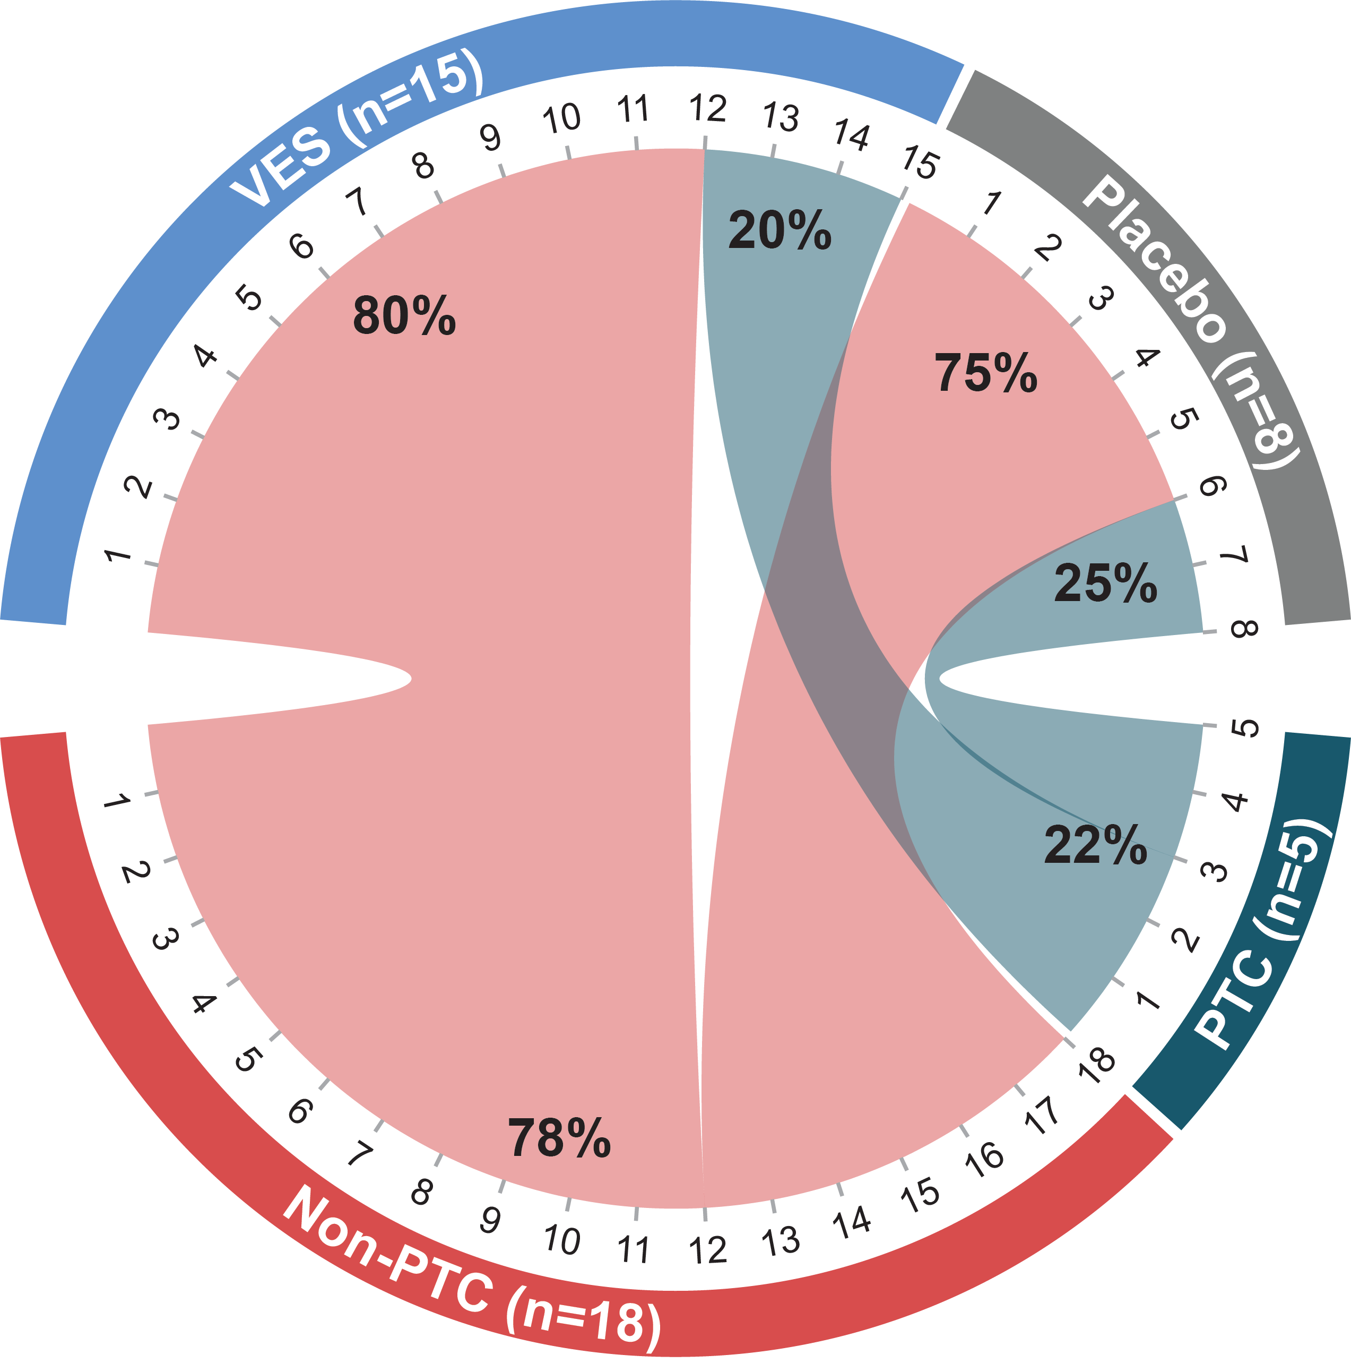
Results: HIV Post-treatment Control
Plasma HIV-1 RNA During ATI
100,000
Non-PTC, n=18
PTC, n=5
10,000
Plasma HIV-1 RNA, c/mL
1000
100
n | Placebo n=8 | VES n=15 | Total n=23
PTC | 2 | 3 | 5
Non-PTC | 6 | 12 | 18
0
100
200
300
400
0
100
200
300
400
Day
3/15 VES-treated participants (20%) and 2/8 placebo-treated participants (25%) were identified as PTCs
Among the 23 participants who completed the ATI, 5 (22%) achieved a PTC phenotype and 18 were classified as non-PTC

Slide 7
Pre-ATI Immune Biomarkers That Were Significantly Different Between PTC and Non-PTC*
Pre-ATI ITAC
n=23
CD8⁺CD69⁺ T Cells
n=21
CD4⁺HLA-DR⁺CD38⁺ T Cells
n=21
p=0.024
p=0.031
p=0.040
Pre-ATI ITAC, and CD8⁺CD69⁺ and CD4⁺ HLA-DR⁺CD38⁺ T cells were found to be significantly higher in the non-PTC (n=18) vs PTC (n=5) group
*Wilcoxon rank-sum test was used to compare difference in levels of key biomarkers between non-PTC and PTC groups; nominal p-values shown.

Slide 8
Summary of Key Pre-ATI Biomarkers in Relationship to Time to HIV Rebound Using Cox Proportional-Hazards Model
Biomarkers | Time to 1st Rebound to Plasma HIV-1 RNA of 200 c/mL |  |  |  | Time to 1st Rebound to Plasma HIV-1 RNA of 1000 c/mL
 | n | HR (95% CI) | p-Value | FDR | n | HR (95% CI) | p-Value | FDR
CD8⁺CD69⁺ T cells | 21 | 10.8 (2.2, 52.6) | 0.003 | 0.051 | 21 | 7.9 (2.1, 30.2) | 0.002 | 0.039
CD69⁺ NK cells | 21 | 1.7 (0.7, 4.2) | 0.25 | 0.668 | 21 | 1.2 (0.5, 2.9) | 0.07 | 0.548
CD8⁺CD38⁺ T cells | 21 | 0.6 (0.2, 1.5) | 0.26 | 0.668 | 21 | 0.6 (0.2, 1.4) | 0.17 | 0.577
CD14⁺CD16⁺ monocytes | 21 | 0.6 (0.2, 1.5) | 0.26 | 0.668 | 21 | 0.8 (0.3, 1.8) | 0.24 | 0.577
CD4⁺Ki67⁺ T cells | 21 | 0.6 (0.2, 1.5) | 0.29 | 0.668 | 21 | 1.2 (0.5, 3.1) | 0.26 | 0.577
CD4⁺HLA-DR⁺CD38⁺ T cells | 21 | 0.6 (0.2, 1.6) | 0.29 | 0.668 | 21 | 1.5 (0.6, 3.7) | 0.27 | 0.577
pDC (CD54 GMFI) | 21 | 0.6 (0.3, 1.6) | 0.32 | 0.668 | 21 | 0.5 (0.2, 1.3) | 0.27 | 0.577
IFNα | 23 | 2.1 (0.5, 1.0) | 0.33 | 0.668 | 23 | 4.7 (0.9, 24.8) | 0.29 | 0.577
IP10 | 23 | 0.7 (0.3, 1.6) | 0.39 | 0.685 | 23 | 0.8 (0.4, 1.9) | 0.40 | 0.711
CD16⁺ NK cells | 21 | 1.4 (0.6, 3.4) | 0.47 | 0.747 | 21 | 1.7 (0.7, 4.2) | 0.52 | 0.818
IL-1RA | 20 | 1.3 (0.5, 3.1) | 0.62 | 0.904 | 20 | 1.1 (0.4, 2.6) | 0.64 | 0.818
CD8⁺HLA-DR⁺CD38⁺ T cells | 21 | 1.1 (0.5, 2.7) | 0.79 | 0.914 | 21 | 1.7 (0.7, 4.4) | 0.66 | 0.818
pDC (CD40 GMFI) | 21 | 1.1 (0.5, 2.7) | 0.79 | 0.914 | 21 | 1.7 (0.7, 4.3) | 0.70 | 0.818
CD4⁺CD69⁺ T cells | 21 | 1.1 (0.5, 2.7) | 0.80 | 0.914 | 21 | 0.6 (0.2, 1.5) | 0.72 | 0.818
ITAC | 23 | 1.1 (0.5, 2.5) | 0.88 | 0.937 | 23 | 1.2 (0.5, 2.7) | 0.91 | 0.966
CD8⁺Ki67⁺ T cells | 21 | 1.0 (0.4, 2.5) | 0.95 | 0.947 | 21 | 1.0 (0.4, 2.5) | 0.97 | 0.966
CI, confidence interval; FDR, false discovery rate; HR, hazard ratio.

Slide 9
Higher Level of Pre-ATI CD8⁺CD69⁺ T Cells Was Associated With Shorter Time to HIV Rebound*
CD8⁺CD69⁺ T cells ≤ median
CD8⁺CD69⁺ T cells > median
Time to 1st Rebound to
Plasma HIV-1 RNA 200 c/mL
Time to 1st Rebound to
Plasma HIV-1 RNA 1000 c/mL
100
p=0.003
FDR=0.051
100
p=0.002
FDR=0.039
75
75
Participants With
Plasma HIV-1 RNA <200 c/mL, %
Participants With
Plasma HIV-1 RNA <1000 c/mL, %
50
50
25
25
0
0
0
2
4
6
8
0
5
10
15
20
n at risk
Week
Week
≤ Median
11
11
10
5
1
11
10
2
1
1
> Median
10
10
8
0
0
10
4
0
0
0
*Levels of key biomarkers from last collection prior to ART interruption were used to assess association with time to 1st rebound to plasma HIV-1 RNA of 200 or 1000 c/mL during ATI using Cox proportional-hazards model.

Slide 10
Conclusions
Among 23 HIV viremic controllers who completed Study GS-US-382-3961, 5 (22%) were identified as PTC according to their plasma HIV-1 RNA during ATI (independent of treatment assignment)
There were 3 biomarkers at the pre-ATI time point found to be higher in the non-PTC vs PTC group: plasma ITAC, and CD8⁺CD69⁺ and CD4⁺HLA-DR⁺CD38⁺ T cells
A higher frequency of CD8⁺CD69⁺ T cells at pre-ATI was associated with a shorter time to HIV rebound
These data suggest that higher immune activation pre-ATI may be linked to greater HIV replication and results in faster HIV rebound
Interventions aimed at sustained post-treatment control may ultimately require a balanced enhancement of innate and adaptive immune responses, likely only achievable with combination treatments
This analysis was limited by the small number of participants, and further studies with larger independent cohorts are needed to validate the biomarkers that were found to be associated with time to HIV rebound and post-treatment control

Slide 11
Acknowledgments
We extend our thanks and appreciation to the participants, their partners and families, the study teams, and the study investigators: Principal Investigator: Steven Deeks; Clinical Investigators: Moti Ramgopal, Cynthia Brinson, Edwin DeJesus, Anthony Mills, Peter Shalit; Biomarker Analysis: UCSF Core Immunology Lab: Norman Jone, Valerie Girling; Gilead: Liao Zhang, Gesham Magombedze, Yanhui Cai, Peter Shweh, Donovan Verrill, Steven Pan, Susan Guo, Zongbo Shang, Ondrej Podlaha, Vlad Malkov, Jinfeng Liu, Romas Geleziunas, Elena Vendrame, Devi SenGupta, Jeffrey J. Wallin. These studies were funded by Gilead Sciences, Inc.

