Slide 1


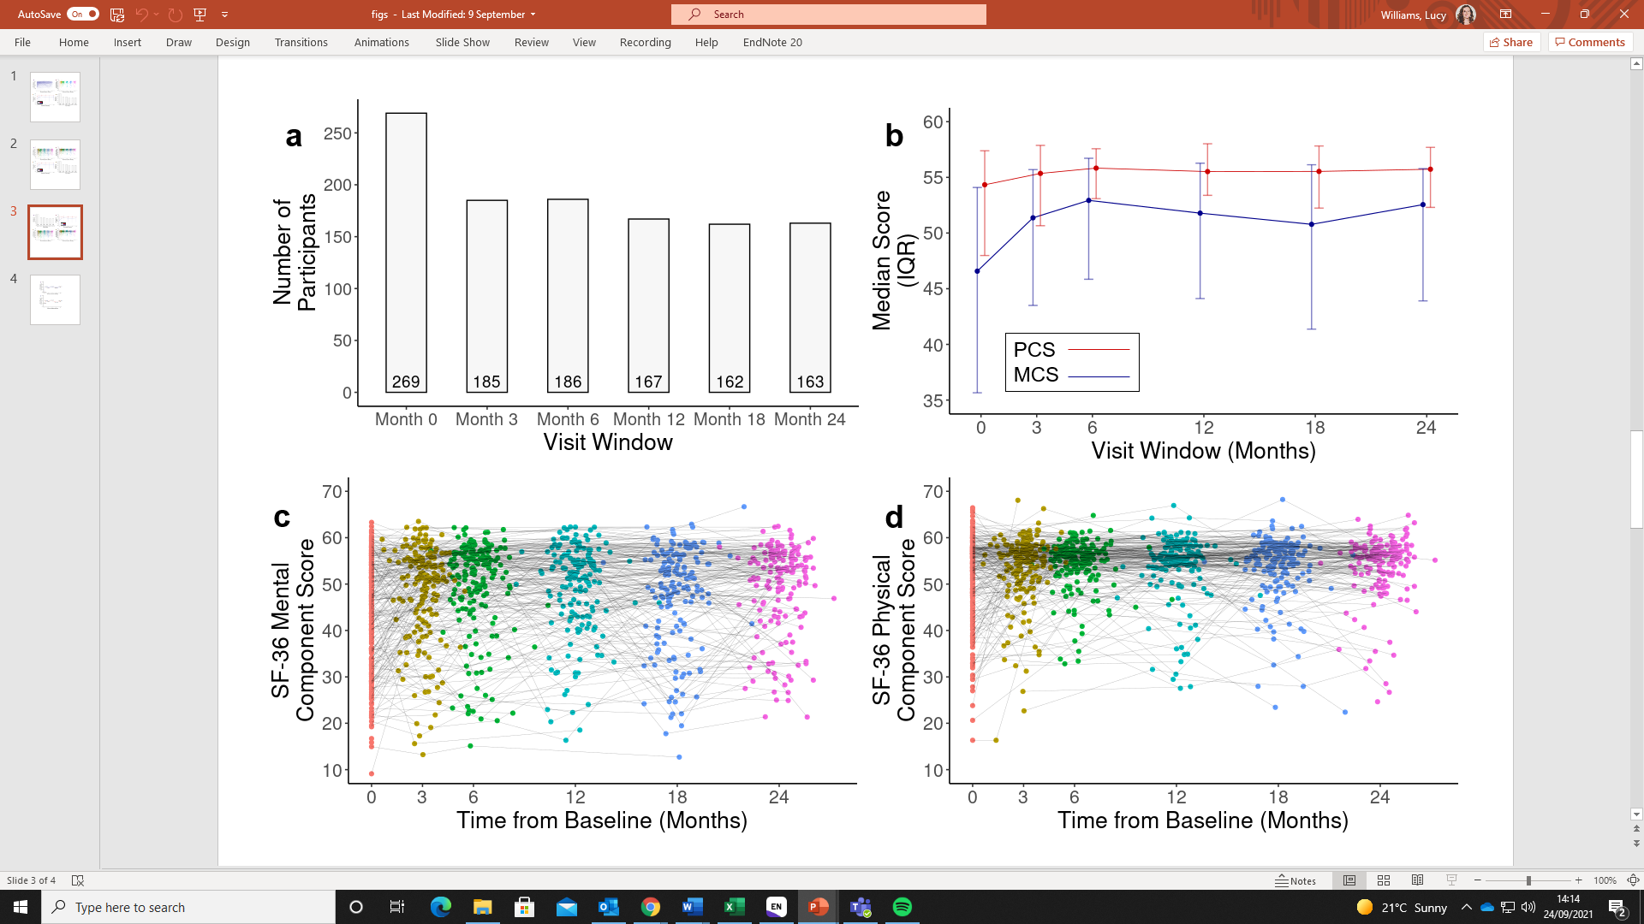










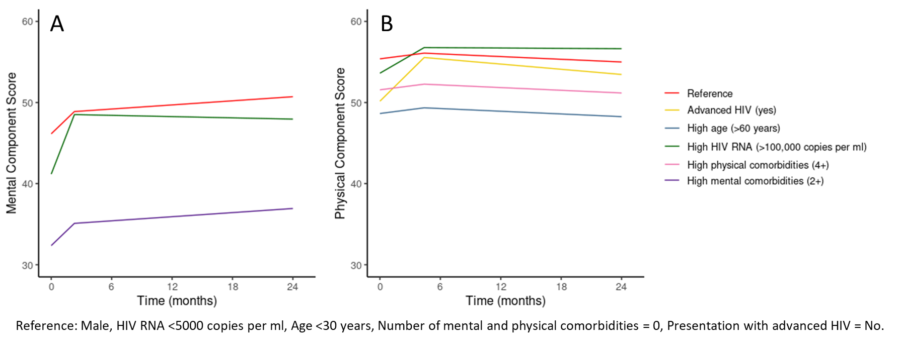


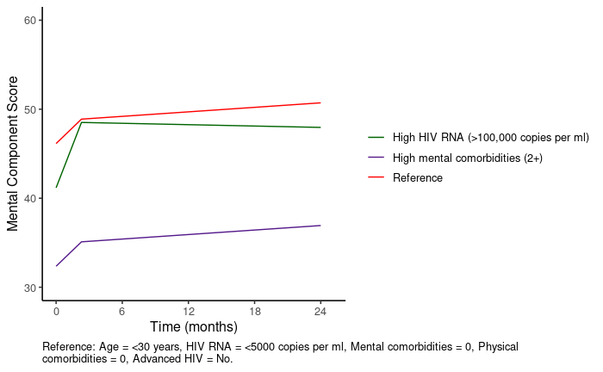


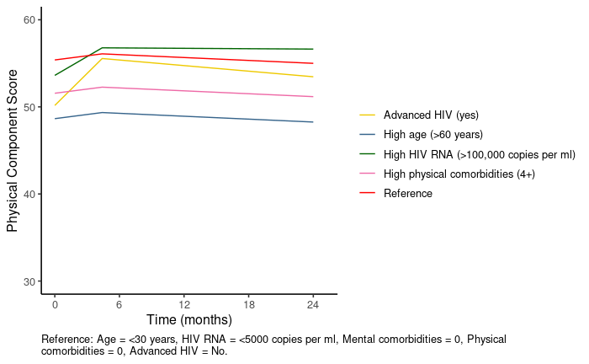

Analyses of Patient Reported Outcomes for Appropriately Tailoring to the Individual Needs of HIV-1 Patients
Lucy Williams^{1,2}, Andrea Marongiu¹, Filippos Filippidis², Marion Heinzkill¹, Geraldine Reilly¹, Anna van Troostenburg¹, Richard Haubrich¹, Heribert Ramroth¹
Gilead Sciences, Inc.
333 Lakeside Drive
Foster City, CA 94404
Tel: (650) 574-3000
¹Gilead Sciences, Inc., Foster City, CA, United States; ² School of Public Health, St Mary’s Campus, Imperial College London, London, United Kingdom
Introduction
Results
Conclusions
Patient reported outcomes (PROs) are important for understanding the needs of people living with HIV (PLHIV)¹ and are being increasingly used to support the interpretations of other clinical outcomes².
Table 1. Baseline demographic, clinical and SF-36 characteristics of the TAFNES treatment-naïve population
Figure 1. SF-36 mental component score (MCS) and physical component score (PCS) over the two-year follow-up
Statistical conclusions:
The wGEE is preferable over simplistic statistical approaches because it provides more detailed information on patients’ treatment experiences (Table 2).
Moreover, statistical assumptions of the simplistic models might be invalid.
The methodology proposed can be used for other PROs with numeric, count or binary data.
Total Population [n = 293]
Sex (Male) (N, %) | 275 (93.9)
Mean Age (sd) | 38.6 (11.0)
Median HIV RNA, log c/mL (IQR) | 10.3 (9.2-11.9)
<50 c/mL (N, %) | 3 (1.0)
>100,000 c/mL (N, %) | 89 (30.4)
Mental comorbidities (N, %)
0 | 248 (84.6)
1 | 40 (13.7)
2,3 | 5 (1.7)
Physical comorbidities (N, %)
0 | 157 (53.6)
1 | 77 (26.3)
Advanced HIV disease (Yes) (N, %) | 55 (18.8)
Median MCS (IQR) | 46.6 (35.7-54.1)
Median PCS (IQR) | 54.3 (48.0-57.4)
However, simplistic statistical approaches that provide similarly simplistic, and potentially biased conclusions are often used for analyses³⁻⁵.
Patient’s benefit:
The wGEE allows for communication of longitudinal changes in PROs and how these changes differ depending on patients’ health and socio-demographic characteristics.
Allows physicians to concentrate on individual patients’ needs
We propose an alternative regression modelling approach to extract detailed information on longitudinal changes in PROs and how they differ between patients.
Table 2. Strengths and limitations of alternative statistical approaches for PRO analyses
Approach | Strengths | Limitations
Simplistic statistical approaches (e.g. paired T-tests) | Easy to perform Easy to interpret | Simplistic interpretation Assumes that people who miss visits or are lost to follow up are no different to people who provide PRO data at all follow-up visits Compares only two visit windows at a time Too many tests conducted to compare various windows over time and subgroups which jeopardises statistical validity. Requires individuals to have provided PRO data at both visit windows being compared
Weighted Generalised Estimating Equation (wGEE) | Can handle data where participants have missed visits Analysis of large population allows for more precise and reliable estimates Can identify patient characteristics that are associated with high or low PROs, and differences in how they change over time (i.e. accounts for the substantial heterogeneity in the longitudinal changes in MCS and PCS across individuals) Doesn’t assume that people who miss visits or are lost to follow up are no different to people who provide PRO data at all follow-ups Can analyse numeric, count and binary data Can handle data with ceiling and floor effects | Analysis can be complex and requires a weighting scheme
sd = standard deviation; IQR = interquartile range; MCS = mental component score; PCS = physical component score. MCS and PCS range 0-100. A score of 50 represents the average in the reference USA population.
a) Number of individuals providing evaluable SF-36 data in each visit window; b) Population-level change in median (Inter-Quartile Range) MCS (blue) and PCS (red); c) Individual-level change in PCS; d) Individual-level change in MCS. Points in c) and d) coloured by visit window assigned in data processing: Red = Baseline, Yellow = 3 months, Green = 6 months, Turquoise = 12 months, Blue = 18 months, Pink = 24 months.
Methods
Most patients were male, had no physical or neuropsychiatric comorbidities and had not presented with advanced HIV
269 patients (91.8%) provided evaluable SF-36 data at baseline but this dropped to 185 (63.1%) at month 3 and 163 (60.6%) at month 24 (Figure 1a).
The overall population MCS and PCS increased between baseline
and month 6, then displayed a plateau or slight decline (Figure 1b).
There was substantial heterogeneity in the longitudinal changes in MCS and PCS across individuals (Figures 1c and 1d).
We collected PRO data from treatment naive PLHIV in the German observational cohort study, TAFNES. Data were collected at treatment initiation and during regular follow up clinical visits at 3, 6, 12, 18 and 24 months.
Figure 2. Adjusted SF-36 mental (A) and physical (B) component scores over the two-year follow-up, estimated using weighted generalised estimating equations
The Short Form-36 (SF-36) PRO measures mental and physical health-related quality of life (HRQoL) through the mental and physical component scores, respectively (MCS and PCS). MCS and PCS range 0-100, with higher scores representing better HRQoL.
The population-average mental and physical health-related quality of life (HRQoL) statistically significantly improved after treatment initiation (Figures 1 and 2).
- MCS increased by 1.8 points per month up to 2 months, then plateaued.
PCS increased by 0.43 points per month up to 4 months, then plateaued.
Older participants and those with physical comorbidities had poorer physical HRQoL throughout the two year follow-up.
Participants with neuropsychiatric comorbidities had poorer mental HRQoL throughout the two year follow-up.
Participants with high viral loads at treatment initiation had poorer mental and physical HRQoL at treatment initiation but showed greater improvements over follow up.
We applied multivariable wGEEs to the SF-36 MCS and PCS, with time modelled continuously using piecewise linear splines.
The following covariates were included: age, sex, number of neuropsychiatric comorbidities, number of physical comorbidities, HIV viral load at treatment initiation, and presentation with advanced HIV (CD4 cell count ≤200/ul and/or AIDS-defining event)
Reference
References
Advanced HIV (yes)
Kall M, Marcellin F, Harding R, Lazarus J V., Carrieri P. Patient-reported outcomes to enhance person-centred HIV care. Vol. 7, The Lancet HIV. 2020. p. e59–68.
Mercieca-Bebber R, King MT, Calvert MJ, Stockler MR, Friedlander M. The importance of patient-reported outcomes in clinical trials and strategies for future optimization. Patient Relat Outcome Meas. 2018;Volume 9:353–67.
Brundage M, Bass B, Davidson J, Queenan J, Bezjak A, Ringash J, et al. Patterns of reporting health-related quality of life outcomes in randomized clinical trials: Implications for clinicians and quality of life researchers. Qual Life Res. 2011;20(5):653–64.
Bylicki O, Gan HK, Joly F, Maillet D, You B, Péron J. Poor patient-reported outcomes reporting according to CONSORT guidelines in randomized clinical trials evaluating systemic cancer therapy. Ann Oncol. 2015;26(1):231–7.
Efficace F, Fayers P, Pusic A, Cemal Y, Yanagawa J, Jacobs M, et al. Quality of patient-reported outcome reporting across cancer randomized controlled trials according to the CONSORT patient-reported outcome extension: A pooled analysis of 557 trials. Cancer. 2015;121(18):3335–42.
RAND (1994). "36-Item Short Form Survey (SF-36)." Retrieved 27/09/2021, from https://www.rand.org/health-care/surveys_tools/mos/36-item-short-form.html
Reference: Male, HIV RNA <5000 copies per ml, Age <30 years, Number of mental and physical comorbidities = 0, Presentation with advanced HIV = No.
Age >60 years
HIV RNA >100,000 copies
Physical comorbidities 4+
Mental comorbidities 2+
Presented at the 18th European AIDS Conference (EACS), 27-30 October 2021, Online & London, UK
© 2021 Gilead Sciences, Inc. All rights reserved.

