Slide 1
SVR4 and SVR12 with an interferon-free regimen of BI 201335 AND BI 207127,
+/- ribavirin, in treatment-naïve patients with chronic genotype-1 HCV infection:
Interim results of SOUND-C2
Stefan Zeuzem,¹ Vicente Soriano,² Tarik Asselah,³ Jean-Pierre Bronowicki,⁴
Ansgar W. Lohse,⁵ Beat Müllhaupt,⁶ Marcus Schuchmann,⁷ Marc Bourliere,⁸
Maria Buti,⁹ Stuart Roberts,¹⁰ Ed Gane,¹¹ Jerry O. Stern,¹² George Kukolj,¹²
Luyan Dai,¹² Wulf O. Böcher,¹³ Federico J. Mensa¹³
¹Klinikum der J. W. Goethe-Universität, Frankfurt am Main, Germany; ²Department of Infectious Diseases, Hospital Carlos III, Madrid, Spain; ³Hôpital Beaujon, Clichy, France; ⁴Hôpital de Brabois, Vandoeuvre, France; ⁵University Hospital Hamburg-Eppendorf, Hamburg; ⁶University Hospital of Zurich, Zurich, Switzerland; ⁷University Hospital Mainz, Mainz, Germany; ⁸Hopital Saint Joseph, Marseille Cedex, France; ⁹Hospital Vall d’Hebron, Barcelona, Spain; ¹⁰Alfred Hospital, Department of Gastroenterology, Melbourne, Australia; ¹¹Auckland Clinical Studies, Auckland, New Zealand; ¹²Boehringer Ingelheim Pharmaceuticals, Ridgefield, CT, USA; ¹³Boehringer Ingelheim Pharma GmbH & Co KG, Biberach, Germany

Slide 2
Speaker declaration
I have financial relationships within the last 12 months relevant to my presentation with Boehringer Ingelheim Pharmaceuticals
My presentation includes discussion of off-label or investigational use of:
BI 201335
BI 207127
Ribavirin
Other affiliations or financial interests:
Abbott, Achillion, AstraZeneca, BMS, Gilead, Inhibitex, iTherX, Janssen, Merck, Novartis, Pharmasset, Roche, Santaris, Tibotec, Vertex

Slide 3
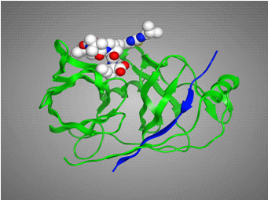
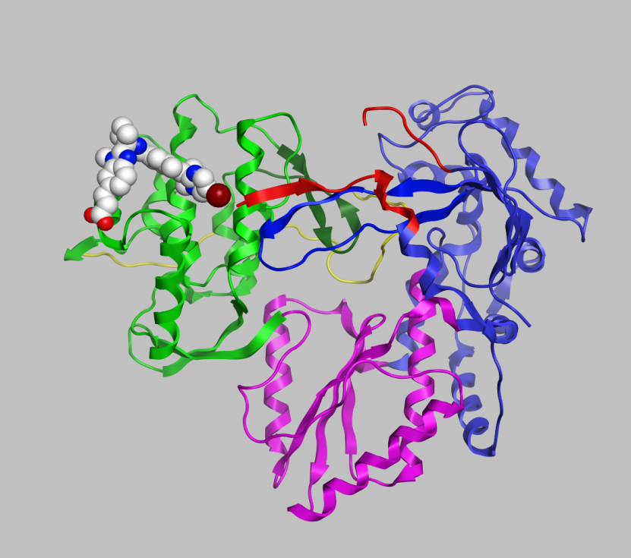
Background
BI 201335
BI 207127
2nd generation protease inhibitor
Nanomolar potency in vitro
PK profile supportive of QD dosing
Non-nucleoside NS5B inhibitor
Nanomolar potency in vitro
PK profile supportive of BID or TID dosing
Phase Ib study of BI 201335 + BI 207127 + RBV (SOUND-C1)¹:
  100% RVR achieved in BI 207127 600 mg TID group
  No severe AEs or discontinuations due to AEs during 4 weeks’ treatment
1. Zeuzem S, et al. Gastroenterology 2011;141:2047–2055
Notes:
BI 201335 is a potent and selective second-generation NS3/4A protease inhibitor currently in phase III of clinical development
BI 207127 is a thumb pocket 1 non-nucleoside NS5B polymerase inhibitor; as monotherapy, it achieved 3 log HCV RNA decay in GT-1 (up to 4 log HCV RNA decay in GT-1b)

Slide 4
Study design
(n=81)
(n=80)
(n=77)
(n=78)
(n=46)
BI 201335 120 mg QD +
BI 207127 600 mg TID + RBV
Follow-up
BI 201335 120 mg QD + BI 207127 600 mg TID + RBV
Follow-up
BI 201335 120 mg QD + BI 207127 600 mg TID + RBV
Follow-up
BI 201335 120 mg QD + BI 207127 600 mg BID + RBV
Follow-up
BI 201335 120 mg QD + BI 207127 600 mg TID, no RBV
Follow-up
Day 1 Week 16 Week 28 Week 40
Phase IIb, multicentre, open-label, randomised (1:1:1:1:1)ª
  Treatment-naïve patients with chronic HCV GT-1
Stratified by GT-1 subtype (1a vs 1b) and IL28B genotype (CC vs non-CC)
Compensated cirrhosis allowed; 18–75 years of age, HCV RNA >100 000 IU/mL
Primary endpoint: SVR 12
All analyses are ITT
ªRandomisation to the TID28W, no RBV arm was stopped early due to FDA feedback on protocol design after 46 patients were randomised
Initial doses of 240 mg (BI 201335) and 1200 mg (BI 207127) were given on the first day of treatment;
RBV dosed at 1000 mg/day (<75 kg body weight) or 1200 mg/day (≥75 kg body weight)
BID, twice daily; QD, once daily; TID, three-times daily

Slide 5
Baseline characteristics
 | TID16W (n=81) | TID28W (n=80) | TID40W (n=77) | BID28W (n=78) | TID28W, no RBV (n=46)
Male, n (%) | 45 (56) | 41 (51) | 36 (47) | 41 (53) | 24 (52)
White, n (%) | 79 (98) | 78 (98) | 76 (99) | 77 (99) | 46 (100)
Mean age, years (SD) | 48.6 (11.3) | 47.3 (11.2) | 48.9 (10.7) | 47.9 (11.1) | 45.3 (13.0)
Mean BMI, kg/m² (SD) | 25.3 (4.1) | 25.5 (4.1) | 24.8 (3.8) | 25.0 (3.6) | 25.5 (3.8)
Liver cirrhosis, n (%) | 9 (11) | 7 (9) | 5 (7) | 13 (17) | 3 (7)
IL28Bª GT C/C, n (%) | 21 (26) | 21 (26) | 19 (25) | 19 (24) | 12 (26)
HCV GT-1a^{b}, n (%) | 34 (42) | 32 (40) | 34 (44) | 30 (38) | 18 (39)
HCV GT-1b^{b}, n (%) | 47 (58) | 48 (60) | 43 (56) | 48 (62) | 28 (61)
Baseline HCV RNA^{c}, n (%) ≥800,000 IU/mL | 70 (86) | 66 (83) | 67 (87) | 66 (85) | 36 (78)
ª IL28B SNP rs 12979860
^{b} HCV GT-1 subtype analyses with TRUGENE®, if GT result unspecified INNO-LiPA 2.0
^{c} Plasma HCV RNA was measured using the Roche COBAS® TaqMan HCV/HPS assay v2.0, with a lower limit of quantification (LLOQ) of 25 IU/mL and a lower limit of detection (LLOD) of approximately 15 IU/mL

Slide 6
Primary endpoint:
Sustained virological response (ITT)
ª
SVRª (%)
48/81
49/80
43/77
53/78
18/46
7127 dosing
Duration (weeks)
RBV +/-
TID
16
+
TID
28
+
TID
40
+
BID
28
+
TID
28
-
ªData for 40-week group are SVR4 rates as SVR12 data are not yet available
SVR: HCV RNA undetected at 4 weeks (SVR4) and 12 weeks (SVR12) after treatment completion
All groups received BI 201335 120 mg QD for the same duration as BI 207127 (16, 28 or 40 weeks)

Slide 7
SVR according to subtype (GT-1a and GT-1b)
(ITT)
GT-1a
GT-1b
7127 dosing
Duration (weeks)
RBV +/-
TID
16
+
TID
28
+
TID
40
+
BID
28
+
TID
28
-
ªData for 40-week group are SVR4 rates as 12-week data not yet available
All groups received BI 201335 120 mg QD for the same duration as BI 207127 (16, 28 or 40 weeks)

Slide 8
SVR according to IL28B GT (CC vs non-CC)
(ITT)
Non-CC
CC
7127 dosing
Duration (weeks)
RBV +/-
TID
16
+
TID
28
+
TID
40
+
BID
28
+
TID
28
-
ªData for 40-week group are SVR4 rates as 12-week data not yet available
All groups received BI 201335 120 mg QD for the same duration as BI 207127 (16, 28 or 40 weeks)

Slide 9
SVR according to IL28B GT and viral subtype
BID28W: 1a non-CC vs 1b (all) + 1a-CC
(ITT)
1a non-CC
1a CC
1b non-CC
1b CC
84
82
75
SVR (%)
SVR (%)
32
7127 dosing
Duration (weeks)
RBV +/-
BID
28
+

Slide 10
SVR according to IL28B GT and viral subtype
1a non-CC vs 1b (all) + 1a-CC
(ITT)
1a non-CC
All 1b and 1a-CC
SVRª (%)
7127 dosing
Duration (weeks)
RBV +/-
TID
16
+
TID
28
+
TID
40
+
BID
28
+
TID
28
-
ªData for 40-week group are SVR4 rates as 12-week data not yet available
All groups received BI 201335 120 mg QD for the same duration as BI 207127 (16, 28 or 40 weeks)

Slide 11
On-treatment failures and relapse
1b (all) and 1a-CC
On-treatment failureª
Relapse
7127 dosing
Duration (weeks)
RBV +/-
TID
16
+
TID
28
+
TID
40
+
BID
28
+
TID
28
-
ªOn-treatment failure = breakthrough

Slide 12
On-treatment failures and relapse
1a non-CC
On-treatment failureª
Relapse
7127 dosing
Duration (weeks)
RBV +/-
TID
16
+
TID
28
+
TID
40
+
BID
28
+
TID
28
-
ªOn-treatment failure = breakthrough

Slide 13
Common AEs: Severity and discontinuations
 | Number (%) of patients
 | TID16W (n=81) | TID28W (n=80) | TID40W (n=77) | BID28W (n=78) | TID28W, no RBV (n=46)
D/C due to AEs | 4 (4.9) | 10 (12.5) | 19 (24.7) | 6 (7.7) | 5 (10.9)
Photosensitivity AEs
Moderate | 4 (5) | 3 (4) | 6 (8) | 0 | 0
Severe | 0 | 1 (1) | 2 (3) | 0 | 0
Jaundice AEs
Moderate | 2 (3) | 6 (8) | 3 (4) | 2 (3) | 0
Severe | 0 | 0 | 0 | 0 | 0
Rash AEs
Moderate | 2 (3) | 2 (3) | 2 (3) | 0 | 4 (9)
Severe | 1 (1) | 0 | 1 (1) | 0 | 0
Vomiting AEs
Moderate | 4 (5) | 10 (13) | 3 (4) | 3 (4) | 2 (4)
Severe | 0 | 0 | 4 (5) | 0 | 1 (2)
Diarrhoea AEs
Moderate | 1 (1) | 4 (5) | 3 (4) | 4 (5) | 2 (4)
Severe | 0 | 0 | 1 (1) | 0 | 0
Rash graded as moderate (diffuse, 30% to 70% body surface area) or severe (generalised, or mucous membrane involvement, organ dysfunction, anaphylaxis or life threatening) by rash management plan
Other AEs judged per patient tolerability as moderate (interference with usual activity) or severe (incapacitating or causing inability to work or to perform usual activities)

Slide 14
Worst grade 3 and 4 lab abnormalities on treatment
 | TID16W (n=81) | TID28W (n=80) | TID40W (n=77) | BID28W (n=78) | TID28W, no RBV (n=46)
Haemoglobin
Grade 3 | 0 | 2 (3) | 3 (4) | 1 (1) | 0
Grade 4 | 0 | 0 | 0 | 1 (1) | 0
White cells
Grade 3 | 0 | 0 | 0 | 0 | 0
Grade 4 | 0 | 0 | 0 | 0 | 0
Platelets
Grade 3 | 0 | 0 | 0 | 0 | 0
Grade 4 | 0 | 0 | 0 | 0 | 0
ALT/GPT
Grade 3 | 1 (1) | 0 | 0 | 2 (3) | 0
Grade 4 | 0 | 0 | 0 | 0 | 0
Total bilirubinª
Grade 3 | 33 (41) | 15 (19) | 20 (26) | 20 (26) | 6 (13)
Grade 4 | 4 (5) | 10 (13) | 5 (6) | 10 (13) | 0
ªAll patients had a predominance of unconjugated bilirubin (UGT 1A1 inhibition)
Gradings based on (Division of AIDS (DAIDS) gradings for laboratory abnormalities

Slide 15
Conclusions
The IFN-free combination of BI 201335 + BI 207127 + RBV demonstrated high efficacy and a good safety profile
  16 to 28 weeks of treatment with BI 201335 + BI 207127 + RBV achieved high SVR rates
  Up to 82% of GT-1a (IL28B: CC) and GT-1b patients (IL28B: CC + non-CC) achieved SVR
    Rates of on-treatment failure and relapse were low in this patient population
  Combination with ribavirin remains necessary
  The BID (for BI 207127) regimen demonstrated the a favourable safety and tolerability profile with a low rate of discontinuation
  Mostly mild effects on RBC and no effect on WBC and PLT counts were observed
  Sub-analysis of cirrhotic population in SOUND-C2: Poster 1420 in the late breaker area of the poster hall today
Phase III studies investigating the BID regimen in the 1a-CC and 1b population are planned

Slide 16
Acknowledgements
Patients and study investigators at study centres in the following countries:
Australia | Germany | Romania
Peter Angus | Keikawus Arastéh | Emanoil Ceausu
Stuart Roberts | Thomas Berg | Liliana Preotescu
Austria | Michael Geissler | Adrian Streinu-Cercel
Peter Ferenci | Ansgar Lohse | Spain
Michael Gschwantler | Michael Manns | Maria Buti
Andreas Maieron | Stefan Mauss | José Luis Calleja
France | Marcus Schuchmann | Moises Diago
Tarik Asselah | Stefan Zeuzem | Xavier Forns
Marc Bourliere | New Zealand | Javier Garcia-Samaniego
Jean-Pierre Bronowicki | Ed Gane | Vicente Soriano
Dominique Larrey | Portugal | Switzerland
Joseph Moussalli | Filipe Calinas | Tilman Gerlach
Stanislas Pol | Guilherme Macedo | Markus Heim
Jean-Pierre Zarski | Leopoldo Matos | Darius Moradpour
Fabien Zoulim | Célia Oliveira | Beat Müllhaupt
 | Cristina Valente | Jürg Reichen
Boehringer Ingelheim for sponsoring the study and their clinical and statistical teams for study monitoring, data collection and analysis
Editorial support provided by Nicky French of Adelphi Communications Ltd and funded by Boehringer Ingelheim

