Slide 1
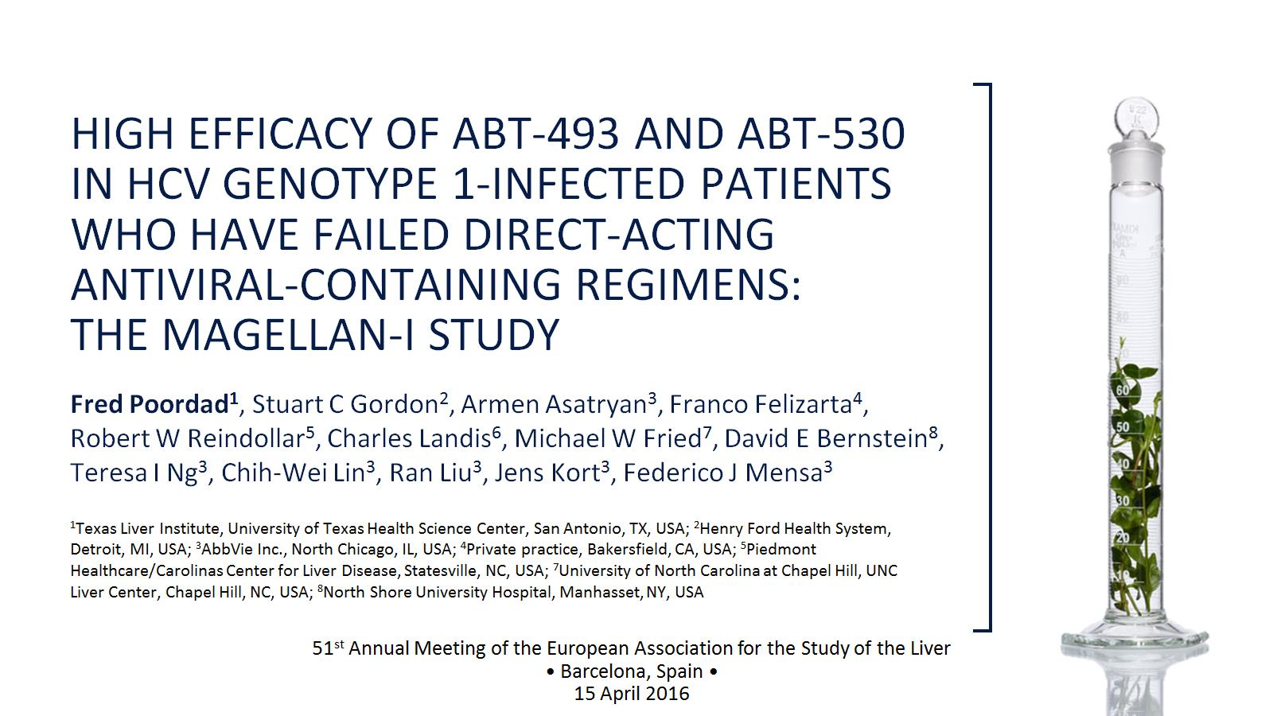
HIGH EFFICACY OF ABT-493 AND ABT-530 IN HCV GENOTYPE 1-INFECTED PATIENTS WHO HAVE FAILED DIRECT-ACTING ANTIVIRAL-CONTAINING REGIMENS: THE MAGELLAN-I STUDY

Slide 2
Disclosures

Slide 11
MAGELLAN-I Study Design

Slide 12
Demographics and Patient Characteristics

Slide 20
Patients With ≥2 RAVs: 92% (23/25) SVR12

Slide 24
Acknowledgements

