Slide 1

MAGELLAN-1, PART 2: GLECAPREVIR/PIBRENTASVIR FOR 12 OR 16 WEEKS IN PATIENTS WITH CHRONIC HCV GENOTYPE 1 OR 4 AND PRIOR DIRECT-ACTING ANTIVIRAL TREATMENT FAILURE

Slide 2
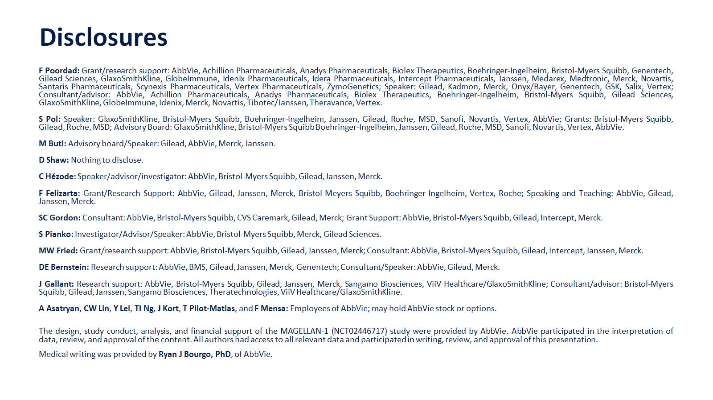

Slide 3
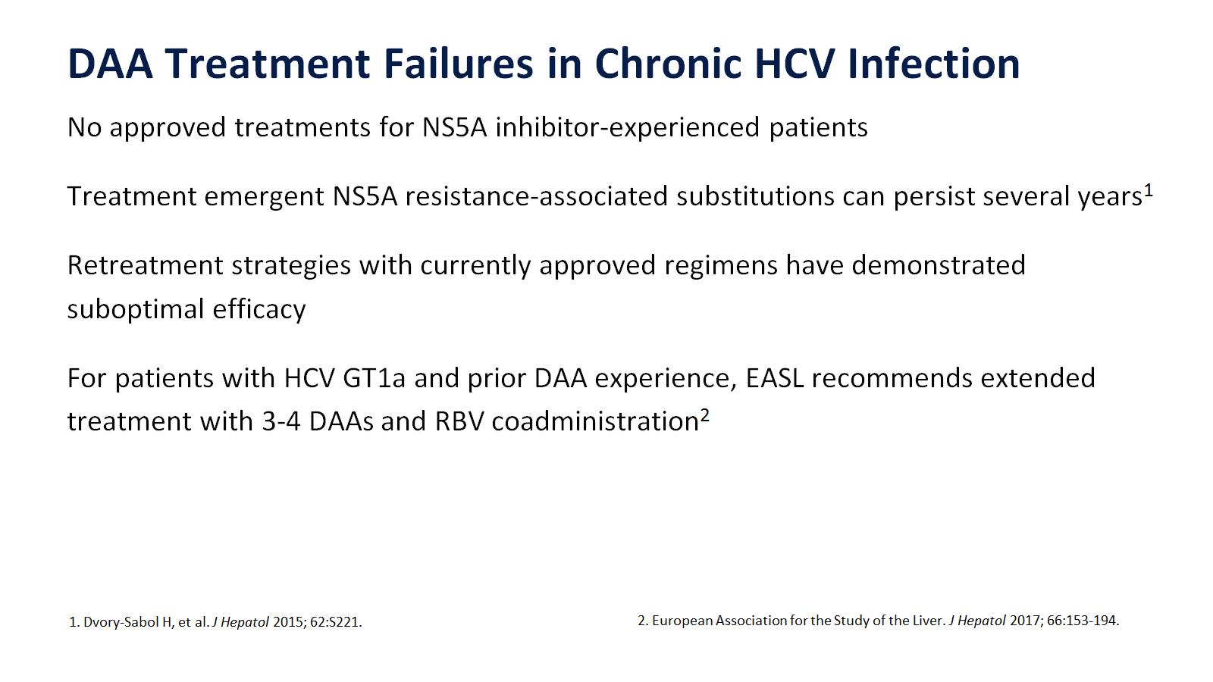

Slide 4
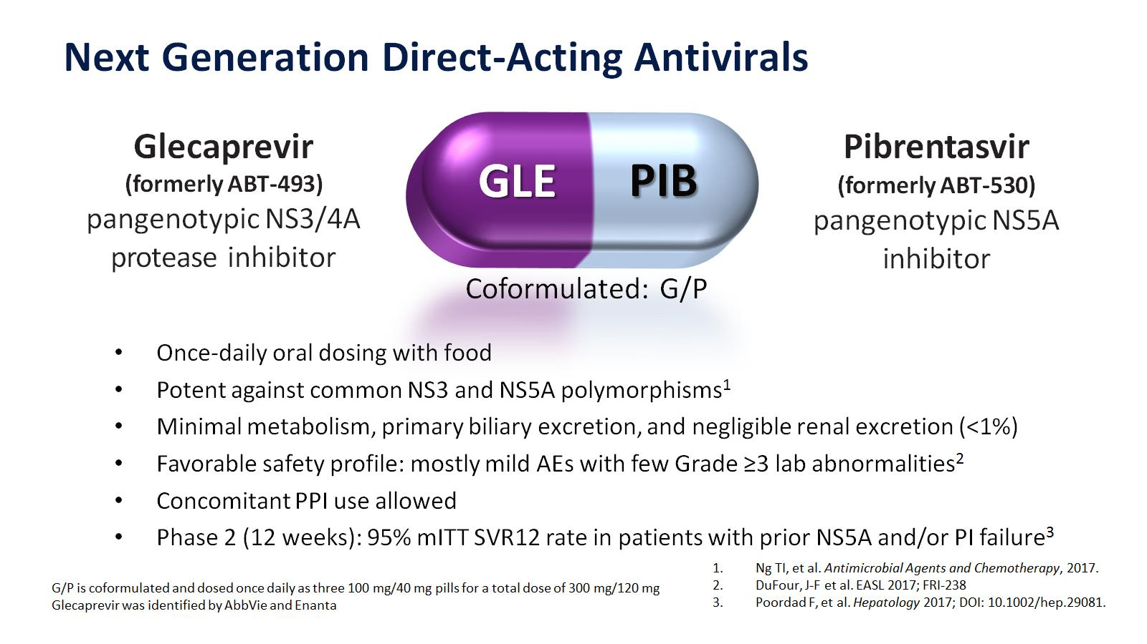
Next Generation Direct-Acting Antivirals

Slide 5
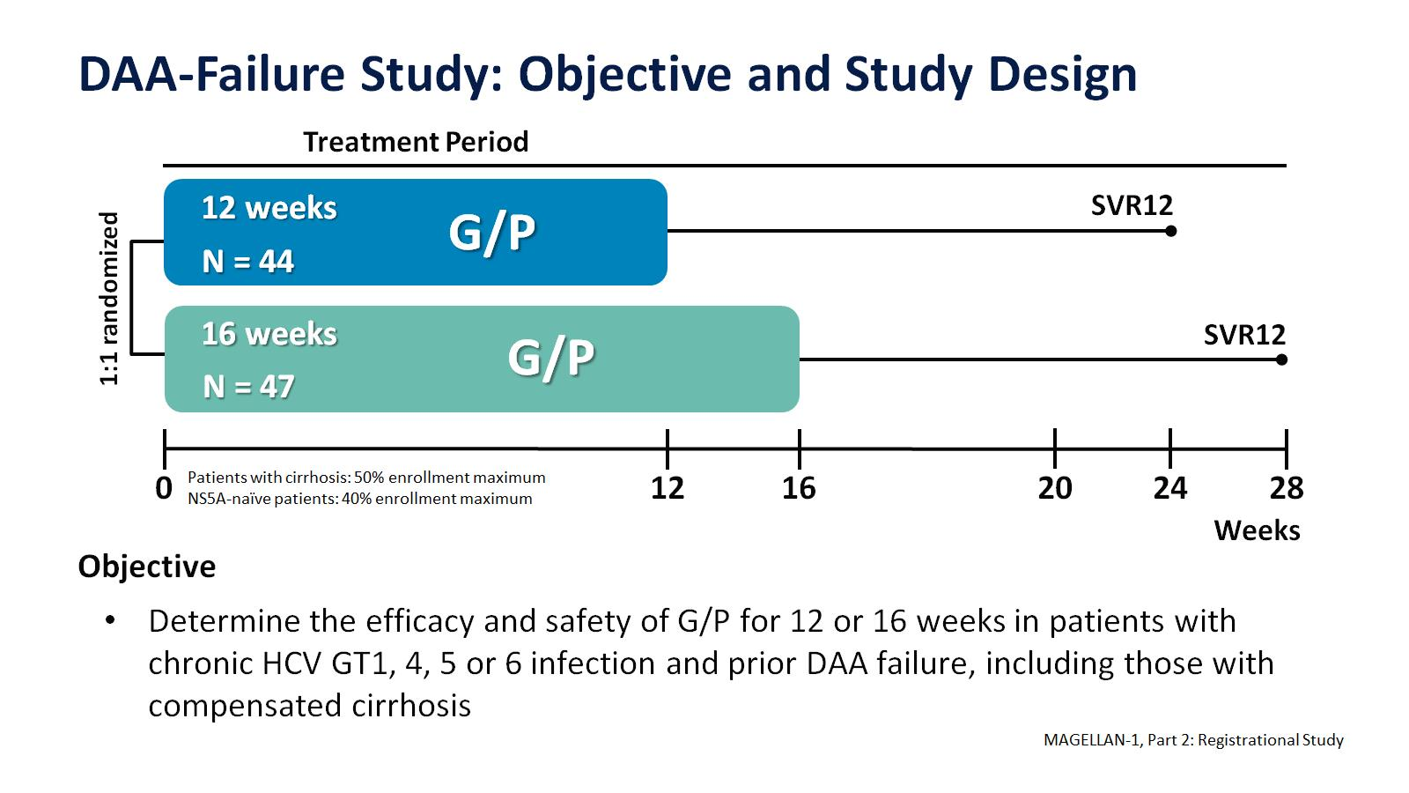

Slide 6
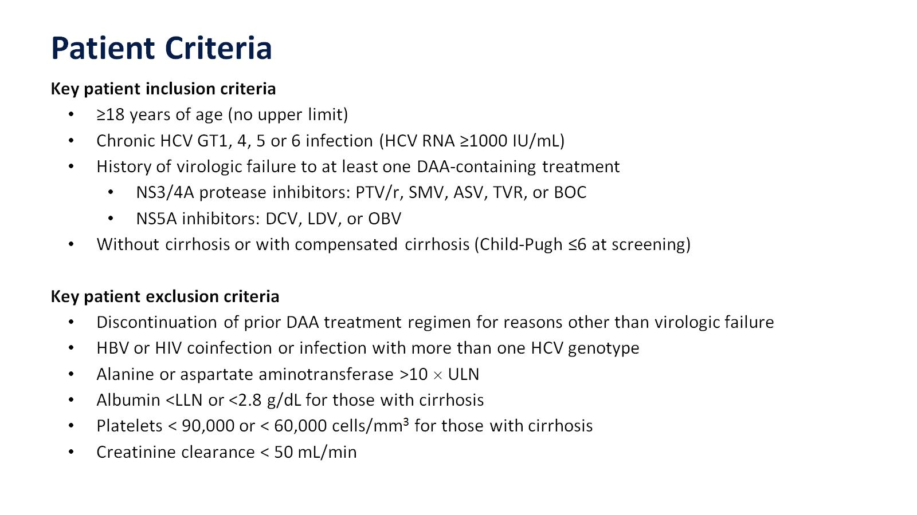

Slide 7
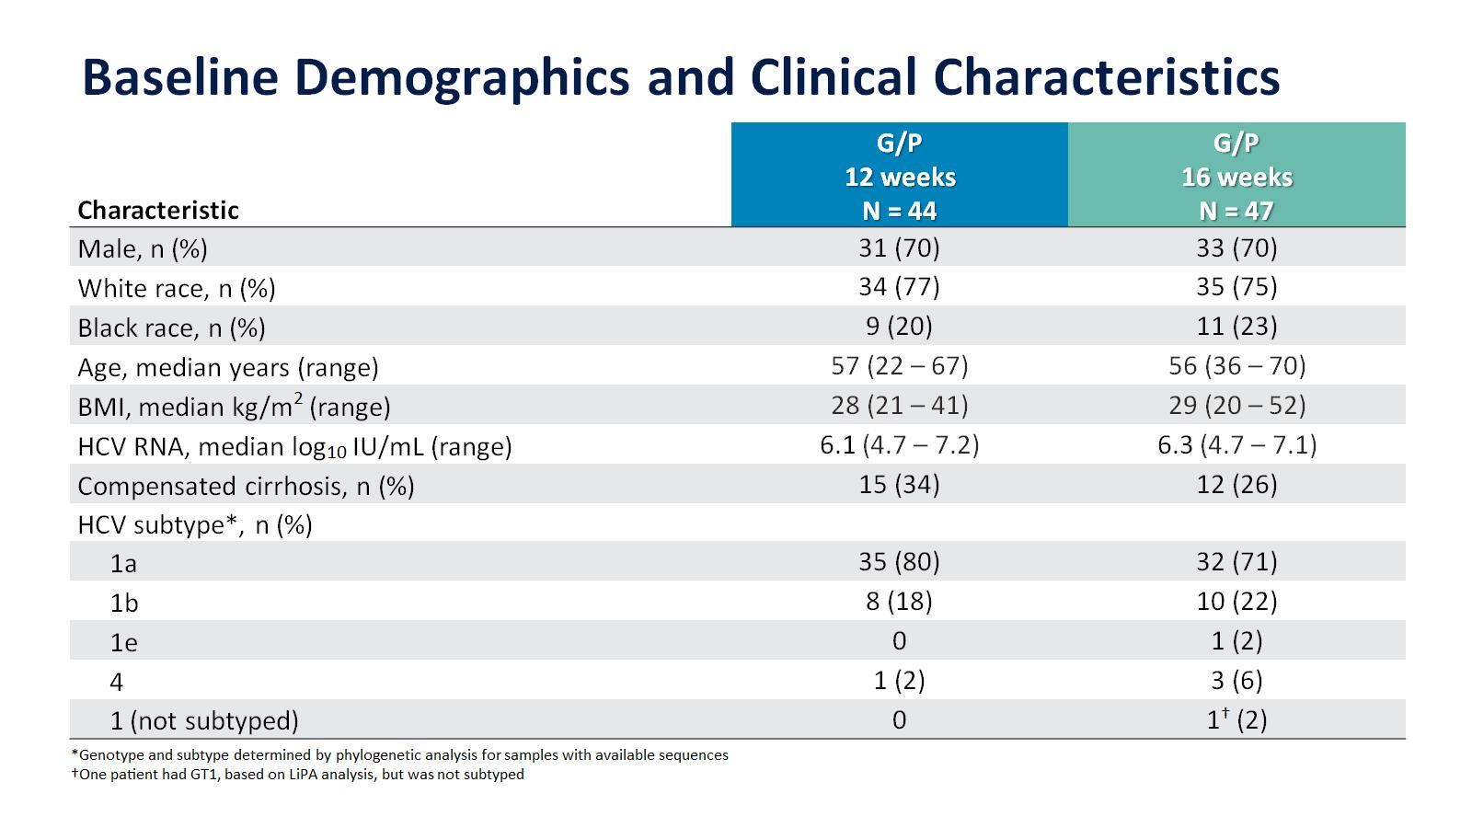

Slide 8
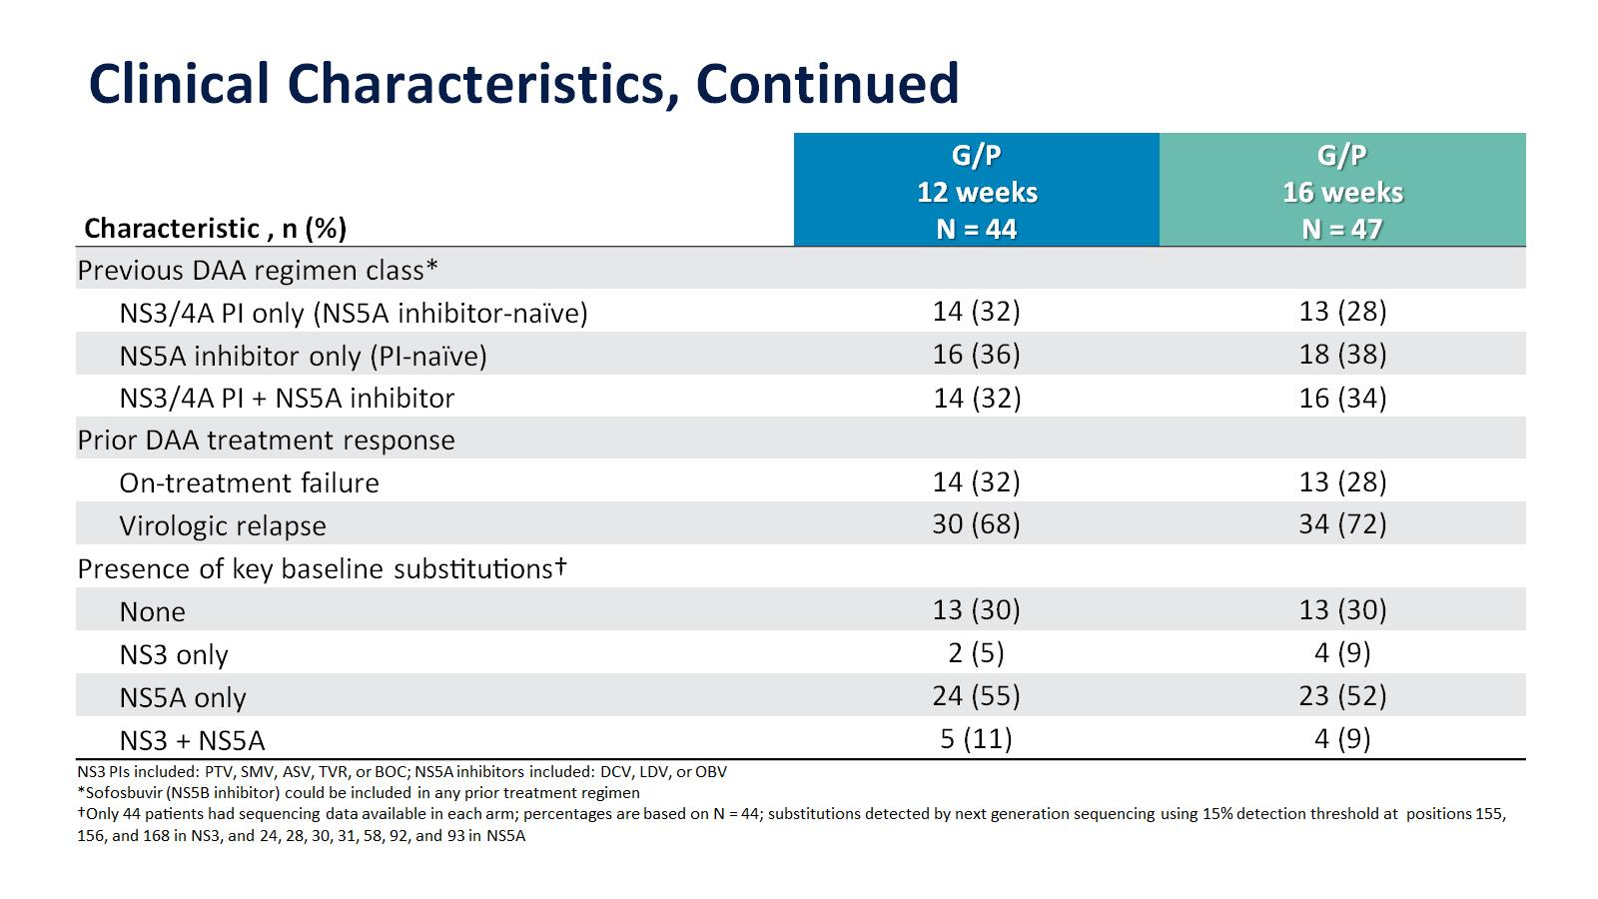

Slide 9
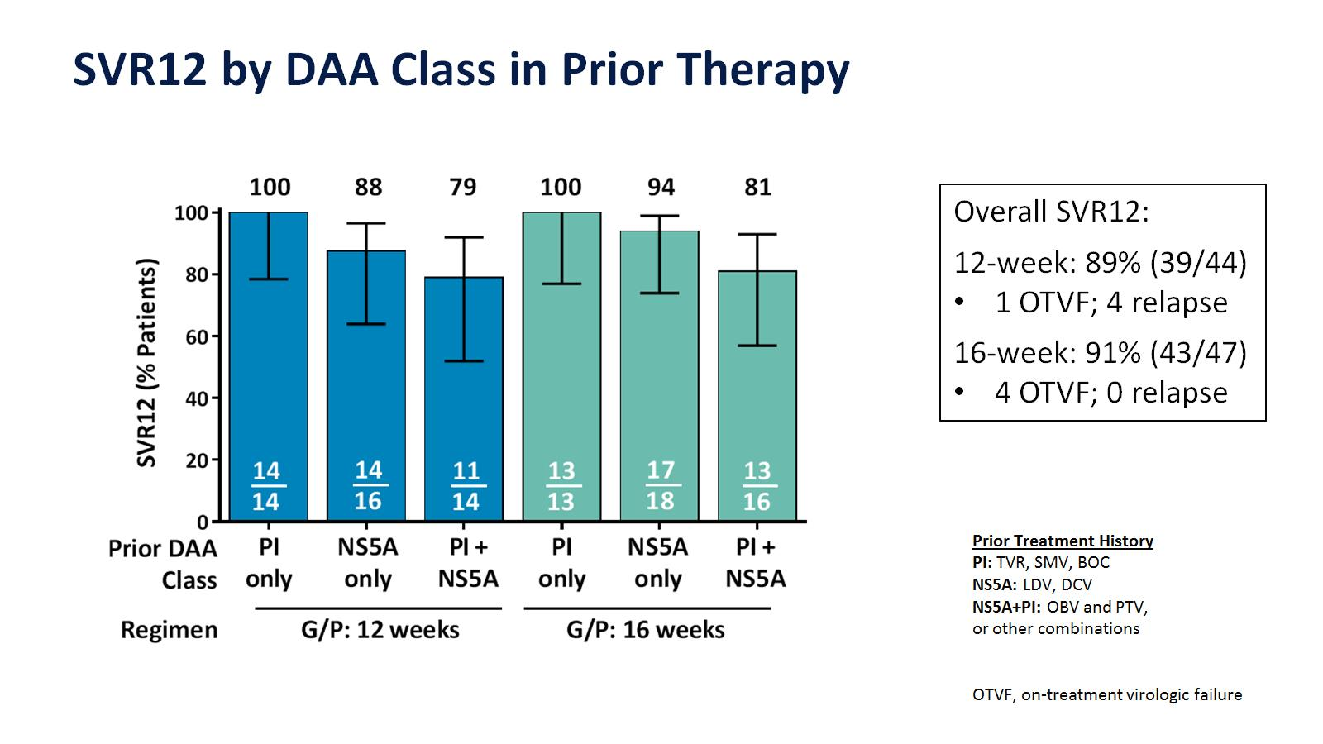

Slide 10
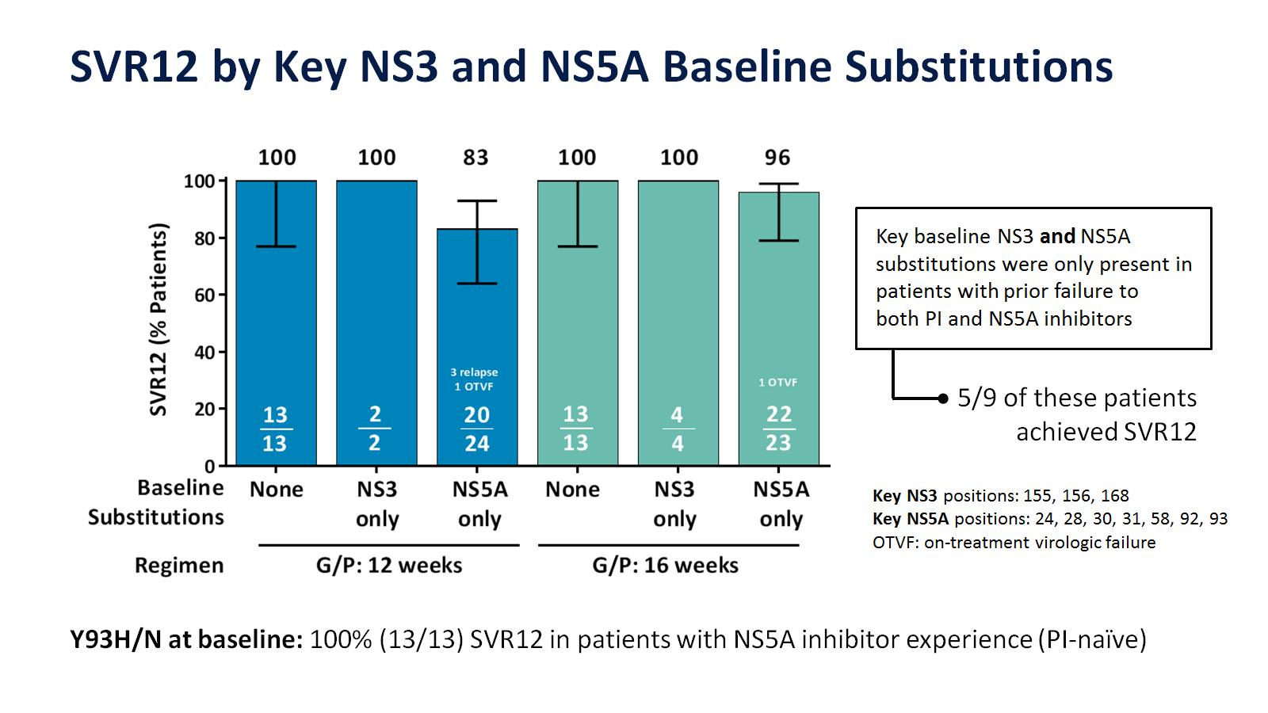

Slide 11
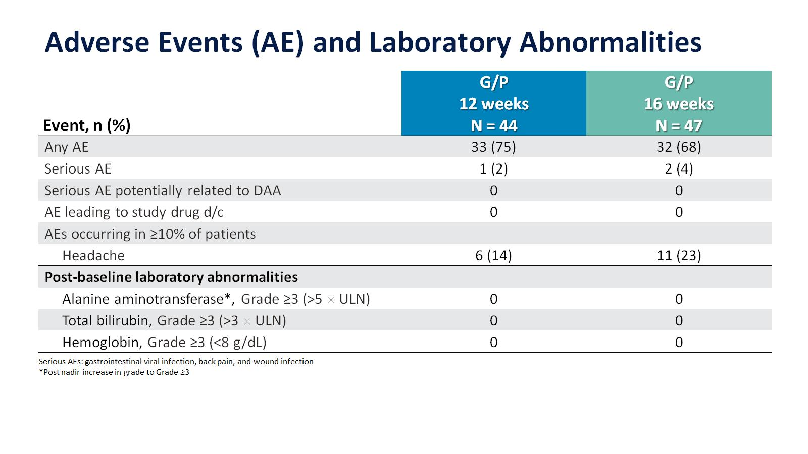

Slide 12
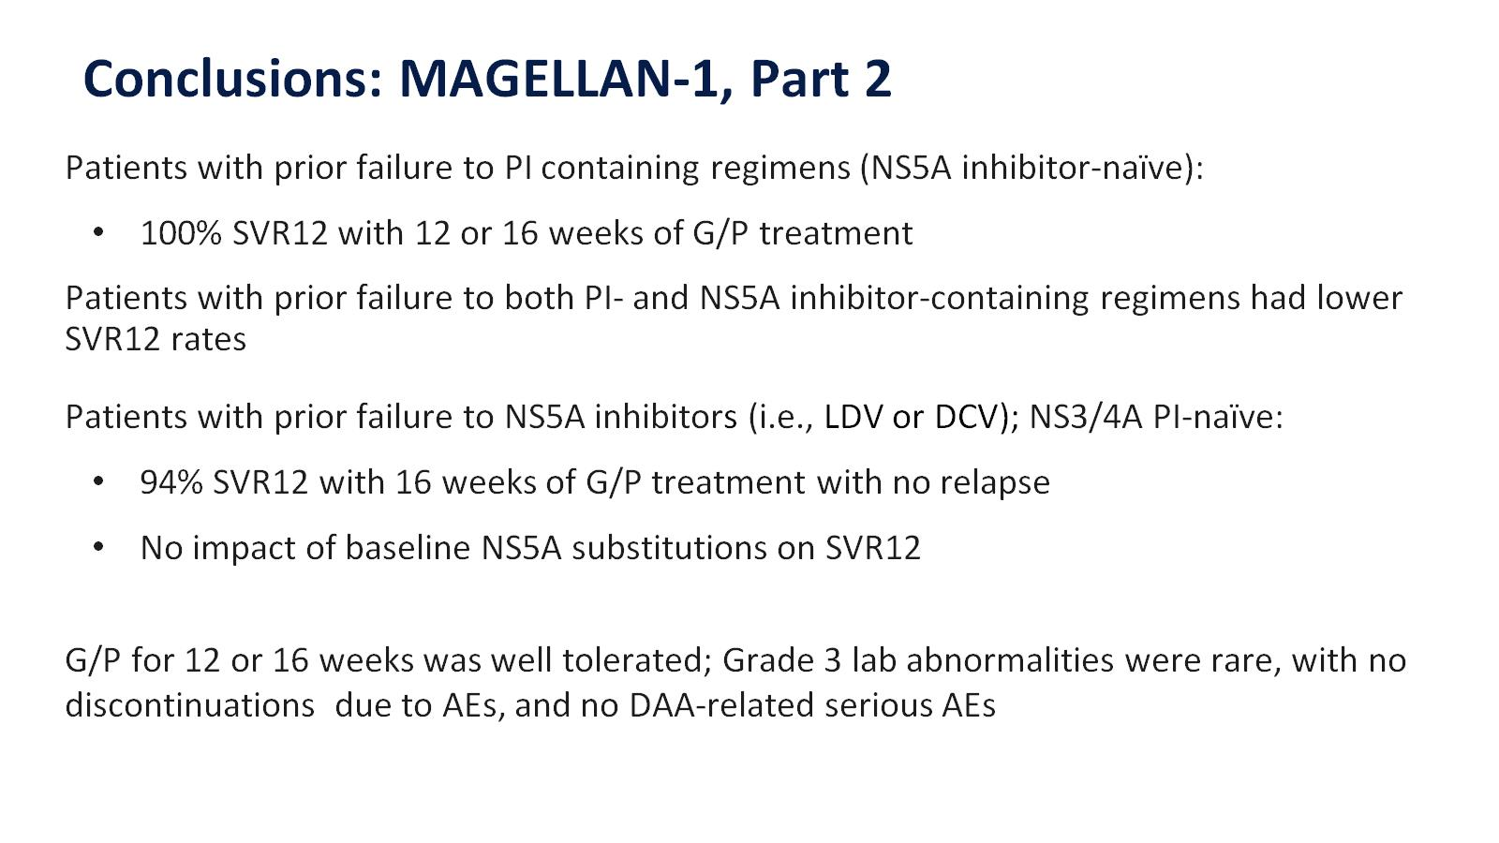

Slide 13
