Slide 1
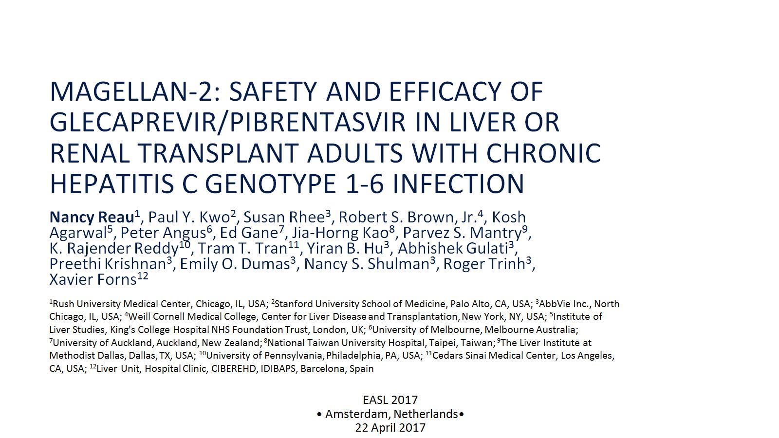
MAGELLAN-2: Safety and Efficacy of Glecaprevir/Pibrentasvir in Liver or Renal Transplant Adults with Chronic Hepatitis C Genotype 1-6 Infection

Slide 2
