Slide 1








A-899-0059-12977
A two-arm (proof of concept) randomised phase II trial Vorinostat plus a prime boost Vaccine
Presented by Professor Sarah Fidler
on behalf of the RIVER study team and investigators

Slide 2
Disclosures
MSD donated drugs (Raltegravir and Vorinostat) and GSK contributed some of its intellectual property to the study through an industry academic partnership.

Slide 3


HIV Cure approach “Kick and Kill”
Latency reversal
Immune system
ART
‘Shock’
‘Kill’
HIV
genome
HIV
proteins
Dying
infected cell
1. Deeks SG. Nature 2012;487:439–40. 2. Walker-Sperling VE, et al. J Virol 2015;89:9631–8.

Slide 4
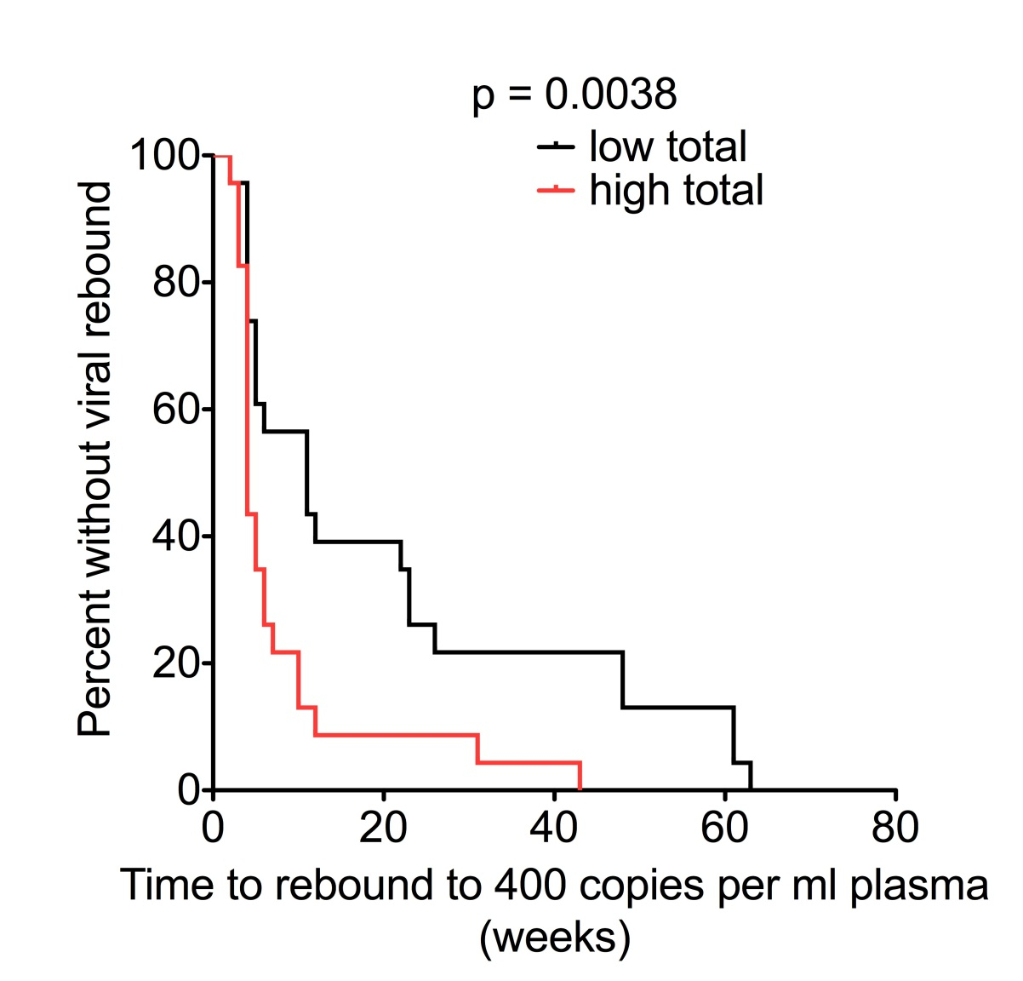
Total HIV DNA predicts time to viral rebound after Treatment interruption; The SPARTAC study
Williams et al eLife

Slide 5
RIVER study design
Treated Primary HIV infection:
  lowest reservoirs, preserved immune responses
The Kick:
  HDAC inhibitor Vorinostat
The Kill:
  ChAdV63.HIVconsv and MVA.HIVconsv*
Design:
  Randomised control comparison with ART alone
Primary endpoint:
  Total HIV DNA in peripheral blood CD4+ T-cells at weeks 16 & 18 post randomisation
*Letourneau S Plos One 2007

Slide 6
Study design
Individual with defined PHI
Immediate standard ART
(irrespective of CD4) + integrase inhibitor
Vaccination:
Prime ChAdV63.HIVconsv at randomisation
Boost MVA.HIVconsv
week 8 post-randomisation
Vorinostat
400mg od every 72 hours* total 10 doses
Approx. 24 weeks
Undetectable viral load
Randomisation
ART only
ART + V + V
18 weeks
Vaccines
HDACi
Primary outcome: total proviral DNA in CD4+ T cells
Secondary outcomes
*Archin et al J Clin Invest 2017
Aug 1;127(8):3126-3135.

Slide 7
Outcome measures
Primary outcome
  Total HIV DNA in CD4+ T-cells averaged across post-randomisation weeks 16 and 18.
  Comparison of two groups on a log₁₀-scale by analysis of covariance with adjustment for values at randomisation.
Secondary outcomes
  Clinical and laboratory adverse events all grades including SAE;
  HIV integrated DNA;
  HIV cell associated RNA;
  HIV viral load <1 copy/mL;
  Viral outgrowth
  HDAC inhibition
  P24 ultra-sensitive assay
  T-cell responses ICS
  Ex vivo viral inhibition assays
Substudy HIV reservoir in GALT

Slide 8
Method of PHI diagnosis
Note: PHE RITA test algorithm reported as “Incident” confirming the HIV-1 antibody avidity is consistent with recent infection (within the preceding 16 wks)
Notes:
Can you change the title of study arms throughout to ART only and ART + V + V

Slide 9
Description of participants at randomisation
 | ART only N = 30 | ART + V + V N = 30 | Total n = 60
Age (years) | 31 (30,38) | 35 (28,44) | 32 (29,40)
Gender | 30 (100%) male | 30 (100%) male | 60 (100%) male
Route of transmission MSM MSW Other | 26 (87%) 1 (3%) 3 (10%) | 29 (97%) 1 (3%) 0 | 55 (92%) 2 (3%) 3 (5%)
CD4 count (cells/mm³) | 694 (561, 844) | 710 (579, 759) | 708 (568, 788)
HIV Viral Load (copies/mL) <50 50 - <200 | 29(97%) 1 (3%) | 30 (100%) 0 | 59 (98%) 1 (2%)
Weeks since PHI diagnosis to randomisation | 28 (27,41) | 28 (27,34) | 28 (27,36)
Note: Numbers are N (%) or median (IQR)

Slide 10
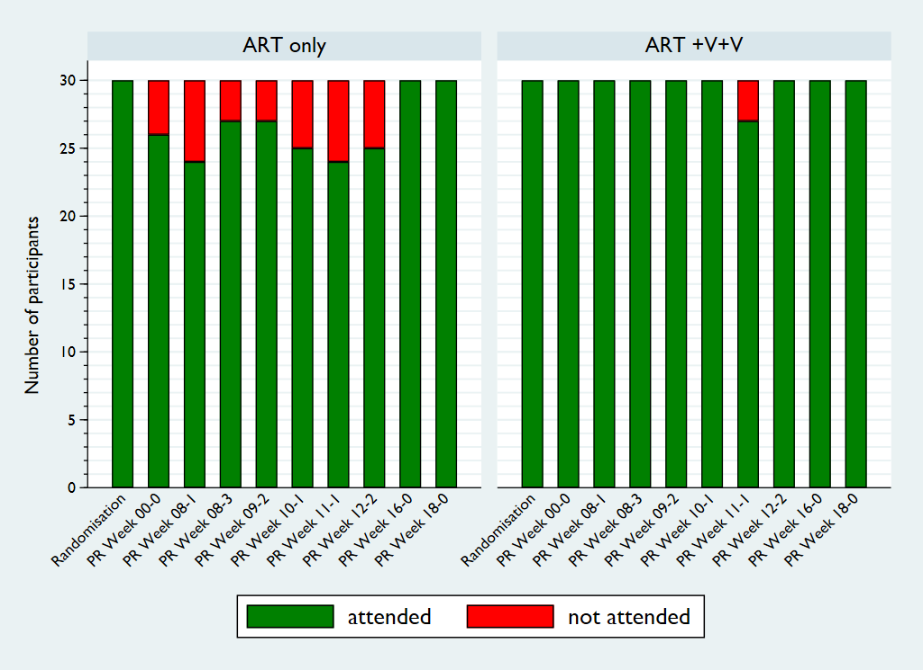
Attendance of scheduled trial visits

Slide 11
Clinical adverse events
 | ART only | ART + V + V
 | N=30 | N=30
Any AE post-randomisation
no | 8 (27%) | 1 (3%) | p = 0.026
yes | 22 (73%) | 29 (97%)
Maximum grade
mild | 10 (33%) | 21 (70%) | p = 0.023
moderate | 6 (20%) | 7 (23%)
severe | 6 (20%) | 1 (3%)
Median N of AEs post-randomisation | 1 (0,2) | 3 (2,5) | p < 0.001
Notes:
Grade 3 events:
- Infections And Infestations: Acute Hepatitis A (n=1), Influenza (n=1),
Proctitis Herpes (n=1), Shingles (n=1)
- Injury, Poisoning And Procedural Complications: Wrist Injury (n=1)
- Musculoskeletal And Connective Tissue Disorders: Back Pain (n=2; 1 Arm A, 1 Arm B)

Slide 12
Primary outcome
Difference by arm in total HIV DNA/ million CD4+ T-cells at weeks 16 & 18 post-randomisation

Slide 13
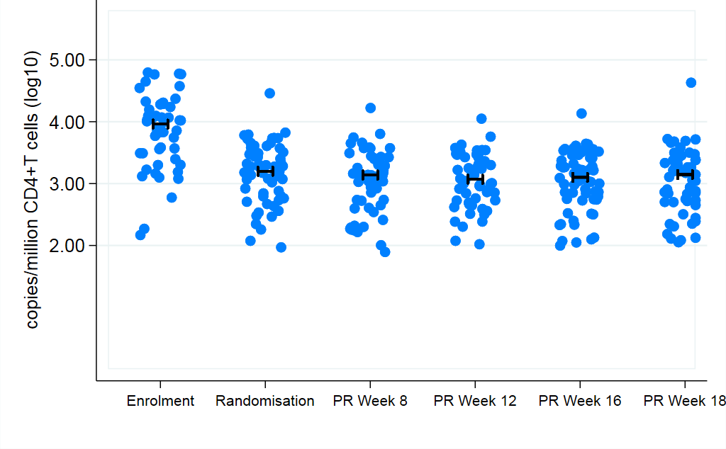
Total HIV DNA over time for all participants
3.84 | 3.14 | 3.03 | 3.06 | 3.04 | 3.04 | log₁₀, mean
Individual results plus median (for both arms combined)
Notes:
Can you add a p value for the change between baseline and randomization vs week 16 & 18 combined altogether
Mean total HIV-DNA was 3.84 log₁₀ copies/million CD4+ T-cells at enrolment (stratum 1), decreasing to 3.14 at randomisation. Total HIV-DNA then decreased further to weeks PR-16/18 without difference between the two arms: -0.11 (95% CU -0.17;-0.06), and -0.07 (-0.12;-0.02) log₁₀ HIV-DNA copies/million CD4+ T-cells in control and intervention arm, respectively. There was no significant difference in the primary endpoint

Slide 14
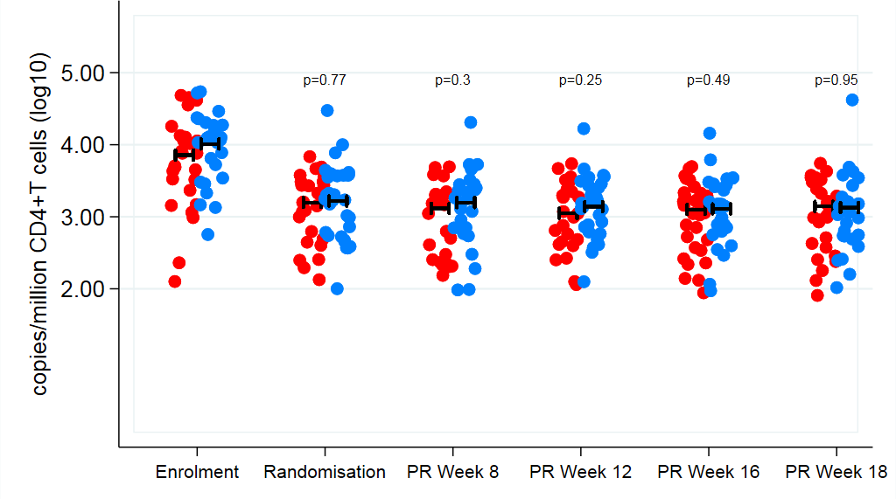
Total HIV DNA over time, by arm
Primary endpoint: Difference (ART+V+V minus ART only) in mean log₁₀ HIV DNA copies/million CD4+T cells averaged across PR weeks 16 and 18: 0.04 (95% CI: -0.03 to 0.11); p=0.26
ART only ART +V+V
Notes:
Can you rename the slides rename the arms of the study and also add in p value
Plus overall estimated change from baseline (randomization to primary outcome)
So slides 16 and 17 all into one slide

Slide 15
Secondary endpoints

Slide 16
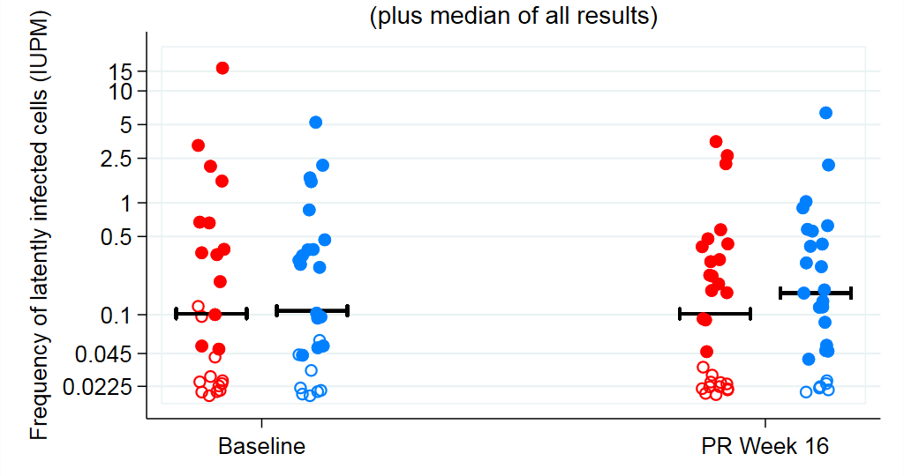
Viral outgrowth assay: a measure of replication competence Professor Andrew Lever (Cambridge)
p = 0.402
ART only ART +V+V
Notes:
Again can you adapt this slide to
rename the title of the graph
Rename the study arms
Baseline is randomization maybe we can stick to that throughout
Add the p values to show there is no significant difference between ART only and ART + V + V in terms of viral outgrowth assay

Slide 17
HIV-specific T cell responses: Methods
Professor Lucy Dorrell (Oxford)
Intracellular cytokine staining (ICS)
Measuring the following markers for both CD4 and CD8 T cells:
  IFNg+
  IL2+
  TNFa+
  CD107a+ (degranulation marker)
  CD154+ (activation marker)
Time-points: Enrolment, Randomisation, PR 9-2, PR 12-2
Outcome: For each marker, the magnitude of a response is defined as the number of positive cells as percentage of their parental populations, after subtracting the negative control.
Notes:
We decided when we met with Lucy and team that we would select one figure for CD4 ICS and one for CD8 for polyfunctional analysis

Slide 18
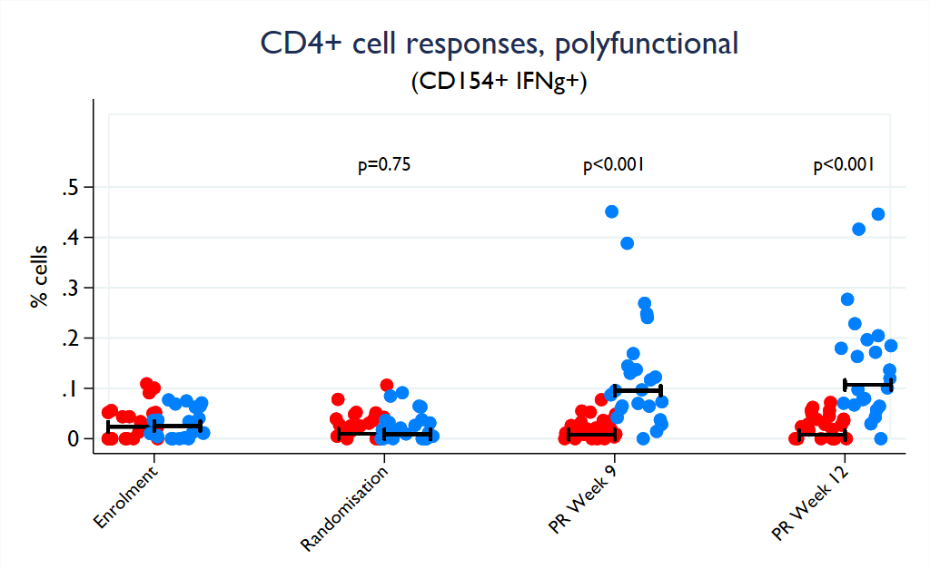
ART + V + V boosts functional HIV-specific CD4+ T cells
CD154+ IFN-g+ cells (% CD4+ T cells)
p-values: rank tests for difference
between groups per time-point
ART only ART +V+V
Notes:
Change the name of the study arms

Slide 19
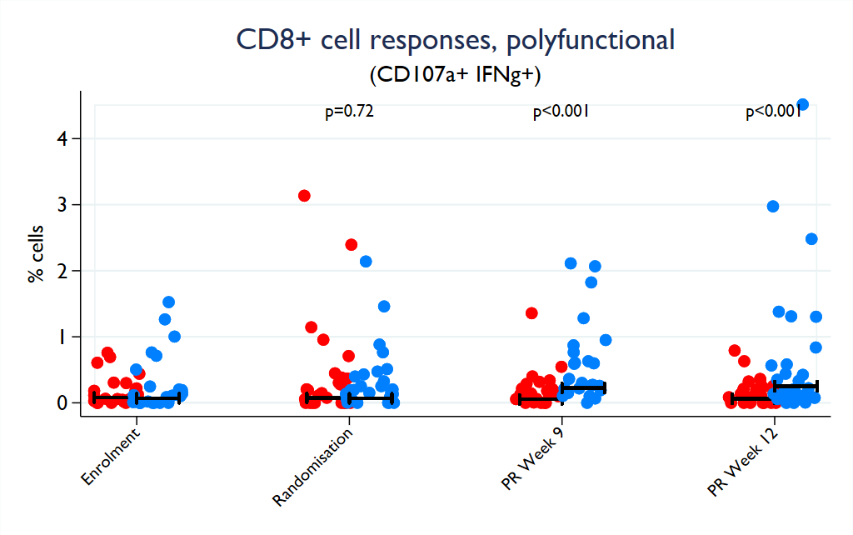
ART + V + V boosts functional HIV-specific CD8+ T cells
CD107+ IFN-g+ cells (% CD8+ T cells)
p-values: rank tests for difference
between groups per time-point
ART only ART +V+V
Notes:
Change the name of the study arms

Slide 20
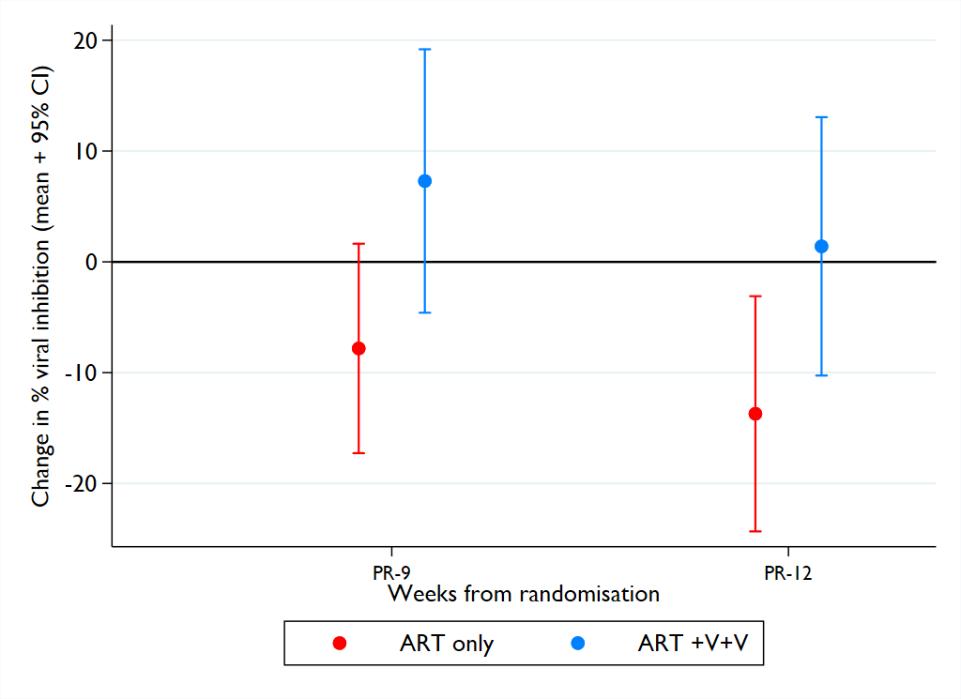
ART + V + V preserves CD8+ T cell killing capacity
Overall difference in mean change between the arms: p = 0.038
Ahmed et al Vaccine.
2016 Feb 24;34(9):1215-24.
Notes:
Change the name of the study arms

Slide 21
Additional secondary endpoints
HDAC inhibition:
  N = 22 participants from ART + V + V arm
  Acetylation 2 hours post vorinostat had increased by a factor of 3.2 (95%CI 2.4-4.2; p<0.001) compared to pre vorinostat, with no difference between visits.
Awaited results:
  CA-RNA, ULVL, epitope mapping, 2LTR, integrated DNA
  Gut sub-study n = 10 measures of viral reservoir terminal ileum, rectum and PBMC by arm

Slide 22
Summary of findings
The interventions used in this trial did no harm
No significant difference in measures of HIV DNA at weeks 16 & 18 post randomisation between arms.
Outstanding commitment from participants
  No loss to follow-up
  97% adherence to intervention.
Vorinostat significantly increased histone deacetylation.
ART + V + V significantly stimulated HIV-specific CD4 and CD8 T-cell responses compared with controls.
Study highlights importance of a control arm. The result is definitive, but disappointing

Slide 23
Discussion
This approach to “kick and kill” did not confer any significant reduction to the HIV reservoir over ART alone, as measured by total HIV DNA, 1 year after PHI, however, this does not mean the approach is wrong;
It may be the latency reversing agent used here is not potent enough, there are many new agents under study.
It may be the epitopes included in the vaccine constructs were not the correct ones to recognize latently infected cells.
More detailed laboratory research needs to be done to better understand the results.

Slide 24

All the RIVER study participants
RIVER Chief Investigator: Sarah Fidler
RIVER co-investigator and laboratory lead: John Frater
RIVER statisticians: Abdel Babiker, Wolfgang Stöhr
RIVER laboratory investigators: Lucy Dorrell, Tom Hanke, Andrew Lever, Myra McClure, Steve Kaye, Matt Pace, Axel Fun, Mikaila Bandara, Maryam Khan, Andrew Lovell, HongBing Yang, Jakub Kopycinski, Natalia Olejniczak, Helen Brown, Nicola Robinson, Otto Erlwein, Alison Crook
RIVER trial management team: Sarah Pett, Rachel Bennett, Michelle Gabriel, Fleur Hudson, Aminata Sy, Adam Gregory, Hanna Box, Cherry Kingsley, Katie Topping
RIVER clinical investigators: Sarah Fidler, Sabine Kinloch, Sarah Pett, Julie Fox, Amanda Clarke, Mark Nelson, Margaret Johnson
RIVER Trial Steering Committee (TSC): Independent Members: Eric Sandström , Janet Darbyshire, Frank Post, Chris Conlon, Jane Anderson, Mala Maini
RIVER Independent Data and Monitoring Committee (IDMC): Tim Peto, Peter Sasieni, Veronica Miller, Ian Weller
Community of people living with HIV: Simon Collins, Damian Kelly
CHERUB collaboration
Funders: MRC (MRL00528X1), NIHR Imperial BRC, NIHR Oxford BRC, NIHR Cambridge BRC
Industry partners: MSD, GSK
IS PHI the best time to move towards an HIV cure?

Slide 25
Limitations
Surrogate markers of HIV reservoir only
Evaluated at an early time-point post-intervention

Slide 26
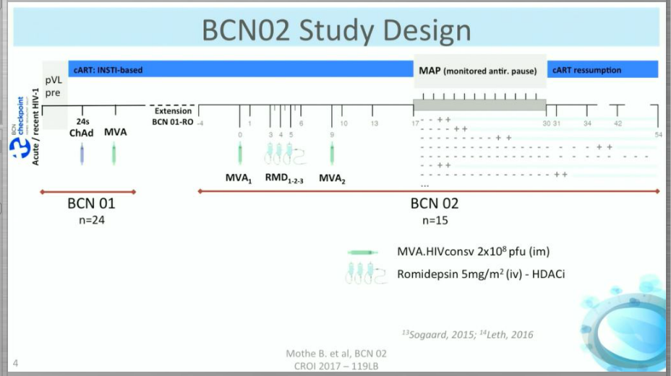
BCN 02 Study
A rollover from a prior trial that administered two therapeutic vaccines & had started ART within three months of HIV infection
Participants receive vaccine plus Romipdesin
Notes:
The vaccine vectors were based on a chimpanzee adenovirus (ChAdV63) and modified Vaccinia Ankara strain (MVA), both encoding antigens designed to focus T cell responses on highly conserved parts of HIV, including elements from the Gag, Pol, Env and Vif proteins

Slide 27
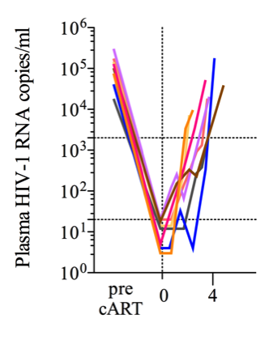
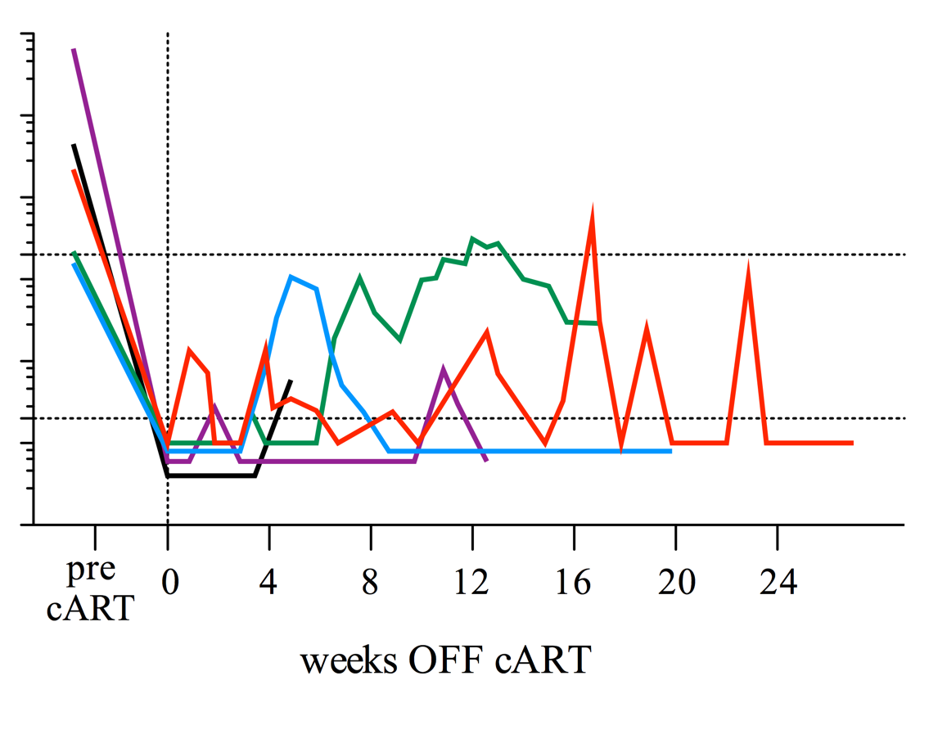
HIV+
Better Control of Viremia
BCN 02 (Mothe & Brander)
ART
STOP
ART
STOP
8/13
4-5/13
weeks
weeks
Mothe et al. presented at CROI (2017)

Slide 28
BCN 02 - Results
Five out of 13 recipients of the interventions have since interrupted ART and displayed control of viral load to low levels for several months (the longest a little over six months)
The frequency of viral load containment in the cohort (~38%) is higher than has been observed in any studies involving early initiation of ART (where rates have varied from 0-15%).
The contribution of romidepsin is unclear due to the lack of any control group

Slide 29
Analysis of the primary endpoint
Model | N | Difference in log₁₀ total HIV-DNA at weeks 16/18: Arm B vs Arm A | SE | 95% CI | p-value
unadjusted | 60 | 0.107 | 0.128 | (-0.148-0.363) | 0.404
Adjusted for baseline total HIV-DNA | 58 | 0.039 | 0.035 | (-0.032-0.109) | 0.279
Adjusted for baseline total HIV-DNA & stratum | 58 | 0.039 | 0.036 | (-0.033-0.110) | 0.282
as c), with multiple imputation of missing baseline values | 60 | 0.041 | 0.036 | (-0.031- 0.113) | 0.256
as c), excluding patients with incomplete intervention | 55 | 0.039 | 0.037 | (-0.035-0.113) | 0.292

Slide 30
Total HIV-DNA: estimated change from baseline
Change from randomisation to PR Week 16/18 : Total HIV-DNA log₁₀ copies/10⁶ CD4 cells
------------------------------------------------------------------------------
| Change Std. Err. t P>|t| [95% Conf. Interval]
-------------+----------------------------------------------------------------
rx |
Arm A | -0.11 0.03 -4.27 0.000 -0.17 -0.06
Arm B | -0.07 0.02 -2.93 0.005 -0.12 -0.02
------------------------------------------------------------------------------
overall | -0.09 0.02 -5.12 0.000 -0.13 -0.06
------------------------------------------------------------------------------

Slide 31
Viral outgrowth assay
Model | N | IUPM at week 16: Arm B vs Arm A | SE | 95% CI | p-value
Median regression | 38 | -0.04 | 0.13 | -0.31 - 0.23 | 0.743
Model | N | Log₁₀ IUPM at week 16: Arm B vs Arm A | SE | 95% CI | p-value
Interval regression | 56 | 0.19 | 0.22 | -0.25 - 0.62 | 0.402
Note: Models adjusted for stratum

Slide 32
Discussion
Did we measure HIV reservoir too soon?
Did we use the best outcome measure of ”cure”
Was this the wrong approach, what is the future for Kick and Kill?

