Slide 1
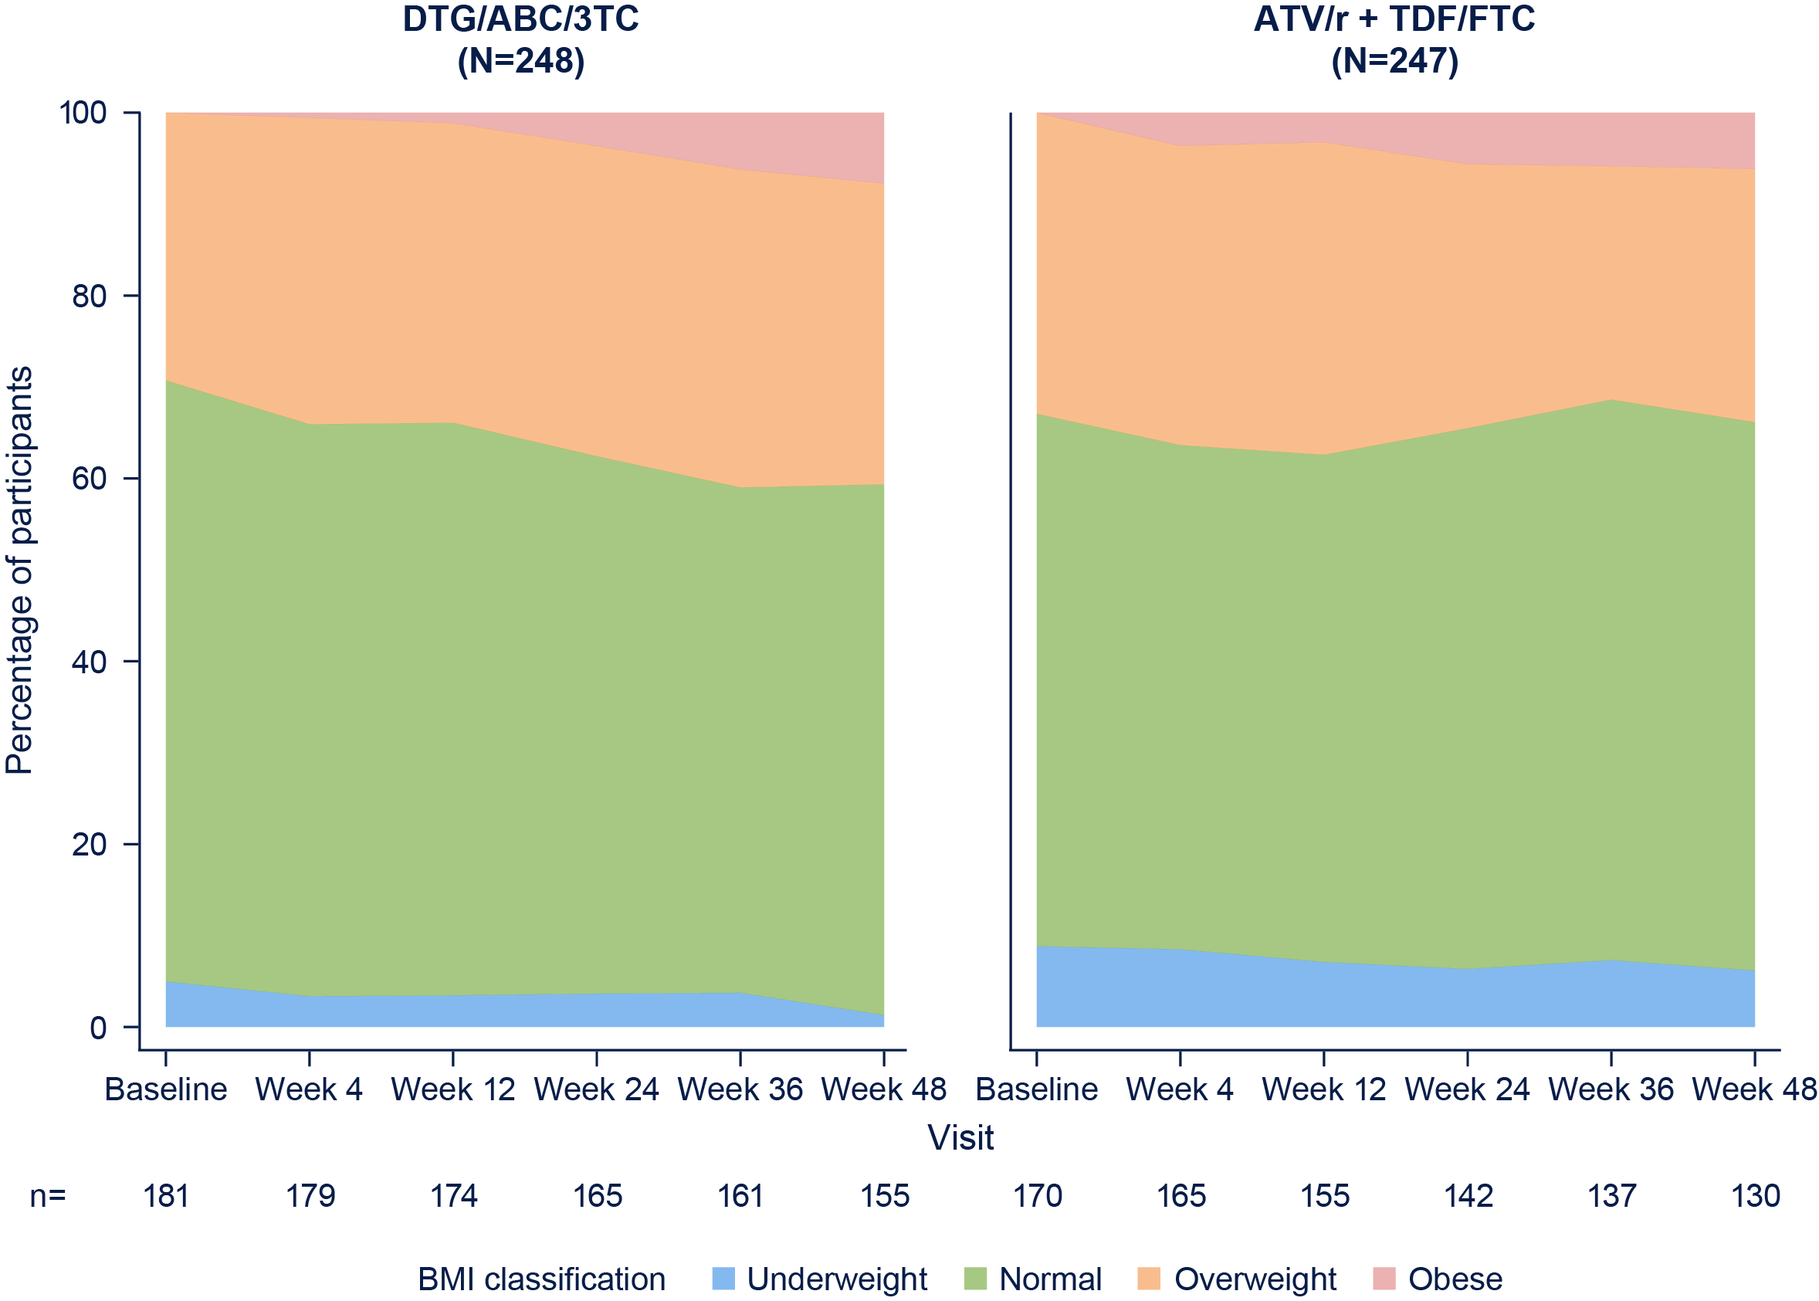
WEIGHT CHANGE AMONG TREATMENT-NAIVE WOMEN INITIATING DOLUTEGRAVIR IN THE ARIA STUDY
Sharon Walmsley,¹ Catherine Orrell,² Maria-Jesus Perez-Elias,³ Jean-Michel Molina,⁴ Bryn Jones,⁵ Brian Wynne,⁶ Richard Grove,⁷ Allan Tenorio,⁶
Lloyd Curtis,⁷ Jean van Wyk,⁵ Ann Buchanan,⁶ Choy Man⁶
  ¹University Health Network, Toronto, ON, Canada; ²University of Cape Town, Desmond Tutu HIV Foundation, Cape Town, South Africa; ³Hospital Universitario Ramon y Cajal, Madrid, Spain;
  ⁴Saint-Louis Hospital, Paris, France; ⁵ViiV Healthcare, Brentford, UK; ⁶ViiV Healthcare, Research Triangle Park, NC, USA; ⁷GlaxoSmithKline, Uxbridge, UK
PEB0233
Introduction
      Dolutegravir (DTG) and bictegravir are INSTIs that have
      been associated with greater weight gain in recent studies compared with other core agents¹
      In the ADVANCE study, weight gain was more pronounced
      in women of African heritage and was also associated with tenofovir alafenamide–based regimens²
      In the primary analysis of the ARIA study at Week 48, DTG/ABC/3TC fixed-dose combination demonstrated superior efficacy to ATV/r + TDF/FTC³
      Here we describe a retrospective analysis of weight change
      in women with HIV-1 taking DTG/ABC/3TC in the ARIA study (GSK study number, 117172; ClinicalTrials.gov identifier, NCT01910402)
    Weight Outcomes
      Adjusted mean change in weight from baseline to Week 48
      for the DTG vs ATV/r group was 2.61 vs 1.41 kg (difference, 1.20 kg [95% CI, 0.10-2.30]; P=0.0328; Figure 2)
      In a subgroup of 99 participants who continued on DTG/ABC/3TC through Week 96 (median age, 36 years;
      24% African American), mean (SD) change in weight was 1.30 (4.65) kg at Week 48 and 1.99 (5.73) kg at Week 96 (Figure 3)
      Mean (SD) change in weight from baseline in the 60 participants with weight assessments at Week 264 was
      2.14 (4.82) kg at Week 48, 2.83 (6.02) kg at Week 96, 3.17 (6.72) kg at Week 144, 3.58 (6.78) kg at Week 192, and 3.73 (7.40) kg at Week 264
      Increases in weight of 10% or more were experienced by 18% of participants in the DTG group and 15% of participants in the ATV/r group through Week 48
        Increases in weight of ≥3% and ≥5% were experienced by 48%
        and 36% of participants in the DTG group and 39% and 28% of participants in the ATV/r group, respectively
      Several baseline characteristics were associated with ≥10% increase in weight (Figure 4)
      Among race subgroups, increases in adjusted mean weight were largest among women of African heritage in both treatment groups; however, the difference between groups was relatively small (0.99 kg)
    BMI Outcomes
      Adjusted mean change in BMI from baseline to Week 48 was 1.01 vs 0.56 kg/m² in the DTG vs ATV/r group (difference,
      0.45 kg/m² [95% CI, 0.02-0.88]; P=0.0388)
      Treatment-emergent obesity was observed in 8% of the DTG group and in 6% of the ATV/r group at Week 48 (Figure 6)
    Figure 4. Factors Associated With ≥10% Increase of Weight at Week 48
DTG : non-DTGª
1.124 (0.630, 2.004)
    Figure 6. BMI Classification by Treatment Group and Visit Through Week 48^{a,b}
*
    Table 1. Demographics and Baseline Characteristics
    (ITT-E Population)
Baseline weight^{b}
0.973 (0.953, 0.992)
*
 | DTG/ABC/3TC (N=248) | ATV/r + TDF/FTC (N=247)
Age, median (range), y | 37.5 (19-79) | 37.0 (20-65)
Race, n (%)
African American/African heritage | 102 (41) | 108 (44)
White | 115 (46) | 107 (43)
Asian | 22 (9) | 23 (9)
HIV-1 RNA, mean, log₁₀ c/mL | 4.48 | 4.44
HIV-1 RNA >100,000 c/mL, n (%) | 69 (28) | 66 (27)
CD4+ cell count, mean, cells/mm³ | 370 | 380
CD4+ cell count <350 cells/mm³, n (%) | 130 (52) | 123 (50)
Weight, mean (SD), kg | 70.1 (19.3) | 71.8 (21.0)
BMI, mean (SD), kg/m² | 26.8 (6.9) | 27.3 (7.4)
Black : non-black^{c}
2.714 (1.469, 5.014)
Methods
      ARIA was a phase IIIb randomized, open-label, multicenter, parallel-group, non-inferiority study of treatment-naive women with HIV-1
      The primary endpoint was the proportion of participants with HIV-1 RNA <50 c/mL at Week 48 using the FDA Snapshot algorithm (−12% non-inferiority margin)
      Only baseline (BL) weight data were prospectively captured within the case report form; however, weight data at study visits were submitted to the central laboratory for calculation of eGFR via the Cockcroft-Gault equation
      Weight data were retrieved retrospectively from the central laboratory for this analysis; of note, the data were not collected within standardized study procedures or subject to source data verification
        A retrospective data review was conducted to confirm the quality of the retrieved data
      Data after Week 48 were available from a small subset only, which comprised participants in countries with later access to DTG/ABC/3TC
*
Screening viral load^{d}
1.840 (1.193, 2.839)
Screening CD4+ cell count^{e}
*
0.997 (0.995, 0.999)
0.5
5
    Figure 1. Study Design
Odds ratio for ≥10% increase (95% CI)
Treatment-naive
female adults
HIV-1 RNA >500 c/mL
Hepatitis B negative
HLA-B*5701 negative
DTG/ABC/3TC
DTG/ABC/3TC
Logistic regression model included treatment and race (black, non-black) and continuous covariates baseline weight, screening CD4+ cell count, and screening log₁₀ plasma HIV-1 RNA. *P<0.05. ªOdds of a 10% increase in weight at Week 48 are 1.124 for DTG vs non-DTG (not statistically significant). ^{b}For each kilogram baseline weight increase by 1 kg, odds of a 10% increase in weight at Week 48 decrease 0.027 (1-0.973). ^{c}Odds of a 10% increase in weight at Week 48 are 2.714 for black vs non-black participants. ^{d}For each log₁₀ increase in screening viral load, odds of a 10% increase in weight at Week 48 increase by 1.840. ^{e}For each CD4+ cell/mm³ increase in screening CD4+ cell count, odds of a 10% increase in weight at Week 48 decrease 0.003.
ATV/r + TDF/FTC
Randomizationª
1:1
Week 48
primary analysis
      Adjusted mean weight increase in the DTG group was significantly higher (P<0.05) vs the ATV/r group in the following subgroups: BL CD4+ ≤350 cells/mm³, BL HIV-1 RNA >100,000 c/mL, age ≥37 years, BMI ≥25 kg/m², and women of white race (Figure 5)
ªStratified by baseline HIV-1 RNA (≤ or >100,000 c/mL) and CD4+ cell count (≤ or >350 cells/mm³).
    Figure 2. Adjusted Mean Change From Baseline in
    Weight (kg) by Visit Through Week 48
ªUnderweight: <18.5 kg/m²; normal: ≥18.5 to <25 kg/m²; overweight: ≥25 to <30 kg/m²; obese: ≥30 kg/m².
^{b}Excludes participants obese at baseline.
*
*
    Figure 5. Subgroup Analysis: Adjusted Mean Weight Change (SEM) to Week 48
*
n=208
(0.38)
ATV/r + TDF/FTC (N=247)
DTG/ABC/3TC (N=248)
Conclusions
      Initiation of DTG/ABC/3TC was associated with moderate but significantly higher weight gain compared with the ATV/r group over 48 weeks
      The proportion of women experiencing a 10% or more increase in weight or treatment-emergent obesity was similar between treatment groups
      Consistent with other studies,⁴ increases in weight were associated with lower baseline CD4+ cell counts and higher HIV-1 RNA levels across study groups
      Long-term data indicate that the rate of weight increase moderated after the first year with DTG
n=192
(0.40)
(0.70)
Baseline HIV-1
RNA, c/mL
n=58
(0.75)
n=49
(0.44)
n=150
(0.45)
n=143
(0.56)
Baseline CD4+
count, cells/mm³
n=94
(0.56)
n=95
n=114
(0.55)
(0.52)
DTG, n 248 245 236 225 220 208
n=97
(0.79)
ATV/r, n 247 238 226 212 204 192
n=49
(0.79)
Region
n=49
(0.45)
n=159
(0.47)
The MMRM included fixed effects terms for treatment, visit, screening plasma HIV-1 RNA (continuous), screening CD4+ cell count (continuous), race (African American/African heritage, other), and interaction of visit by treatment and the corresponding baseline weight value as a fixed effect covariate. *P<0.05 for DTG vs ATV/r.
n=143
(0.56)
n=99
(0.59)
n=91
(1.93)
n=9
(2.16)
    Figure 3. Mean Change From Baseline in Weight (kg) by Visit Through Week 96 (in Participants in the DTG Group With a Weight Assessment at Week 96)
Race
n=7
(0.62)
n=78
(0.62)
n=77
(1.25)
n=22
(1.35)
Results
    Participant Characteristics
      495 women were randomized and treated: DTG group, 248; ATV/r group, 247³
        Participants were enrolled from 12 countries, with the highest enrollment from the United States (n=134), South Africa (n=66), and Spain (n=54)
      Baseline characteristics were balanced between treatment groups (Table 1)
n=17
(0.52)
n=114
(0.53)
Age group†
n=110
(0.56)
n=94
(0.59)
n=82
(0.61)
Baseline
BMI,
kg/m²
n=99
(0.62)
n=102
(0.59)
Acknowledgments: This study was funded by ViiV Healthcare. The authors thank all participants in the ARIA study, all investigators and site staff, the study teams, and all contributors from ViiV Healthcare and GSK. Editorial assistance and graphic design support for this poster were provided under the direction of the authors by MedThink SciCom and funded by ViiV Healthcare.
n=109
(0.65)
n=89
Difference, kg (95% CI)§
  References: 1. Sax et al. Clin Infect Dis. 2019 [Epub ahead of print]. 2. Venter et al. N Engl J Med. 2019;381:803-815. 3. Orrell et al. Lancet HIV. 2017;4:e536-e546. 4. Hsu et al. EACS 2020; Basel, Switzerland. Poster PE2/32
*95% CI not presented because of low n. †Age group cutoff based on median age. ‡Adjusted mean is the estimated mean change from baseline at each visit in each group calculated from a repeated measures model adjusting for treatment, visit, race, screening CD4+ cell count (continuous), log₁₀ screening plasma HIV-1 RNA (continuous), baseline BMI, weight at baseline, treatment-by-visit interaction, and baseline weight-by-visit interaction, with visit as the repeated factor. §Adjusted mean weight change for DTG/ABC/3TC minus adjusted mean weight change for ATV/r + TDF/FTC.
Corresponding author: Sharon Walmsley; Sharon.Walmsley@uhn.ca
Changes were calculated for non-missing data at post-baseline visits.

