Slide 1
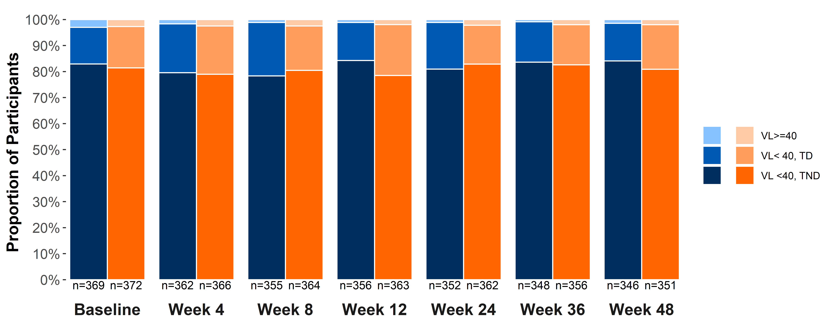
COMPARISON OF VIRAL REPLICATION AT <40 C/ML FOR 2-DRUG REGIMEN (2DR) OF DOLUTEGRAVIR/LAMIVUDINE
(DTG/3TC FDC) VERSUS 3-DRUG REGIMEN (3DR) BASED ON TENOFOVIR ALAFENAMIDE (TAF) (TBR) IN THE TANGO STUDY
Ruolan Wang,¹ Jonathan Wright,² Mounir Ait-Khaled,³ Thomas Lutz,⁴ Olayemi Osiyemi,⁵ Miguel Gorgolas,⁶ Rifaz Razeek,² Manrajdeep Virk,²
Maria Claudia Nascimento,³ Allan R. Tenorio,¹ Mark Underwood¹
¹ViiV Healthcare, Research Triangle Park, NC, USA; ²GlaxoSmithKline, Stockley Park, UK; ³ViiV Healthcare, Brentford, UK; ⁴Infektio Research, Frankfurt, Germany; ⁵Triple O Research Institute PA,
West Palm Beach, FL, USA; ⁶Jiménez Díaz Foundation University Hospital, Madrid, Spain
PEB0238
Introduction
      The TANGO study demonstrated that switching to a 2-drug regimen (2DR) of dolutegravir/lamivudine fixed-dose combination (DTG/3TC FDC) was non-inferior to continuing a tenofovir alafenamide–based 3-drug regimen (TBR 3DR) in maintaining virologic suppression in HIV-1–infected, ART-experienced adults through Week 48¹
      The Abbott RealTime plasma HIV-1 assay measures viral load (VL) from 40 c/mL to 10,000,000 c/mL, and generates qualitative target detected (TD) or target not detected (TND) results for VL <40 c/mL
      We assessed very-low-level viral replication measures of TND vs TD, as well as quantitative viral replication ≥40 c/mL for 2DR vs 3DR through Week 48 in the TANGO study
Figure 2. Summary of Proportion of Participants With
HIV-1 RNA <40 c/mL and TND, <40 c/mL and TD, and ≥40 c/mL by Visit
The proportion of participants with HIV-1 RNA <50 c/mL (Snapshot virologic success) at Week 48 was 93.2% in the DTG/3TC arm vs 93.0% in the TBR arm, with adjusted treatment difference (95% CI), 0.2% (−3.4, 3.9)¹
DTG/3TC
    Table 2. Summary of Study Outcomes (Plasma HIV-1 RNA
    <40 c/mL and TND) at Week 48 – Snapshot Analysis (ITT-E Population)
TBR
Outcome, n (%) | DTG/3TC (N=369) | TBR (N=372)
HIV-1 RNA <40 c/mL | 341 (92.4) | 344 (92.5)
HIV-1 RNA <40 c/mL and TND* | 291 (78.9) | 284 (76.3)
HIV-1 RNA <40 c/mL and TD | 50 (13.6) | 60 (16.1)
HIV-1 RNA ≥40 c/mL | 3 (0.8) | 2 (0.5)
Discontinued for lack of efficacy | 0 | 2 (0.5)
Discontinued for other reasons while HIV-1 RNA ≥40 c/mL (or <40 c/mL and TD) | 2 (0.5) | 3 (0.8)
Change in ART | 0 | 0
No virologic data at Week 48 | 23 (6.2) | 21 (5.6)
Discontinued study due to AE or death | 12 (3.3) | 1 (0.3)
Discontinued study for other reasons while HIV-1 RNA <40 c/mL and TND or no on-treatment HIV-1 RNA | 11 (3.0) | 19 (5.1)
On study but missing data in window | 0 | 1 (0.3)
Note: Denominator n at each visit is number of participants with available viral load data within the visit window.
    Figure 1. TANGO Study Design
      At Baseline, proportion with each VL category was similar between treatment arms (Table 1)
      By Baseline VL category, there were similar proportions of post-Baseline TD and TND categories across the 2DR and 3DR arms
        Of those with TND at Baseline, 53% on 2DR and 46% on 3DR had TND
        at all visits through Week 48
      Frequencies of TND at all visits were notably higher for participants with Baseline TND than with Baseline TD
      Participants with Baseline TD had more occurrences of at least
      one TD through all visits than TND at all visits
      Numbers of participants with VL ≥50 c/mL or 40≤ VL <50 c/mL
      at all visits were low across all Baseline categories
  Randomized, open-label, multicenter, parallel-group, non-inferiority study
Screening
Randomizationª
1:1
Early-switch phase
Late-switch
phase
Continuation
phase
Adults, virologically suppressed (HIV-1 RNA
<50 c/mL) for >6 months
Stable TAF-based regimen
DTG/3TC (N=369)^{b}
DTG/3TC
TAF-based regimen (N=372)
DTG/3TC
DTG/3TC
Eligibility criteria
≥2 documented HIV-1 RNA measurements <50 c/mL
No HBV infection or need for HCV therapy
No prior VF and no documented NRTI or INSTI resistance
TAF/FTC + PI or INSTI or NNRTI as initial regimen^{c}
Day
1
Week
24
Week
48
Week
96
Week
144
Week
148
Week
196
*Adjusted difference (95% CI) in proportion with VL <40 c/mL and TND for DTG/3TC − TBR was 2.5% (−3.5%, 8.5%).
Australia
Belgium
Canada
France
Germany
Japan
Netherlands
Spain
United Kingdom
United States
      The proportion with HIV-1 RNA <40 c/mL and TND was high and similar across the DTG/3TC and TBR arms, consistent with the Week 48 Snapshot success results as measured by VL <50 c/mL and <40 c/mL (Table 2)
Primary endpoint^{d}: participants
with virologic failure per
FDA Snapshot (ITT-E)^{e}
Countries
ªStratified by Baseline third agent class (PI, INSTI, or NNRTI). ^{b}2 participants excluded who were randomized but not exposed to study drug. ^{c}Participants with initial TDF treatment who switched to TAF ≥3 months before screening, with no changes to other drugs in their regimen, were also eligible. ^{d}4% non-inferiority margin. ^{e}Includes participants who changed a background therapy component or discontinued study treatment for lack of efficacy before Week 48, or who had HIV-1 RNA ≥50 c/mL in the 48-week window.
    Table 1. Changes in Quantifiable and Non-Quantifiable HIV-1 RNA Levels by Baseline VL Categories Through Week 48
Methods
      Participants were randomized 1:1 to receive 2DR or 3DR; proportions with TND and TD status for VL <40 c/mL as well as proportions with VL ≥40 c/mL were analyzed by visit through
      Week 48
      Classification of participants into VL ≥50 c/mL, 40≤ VL <50 c/mL, and TD or TND (when VL <40 c/mL) was performed on Baseline and post-Baseline outcomes
      Proportion of participants with VL <40 c/mL and TND, VL
      <40 c/mL and TD, and VL ≥40 c/mL was presented based on participants with available HIV-1 RNA data by visit through
      Week 48
      Week 48 FDA Snapshot was performed for the HIV-1 RNA
      <40 c/mL and TND endpoint
Baseline |  | DTG/3TC (N=369) |  |  | TBR (N=372)
 |  | TND | TD | ≥40 c/mL | TND | TD | ≥40 c/mL
 |  | n=302* (82%) | n=51* (14%) | n=11* (3%) | n=303* (81%) | n=59* (16%) | n=9* (2%)
Post-Baseline | VL ≥50 c/mL** | 8 (3%) | 5 (10%) | 1 (9%) | 18 (6%) | 6 (10%) | 1 (11%)
 | 40≤ VL <50 c/mL** | 4 (1%) | 5 (10%) | 1 (9%) | 8 (3%) | 3 (5%) | 1 (11%)
 | VL <40 c/mL and TD** | 129 (43%) | 28 (55%) | 8 (73%) | 137 (45%) | 39 (66%) | 5 (56%)
 | VL <40 c/mL and TND** | 161 (53%) | 13 (25%) | 1 (9%) | 140 (46%) | 11 (19%) | 2 (22%)
Conclusions
      The proportions of participants with VL <40 c/mL and TND by visit were high and similar across the DTG/3TC and TBR arms through Week 48
      There were similar proportions of participants with post-Baseline TD/TND categories by Baseline VL classification across arms
      Post-Baseline qualitative viremia by TD measure appeared more commonly associated with Baseline TD than with Baseline TND, though the majority (80% or more) of participants with TD at Baseline still maintained VL <40 c/mL (TND or TD) after Baseline
      Using the more stringent VL <40 c/mL and TND threshold, there was no difference in proportion of events between DTG/3TC 2DR and TBR 3DR at Week 48 (Snapshot)
Post-Baseline categories are mutually exclusive and determined by highest VL observed. Five participants with Baseline VL
<40 c/mL in the DTG/3TC arm and one participant with Baseline VL ≥50 c/mL in the TBR arm not presented due to no post-Baseline VL data. *n: Participants with post-Baseline VL data (percentages based on N). **Percentages based on n.
      With a total of 734 participant samples tested for baseline resistance, 7 (1%) had pre-existing, archived mutation mixture M184M/V or M184M/I and maintained viral suppression (HIV-1 RNA <50 c/mL) through Week 48²
        3/4 of these participants on 2DR vs 2/3 on 3DR had TND at Baseline and all visits through Week 48
        One participant on 2DR with Baseline VL of 67 c/mL had TD at Week 8 and Week 48, respectively, and TND at the rest of the visits
        One participant on 3DR with Baseline VL of 58 c/mL had 2 VLs between 40 to 50 c/mL, 2 VLs with TD, and 2 VLs with TND, respectively, through Week 48
Results
      The proportion of participants with VL <40 c/mL and TND per visit through Week 48 was high and similar in both treatment arms (Figure 2)
Acknowledgments: This study was funded by ViiV Healthcare. We thank everyone who has contributed to the success of this study, including all participants and their families; the TANGO clinical investigators and their staff; and the ViiV Healthcare, GlaxoSmithKline, Pharmaceutical Product Development, and Phastar team members. Editorial assistance and graphic design support for this poster were provided under the direction of the authors by MedThink SciCom and funded by ViiV Healthcare. We would also like to thank Mariah Franklin for assistance with poster development and Joseph Horton for assistance with the graph.
References: 1. van Wyk et al. Clin Infect Dis. 2020 [Epub ahead of print]. doi: 10.1093/cid/ciz12432. 2. Wang et al. CROI 2020; Boston, MA. Poster 489.
Corresponding author: Ruolan Wang; ruolan.h.wang@viivhealthcare.com

