Slide 1
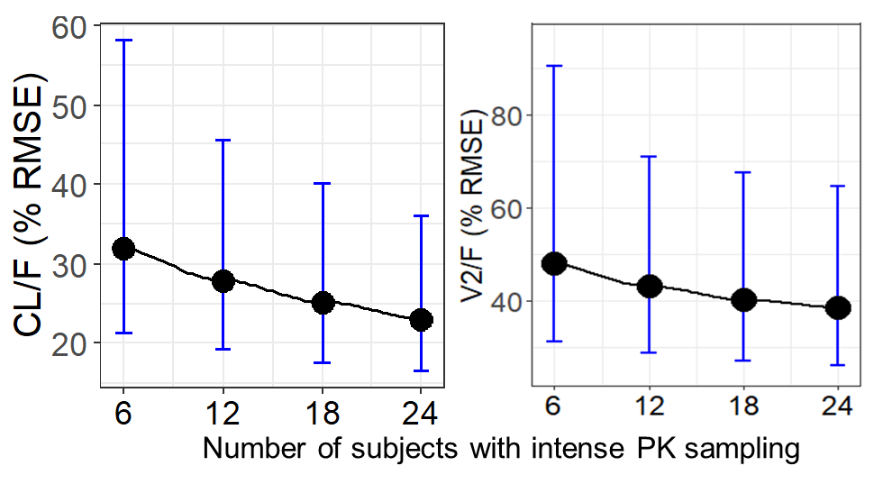
MODEL-BASED APPROACH OF DOSE SELECTION AND OPTIMAL PK SAMPLING OF FOSTEMSAVIR FOR PEDIATRIC PATIENTS WITH MULTIDRUG RESISTANT HIV-1 INFECTION
PEB0291
Nilay Thakkar,¹ Mindy Magee,¹ Katy Moore,² Peter Ackerman,² Shiven Chabria,² Cyril Llamoso,² Navin Goyal¹
  ¹GlaxoSmithKline, Clinical Pharmacology Modeling and Simulation, Collegeville, PA, USA; ²ViiV Healthcare, Research Triangle Park, NC, USA
Introduction
      Fostemsavir (FTR) is a human immunodeficiency virus type 1
      (HIV-1) attachment inhibitor in Phase 3 development for the treatment of heavily treatment-experienced (HTE) adults and children with multidrug-resistant HIV-1 infection.
      FTR is an extended-release prodrug and is hydrolyzed by alkaline phosphatase in the gastrointestinal lumen to its active moiety, temsavir (TMR). TMR is primarily metabolized by esterase-mediated hydrolysis with contributions from cytochrome P450 (CYP) 3A4.
      The current analysis demonstrates the application of a model-based approach to select optimal doses and a PK sampling strategy to help design an efficient clinical trial of FTR in pediatric patients by leveraging the comprehensive data from the adult program.
Methods
      The TMR adult population (POP) PK model¹ with weight-based allometric scaling was used for simulations with parameter uncertainty using the mrgsolve package in R. 500 trials were simulated using different doses by weight bands, and scenarios accounting for both the presence and absence of CYP3A4 inducer or inhibitor to evaluate the probability of success (PoS) based on Cmax and Ctau-defined criteria to maintain exposures comparable to those observed in the adult population.²
      Clinical trial simulations were also conducted to assess optimal
      PK sampling schemes and subject numbers. The final TMR
      POP PK model was used for parameter estimation and compared to the true value for each subject to calculate the precision of PK parameter estimates.
    Figure 1. % RMSE of CL/F and V2/F Across Different Numbers of Subjects With Intense Sampling
Results
      Dosing simulations demonstrated that the adult dose of FTR 600 mg BID for pediatric subjects ≥35 kg and FTR 400 mg BID for subjects ≥20 to <35 kg meet defined criteria by providing comparable adult TMR exposure that established FTR safety and efficacy (Table 1).
      Figure 1 summarizes the CL/F and V2/F precision as measured by % root mean square error (% RMSE) across different sampling schemes and number of subjects with intense sampling.
      This analysis identified that for the intense sampling portion of the study, 6 PK sampling times in a dosing interval (1, 2, 4, 6, 8, and 12 h post-dose) ±30 min in at least 12 of 50 subjects in the ≥35-kg cohort would give the optimal precision in CL/F and V2/F (Figure 1).
      The solid black circles represent the median % RMSEs, and the lower and upper whiskers represent the 5th and 95th percentiles % RMSEs of CL/F and V2/F with no PK parameters fixed or with Q, V3/F, D1, and KA fixed.
Objectives
      To identify the optimal dosing regimen(s) by body weight
      for FTR in pediatric patients with multidrug-resistant
      HIV-1 infection.
      To identify the optimal PK sampling times and the number of subjects for which intense sampling is to be collected.
Discussion
      The doses were selected to maintain a balance in safety and
      efficacy while retaining a simplified dosing regimen in subjects
      with HIV-1 weighing down to 20 kg.
      Optimal PK sampling analysis helped to identify the PK sampling scheme and demonstrated that intense PK sampling data from 12 subjects in the ≥35-kg cohort would provide adequate confidence in selecting doses that provide target Cmax and Ctau values.
    Table 1. Percent Probability of Maintaining Cmax and Ctau Threshold Levels By Pediatric Weight Bands
Conclusions
      The model-based approach allowed selecting optimal doses for pediatric subjects with body weight down
      to 20 kg.
      Based on the analysis, optimal PK sampling times
      for intensive sampling are 1, 2, 4, 6, 8, and 12 h post-dose with intensive PK sampling to be conducted in at least 12 subjects in the ≥35-kg cohort.
 | Scenario | Criteriaª | Weight bands (kg)
 |  |  | 20 - ≤25 | 25 - ≤30 | 30 - <35 | 35 - ≤40 | 40 - ≤45 | 45 - ≤50 | 50 - ≤55 | 40 - ≤70
Proposed Dose Regimen |  |  | 400 mg BID |  |  | 600 mg BID
Cmax PoS^{b} (%) | FTR Alone | 10 msec, 80% | 99.8 | 100 |  |  |  | 100
 | FTR + Inhibitor | 10 msec, 80% | 62.6 | 94.4 | 99.8 | 69.0 | 96.0 | 99.6 | 99.8 | 100
Ctau PoS^{b} (%) | FTR Alone^{c} | 134 ng/mL, 80% | 97.2 | 96.4 | 94.2 | 100 |  |  |  | 99.8
 | FTR + Inducer^{d} | 49 ng/mL, 80% | 90.2 | 84.0 | 85.6 | 99.6 | 99.4 | 98.4 | 98.6 | 98.0
ªCriteria represented as target [e.g., 10 msec QTc threshold for Cmax (corresponding to 7500 ng/mL) or 10th percentile of Ctau] and percentage participants aimed to achieve success in (e.g., 80% is success in 8 out of 10 participants). ^{b}Summary of probability of success (PoS) based on 500 trials containing 100 participants in each weight band across different scenarios in each trial. ^{c}Based on Phase 3 data for FTR 600 mg BID alone, adult 10th percentile Ctau = 134 ng/mL. ^{d}Based on Phase 3 data for FTR 600 mg BID with a moderate inducer, adult 10th percentile Ctau = 49 ng/mL.
  Acknowledgments: This study was funded by ViiV Healthcare.
References: 1. Parasrampuria et al. CROI 2020; Boston, MA. Poster 463. 2. Lagishetty et al. Clin Transl Sci. 2020 [Epub ahead of print].
Corresponding author: Nilay Thakkar; nilay.x.thakkar@gsk.com

