Slide 1

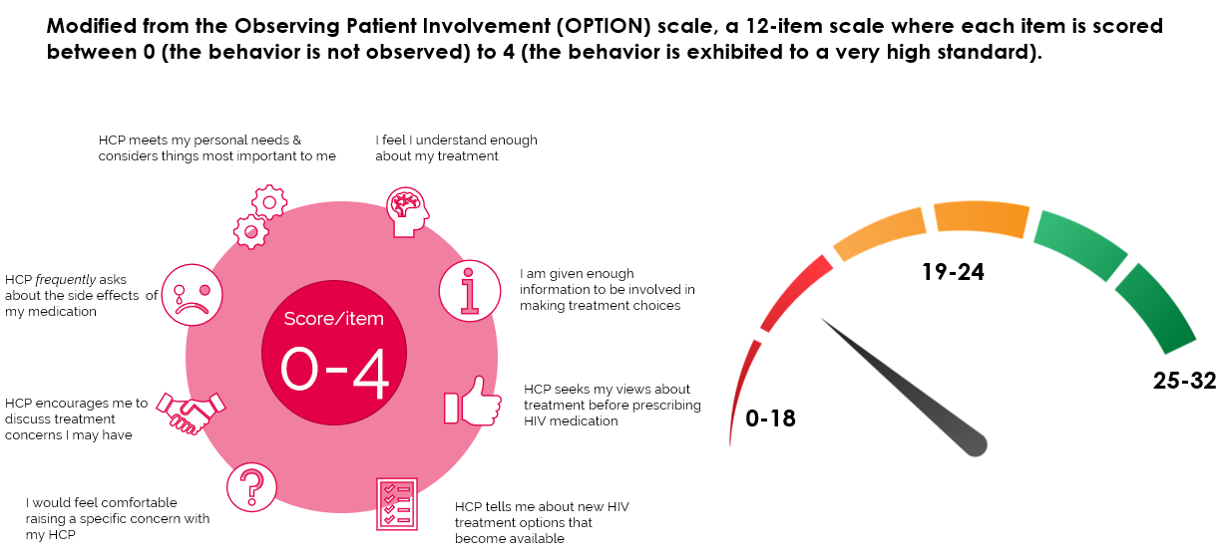

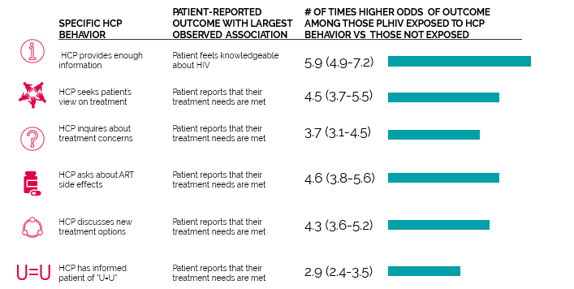

PUTTING THE HEART BACK INTO HAART: GREATER HCP–PATIENT ENGAGEMENT IS ASSOCIATED WITH BETTER HEALTH OUTCOMES AMONG PERSONS LIVING WITH HIV (PLHIV) ON TREATMENT
Chinyere Okoli,¹ Garry Brough,² Brent Allan,³ Erika Castellanos,⁴ Benjamin Young,⁵ Anton Eremin,⁶ Giulio Maria Corbelli,⁷ Marta Mc Britton,⁸ Marvelous Muchenje,⁹ Nicolas Van de Velde,¹ Patricia de los Rios⁹
  ¹ViiV Healthcare, Brentford, Middlesex, UK; ²UK CAB and Positively UK, London, UK; ³The International Council of AIDS Service Organizations (ICASO), Toronto, ON, Canada; ⁴Global Action for Trans Equality (GATE), New York, NY, USA; ⁵ViiV Healthcare, Research Triangle Park, NC, USA; ⁶AIDS Center Foundation, Moscow, Russia; ⁷European AIDS Treatment Group, Rome, Lazio, Italy; ⁸Instituto Cultural Barong, São Paulo, Brazil; ⁹ViiV Healthcare, QB, Canada
PED0808
Background
      While in many settings HIV care involve fewer face to face appointments, a greater movement pushes toward achieving the UNAIDS 90-90-90 targets¹
        In this context, optimizing the relationship between healthcare provider (HCP) and patient is critical
      In addition, inclusion of a fourth “90” target is intended to ensure that 90% of all people living with HIV (PLHIV) have good health-related quality of life (QOL)¹
      Today there is increasing recognition by HCPs to work towards achieving the fourth 90 as an added marker of treatment success beyond virologic control
      We investigated healthcare provider (HCP)–patient communication and engagement and explored associations with indicators of Quality of Life and health outcomes among PLHIV
    Figure 2. Perceived HCP Communication Barriers Reported by PLHIV,
    by Self-Reported Viral Load Status
      The top issues considered treatment priorities among those diagnosed for ≥2 years were concerns regarding (Figure 4):
        ART side effects (67%) and
        Long-term impacts (60.5%)
        Transmitting HIV (60.1%)
      Yet, among those rating these issues as important, ~one-third were uncomfortable discussing with their HCP
      Prevalence of positive outcomes increased with increasing
      HCP engagement (Figure 6)
        For example, the percentage who did not miss a single dose in the past month was 20% among those with low engagement, 23% with medium, and 43% with high engagement
        Within adjusted analyses, consistent results were seen. Odds of 100% adherence (0 missed dose/past 30d) were 1.3 and 3.0 higher among those with moderate and high engagement respectively, compared to low HCP engagement (all P<0.05)
    Figure 4. Illustrates treatment priorities of PLHIV who had been on ART for ≥2 Years and the proportion not comfortable discussing this with their HCP (N=1841)
    Figure 6. Relationship Between Extent of HCP–Patient Engagement and Health-Related Outcomes Among PLHIV (N=2389)
Methods
      We analyzed data from the 2019 Positive Perspectives Survey of PLHIV in 25 countries (N=2389)²
      This was a web-based survey conducted between April 2019 and January 2020 to capture attitudes, perceptions, and knowledge about antiretroviral therapy (ART)
        An advisory committee comprising PLHIV, PLHIV advocacy groups, and HCPs helped identity key themes
      A combination of different non-probability-based sampling approaches was used to recruit participants, including snowball sampling, targeted sampling within Patient Advocacy Groups, Patient Support Groups or HIV Charities; and use of existing panels of PLHIV
      Surveyed participants were from North America (N=520), Europe (N=1119), Latin America (N=221), Asia (N=230), Australia (N=120), and South Africa (N=179)
      Inclusion criteria were as follows:
        Male or female, aged 18 to 84 years, and willing and able to provide electronic/verbal informed consent to participate
        Self-identify as having been diagnosed by a doctor or other HCP as being HIV seropositive, and currently on ART
        Resident of selected country and be able to communicate in the language with which the survey is being administered
    Key Measures and Approach
      Participants were asked, “What is your most recent viral load?”
        Those answering “undetectable” or “suppressed” were classified as reporting viral suppression; those answering “detectable” or “unsuppressed” were classified as reporting being virally unsuppressed; and those answering, “I don’t know” or “prefer not to say” were classified as indeterminate status
      Participants were classified as fully (100%) adherent if they did not report missing ART for even one time in the
      past month
      Individuals diagnosed with HIV for 2 years or longer before the survey were classified as being treatment experienced
      Patient engagement in care (low, moderate, high), was measured based on a modified version of the Observing Patient Involvement scale³
      Data were analyzed using descriptive and multivariable techniques
      Figure 1 illustrates the 12-item Observing Patient Involvement scale
    Figure 1. Modified From the Observing Patient Involvement (OPTION) Scale, a 12-Item Scale Where Each Item Is Scored Between 0 (the Behavior Is Not Observed) to 4 (the Behavior Is Exhibited to a Very High Standard)
      Those not virally suppressed were the most likely to report barriers
      Overall, 68% had shared their HIV status with a family doctor not providing HIV care, and this was higher among those virally suppressed (72%) than either those
      non-suppressed (57%) or with indeterminate status (51%)
      Figure 3 illustrates indicators of engagement in care
    Figure 3. Reported Indicators of Engagement in Care (N=2389)
      Figure 5 details the relationship between engagement in care and health outcomes
Discussion
      Good communication with HCPs on specific issues was associated with PLHIV reporting better understanding of their treatment and perceiving their treatment needs as met
      Even for the top three issues deemed as current priorities to PLHIV (ART side effects, long-term impacts of ART, and transmitting HIV to a partner), about a third of affected PLHIV did not feel comfortable sharing these concerns to their HCPs
      Of HCP behaviors assessed, the one most strongly predictive of patients’ desire to be involved in care
      was HCPs discussing of new treatment options
      with patients
      Improving quality of communication between patients and HCPs may better support the fourth 90 goal of improving aspects of quality of life
        PLHIV can be empowered by community and patient associations to ask HCPs who care about their
        health issues
    Figure 5. Adjusted Odds Ratios and Corresponding 95% Confidence Intervals for the Relationship Between Engagement in Care and Health Outcomes (N=2389)
HCP-related indicators
Results
Table 1. Characteristics of the Study Population (N=2389)
      Most of the study population reported being virally suppressed (74%); younger (<50 y, 71%); men (68%); and diagnosed prior to 2017 (77%; Table 1)
      Figure 2 details perceived communication barriers by PLHIV of HCPs by viral load status
Logistic regression models controlled for gender, sexual orientation, age, duration of disease,
comorbidities, region, and education. Values indicated with confidence intervals (CL).
PLHIV-related indicators
      Specific HCP behaviors were associated with various patient responses differentially
      The strongest patient responses attributable to specific HCP behaviors are shown above
      PLHIV reporting that their HCP provided them with enough information to be involved in making treatment choices had 5.9 times higher odds than those not provided with enough information
      Involvement of patients in care, eg, seeking their view before prescribing new treatment was associated with 4.5 times higher odds of perceiving treatment needs as being met
      Of HCP behaviors assessed, the one most strongly predictive of patients’ desire to
      be involved in care was HCPs discussing of new treatment options with patients
      (AOR=1.35; P<0.05)
  Acknowledgments: Authors would like to thank all the PLHIV that participated in this study. Data analyses and medical writing support were provided by Zatum LLC. This study was funded by ViiV Healthcare. Editorial assistance and graphic design support for this poster were provided under the direction of the authors by MedThink SciCom and funded by ViiV Healthcare.
  Conflicts of Interest: CO, MMB, and MM are employees of ViiV Healthcare.
      59% were updated on new treatment options
      63% reported their HCP asked their views before new treatments
      72% reported they understood their HIV treatment
        However, 65% still wanted more involvement
  References: 1. Lazarus et al. BMC Med. 2016;14:94. 2. Okoli et al. Prev Chronic Dis. 2020;17:190359. 3. Elwyn et al. Qual Saf Health Care. 2003;12:93-99.
Corresponding author: Chinyere Okoli; chinyere.x.okoli@viivhealthcare.com

