Slide 1
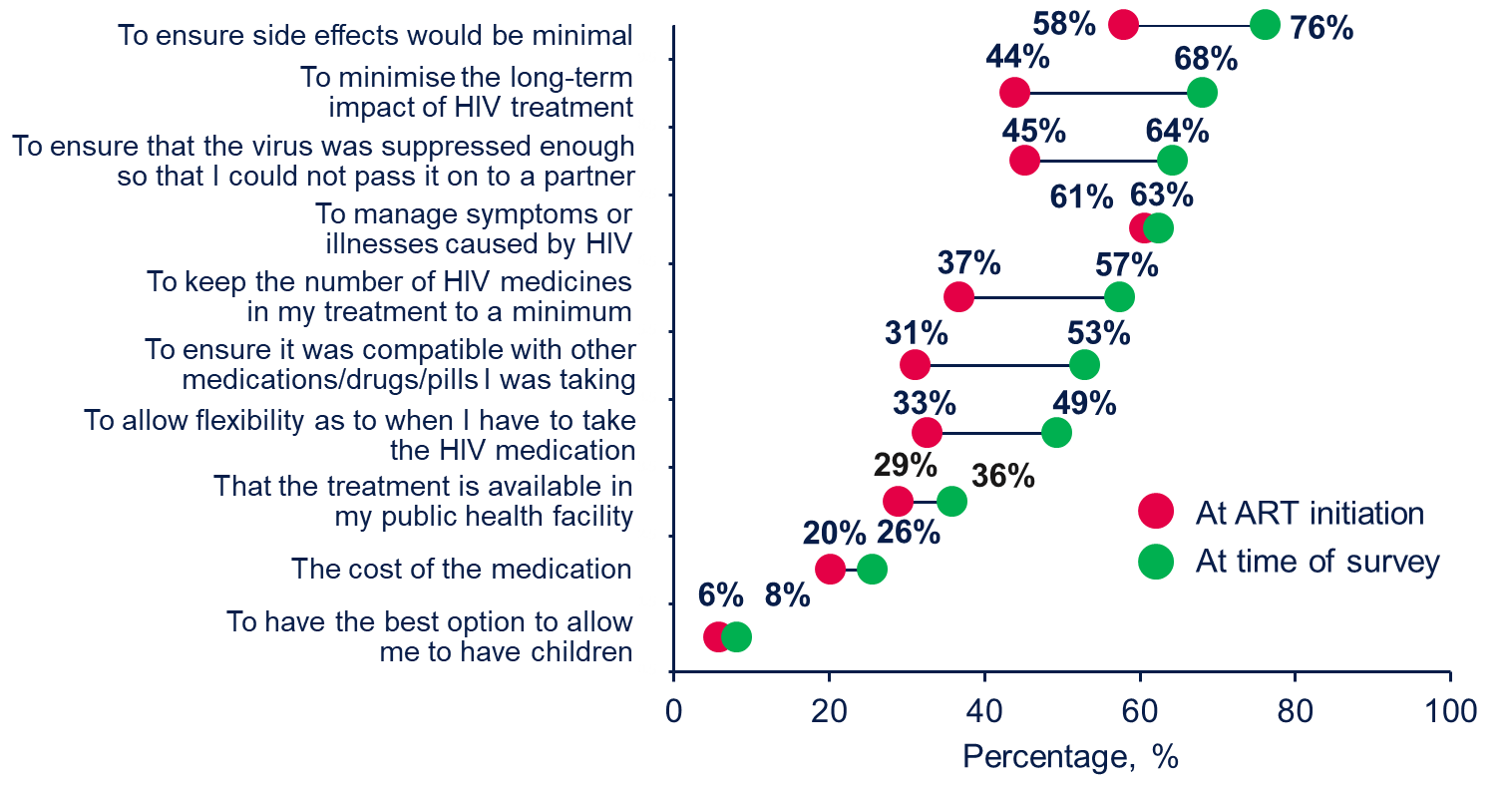
UNDERSTANDING THE CHANGING TREATMENT CONCERNS OF OLDER PEOPLE LIVING WITH HIV (PLHIV) AND DIFFICULTIES WITH PATIENT-PROVIDER COMMUNICATION
PED0787
Duncan Short,¹ Frank Spinelli,² Chinyere Okoli,¹ Patricia de los Rios³
¹ViiV Healthcare, Brentford, Middlesex, UK; ²ViiV Healthcare, Research Triangle Park, NC, USA; ³ViiV Healthcare Canada, Laval, QC, Canada
Introduction
As people living with HIV (PLHIV) age, their treatment needs may evolve
We compared perspectives on treatment-related concerns and on patient-provider communication in older PLHIV and explored differences based on duration of treatment experience
Change in Treatment Challenges Over Time
Current treatment challenges reported as most important to treatment-experienced older PLHIV, including medicine-related concerns, were the following (Figure 2):
Ensuring minimal side effects (76%; n=482)
Minimizing long-term treatment impact (68%; n=431)
Ensuring viral suppression to prevent transmission to a partner (64%; n=406)
Figure 4. Comfort Level With Discussing Concerns About HIV Treatment Among Treatment-Experienced Older PLHIV (N=632)
Concerns about
Methods
‘Positive Perspectives 2 (PP2)’ is a multinational, cross-sectional, web-based survey of PLHIV (aged 18+) with data collected in 2019 (N=2389)
This analysis focuses upon data from 699 individuals aged ≥50 years living with HIV and currently receiving antiretroviral (ART) treatment
Individuals were stratified by duration of ART treatment: <2 years and ≥2 years
Endpoints in this analysis included patient perspectives at initiation of treatment and at the time of the survey on the following topics:
Treatment-related concerns
Patient-provider communication
Chi-square tests were used for statistical comparisons where noted (P<0.05)
Treatment Concerns
Participants were asked to select any and all of the options that applied for each question
“When you first started HIV treatment, other than ensuring that it was effective, what were your most important considerations?”
“And imagine that you were starting HIV treatment today. Other than ensuring that it is effective, what would be your most important considerations?”
Patient Engagement in Care
Participants were asked to what extent they agreed or disagreed with each of the following statements:
“My provider seeks my views about treatment before prescribing an HIV medication”
“My provider asks me if I have any concerns about the HIV medication I am currently taking”
“I would like to be more involved when it comes to decisions about my HIV treatment”
“My HIV medication prevents me from passing on HIV to others”
Answers “Agree”/“Strongly agree” were coded as 1; “Disagree”/“Strongly disagree”/“Neither agree nor disagree” were coded as 0
Patient-HCP Communication
All participants were asked about comfort level with communication with their HCP
“If it were a concern of yours, to what extent would you feel comfortable raising each of the following with your main HIV care provider?”
“Comfortable” or “Very comfortable” were coded as 1; “Uncomfortable,” “Very Uncomfortable,” or “Neither comfortable nor uncomfortable” were coded as 0
“Why, if at all, would you feel uncomfortable raising concerns with your main HIV care provider?”
Answers were “None” or options to select “Yes” or “No” (see Figure 5)
Figure 2. Change From ART Initiation in Most Important Treatment Challenges for Treatment-Experienced Older PLHIV (N=632)
ART, antiretroviral treatment; PLHIV, people living with HIV.
Most commonly reported barriers to discussing treatment concerns with HCPs among treatment-experienced older PLHIV who perceived a barrier included perception nothing could be done, that HCP knows best, and fear of being labelled ‘difficult’ (Figure 5)
Figure 3. Perspectives of Interactions and Comfort Level With Healthcare Providers for Older PLHIV by Treatment Experience
Figure 5. Barriers to Raising Treatment Concerns Among Treatment-Experienced Older PLHIV Who Perceived a Barrier (N=336)
15%
16%
18%
20%
27%
Results
Participant Characteristics
699 individuals aged ≥50 years from 25 countries were included in this study (Figure 1)
632 individuals received ART for ≥2 years and 67 for <2 years
Baseline characteristics were balanced between groups (Figure 1)
I don’t feel confident enough
I don’t feel it is important enough to bother them
I don’t want to take up more of their time
I’m not sure how to bring it up
There never seems to be enough time or opportunity
28%
31%
33%
34%
Figure 1. Survey Participants Aged ≥50 Years: Demographics and Location
Female (210/699, 30%)
North America (146/520, 28%)
USA, CAN
I don’t think my main HCP's priorities are the same as mine
I don’t want to come across as a ‘difficult’ patient
I feel my main HCP knows best
I don’t believe they can do much about my concerns
White (413/598, 69%)
Europe (357/1119, 32%)
AUT, BEL, DEU, ITA, NLD, POL, PRT, IRL, RUS, ESP, GBR, CHE, FRA
Reported HCP:
Comfortable raising concerns with HCP about:
Uncomfortable, %
Homosexual (369/699, 53%)
Heterosexual (266/699, 38%)
Older adults in the pooled sample, n = 699/2389, 29%
Latin America (50/221, 23%)
ARG, BRA, CHL, MEX
HCP, healthcare provider; PLHIV, people living with HIV.
Conclusions
Providers must acknowledge the evolving and unique needs of PLHIV as they age
Patient-provider communication issues can hinder optimization of care by preventing some needs being broached
Some PLHIV find it difficult to raise issues, including medicine-related concerns, with their current treatments
Comorbidities (581/699, 83%)
Hypertension (33%), high cholesterol (30%), mental health disorders (26%)
Asia (50/230, 22%)
CHN, JPN, KOR, TWN
Interactions With Healthcare Providers
Barriers to raising concerns to HCPs were reported between older PLHIV and their provider in 53% (335/632) of treatment-experienced and 84% (56/67) of newly diagnosed individuals
Treatment-experienced older PLHIV were significantly less likely than newly diagnosed older PLHIV to be asked by their providers about their side effects experienced and new treatment options (P<0.05; Figure 3)
Approximately one-third of all PLHIV aged ≥50 years reported being uncomfortable in raising or discussing concerns about long-term side effects, adherence, general impact on life, and emotional well-being (Figure 4)
Large metropolitan area (428/699, 61%)
Small metropolitan area (210/699, 30%)
Rural area (61/699, 9%)
Australia (65/120, 54%)
AUS
Acknowledgments
We thank everyone who has contributed to the success of this study, including all study participants. This study was funded by ViiV Healthcare. Editorial assistance and graphic design support for this poster were provided under the direction of the authors by MedThink SciCom and funded by ViiV Healthcare.
Conflicts of Interest
Authors are employees of ViiV Healthcare.
Employed full time (196/699, 28%)
Retired (129/699, 18%)
Unable to work (91/699, 13%)
South Africa (31/179, 17%)
ZAF
Corresponding Author
Frank Spinelli; frank.a.spinelli@viivhealthcare.com

